Slide 1
TripleL Trading shopping online
Team 11
Jia Liu, Lingchen Li, Chao Li

Slide 2
Background
Have you ever been tired of running around to buy something urgently?
Have you ever wanted something but cannot find it in online stores?
Have you ever imagined that when you want something, various merchant would contact you to provide best offers?
You can not get it in traditional B2B or B2C mode!

Slide 3
Idea & Goal
Idea: If customers say what they want, supplier would contact with customers actively to provide their offers
Goal: Construct a platform in which the buyer can put up what they wants, and the sellers search to bid on the orders

Slide 4
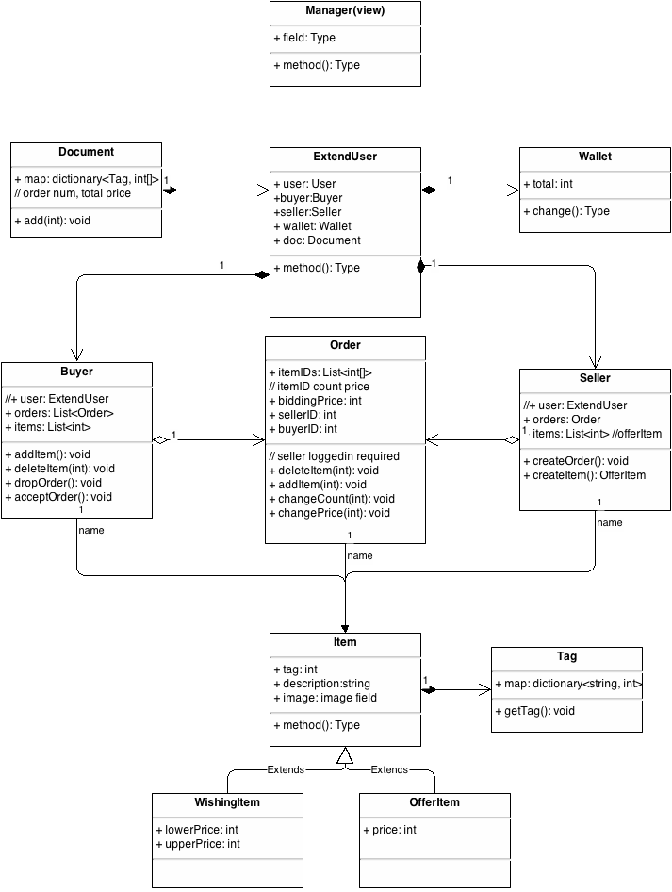
Design Model

Slide 5
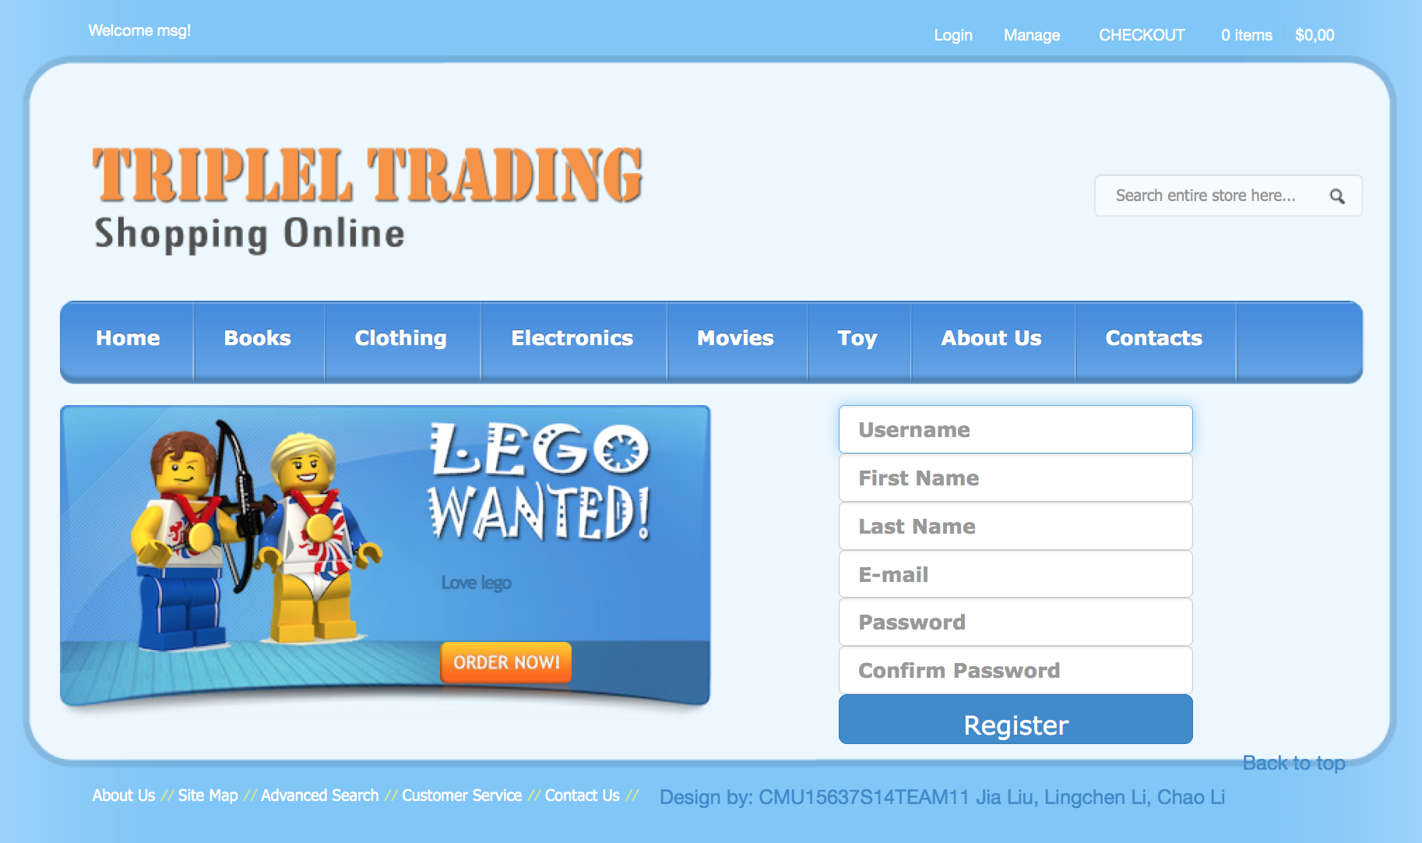
Progress

Slide 6
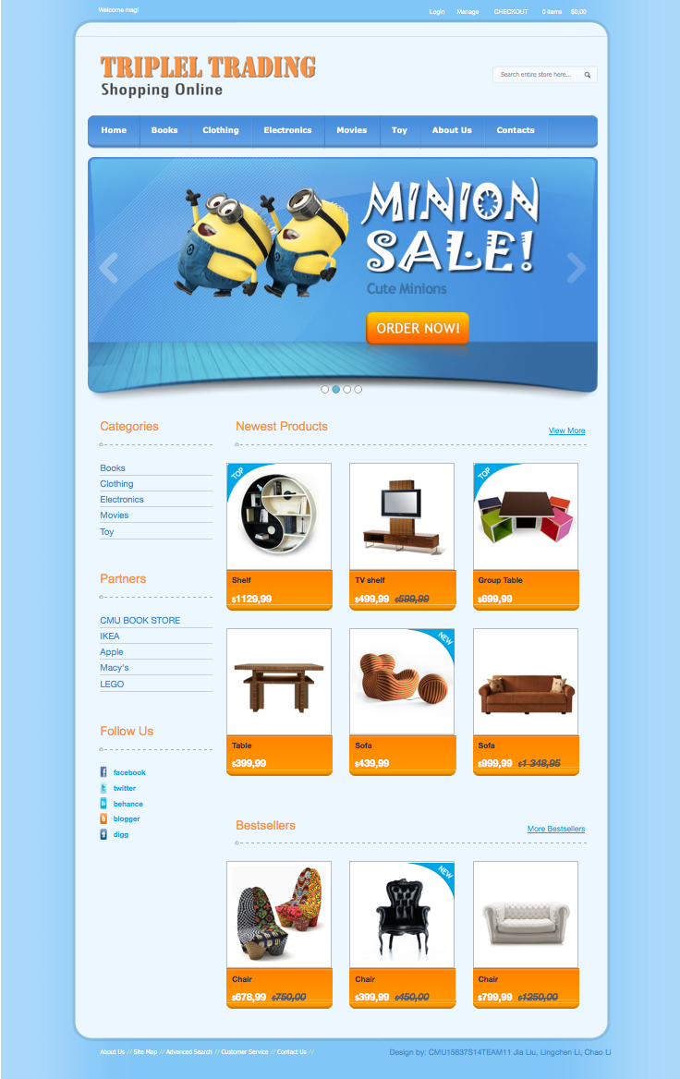
Progress

Slide 7
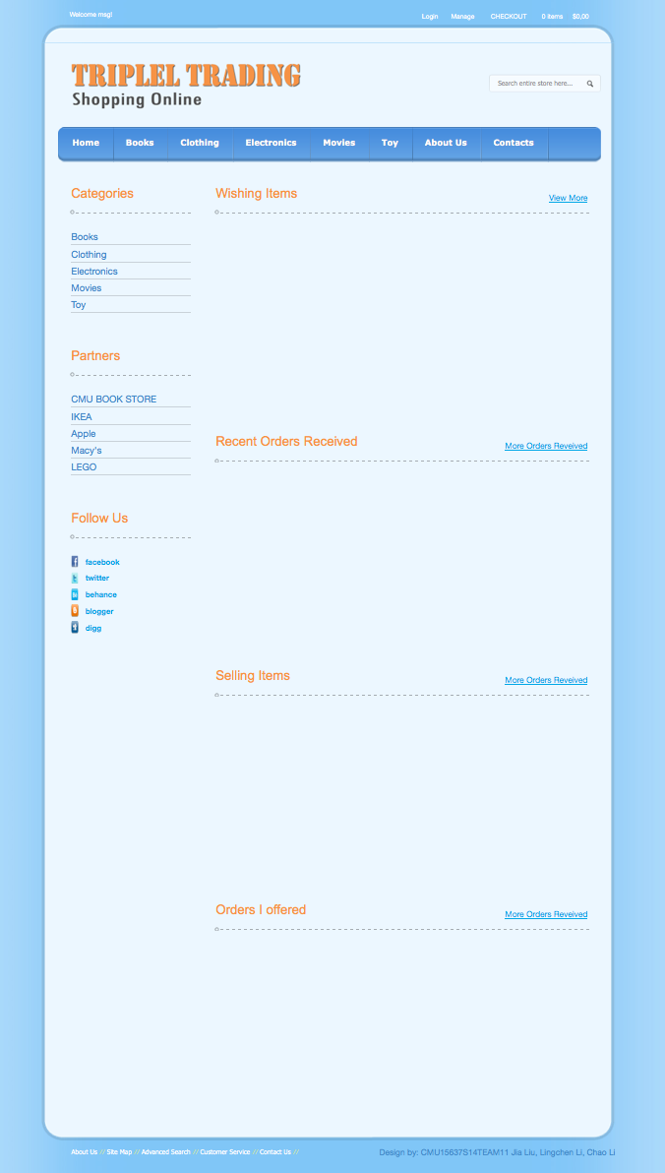
Progress

Slide 8
Plan of Next Phase
For buyer part:
All pages including managing personal transaction, reviewing items posted by sellers
Finish the buyers’ interaction with sellers such as posting new wishing item, accept offers .etc
For seller part:
The flow of goods in the store: posting new item, update inventory, .etc
creating order for specific buyer
If time permitted:
The communication between buyer and seller

Slide 9
Thank You!

