Slide 1
Learning in the brain and in one-layer neural networks
Psychology 209
January 17, 2019

Slide 2
Lecture Outline
Some basic aspects of the neurobiology of learning
The Hebb Rule and emergence of patterns in visual cortex
Associative learning: Hebbian and error-correcting learning
Limitations of the Hebb rule and introduction to error correcting learning – the ‘delta rule’
Credit assignment with the delta rule, and how the delta rule captures some basic learning phenomena in animal and human learning
Learning in a linear, one-layer network
  Introduction to thinking at the level of Patterns
  Pattern similarity and generalization
  Orthogonality and superposition

Slide 3
The brain is highly plastic and changes in response to experience
Alteration of experience leads to alterations of neural representations in the brain.
What neurons represent, and how precisely they represent it, are strongly affected by experience.
We allocate more of our brain to things we have the most experience with.

Slide 4
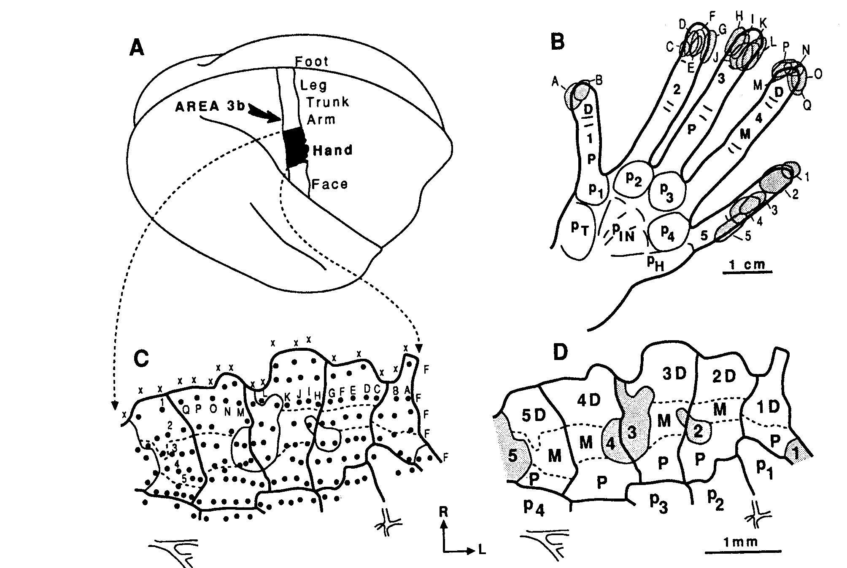
Monkey Somatosensory Cortex

Slide 5
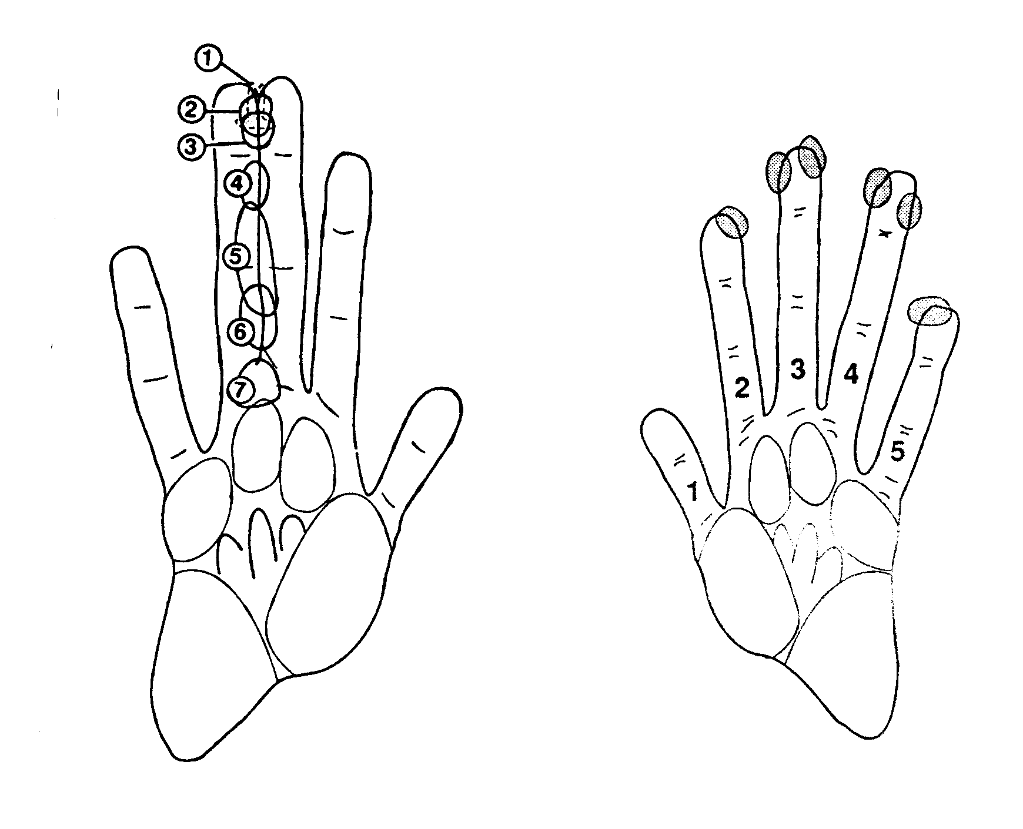
Merzenich’s Joined Finger Experiment
Receptive
fields after
fingers were
sown together
Control
receptive
fields

Slide 6
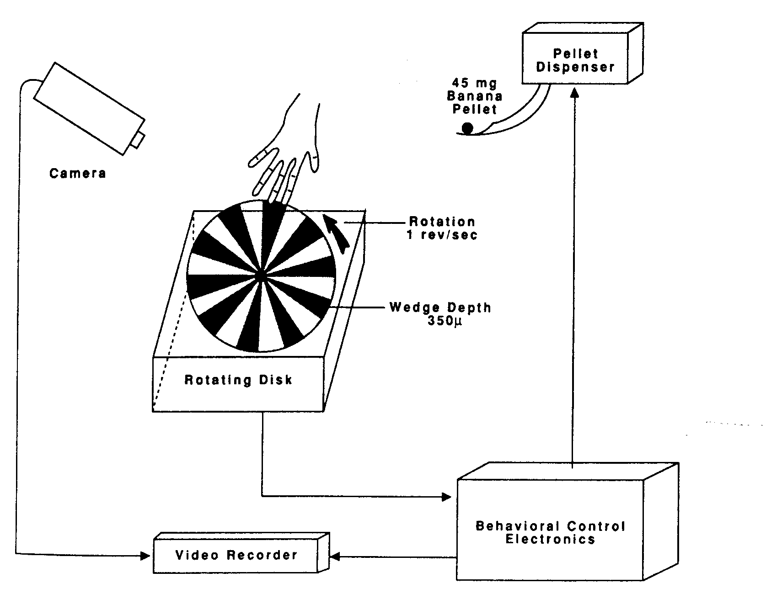
Merzenich’s Rotating Disk Experiment

Slide 7
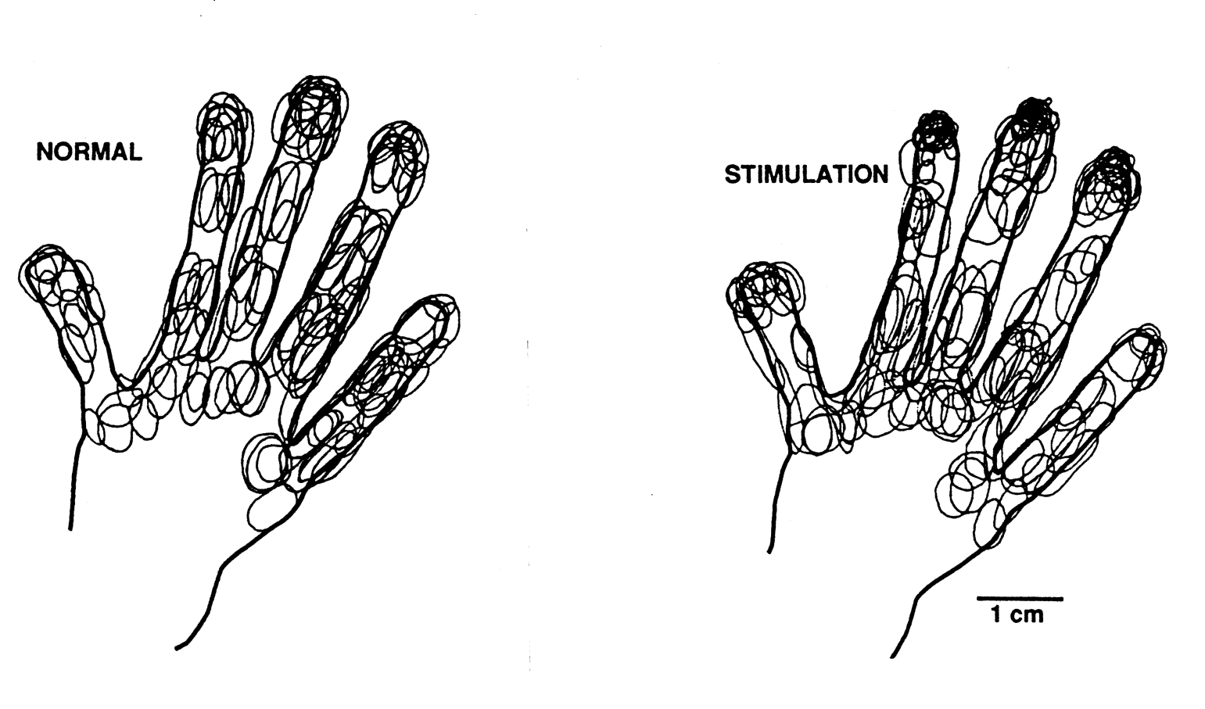
Merzenich’s Rotating Disk Experiment: Redistribution and Shrinkage of Fields

Slide 8
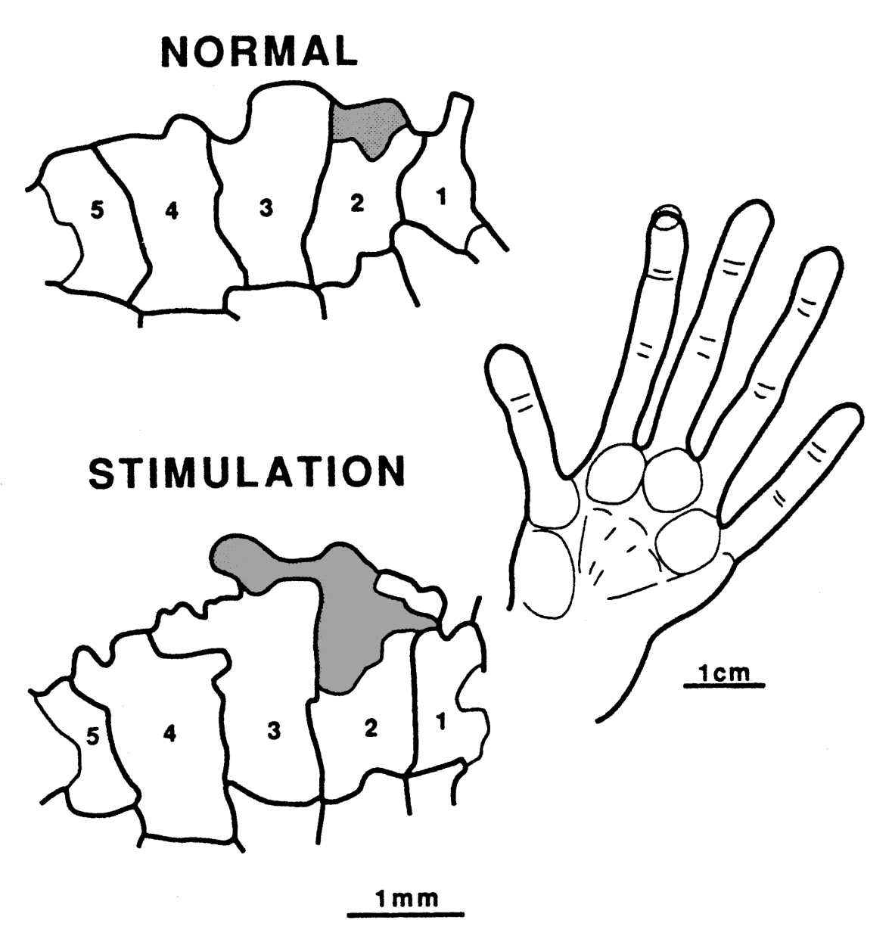
Merzenich’s Rotating Disk Experiment: Expansion of Sensory Representation

Slide 9
Synaptic Transmission and Learning
Learning may occur by changing the strengths of connections.
Addition and deletion of synapses, as well as larger changes in dendritic and axonal arbors, also occur in response to experience.
New neurons may be added in a specialized sub region of the hippocampus, but there seems to be less of this in the neocortex.
Pre
Post

Slide 10
Hebb’s Postulate
“When an axon of cell A is near enough to excite a cell B and repeatedly or persistently takes part in firing it, some growth process or metabolic change takes place in one or both cells such that A’s efficiency, as one of the cells firing B, is increased.”
D. O. Hebb, Organization of Behavior, 1949
In other words:
“Cells that fire together wire together.”
Unknown
Mathematically, this is often taken as:
Δw_{ba} = εa_{b}a_{a}
(Generally you have to subtract something to achieve stability)

Slide 11
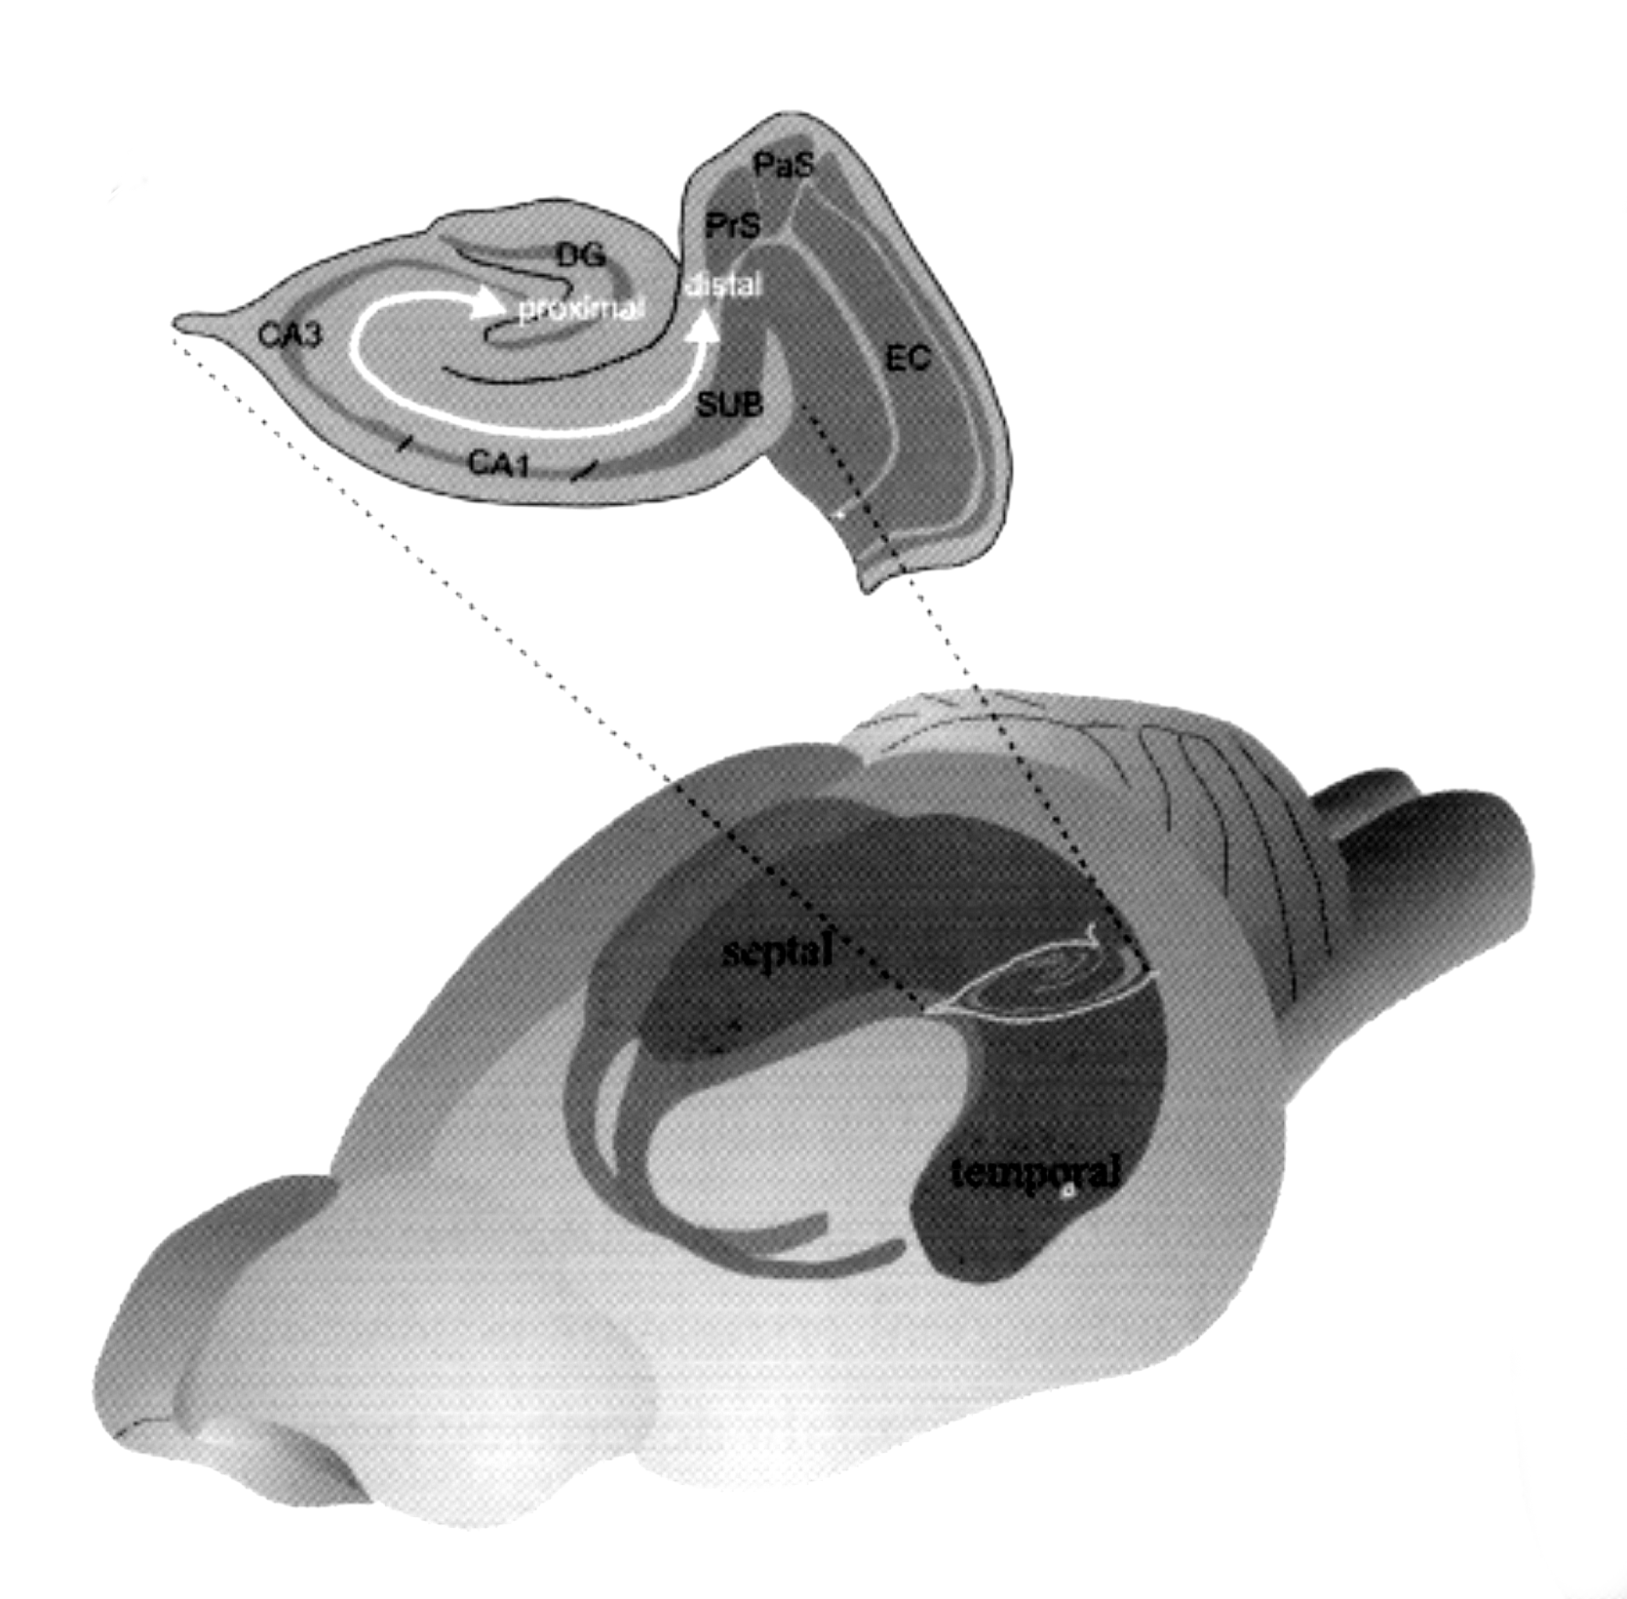

Slide 12
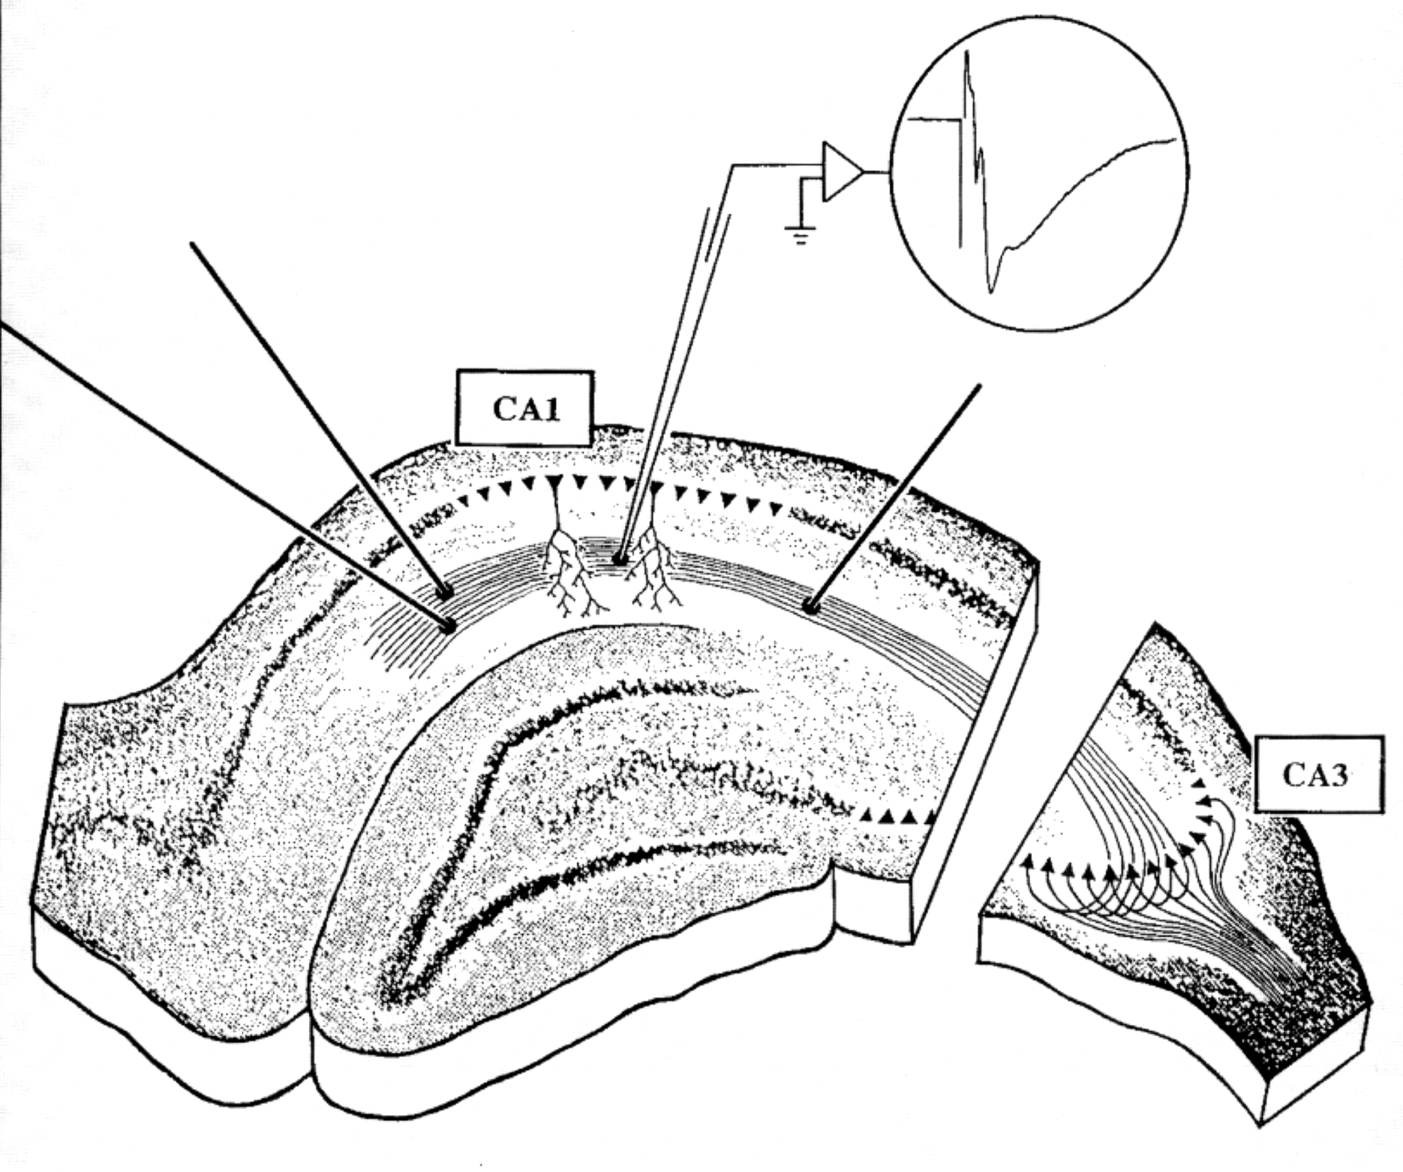
b
a₂
a₁

Slide 13
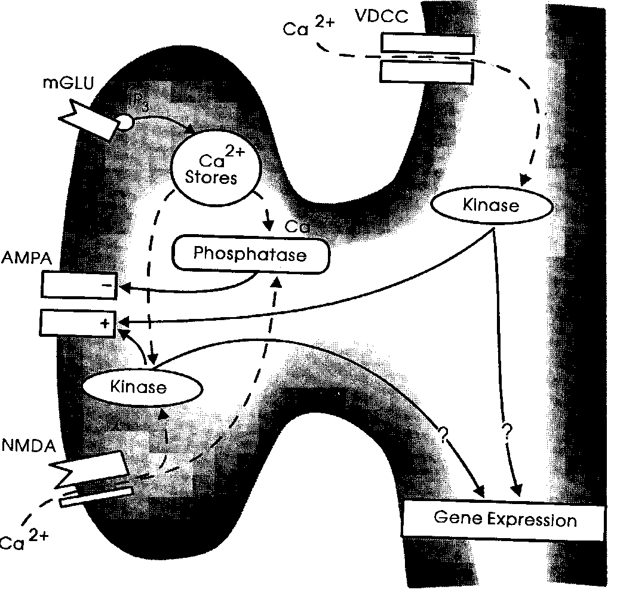
The Molecular Basis of Hebbian Learning (Short Course!)
Glutamate ejected from
the pre-synaptic terminal
activates AMPA receptors,
exciting the post-synaptic
neuron.
Glutamate also binds to the
NMDA receptor, but it only
opens when the level of depolarization on the post-synaptic side exceeds a threshold.
When the NMDA receptor opens,
Ca++ flows in, triggering a
biochemical cascade that results
in an increase in AMPA receptors.
The increase in AMPA receptors
means that an the same amount of transmitter release at a later time will cause a stronger post-
synaptic effect (LTP).

Slide 14
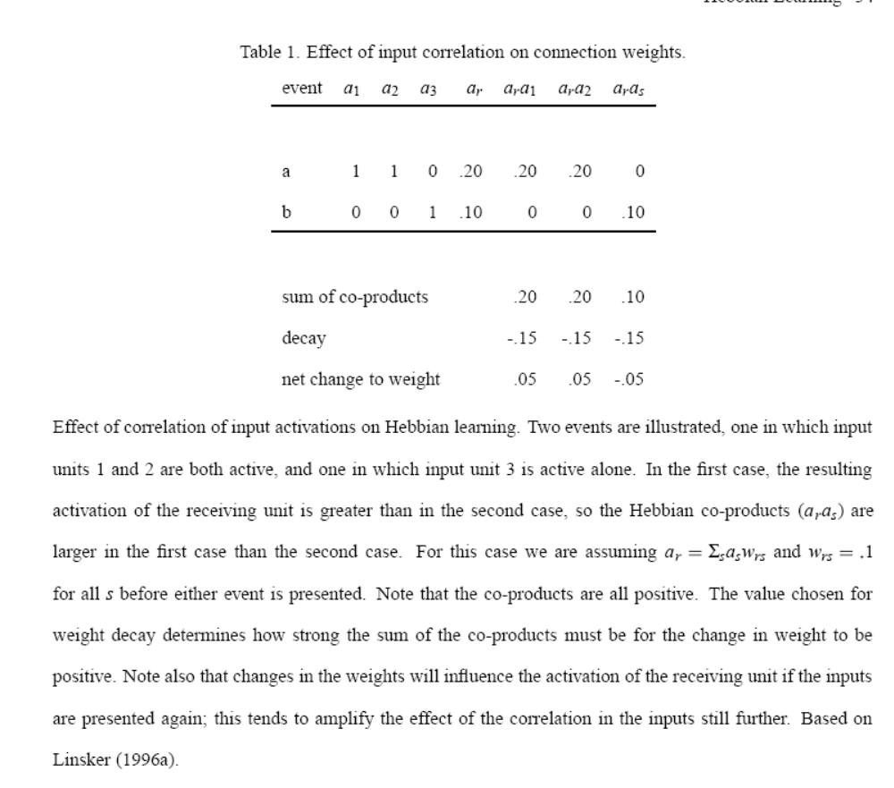
How Hebbian Learning Plus Weight Decay Strengthens Correlated Inputs and Weakens Isolated Inputs to a Receiving Neuron
unit r
1 2 3
input units
Units 1 & 2 active
Unit 3 active alone
Activation rule:
a_{r} = Σ_{s}a_{s}w_{rs}
Initial weights all = .1
Learning Rule:
Δw_{rs} = εa_{r}a_{s} – d
ε = 1.0
d = .075
(2x)
Final weight .15 .15 .05
This works because inputs correlated with other
inputs are associated with stronger activation of
the receiving unit that inputs that occur on their own.

Slide 15

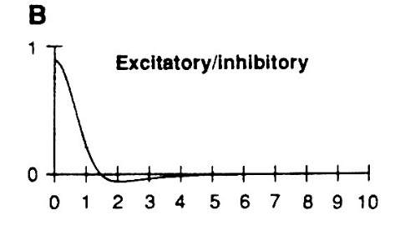
Miller, Keller, and Stryker (Science, 1989) model ocular dominance column development using Hebbian learning
Architecture:
L and R LGN layers and a cortical layer containing 25x25 simple neuron-like units.
Each neuron in each LGN has an initial weak projection that forms a Gaussian hump (illustrated with disc) at the corresponding location in the Cortex, but with some noise around it.
In the cortex, there are short-range excitatory connections and longer-range inhibitory connections, with the net effect as shown in B (scaled version shown next to cortex to indicate approximate scale).

Slide 16
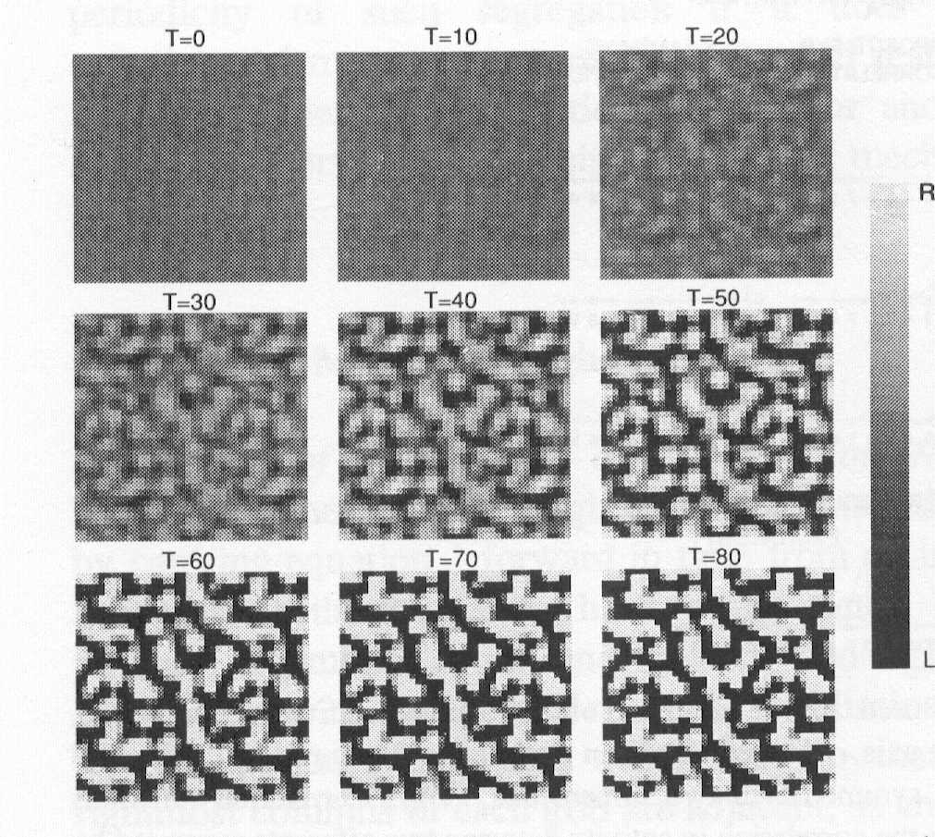
Simulation of Ocular Dominance
Column Development based on Hebbian Learning
Experience and Training:
Before ‘birth’, random activity occurs in each retina. Due to overlapping projections to LGN, neighboring LGN neurons in the same eye tend to be correlated.
No (or less) between eye correlation is assumed.
Learning of weights to cortex from LGN occurs through a Hebbian learning rule:
  Δw_{cl} = εa_{c}a_{l} – decay
(Note that w’s are not allowed to go below 0).
Results indicate that ocular dominance columns slowly develop over time.

Slide 17
Associative Learning: e.g. linking what something looks like to how it sounds
Association by contiguity:
  If a and b occur together, create a connection between them so that a will activate b
    w_{ba} = b*a
Generalize by similarity:
  If a_{t} is similar to a_{l}, activate b also.
How do we represent this similarity?
  We need to think of a and b as patterns to do so.

Slide 18
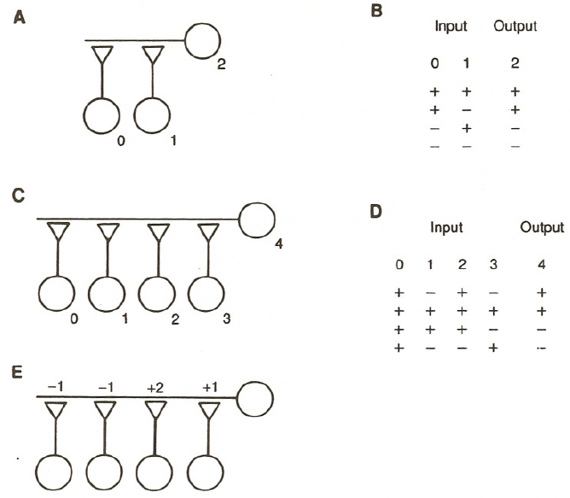
Learning Associations:
Hebbian vs Error-Driven Learning
Hebb Rule:
  Δw_{rs} = εa_{r}a_{s}
Here, we force a_{r} to equal the specified output during learning
Delta Rule:
  Δw_{rs} = ε(t_{r}-a_{r})a_{s}
Now, we ‘tell’ the output unit what activation we want it to have
When we test
a_{r} = Σ_{s}a_{s}w_{rs}
Our new case:
input output
+ + + + +
+ + - - -

Slide 19
Credit Assignment, blocking and screening off
Train on tone -> food:
  Dog salivates to tone
Train on light -> food:
  Dog salivates to light
Blocking:
Train with tone -> food,
then tone + light => food
  Dog does not salivate to light
Division of Labor:
Train on tone + light -> food
  Dog salivates to tone + light, less to tone or light alone
Screening off:
Train on tone + light -> food
interleaved with tone -> no food
  Dog salivates strongly to light alone,
  not to tone + light
These patterns can all be explained by the Delta rule!
Learnable connections
tone
light
Salivation
food
Hard-wired
connection

Slide 20
Associative Learning: e.g. linking what something looks like to how it sounds
Association by contiguity:
  If a and b occur together, create a connection between them so that a will activate b (and vice versa):
    w_{ba} = b*a
Generalize by similarity:
  If a_{t} is similar to a_{l}, activate b also.
How do we represent this similarity?
  We need to think of a and b as patterns to do so.

Slide 21
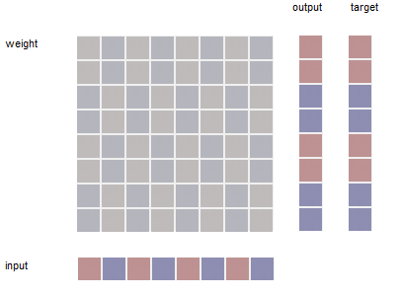
Associating Patterns
w_{rs}
Let i and t be patterns of activation, represented by vectors.
We can associate them by creating a weight between each element of i and each element of t.
  w_{rs} = εt_{r}*i_{s}
Diagram shows weights we’d get after applying the above to the patterns shown with ε = .125
red = positive
blue = negative
Pattern input and ‘target’ are always +1 or -1
‘output’ is what we get if we multiply the input times the weights
  o_{r} = Σ_{s} i_{s}w_{rs}
  Or in vector-matrix notation
  o = Wi
  There are details of whether vectors are rows or columns that we are suppressing for now
o_{r}, t_{r}
i_{s}

Slide 22
Similarity Relations Among
Vectors
Let x and y be vectors of the same length.
  Their dot product is the sum of the products of corresponding elements
    Σ_{i} x_{i} y_{i}
  Their vector correlation or cosine is the extent to which they ‘point in the same direction’. This is often called cos(x,y)
    Σ_{i} x_{i} y_{i} /((Σ_{i} x_{i} x_{i})^{½}(Σ_{i} y_{i} y_{i})^{½})

Slide 23
Generalization by Similarity
If we’ve associated patterns i and t, and present i’, the output we get will be a scaled version of t:
  o = t cos(a,a’)
  Two patterns are orthogonal if cos(i,i’)=0
So what output do we get if i and i’ are orthogonal?

Slide 24
Learning Multiple Associations in the Same set of Weights
We can learn to associate many different i,t pairs in a single pattern associator using the Hebbian learning rule if all of the input patterns are orthogonal:
cos(i^{i},i^{j})=0
For all pairs of patterns i^{i}, i^{j} (superscripts index patterns)
Targets can be any real vectors.
The weight matrix is just the sum of the weight matrices calculated for each pattern separately.
What happens when a test pattern overlaps with more than one of the patterns used at training?

Slide 25
Learning associations with patterns that are linearly independent but not orthogonal
We can use the ‘Delta rule’ instead of the Hebbian learning rule for learning:
  Δw_{rs} = (1/n)(t_{r}-o_{r})*i_{s}
One can learn arbitrary input-output pairs as long as the input patterns are all linearly independent. That means that none of the input patterns can be expressed as a linear combination of all of the other input patterns.
What happens if one of the inputs can be expressed as a linear combination of the others?

Slide 26
Some Patterns to consider in a one-layer pattern associator
One pattern:
a 1.0 -1.0 1.0 -1.0 1.0 -1.0 1.0 -1.0 1.0 1.0 -1.0 -1.0 1.0 1.0 -1.0 -1.0
Three orthogonal patterns:
a 1.0 -1.0 1.0 -1.0 1.0 1.0 -1.0 -1.0 1.0 1.0 -1.0 -1.0 1.0 1.0 -1.0 -1.0
b 1.0 1.0 -1.0 -1.0 1.0 -1.0 1.0 -1.0 1.0 1.0 1.0 1.0 -1.0 -1.0 -1.0 -1.0
c 1.0 -1.0 -1.0 1.0 1.0 1.0 1.0 1.0 1.0 -1.0 -1.0 1.0 1.0 -1.0 -1.0 1.0
Three linearly independent patterns:
a 1.0 -1.0 1.0 -1.0 1.0 1.0 -1.0 -1.0 1.0 1.0 -1.0 -1.0 1.0 1.0 -1.0 -1.0
b 1.0 1.0 -1.0 -1.0 1.0 -1.0 1.0 -1.0 1.0 1.0 1.0 1.0 -1.0 -1.0 -1.0 -1.0
c 1.0 -1.0 1.0 -1.0 1.0 1.0 1.0 1.0 1.0 -1.0 -1.0 1.0 1.0 -1.0 -1.0 1.0

Slide 27
Learning Central Tendencies in a Pattern Associator with the Delta Rule
Choose a small learning rate, e.g. 0.0125
Introduce noise:
Each input and output value is perturbed by noise of +/- 0.5 on each training trial
What happens when we repeatedly present noisy examples of a single pattern?
What about interleaved presentations of noisy versions of each of the three orthogonal patterns?
What about the same with the three linearly independent patterns?
What is the effect of learning rate variation?
  What happens if we start with a high learning rate and gradually decrease it?

Slide 28
Credit Assignment, blocking and screening off
Train on tone -> food:
  Dog salivates to tone
Train on light -> food:
  Dog salivates to light
Train with tone -> food,
then tone + light => food
  Dog does not salivate to light
Train on tone + light -> food
  Dog salivates to tone + light, less to tone or light alone
Train on tone + light -> food
interleaved with tone -> no food
  Dog salivates strongly to light alone
These patterns can all be explained by the Delta rule!
Learnable connections
tone
light
Salivation
food
Hard-wired
connections

