Slide 1
Back Propagation and Representation in PDP Networks
Psychology 209 Jan 22, 2019

Slide 2
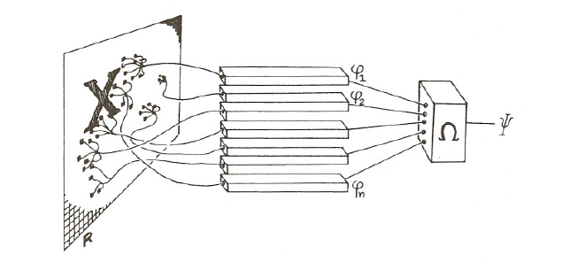
The Perceptron
For input pattern p, teacher t_{p} and output o_{p}, change the threshold
And weights as follows:

Slide 3
AND, OR, XOR
AND Problem
Input Output
0 0 0
1 0 0
0 1 0
1 1 1
OR Problem
Input Output
0 0 0
1 0 1
0 1 1
1 1 1
XOR Problem
Input Output
0 0 0
1 0 1
0 1 1
1 1 0

Slide 4
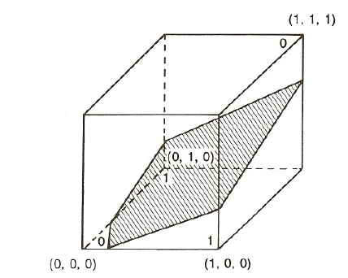
Adding a unit to make XOR solvable

Slide 5




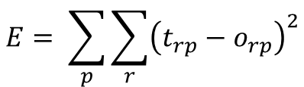

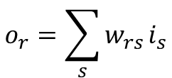

LMS Associator
Output is a linear function of inputs and weights:
$$w_{rs}$$
$$o_{r}$$
$$o_{r}=\sum_{s}{w_{rs}}i_{s}$$
$$i_{s}$$
Find learning rule to minimize the Summed squared Error:
$$E= \sum_{p}{\sum_{r}{{\left(t_{rp}−o_{rp}\right)}^{2}}}$$
Change weight proportional to
to its effect on the E for each P:
$$∆w_{rs}∝−\frac{{∂E}_{p}}{{∂w}_{rs}}$$
E
Where
$$\frac{{∂E}_{p}}{{∂w}_{rs}}=−2(t_{rp}−o_{rp})i_{sp}$$
$$w_{rs}$$

Slide 6
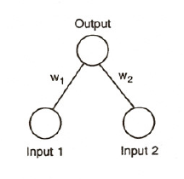
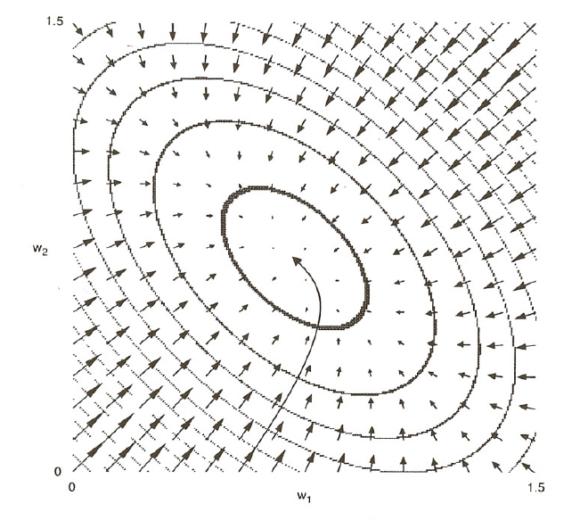
Error Surface for OR function in LMS Associator
Or Problem
Input Output
0 0 0
1 0 1
0 1 1
1 1 1

Slide 7

What if we want to learn how to solve xor?
We need to figure out how to adjust the weights into the ‘hidden’ unit, following the principle of gradient descent:
$$∆w_{rs}∝−\frac{{∂E}_{p}}{{∂w}_{rs}}$$

Slide 8
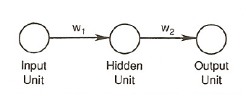


We start with an even simpler problem
Assume units are linear, both weights = 0 and, i = 1, t = 1.
$$∆w_{rs}∝−\frac{∂E}{{∂w}_{rs}}$$
$$\frac{∂E}{{∂w}_{rs}}$$
We use the chain rule to calculate for each weight.
Non-linear hidden units are necessary in general, but understanding learning in linear networks is useful to support a general understanding of the non-linear case

Slide 9
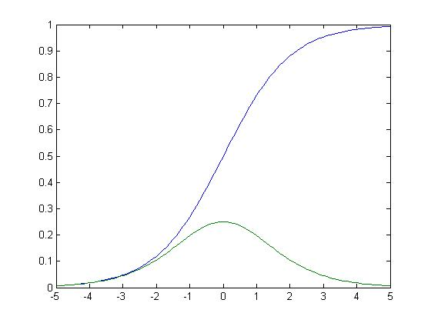
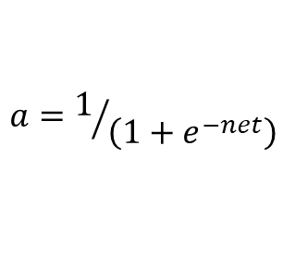
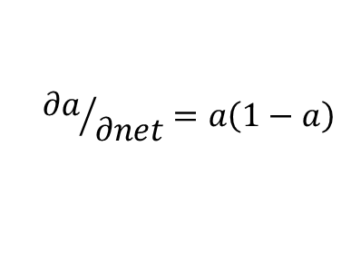
The logistic or ‘sigmoid’ function and its derivative
$$a=1/{\left(1+e^{−net}\right)}$$
Activation
$${∂a}/{∂net}=a\left(1−a\right)$$
Net input

Slide 10
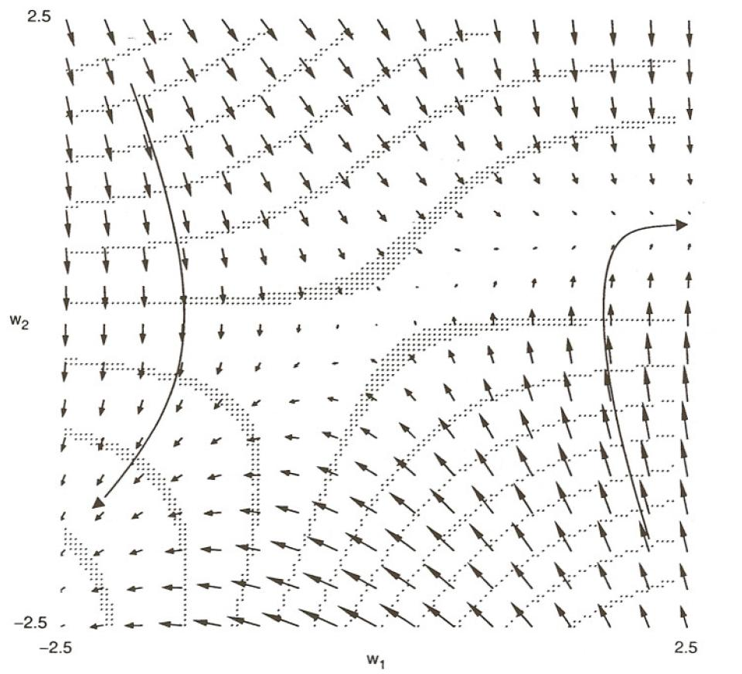
The Non-Linear 1:1:1 Network
Consider network below, with
training patterns:
1->1
0->0
No bias, non-linear activation
at hidden and output level.
Goodness landscape for this network:

Slide 11
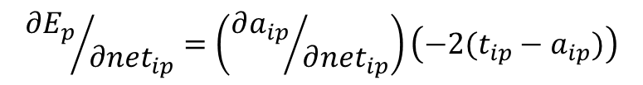


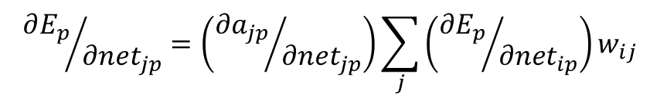
Including the activation function in the chain rule and including more than one output unit leads to:
For weights to output unit i:
$${∂E_{p}}/{{∂net}_{ip}}=\left({∂a_{ip}}/{∂{net}_{ip}}\right)\left(−2(t_{ip}−a_{ip})\right)$$
b_{i}
For weights to hidden unit j:
i
$${∂E_{p}}/{{∂net}_{jp}}=\left({∂a_{jp}}/{∂{net}_{jp}}\right)\sum_{j}{\left({∂E_{p}}/{{∂net}_{ip}}\right)w_{ij}}$$
w_{ij}
j
For both layers, the weight error derivatives can be expressed as
$${∂E_{p}}/{{∂w}_{rs}}=\left({∂E_{p}}/{{∂net}_{rp}}\right)a_{s}$$
How about bias error derivatives?
$${∂E_{p}}/{{∂b}_{r}}=\left({∂E_{p}}/{{∂net}_{rp}}\right)$$

Slide 12
Back propagation algorithm
Propagate activation forward
Calculate error (‘loss’)
Propagate error derivatives backward
Change the weights
Variants:
‘Full Batch Mode’:
Accumulate dE/dw’s across all patterns in the training set before changing weights
Stochastic gradient descent (batch size = N)
Process patterns in permuted order from the training set and adjust weights after each pattern
Adjust weights after N patterns

Slide 13
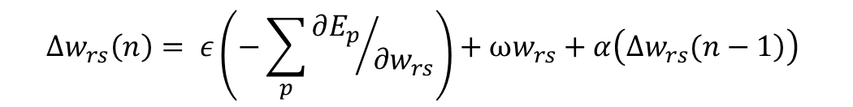
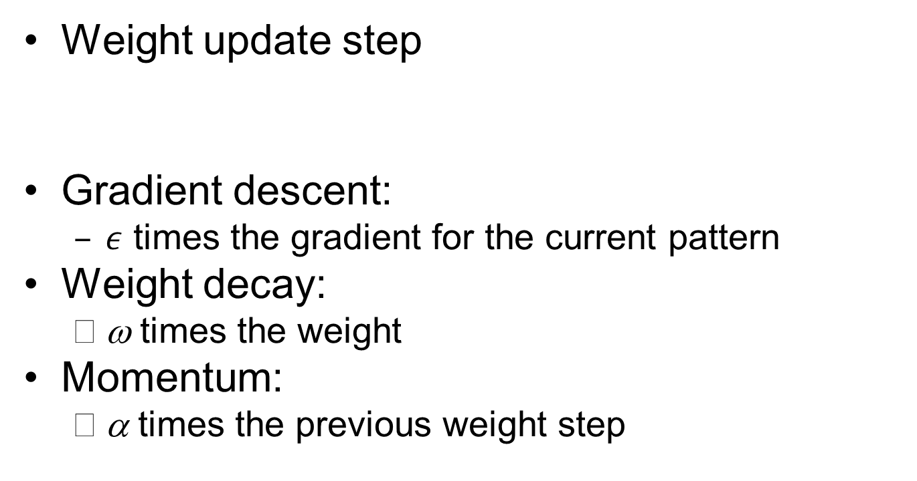
Adding Momentum and Weight Decay
Weight update step
Gradient descent:
$ε$ times the gradient for the current pattern
Weight decay:
ω times the weight
Momentum:
α times the previous weight step
$$∆w_{rs}\left(n\right)= ε\left(−\sum_{p}{{∂E_{p}}/{∂w_{rs}}}\right)+ωw_{rs}+α\left(\left.∆w_{rs}(n−1\right)\right)$$

Slide 14
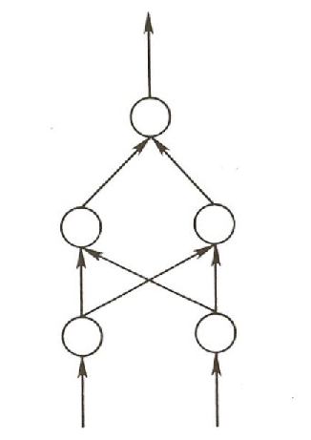
XOR Problem from Next Homework
Uses the network architecture at right.
Uses batch mode with momentum and no weight decay for first part of exercise.
Will allow you to get a feel for the gradient and other issues and explore effects of variation in parameters.
Is implemented in PyTorch but that will stay under the hood for now.

Slide 15
Why is back propagation important?
Provides a procedure that allows networks to learn weights that can solve any deterministic input-output problem.
Contrary to expectation, it does not get stuck in local minima except in cases where the network is exceptionally tightly constrained.
Allows networks to learn how to represent information as well as how to use it.
Raises questions about the nature of representations and of what must be specified in order to learn them.

Slide 16
Is Backprop biologically plausible?
Neurons probably do net send error signals backward across their weights through a chain of neurons at least not at the rates necessary for standard implementations of BP
But we shouldn’t be too literal minded about the actual biological implementation of the learning rule
Some neurons appear to use error signals, and there are ways to use differences between activation signals to carry error information
With the renewed interest in back propagation these days, there is renewed investigation of this issue.

