Slide 1
More on Back Propagation: 1) Optimization Algorithms and Weight Initialization 2) Toward Biologically Plausible Implementations
Psychology 209 January 24, 2019

Slide 2
Optimization Algorithms
Gradient descent variants
Batch gradient descent
Stochastic gradient descent
Mini-batch gradient descent
Challenges
Gradient descent optimization algorithms
Momentum
Nesterov accelerated gradient
Adagrad
Adadelta
RMSprop
Adam
AdaMax
Nadam
AMSGrad
Visualization of algorithms
Which optimizer to choose?
Parallelizing and distributing SGD
Hogwild!
Downpour SGD
Delay-tolerant Algorithms for SGD
TensorFlow
Elastic Averaging SGD
Additional strategies for optimizing SGD
Shuffling and Curriculum Learning
Batch normalization
Early Stopping
Gradient noise

Slide 3


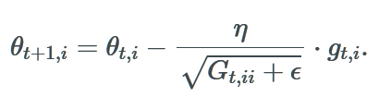

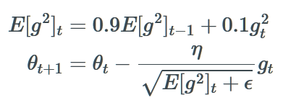
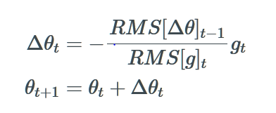
Some of the Algorithms
Vector of weights + biases
Vector of dL/dw
Batch Gradient Descent
Momentum
AdaGrad
RMSprop
AdaDelta
Sum of Squares of g_{t’,I}
up to time t
g_{t}² is the vector of squares of the g_{i,t}
Corresponds to RMS[g]_{t}
RMS of previous change in the parameters

Slide 4
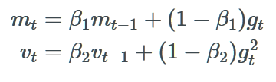
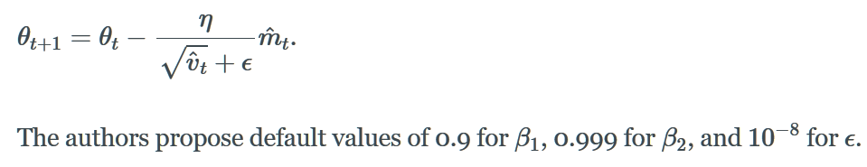
Adam
Two running averages:
Update depends on momentum normalized by variance:

Slide 5
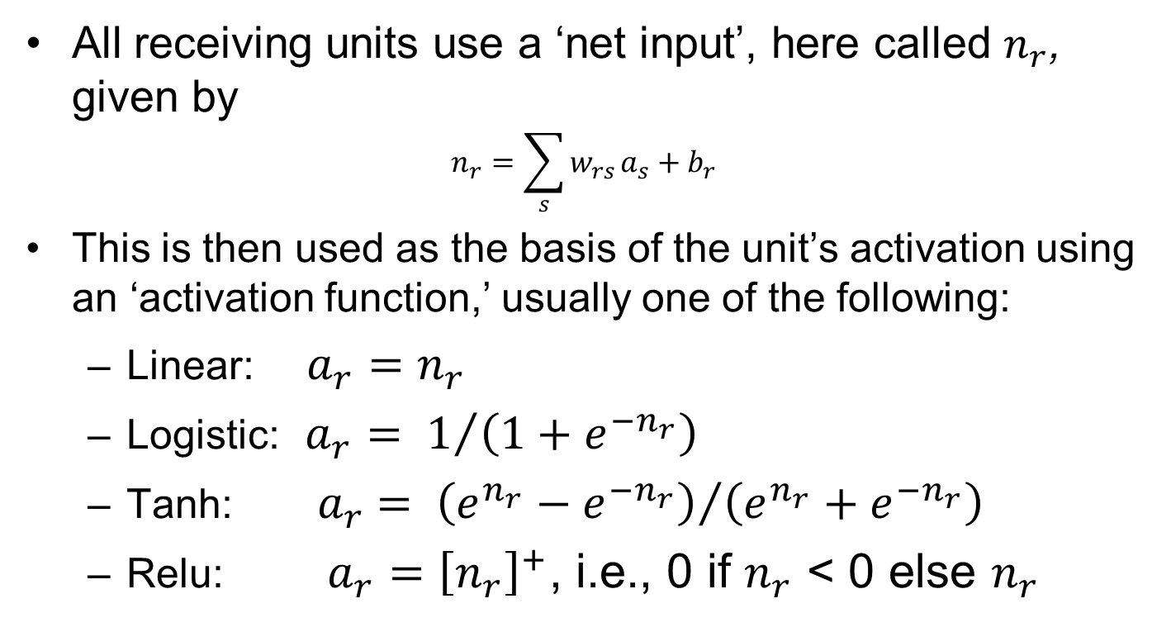
Neural network activation Functions
All receiving units use a ‘net input’, here called $n_{r}$, given by
$$n_{r}=\sum_{s}{w_{rs}}a_{s}+b_{r}$$
This is then used as the basis of the unit’s activation using an ‘activation function,’ usually one of the following:
Linear: $a_{r}=n_{r}$
Logistic: $a_{r}= 1/{\left(1+e^{{−n}_{r}}\right)}$
Tanh: ${ a}_{r} = {\left(e^{n_{r}}−e^{{−n}_{r}}\right)}/{\left(e^{n_{r}}+e^{{−n}_{r}}\right)}$
Relu: $a_{r}={\left[n_{r}\right]}^{+}$, i.e., 0 if $n_{r}$ < 0 else $n_{r}$

Slide 6
The algorithms in action

Slide 7
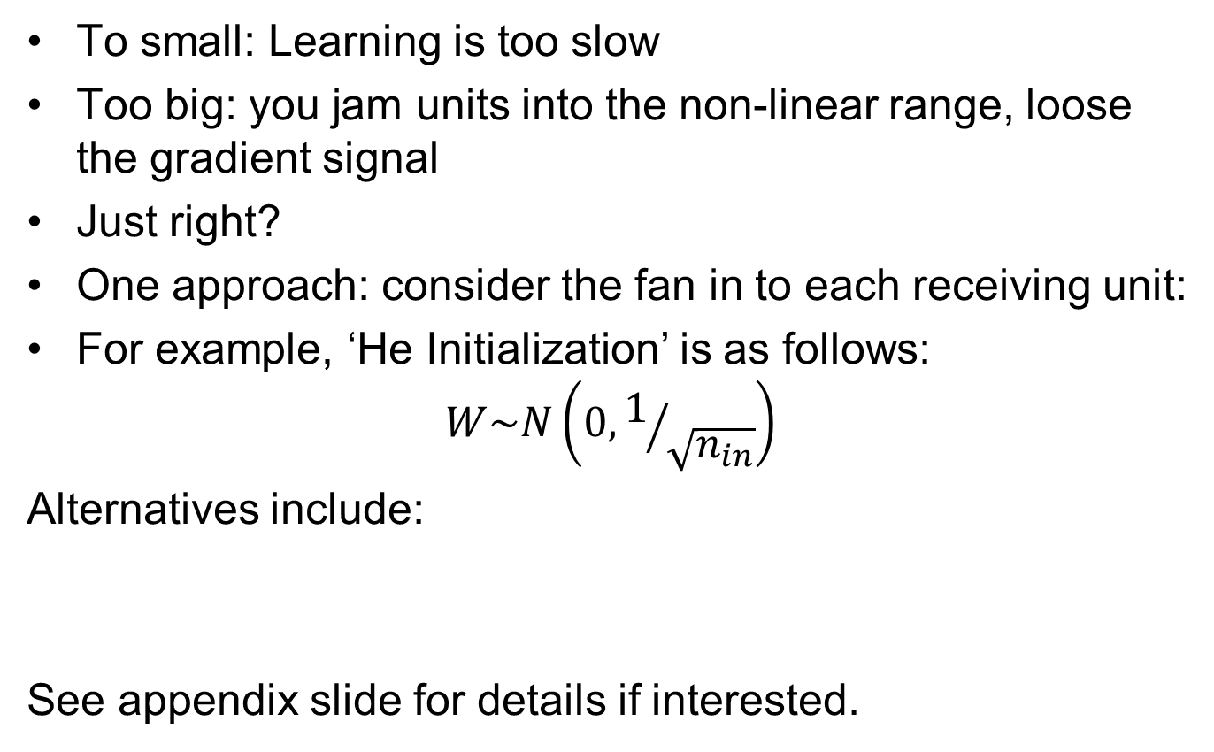
Weight Initialization
To small: Learning is too slow
Too big: you jam units into the non-linear range, loose the gradient signal
Just right?
One approach: consider the fan in to each receiving unit:
For example, ‘He Initialization’ is as follows:
$$W\sim N\left(0,1/{\sqrt{n_{in}}}\right)$$
Alternatives include:
See appendix slide for details if interested.

Slide 8
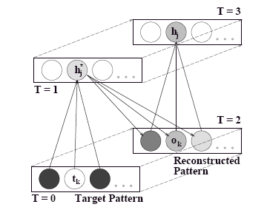

Recirculation Algorith
Assuming symmetric
connections:
jk

Slide 9
Generalized Recirculation
Present input, feed activation forward, compute output, let it feed back and let the hidden state settle to a fixed point.
Then clamp both input and output units into desired state, and settle again.*
t_{k}
h_{j}, y_{j}
s_{i}
*equations neglect the component to the net input at the hidden layer from the input layer.

Slide 10
Random feedback weights can deliver useful teaching signals
Lillicrap TP, Cownden D, Tweed DB, Akerman CJ: Random synaptic feedback weights support error backpropagation for deep learning. Nat Commun 2016, 7:13276 http://dx.doi.org/ 10.1038/ncomms13276.

Slide 11
‘Feedback Alignment’ Equals or Beats BackProp on MNIST in 3 and 4 layer nets

Slide 12
How it works

Slide 13
Can we make it work using Hebbian Learning?
Link to article in Science Direct

Slide 14
Normalized Initialization
Start with a more uniform distribution:
This often works ok
But it leads to degenerate activations at initialization when a tanh function is used.
‘Normalized initialization’ solves the problem (figure) and prodces improvement with tanh nonlinearity:
Now we know even better ways, but we’ll consider these later

