Slide 1
Representation of Language Knowledge:
Is it All in your Connections?
James L. McClelland
Carnegie Mellon University

Slide 2
A Linguistic Universal
Quasi-regularity:
  The tendency for linguistic expressions to reflect general regularities while they are at the same time partially idiosyncratic.

Slide 3
Quasi-Regularity in Inflectional Morphology
Quasi-regular English past-tenses:
  keep-kept
  tell-told
  say-said
  have-had
60% of English Irregulars end in d or t

Slide 4
Quasi-Regularity in Derivational Morphology
  predict, preface
  dirty, rosy, nosy
  assertive, progressive

Slide 5
Quasi-Regularity in Idioms, Constructions, and Collocations
I want to see a doctor.
She felt the baby kick.
He’s gonna kick the bucket any minute.

Slide 6
Quasi-Regularity in Spelling-Sound Correspondences
  pint
  have
  great

Slide 7
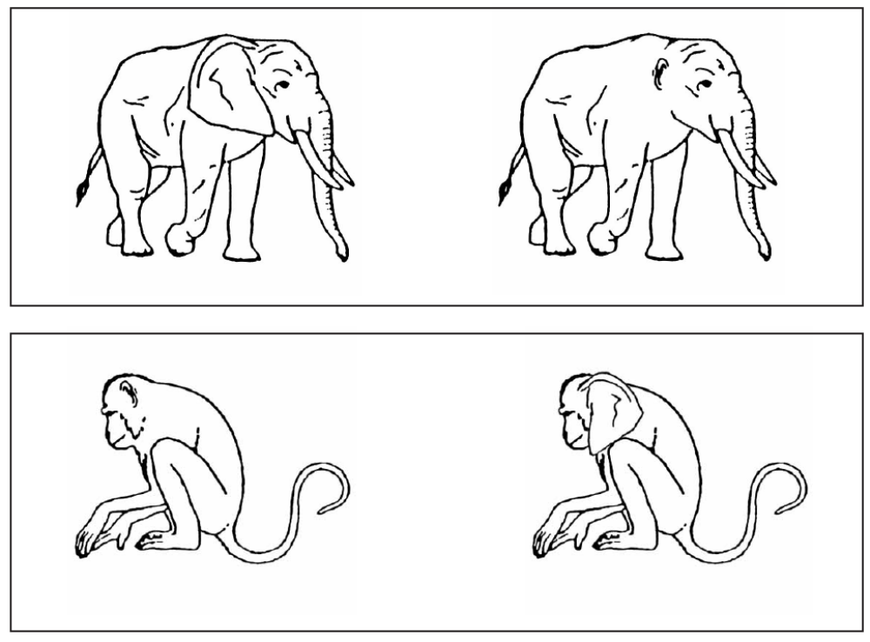
There’s Quasi-Regularity in Nature, Too!

Slide 8
An Alternative Perspective
Some have argued that regular aspects of language conform to ‘algebraic rules’
  They apply to forms solely in virtue of their abstract category membership:
    Pinker el al (Marcus, Ullman, and others)
    Fodor & Pylyshyn (1988)
  They are discovered in a ‘Eureka Moment’
    Marcus et al, 1992; Pinker, 1999
If true this would contradict the connectionist approach… so let’s take a look at the data.

Slide 9
Evidence Against an Algebraic Rule for the English Past Tense
(McClelland & Patterson, TiCS, 2002)
People are sensitive to degree of reliability among regulars forms (Albright and Hayes, 2003)
  Ex: 352 English verbs end in an unvoiced fricative (wish, slice) and all of them take regular past tenses.
  People’s ratings are sensitive to degree of reliability, even controlling for competition from exceptional alternatives.
Choice of regular past for a novel word (frink) depends on meaning (Ramscar, 2002)
  Frinked if frink means a kind of twitching of the eye.
  Frank if it means washing down sardines with vodka.
Purported low-frequency defaults in other languages turn out to be variable and context-specific
(Bybee, 1995; Hahn and Nakisa, 2002).

Slide 10
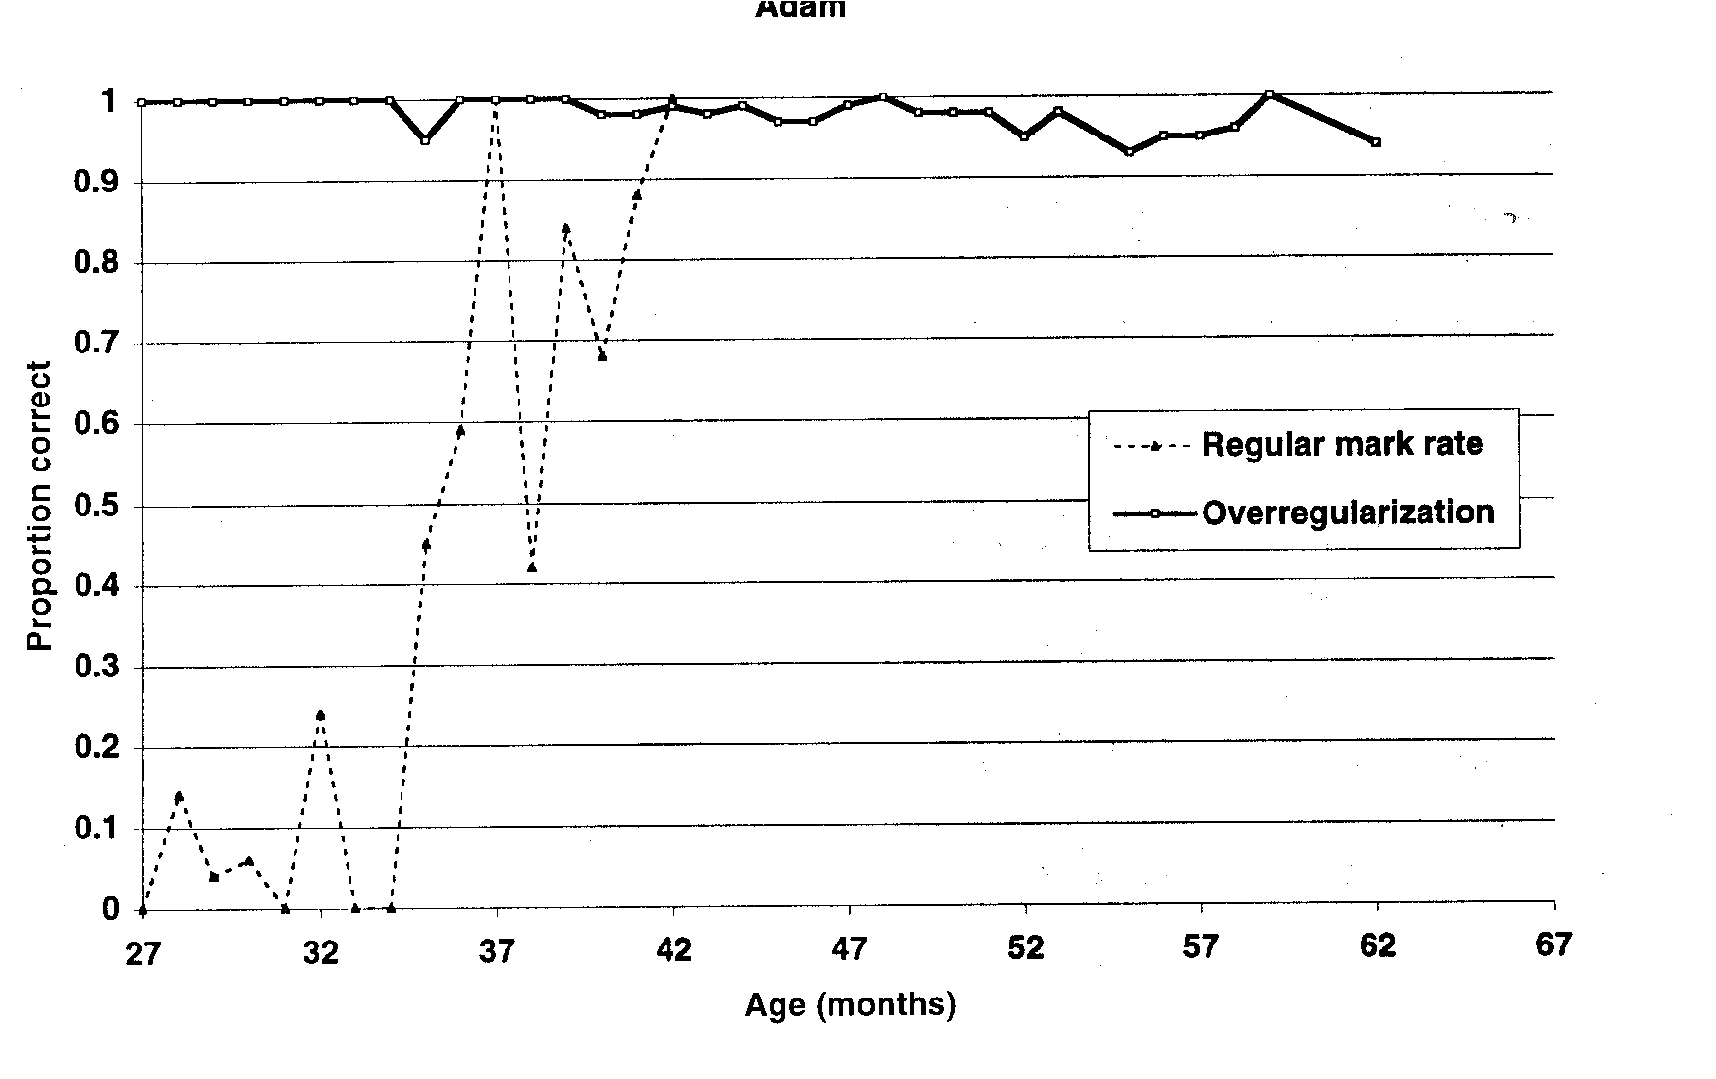
Is the acquisition of the regular past tense sudden?
First Over-Regularization
According to Marcus et al., it is sudden:
  “Adam’s first over-regularization occurred during a three-month period in which regular marking increased from 0 to 100%”
  But let’s see the rest of the data…
Regular Marking

Slide 11

A Reconsideration (J. Hoeffner, 1996)
Hoeffner notes one could just as easily say:
  “Adam’s first over-regularization occurred during a 6-month period in which regular marking went from 24% to 44%”.
The peak at 37 months is based on nine observations, and was not found in Hoeffner’s reanalysis…

Slide 12
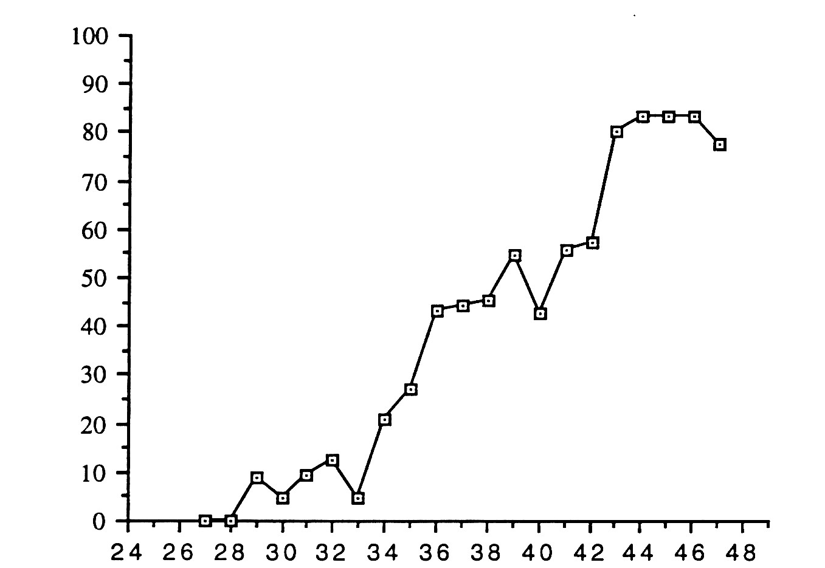
Regular Marking by Adam as Rated by Two Independent Raters (Hoeffner, 1996)

Slide 13
My Thesis
An inherent feature of language is quasi-regularity.
  Any attempt to characterize language accurately must take this into account.
  Language knowledge should be organized so that knowledge of regular patterns is brought to bear even when processing exceptions.
Connectionist models address these issues very nicely!

Slide 14
Key Aspects of
Connectionist Models
They provide a mechanism in which knowledge of regularities is always at work, processing quasi-regular forms by the same procedures used in processing fully regular items.
They help explain
  Why languages have quasi-regular structure
  How language use creates regularity and quasi-regularity as languages change over time

Slide 15
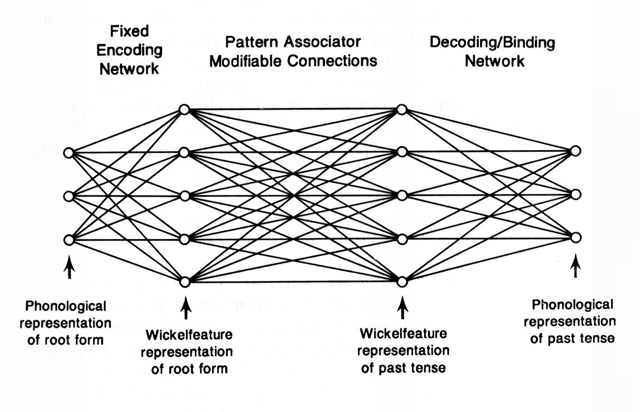
Rumelhart & McClelland (1986)

Slide 16
A Connectionist Model of Word Reading (Plaut, McC, Seidenberg & Patterson, 1996)
Task is to learn to map spelling to sound, given spelling-sound pairs from 3000 word corpus.
Network learns gradually from exposure to pairs in the corpus.
For each presentation of each item:
Input units corresponding to spelling are activated.
Processing occurs through propagation of activation from input units through hidden units to output units, via weighted connections.
Output is compared to the item’s pronunciation.
Small adjustments to connections are made to reduce difference.
/m/ /I/ /n/ /t/
M I N T

Slide 17
Aspects of the Connectionist Model
Mapping through hidden units forces network to use overlapping internal representations.
  -Allows sensitivity to combinations if necessary
  -Yet tends to preserve overlap based on similarity
Connections used by different words with shared letters overlap, so what is learned tends to transfer across items.
/m/ /I/ /n/ /t/
M I N T

Slide 18
Processing Regular Items:
MINT and MINE
/m/ /I/ /n/ /t/
Across the vocabulary, consistent co-occurrence of M with /m/, regardless of other letters, leads to weights linking M to /m/ by way of the hidden units.
The same thing happens with the other consonants, and most consonants in other words.
With the vowel it is more complex:
  The network needs to make some use of post-vowel letters to know whether to activate /I/ or /ai/.
M I N T

Slide 19
Processing an Exception:
PINT
/p/ /ai/ /n/ /t/
Because PINT overlaps with MINT, there’s transfer
  Positive for N -> /n/ and T -> /t/
  Negative for I -> /ai/
Of course P benefits from learning with PINK, PINE, POST, etc.
Knowledge of regular patterns is hard at work in processing this and all other exceptions.
The only special thing the network needs to learn is what to do with the vowel.
Even this will benefit from weights acquired from cases such as MIND, FIND, PINE, etc.
P I N T

Slide 20
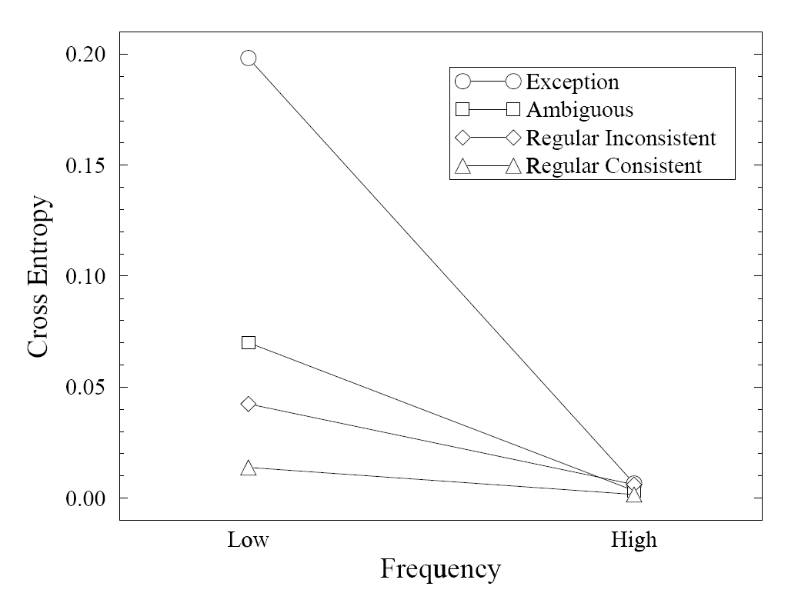
Frequency, regularity, and consistency in word reading
pint
Reaction Time (Humans)
Settling Time (Networks)
crow
mint
have
poke
slow
save
make

Slide 21
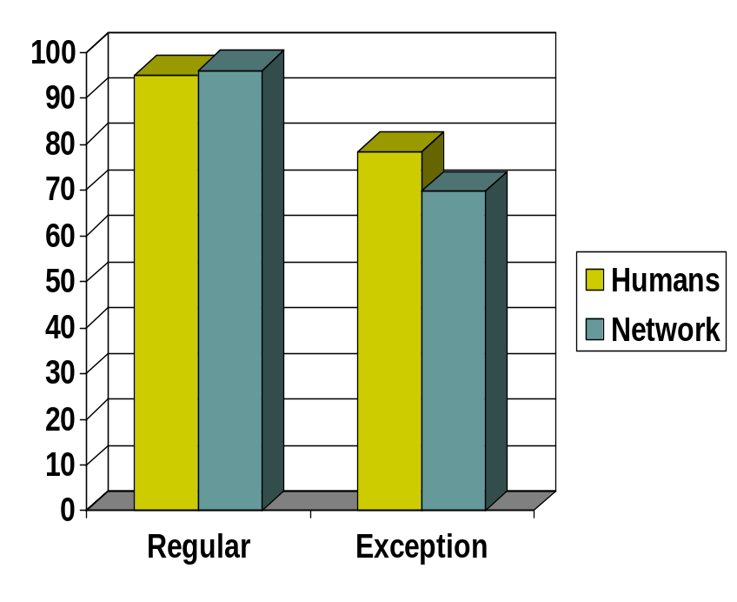
Pronunciation of Nonwords by the Model and by Humans
Glushko (1979) compared:
  ‘Regular’ nonwords, derived from words from consistent neighborhoods:
    NOKE
  ‘Exception’ nonwords, derived from words from inconsistent neighborhoods
    GROOK
    MAVE
    PREAD
Both humans and the model show sensitivity to the inconsistent neighbors
Percent Regular

Slide 22
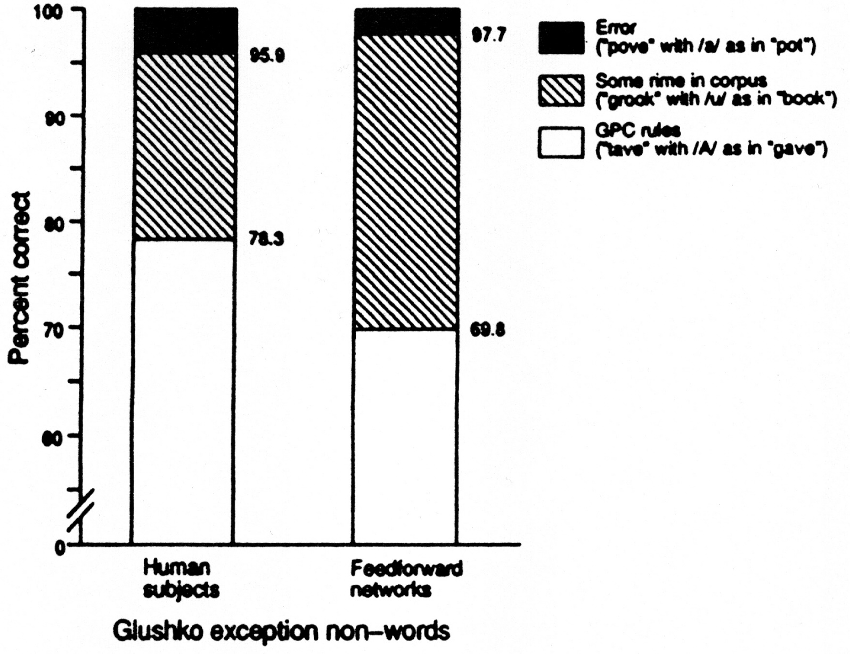
Performance on Exception Non-words
Frank Errors
Rhymes with a Neighbor
Regular by GPC rules
Percent of Responses
Humans Networks

Slide 23
The model exhibits sensitivity to…
Regularities (incl. context sensitive ones) others capture by rules
  M -> /m/, P -> /p/
  C -> /s/ when followed by {I,E}
  O-> ‘oh’ when followed by L{L,D,K,T}
Partial regularities associated with specific vowel-consonant patterns:
OOK as in COOK
EAD as in BREAD
Influences of knowledge of exceptions:
PINT, HAVE
MINT, RAVE
VINT, MAVE
But it has no explicit representations of exceptions,
specific vowel-consonant patterns, or rules.

Slide 24
Some Implications
There may be no lexicon in the mechanisms of language processing; only sensitivity to the idiosyncratic properties of particular items.
The rules that characterize regularities may not have any explicit representation either.
Rules and units of all sizes might be viewed as useful descriptively in characterizing the emergent properties of a system in which none of them are represented as such.

