Slide 1
Learning linguistic structure with simple recurrent neural networks
Psychology 209 - 2019
February 5, 2019

Slide 2
Rules or Connections?
How is it that we can process sentences we’ve never seen before?
Colorless green ideas sleep furiously
Chomsky, Fodor, Pinker, …
Abstract, symbolic rules
S-> NP VP ; NP -> (Adj)* N ; VP-> V (Adv)
The connectionist alternative
Function approximation using distributed representations and knowledge in connection weights

Slide 3
Elman’s Simple Recurrent Network (Elman, 1990)
What is the best way to represent time
Slots?
Or time itself?
What is the best way to represent language?
Units and rules?
Or connectionist learning?
Is grammar learnable?
If so, are there any necessary constraints?

Slide 4
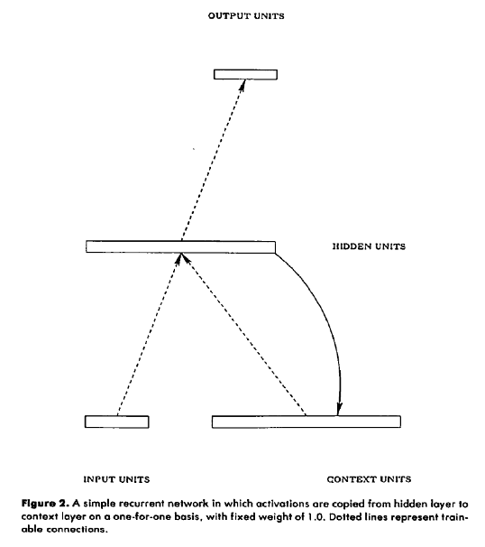
The Simple Recurrent Network
Network is trained on a stream of elements with sequential structure
At step n, target for output is next element.
Pattern on hidden units is copied back to the context units.
After learning it comes to retain information about preceding elements of the string, allowing expectations to be conditioned by prior context.

Slide 5
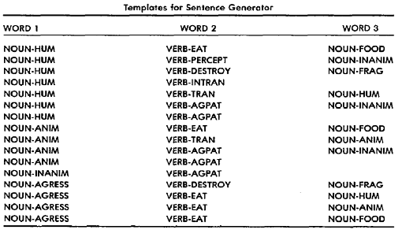
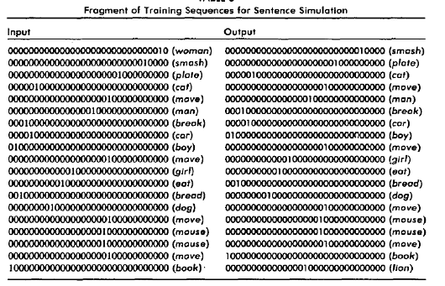
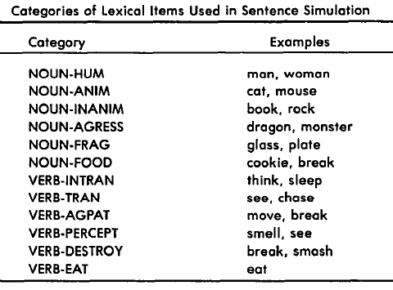
Learning about sentence structure from streams of words

Slide 6
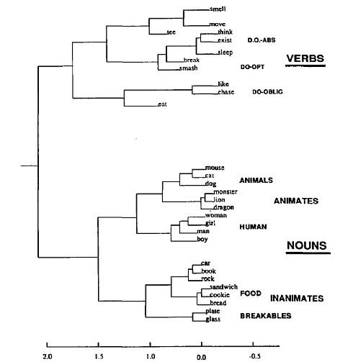
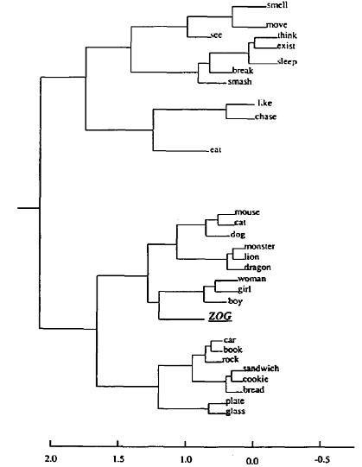
Learned and imputed hidden-layer representations (average vectors over all contexts)
‘Zog’ representation derived by averaging vectors obtained by inserting novel item in place of each occurrence of ‘man’.

Slide 7
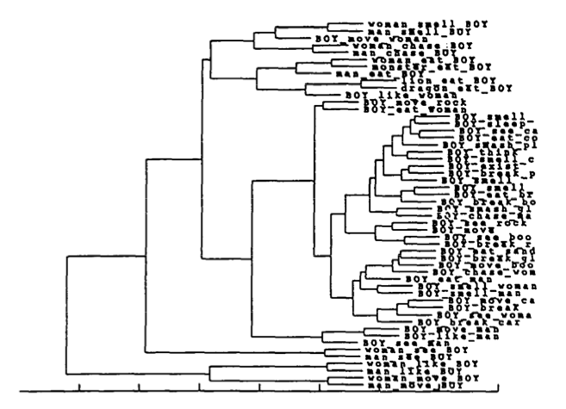
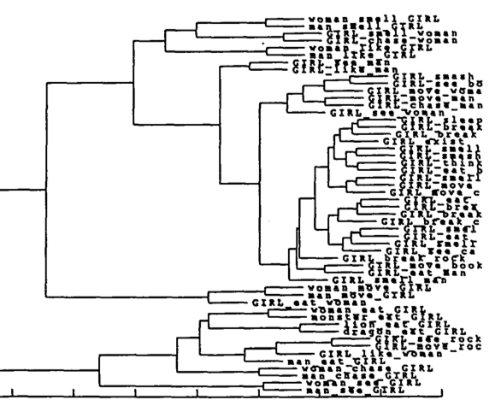
Within-item variation by context

Slide 8
One Question in all of this:
From Sonja:
What is meant by the "co-occurrence structure of the domain“?
Passage from the handbook:
“Crucially, the input patterns representing the nouns and verbs were randomly assigned, and thus did not capture in any way the co-occurrence structure of the domain.”
Preceding text:
Verbs and nouns fell into different sub-types, – there were, for example, verbs of perception (which require an animate subject but can take any noun as object) and verbs of consumption, which require something consumable, and verbs of distruction, each of which had different restrictions on the nouns that could occur with it as subject and object.

Slide 9
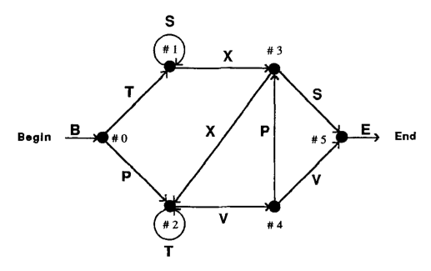
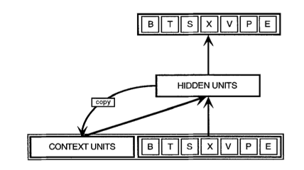
Analyis of SRN’s using Simpler Sequential Structures (Servain-Schreiber, Cleeremans, & McClelland)
The Grammar
The Network

Slide 10
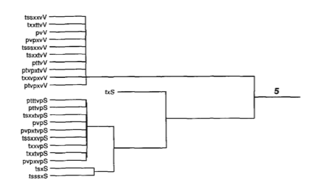
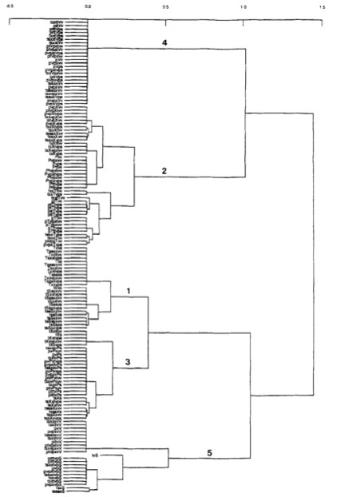
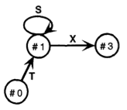
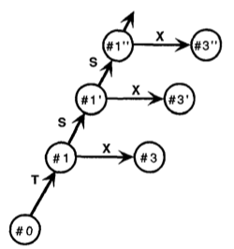
Hidden unit representations with 3 hidden units
True Finite State Machine
Graded State
Machine

Slide 11
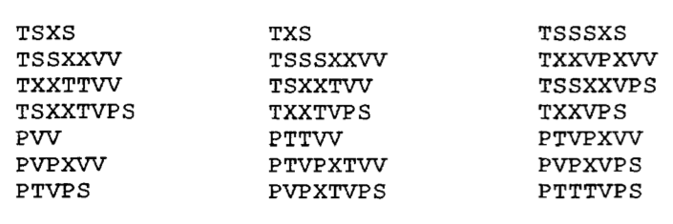
Training with Restricted Set of Strings
21 of the 43 valid strings of length 3-8

Slide 12
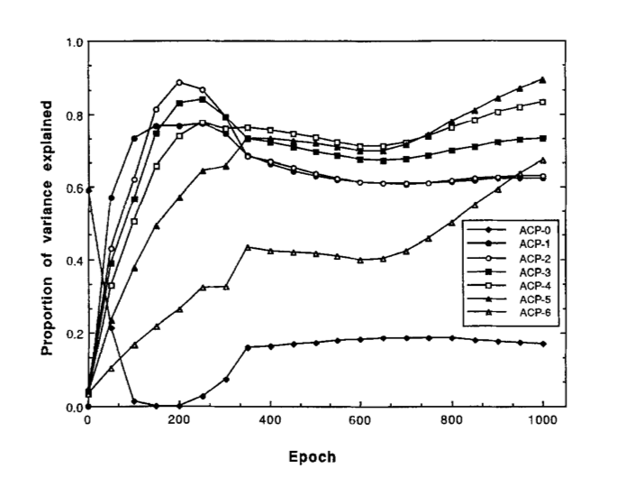
Progressive Deepening of the Network’s Sensitivity to Prior Context
Note: Prior Context is only maintained if it is prediction-relevant at intermediate points.

Slide 13
Relating the Model to Human data
Experiment: Implicit sequence learning
Input is a screen position (corresponding to a letter in the grammar)
Response measure is RT: time from stimulus to button press (very few errors ever occur)
Assumption: anticipatory activation of output unit reduces RT
Fit to data: compare model’s predictions at different time points to human RT’s at these time points.
A pretty good fit was obtained after adding two additional assumptions:
Activation carries over (with decay) from the previous time step
Connection weight adjustments have both a fast and a slow component.

Slide 14

Results and Model Fit
Basic
Model Fit
Human Behavior
Extended
Model Fit

Slide 15
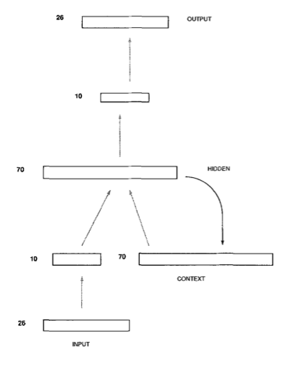
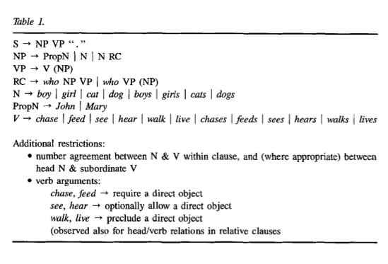
Elman (1991)

Slide 16
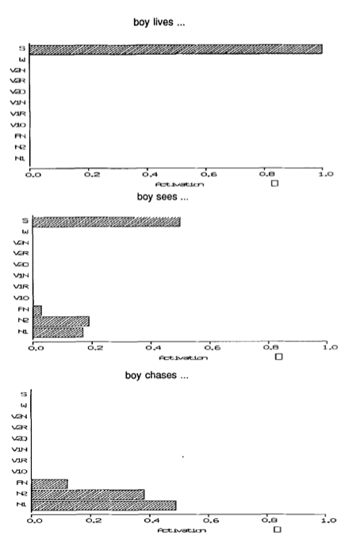
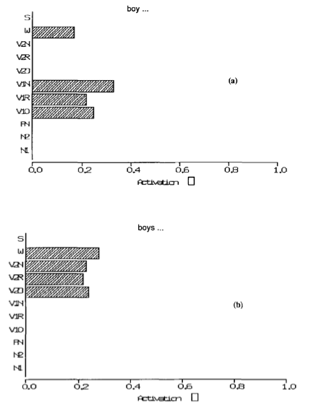
NV Agreement and Verb successor prediction
Histograms show summed activation for classes of words:
W = who
S = period
V1/V2 / N1/N2/PN indicate singular, plural, or proper
For V’s:
N = No DO
O = Optional DO
R = Required DO

Slide 17
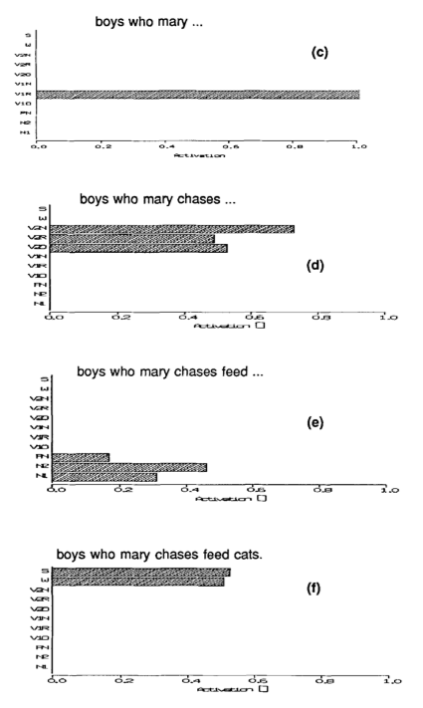
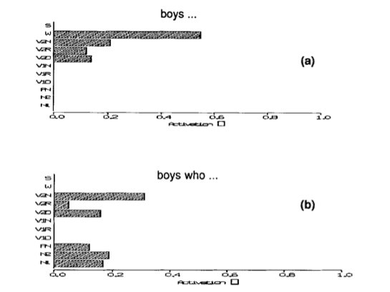
Prediction with an embedded clause

Slide 18
What does it mean that ‘RNN’s are Turing Complete’?
From stack exchange:
The following paper shows that, for any computable function, there exists a finite recurrent neural network (RNN) that can compute it. Furthermore, there exist finite RNNs that are Turing complete, and can therefore implement any algorithm.
Siegelmann and Sontag (1992). On the computational power of neural nets.

Slide 19
Going Beyond the SRN
Back-propagation through time
The vanishing gradient Problem
Solving the vanishing gradient problem with LSTM’s
The problem of generalization and overfitting
Solutions to the overfitting problem
Applying LSTM’s with dropout to a full-scale version of Elman’s prediction task

