Slide 1
RNNs: Going Beyond the SRN in Language Prediction
Psychology 209
February 07, 2019

Slide 2
XOR performance and factors affecting the results
Worst case | #hidden units | Activation Function
394 | 4
196 | 2 | Tanh
69 | 8
60 | 3 | Tanh
54 | 4 | Tanh
37 | 5 | Tanh
25 | 10 | Relu
24 | 10 | Tanh
24 | 5 | Tanh
24 | 3 | Tanh
23 | 12 | Tanh
18 | 32
15 | 16 | Tanh
15 | 100 | Relu
14 | 14 | Relu
11 | 16 | Relu
10 | 50 | Relu
Notes:
196 = Noah
24 = Hermawan
14 = Shaw
10 = Ciric

Slide 3
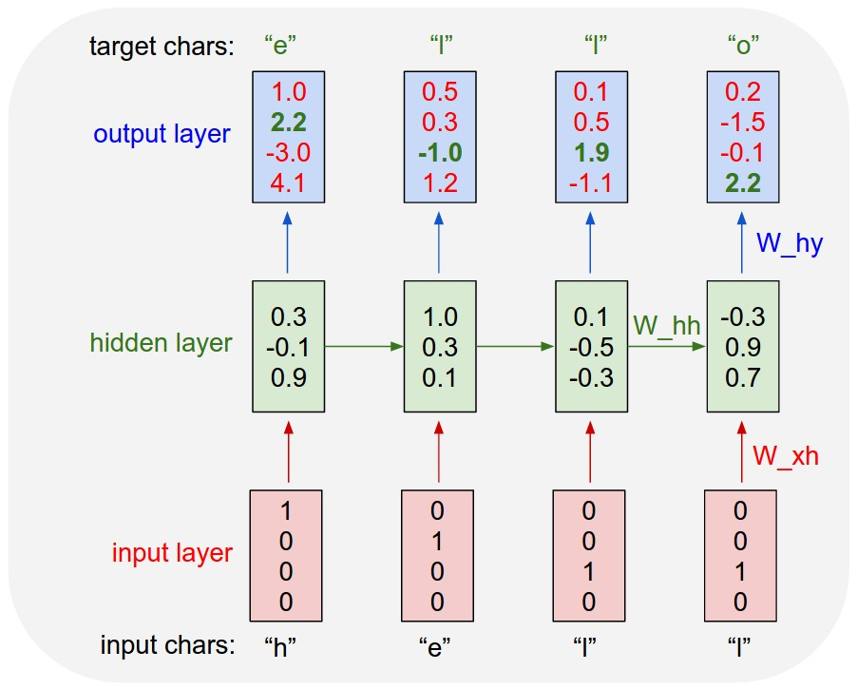
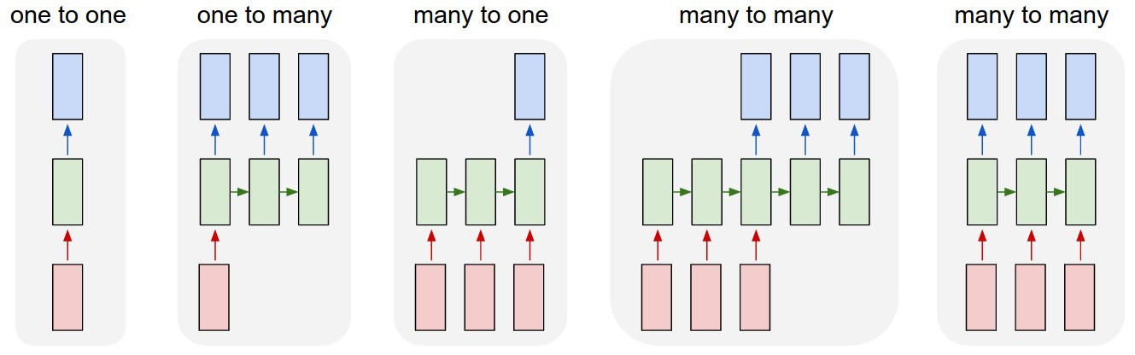

A RNN for character prediction
We can see this as ‘nsteps’ copies of an Elman net placed next to each other. Note that there are only three actual weight arrays, just as in the Elman network.
But now we can do ‘back propagation through time’.
Gradients are propagated through all arrows, and many different paths affect the same weights.
We simply add all these gradient paths together before we change the weights.
What happens when we want to process the next characters in our sequence? We keep the last hidden state, but don’t back-propagate through it.
‘Truncated backpropagation’
Elman net truncates after one step
How many total backward paths (from o_{t} to h_{t-τ}) affect W_{hh}?
…

Slide 4
Parallelizing the computation
Create 20 copies of the whole thing – call each one a stream
Process your text starting at 20 different points in the data.
Add up the gradient across all the streams at the end of processing a batch
Then take one gradient step!
The forward and backward computations are farmed out to a GPU, so they actually occur in parallel using the weights from the last update
…
…
…
…
…
…
…
…
…
…
…
…
…
…
…
…
…
…
…
…

Slide 5
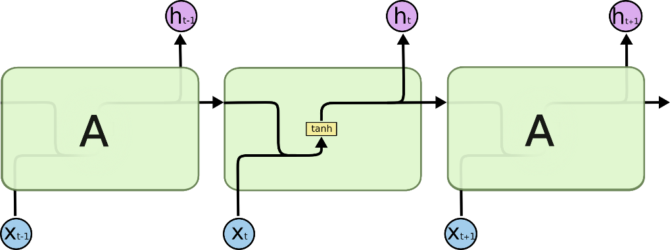


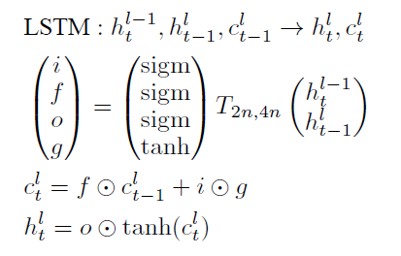
Some problems and solutions
Classic RNN at right
Note superscript l for layer
The vanishing gradient problem
Solution: the LSTM
Has it’s own internal state ‘c’
Has weights to gate input and output and to allow it to forget
Note elementwise multiplication notation

Slide 6
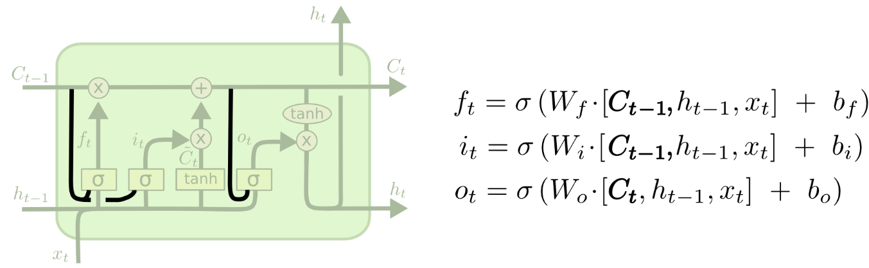
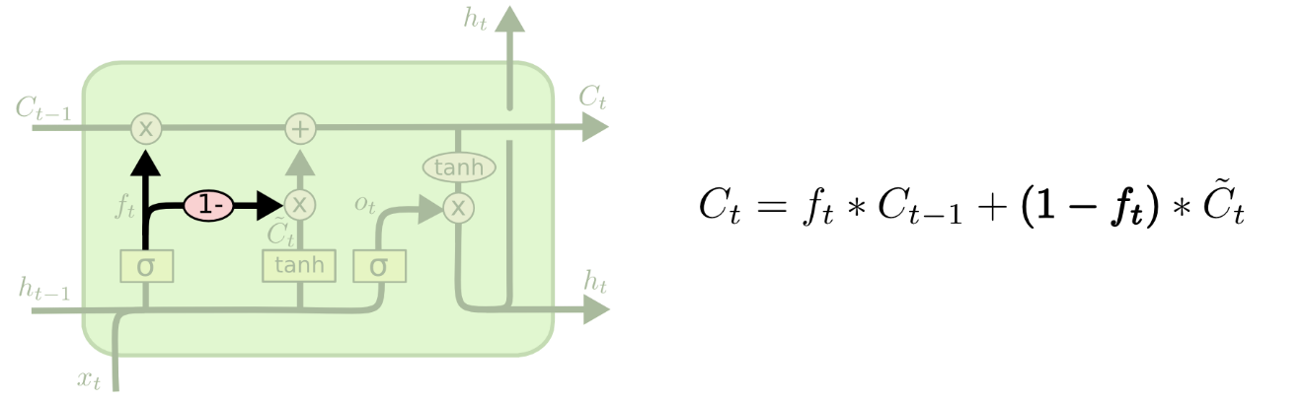
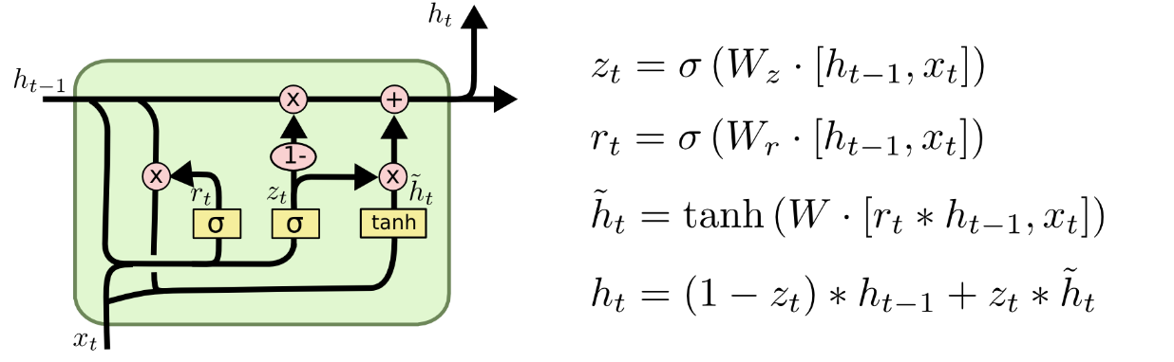
Variants
‘Peep-hole connections’
Tying the input and forget gates
Gated recurrent unit
(Wikipedia version has biases)

Slide 7
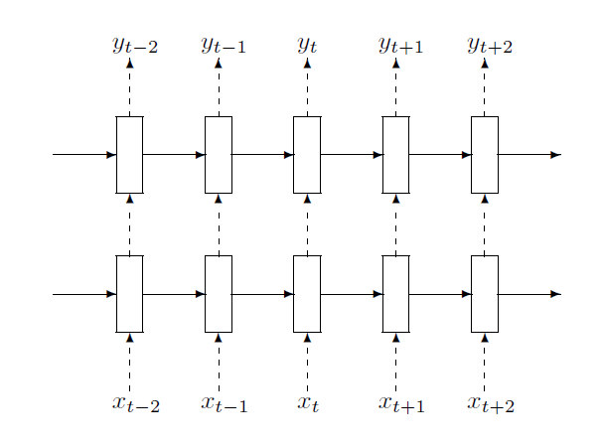
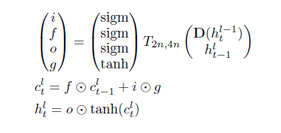
Some problems and solutions
Classic RNN at right
Note superscript l for layer
The vanishing gradient problem
Solution: the LSTM
Has it’s own internal state ‘c’
Has weights to gate input and output and to allow it to forget
Note dot product notation
Overfitting
Solution: Dropout (dotted paths only)

Slide 8
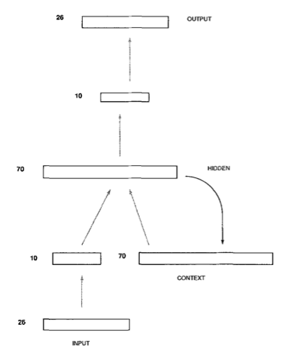
Word Embeddings
Uses a learned word vector instead of one unit per word
Similar to the Rumelhart model of semantic cognition and the first hidden layer of 10 units from Elman (199)
We use backprop to (conceptually) change the word vectors, rather than the input to word vector weights, but it is essentially the same computation.

Slide 9
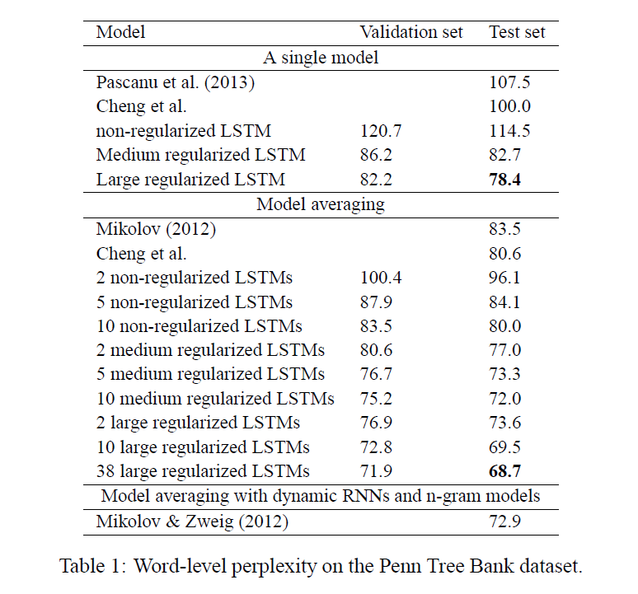
Zaremba et al (2016) https://www.tensorflow.org/tutorials/recurrent/
Uses stacked LSTMs with dropout
Learns its own word vectors as it goes
Shows performance gains compared with other network variants
Was used in the Tensorflow RNN tutorial
Could be used to study lots of interesting cognitive science questions

Slide 10
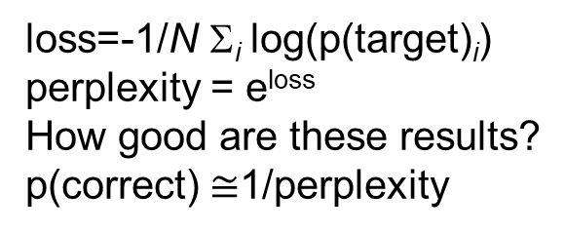
Zaremba et al (2016) – Details of their prediction experiments
https://github.com/tensorflow/models/blob/master/tutorials/rnn/ptb/ptb_word_lm.py
Corpus of ~1.1M words, 10,000 word vocabulary (boy, boys different words). Rare words replaced by <unk>.
Output is a softmax over 10,000 alternatives
Input uses learned embeddings over N Units.
All networks rolled out for 35 steps, using a batch size of 20.
As is standard, training was done with separate training, validation, and test data.
Randomly divide the data into three parts (e.g. ~85% for training, ~7% for validation, ~8% for test)
Run a validation test at many time points during training.
Stop training when validation accuracy stops improving.
Varied hidden layer size:
Non-regularized: 200 units in word embedding and each LSTM layer
Medium regularized: 650 units in embedding and LSTM layers, 50% dropout
Large regularized: 1500 units in embedding and LSTM layers, 65% dropout
loss=-1/N Σ_{i} log(p(target)_{i})
perplexity = e^{loss} How good are these results?
p(correct) $≅$1/perplexity

Slide 11
Optimization algorithms
We have discussed ‘batch gradient descent’, ‘stochastic gradient descent’ and ‘momentum descent’.
There are many other variants, see:
http://sebastianruder.com/optimizing-gradient-descent/
Most common:
RMSprop
Adagrad
Adam

Slide 12
Weight initialization and activity normalization
Weight initialization depends on number of incoming connections – don’t want the total to be too large
Clever initialization can speed learning
E.g., perform SVD on random weights, then reconstruct the weights giving each dimension equal strength (i.e. ignore ‘s’ term)
Normalizing activations can speed learning too
Batch normalization:
For each unit in each layer, make its activations have mean = 0, sd = 1
Layer normalization
Normalize inputs to units in a layer within each training case
Ba, Kiros, & Hinton (2016) https://arxiv.org/abs/1607.06450

