Slide 1
Computer Vision
Spring 2012 15-385,-685
Instructor: S. Narasimhan
Wean Hall 5409
T-R 10:30am – 11:50am

Slide 2
Frequency domain analysis and Fourier Transform
Lecture #4

Slide 3

How to Represent Signals?
Option 1: Taylor series represents any function using polynomials.
Polynomials are not the best - unstable and not very physically meaningful.
Easier to talk about “signals” in terms of its “frequencies”
(how fast/often signals change, etc).

Slide 4
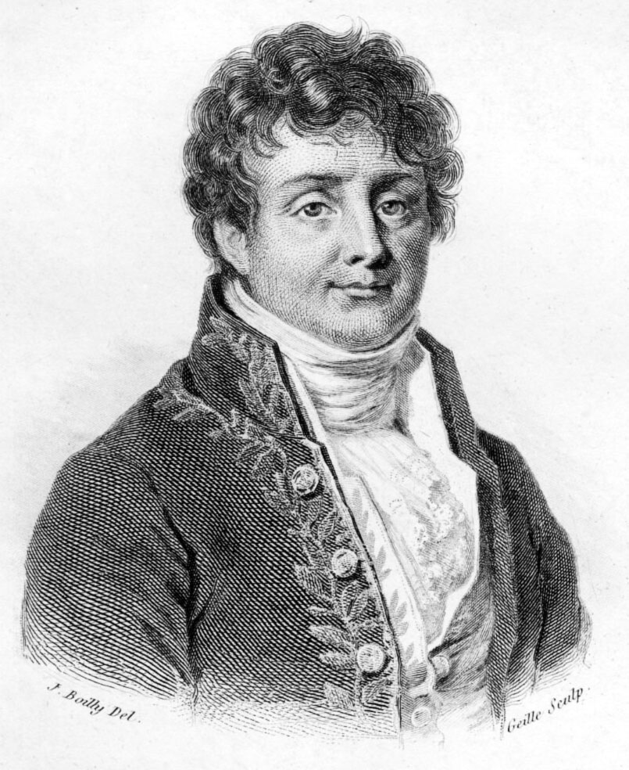
Jean Baptiste Joseph Fourier (1768-1830)
Had crazy idea (1807):
Any periodic function can be rewritten as a weighted sum of Sines and Cosines of different frequencies.
Don’t believe it?
  Neither did Lagrange, Laplace, Poisson and other big wigs
  Not translated into English until 1878!
But it’s true!
  called Fourier Series
  Possibly the greatest tool
  used in Engineering

Slide 5
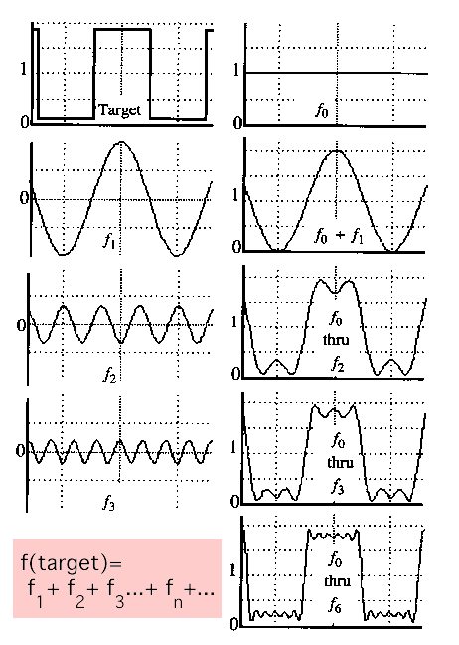
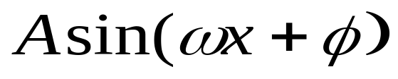
A Sum of Sinusoids
Our building block:
Add enough of them to get any signal f(x) you want!
How many degrees of freedom?
What does each control?
Which one encodes the coarse vs. fine structure of the signal?

Slide 6

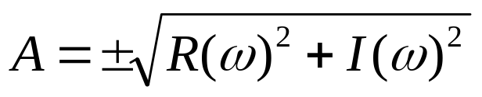
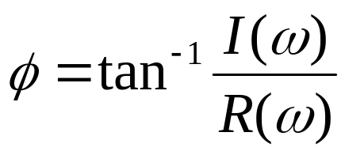
Fourier Transform
We want to understand the frequency ω of our signal. So, let’s reparametrize the signal by ω instead of x:
f(x)
Fourier
Transform
F(ω)
For every ω from 0 to inf, F(ω) holds the amplitude A and phase φ of the corresponding sine
  How can F hold both? Complex number trick!
F(ω)
Inverse Fourier
Transform
f(x)

Slide 7
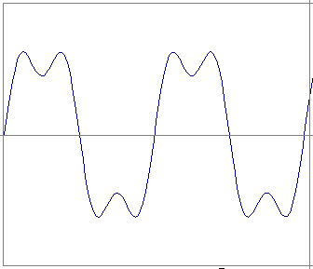
Time and Frequency
example : g(t) = sin(2pi f t) + (1/3)sin(2pi (3f) t)

Slide 8
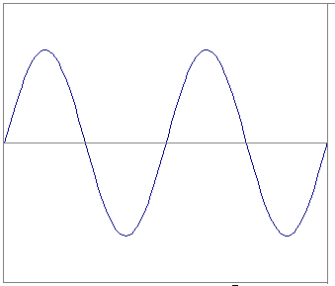
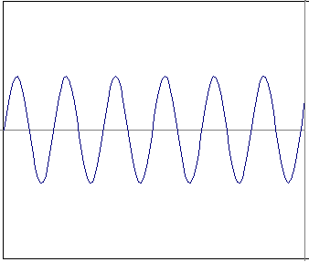
Time and Frequency
example : g(t) = sin(2pi f t) + (1/3)sin(2pi (3f) t)
=
+

Slide 9
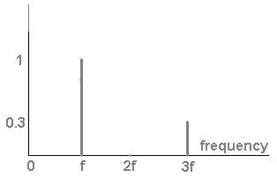
Frequency Spectra
example : g(t) = sin(2pi f t) + (1/3)sin(2pi (3f) t)
=
+

Slide 10

Frequency Spectra
Usually, frequency is more interesting than the phase

Slide 11
Frequency Spectra
=
+
=

Slide 12
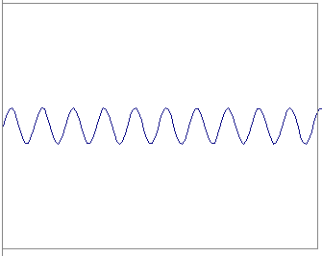
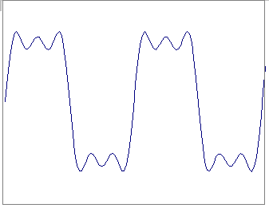
Frequency Spectra
=
+
=

Slide 13
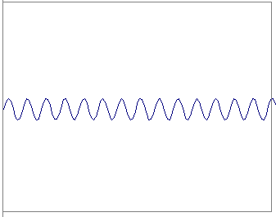
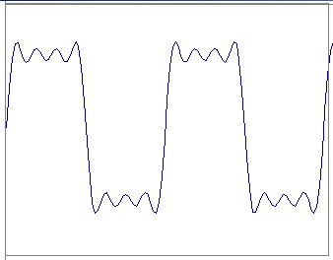
Frequency Spectra
=
+
=

Slide 14
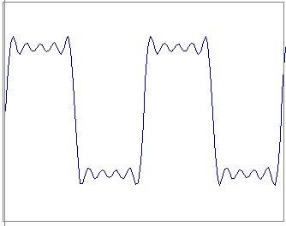
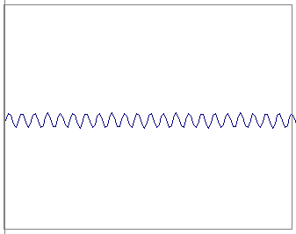
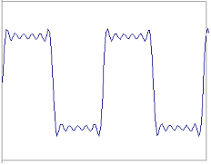
Frequency Spectra
=
+
=

Slide 15
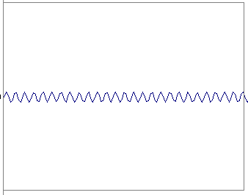
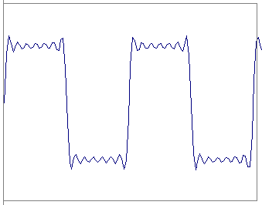
Frequency Spectra
=
+
=

Slide 16
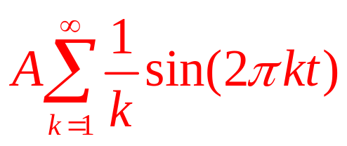
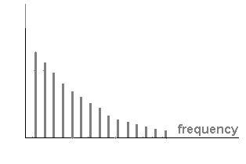
Frequency Spectra
=

Slide 17
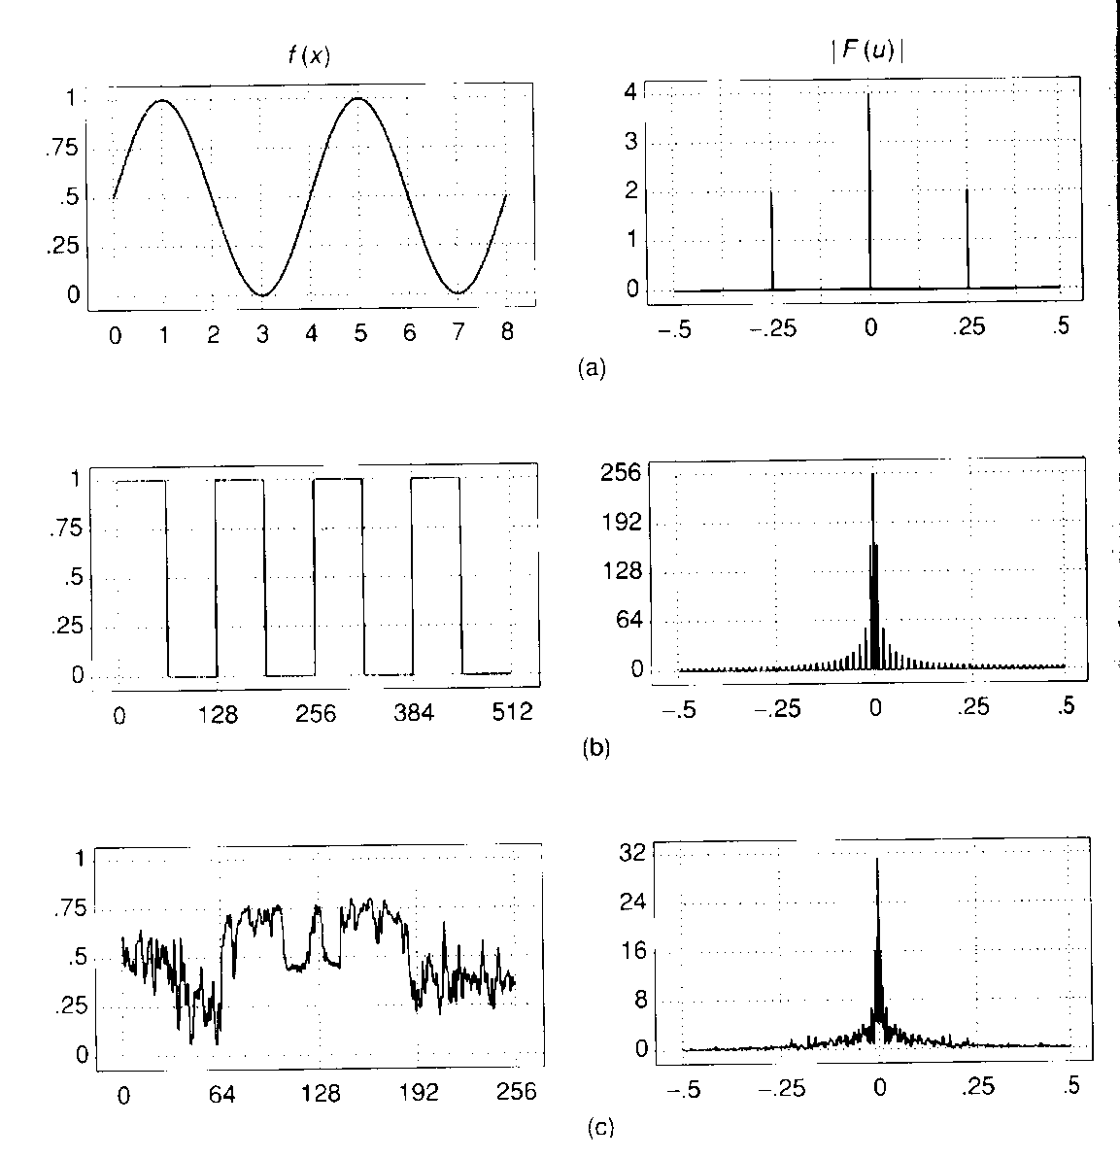
Frequency Spectra

Slide 18
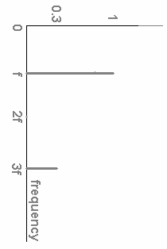
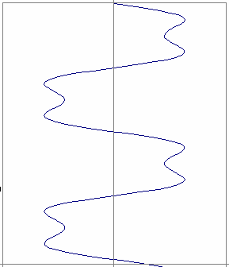
FT: Just a change of basis
M * f(x) = F(ω)
*
=
.
.
.

Slide 19
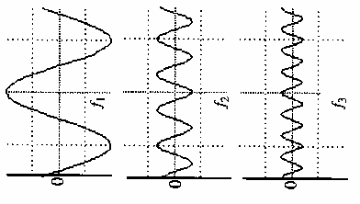
IFT: Just a change of basis
M⁻¹ * F(ω) = f(x)
*
=
.
.
.

Slide 20
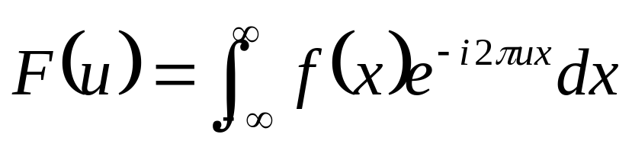
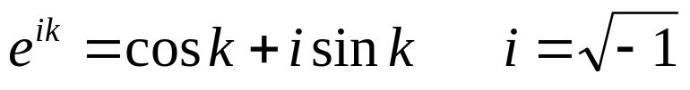
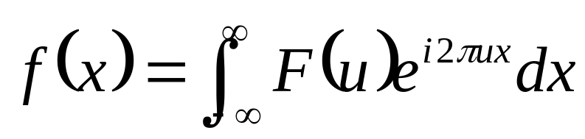
Fourier Transform – more formally
Represent the signal as an infinite weighted sum
of an infinite number of sinusoids
Note:
Arbitrary function
Single Analytic Expression
Spatial Domain (x)
Frequency Domain (u)
(Frequency Spectrum F(u))
Inverse Fourier Transform (IFT)

Slide 21
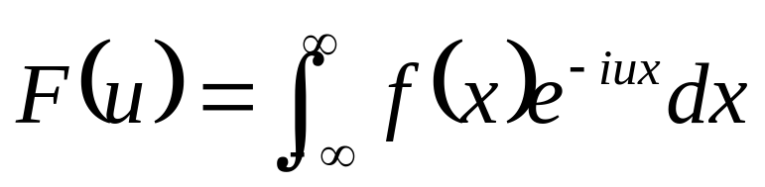
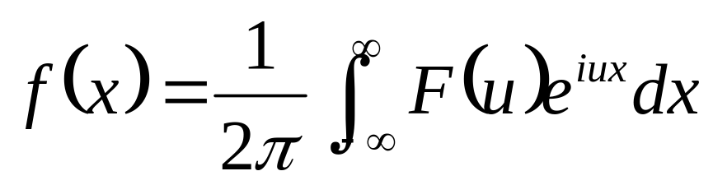
Fourier Transform
Also, defined as:
Note:
Inverse Fourier Transform (IFT)

Slide 22
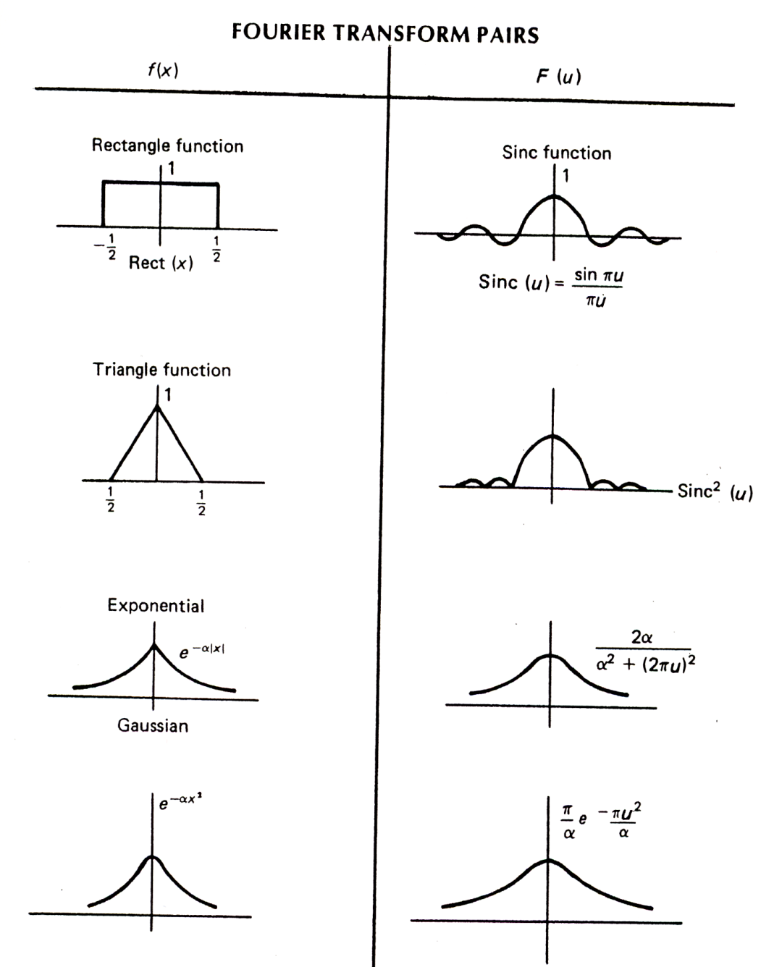
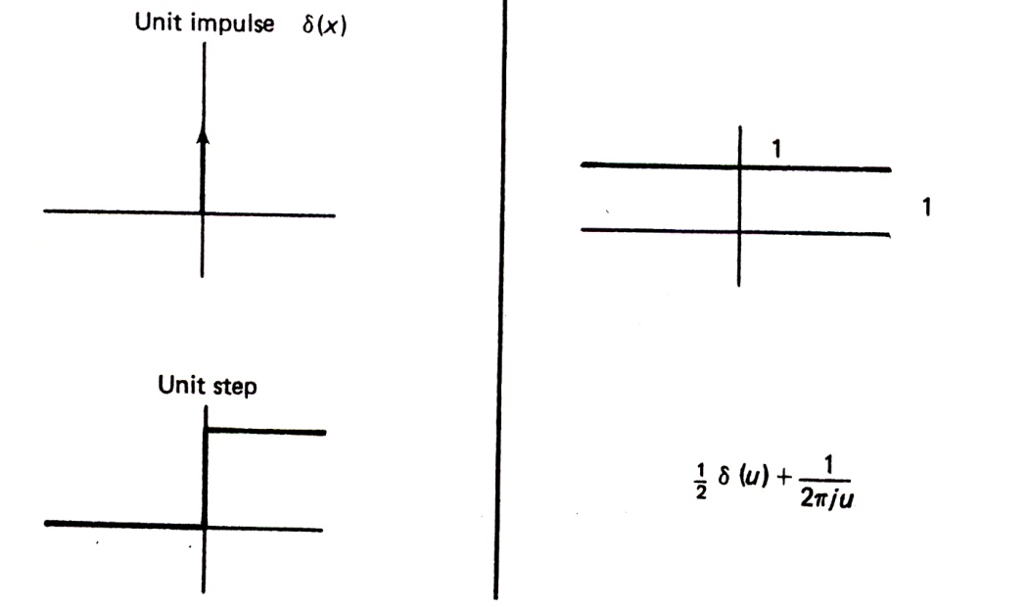

Fourier Transform Pairs (I)
Note that these are derived using
angular frequency ( )

Slide 23
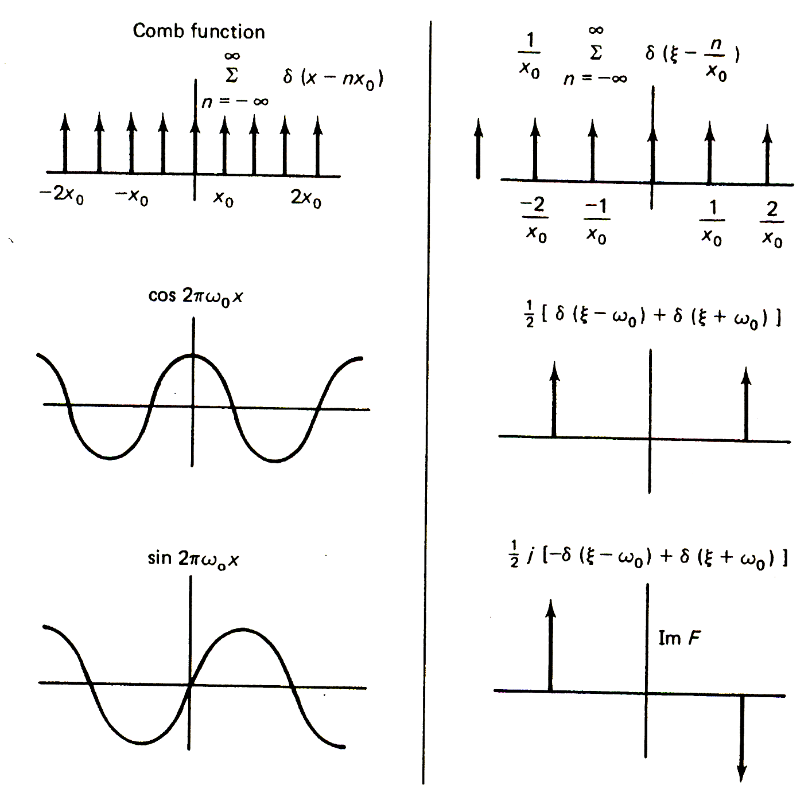
Fourier Transform Pairs (I)
Note that these are derived using
angular frequency ( )

Slide 24
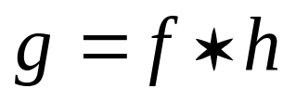
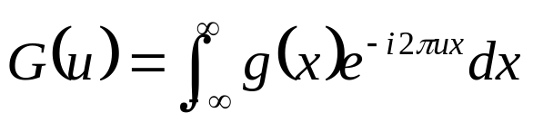
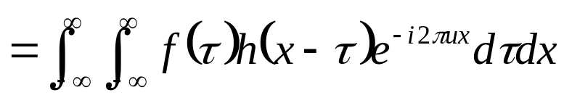
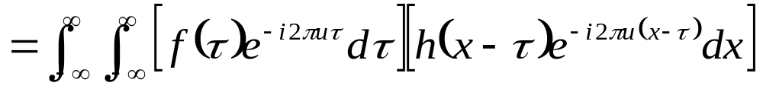
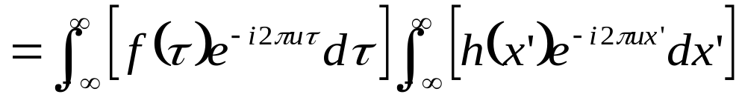


Fourier Transform and Convolution
Let
Then
Convolution in spatial domain
Multiplication in frequency domain

Slide 25

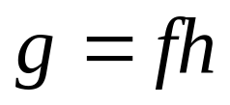










Fourier Transform and Convolution
Spatial Domain (x)
Frequency Domain (u)
So, we can find g(x) by Fourier transform
IFT
FT
FT

Slide 26


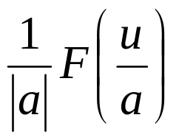









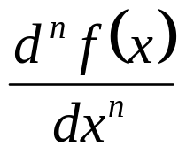
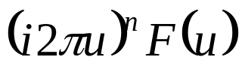

Properties of Fourier Transform
Spatial Domain (x)
Frequency Domain (u)
Linearity
Scaling
Shifting
Symmetry
Conjugation
Convolution
Differentiation
Note that these are derived using
frequency ( )

Slide 27
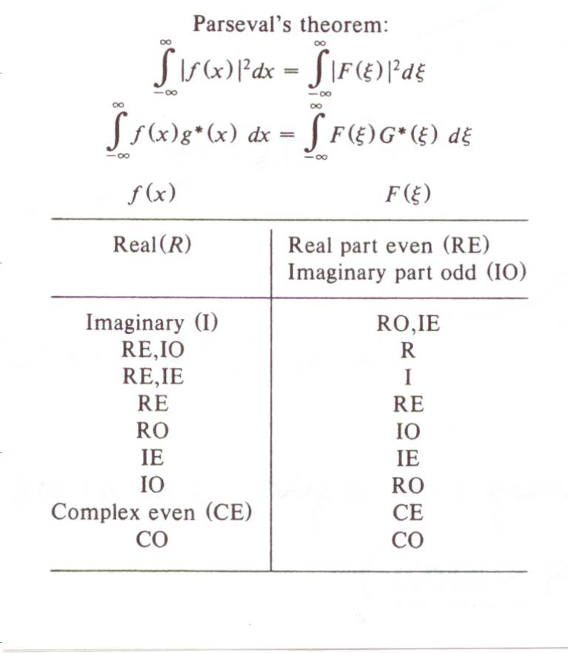
Properties of Fourier Transform

Slide 28
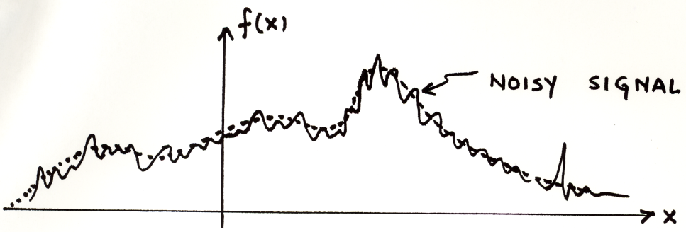


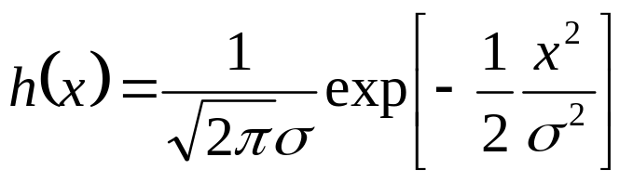



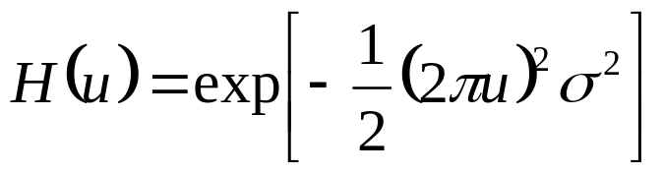
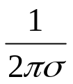


Example use: Smoothing/Blurring
We want a smoothed function of f(x)
Let us use a Gaussian kernel
Then
H(u) attenuates high frequencies in F(u) (Low-pass Filter)!

Slide 29
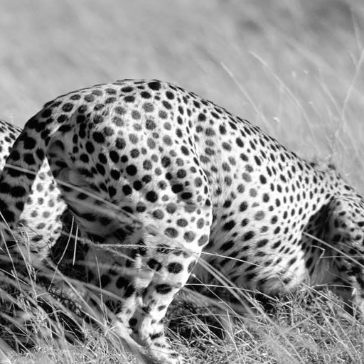
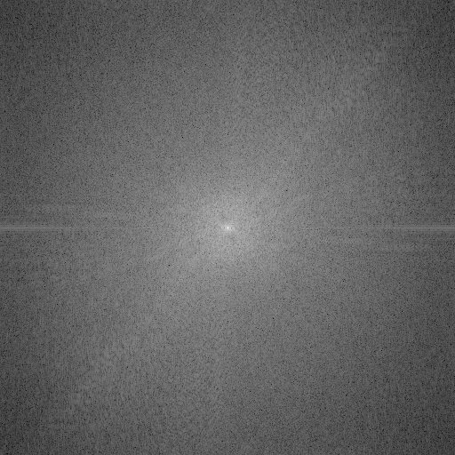
Image Processing in the Fourier Domain
Magnitude of the FT
Does not look anything like what we have seen

Slide 30
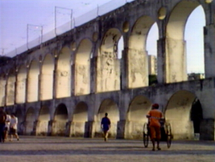
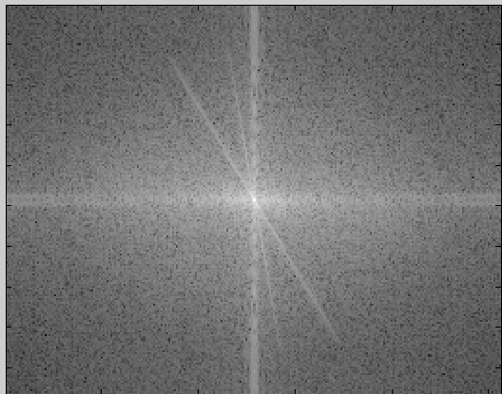
Image Processing in the Fourier Domain
Magnitude of the FT
Does not look anything like what we have seen

Slide 31






Convolution is Multiplication in Fourier Domain
f(x,y)
|F(s_{x},s_{y})|
*
h(x,y)
|H(s_{x},s_{y})|
g(x,y)
|G(s_{x},s_{y})|

Slide 32

Low-pass Filtering
Let the low frequencies pass and eliminating the high frequencies.
Generates image with overall
shading, but not much detail

Slide 33

High-pass Filtering
Lets through the high frequencies (the detail), but eliminates the low frequencies (the overall shape). It acts like an edge enhancer.

Slide 34
Boosting High Frequencies

Slide 35


Most information at low frequencies!

Slide 36

Fun with Fourier Spectra

Slide 37
Next Class
Image resampling and image pyramids
Horn, Chapter 6

