Slide 1
Lecture 12
Applications and demos

Slide 2
Building applications
Previous lectures have discussed stages in processing: algorithms have addressed aspects of language modelling.
All but the simplest applications combine multiple components.
Suitability of application, interoperability, evaluation etc.
Avoiding error multiplication: robustness to imperfections in prior modules.

Slide 3
Demos
Limited domain systems
  CHAT-80
  BusTUC
OSCAR: Named entity recognition for Chemistry
DELPH-IN: Parsing and generation
Blogging birds
Rhetorical structure: Argumentative Zoning of scientific text
Note also: demo systems mentioned in exercises.

Slide 4
CHAT-80
CHAT-80: a micro-world system implemented in Prolog in 1980
CHAT-80 demo
  What is the population of India?
  which(X:exists(X:(isa(X,population) and of(X,india))))
  have(india,(population=574))

Slide 5
Bus Route Oracle
Query bus departures in Trondheim, Norway, built by students and faculty at NTNU.
  42 bus lines, 590 stops, 60,000 entries in database
  Norwegian and English
  in daily use: half a million logged queries
Prolog-based, parser analyses to query language, mapped to bus timetable database
BusTUC demo
  When is the earliest bus to Dragvoll?
  When is the next bus from Dragvoll to the centre?

Slide 6
Chemistry named entity recognition
SciBorg: OSCAR 3 system: recognises chemistry named-entities in documents
  (e.g. 2,4-dinitrotoluene; citric acid)
Series of classifiers using n-grams, affixes, context plus external dictionaries
Used in RSC ProjectProspect
Also used as preprocessor for full parsing
Precision/recall balance for different uses

Slide 7
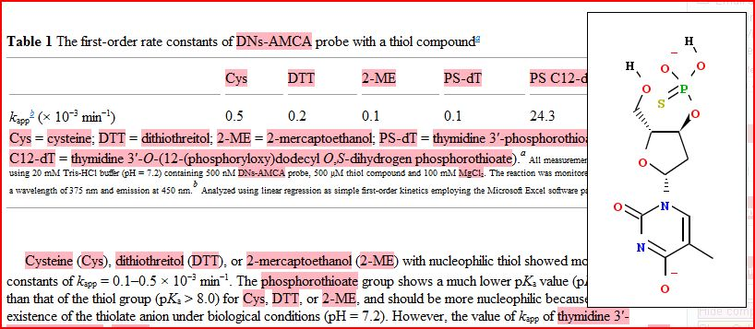
Enhanced browsing of chemistry documents: RSC using OSCAR

Slide 8
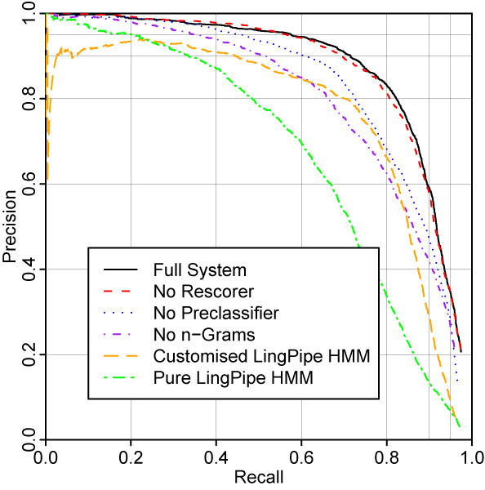
Precision and recall in OSCAR: from Corbett and Copestake (2008)
High precision,
modest recall:
text viewing
Modest precision, high recall: text preprocessing

Slide 9
DELPH-IN
DELPH-IN: informal consortium of 18 groups (EU, Asia, US) develops multilingual resources for deep language processing
  hand-written grammars in feature structure formalism, plus statistical ranking
  English Resource Grammar (ERG): approx 90% coverage of edited text
ERG demo
Metal reagents are compounds often utilized in synthesis.

Slide 10
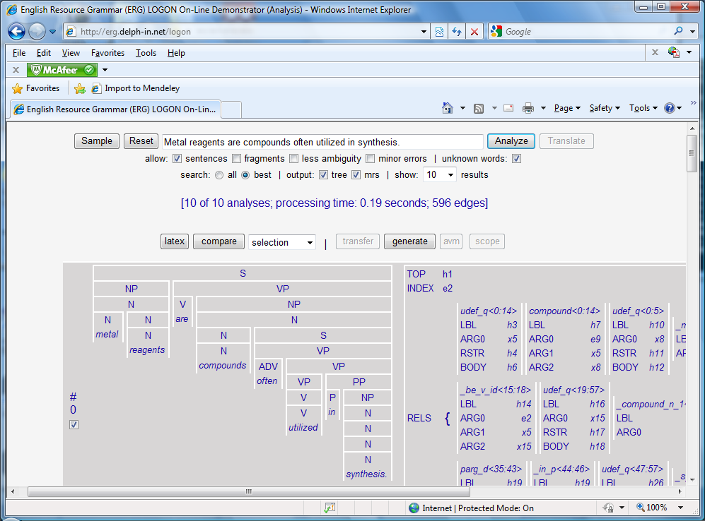

Slide 11
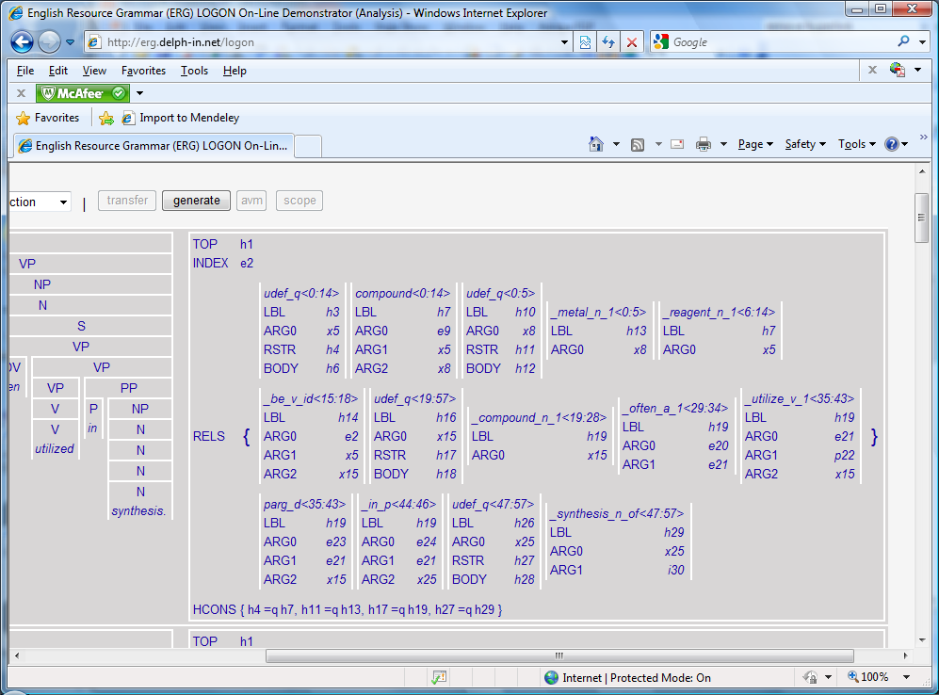

Slide 12
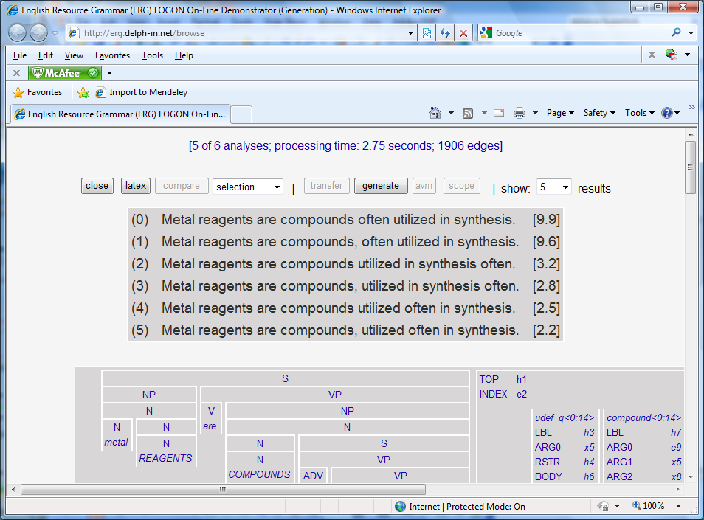

Slide 13
Some uses of the ERG
Automatic email response (YY Corp, commercial use)
Machine Translation
  LOGON research project: Norwegian to English
  smaller-scale MT with other language pairs
Semantic search
  SciBorg (chemistry, research)
  WeSearch (Wikipedia, University of Oslo, research)
English teaching (EPGY, Stanford: 20,000 users a week)
  http://www.delph-in.net/2010/epgy.pdf
Smaller-scale projects in question answering, information extraction, paraphrase ...

Slide 14
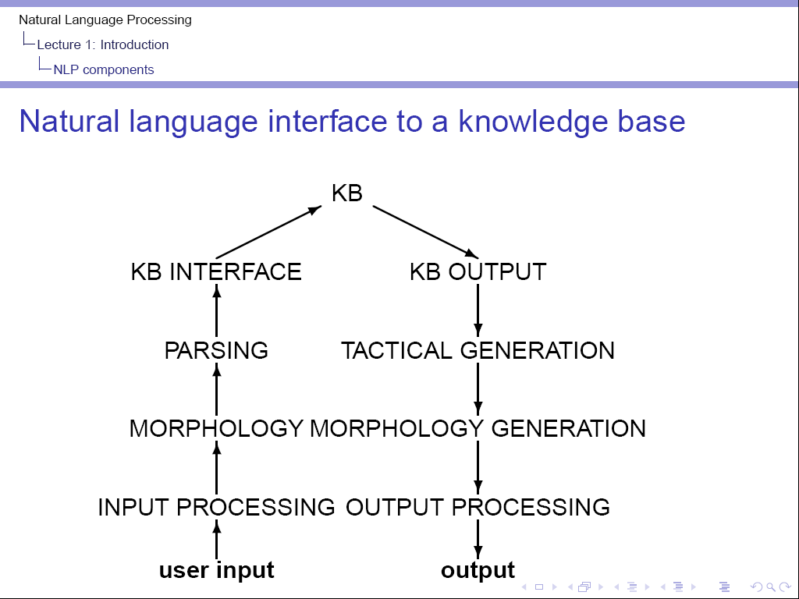
Application- (and
maybe domain-)
specific
Application and domain- independent DELPH-IN
Tools

Slide 15
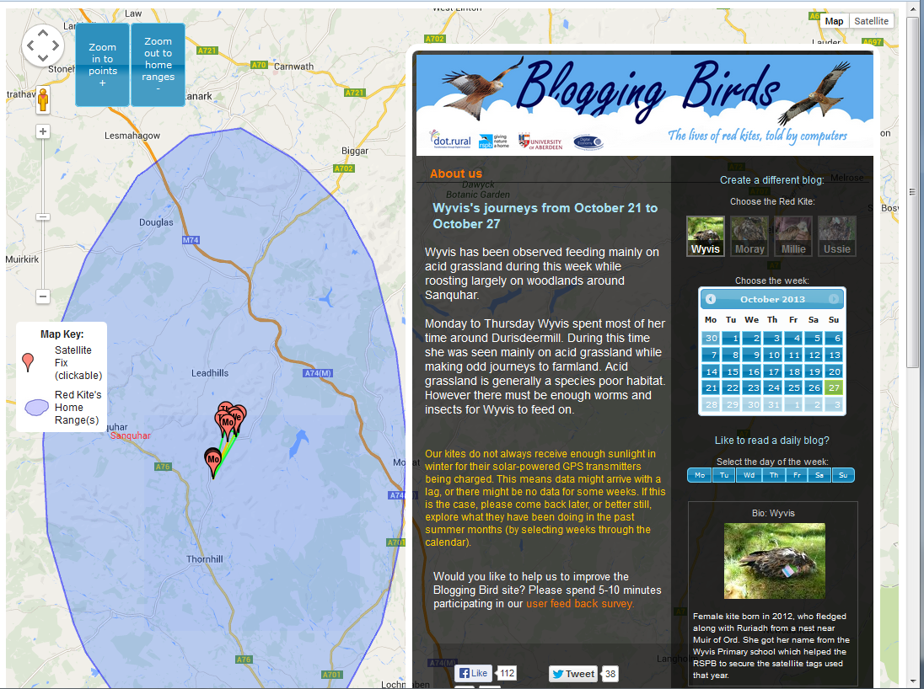
Blogging birds: redkite.abdn.ac.uk

Slide 16


Slide 17
Argumentative Zoning
Finding rhetorical structure in scientific texts automatically
  Research goals
  Criticism and contrast
  Intellectual ancestry
Robust Argumentative Zoning demo
  input text (ASCII via Acrobat)
Usages: search, bibliometrics, reviewing support, training new researchers

Slide 18
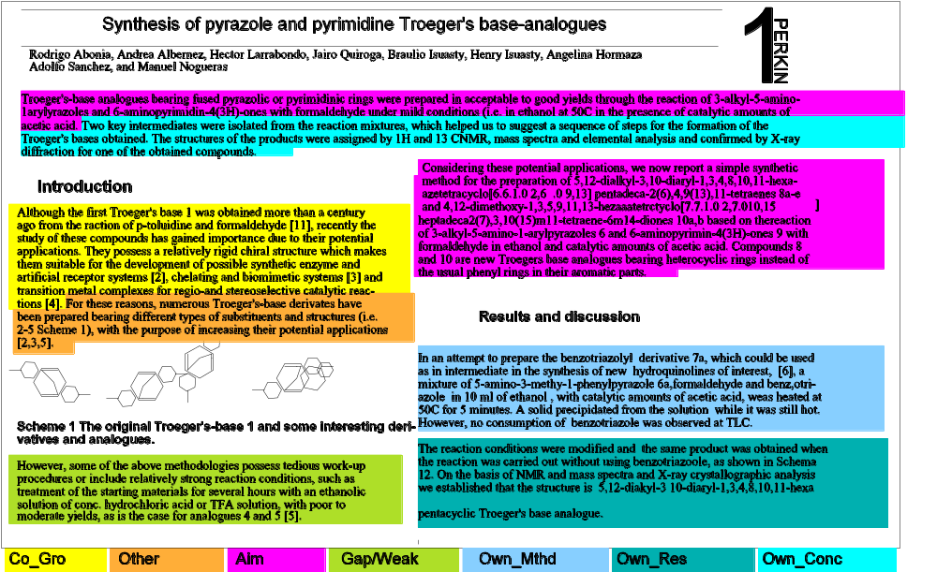

Slide 19
NLP Course conclusions
Theme: ambiguity
levels: morphology, syntax, semantic, lexical, discourse
resolution: local ambiguity, syntax as filter for morphology, selectional restrictions.
ranking: parse ranking, WSD, anaphora resolution.
processing efficiency: chart parsing

Slide 20
Theme: evaluation
training data and test data
reproducibility
baseline
ceiling
module evaluation vs application evaluation
nothing is perfect!

Slide 21
Modules and algorithms
different processing modules
different applications blend modules differently
many different styles of algorithm:
  FSAa and FSTs
  Markov models and HMMs
  CFG (and probabilistic CFGs)
  constraint-based frameworks
  logic and compositional semantics
  inheritance hierarchies (WordNet), decision trees (WSD)
  vector space models (distributional semantics)
  classifiers (anaphora resolution, content selection, …)

Slide 22
More about language and speech processing ...
Information Retrieval course
Part III (or MPhil in Advanced Computer Science):
  language and speech modules
  in collaboration with speech group from Engineering
  http://www.cl.cam.ac.uk/research/nl/postgrads/
  http://www.cl.cam.ac.uk/admissions/acs/

