Slide 1
SyNERGY 2.0
AMBUR, LACEK

Slide 2
The Problem:
Users struggle splitting bills for large groups
Divide multiple items on the bill
Sales tax can be hard to divide evenly
Our Application:
Enables user to easily split bills through a centralized payment service
App will read receipt
Users choose items they bought
Payment distribution through prefered method

Slide 3
Diary Studies
Participants:
3 user that frequently are eating out, going out, and splitting various bills with others
Probe:
Easy and un-intrusive as possible
Ask right after bill split occurs
Asking “background info” questions
Location, number of people, how they divided bill
Asking more in depth questions
Any frustrations when dividing the bill

Slide 4
Analysis
Breakdowns:
Many different forms of payment methods
Frustrations when not everyone has the same one
Difficulties when forced to pay in cash
No one has the right amount, result in overpaying
Forced to seek out friends later for money
New Interface Design:
Include options for not just Venmo payments but other payment methods as well

Slide 5
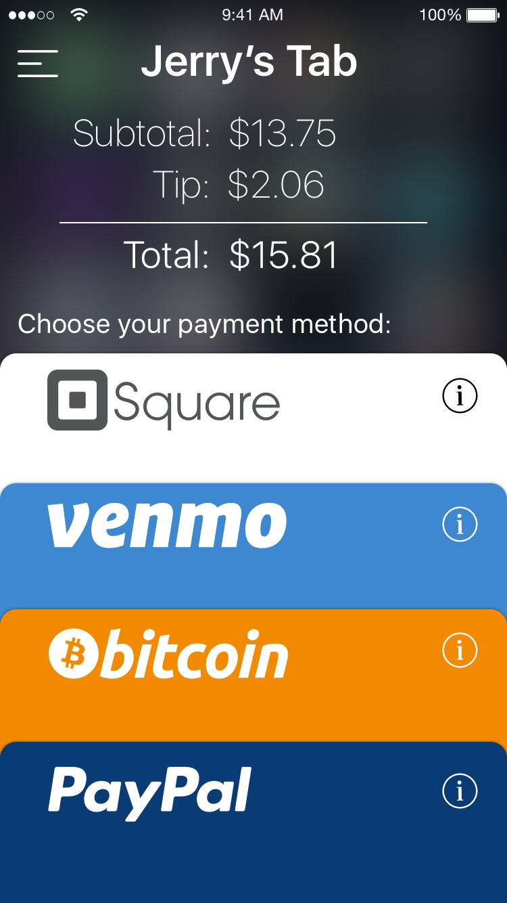
Design Ideas
Prototype:
Enable users to choose their prefered method of payment
Users can select things they bought
Invite friends to split tab with

