Slide 1
FieldChartOCR
Extraction of Handwritten Charts and Tables
DD/MM/YYYY
Feature Name/Product
Your Company Name

Slide 2
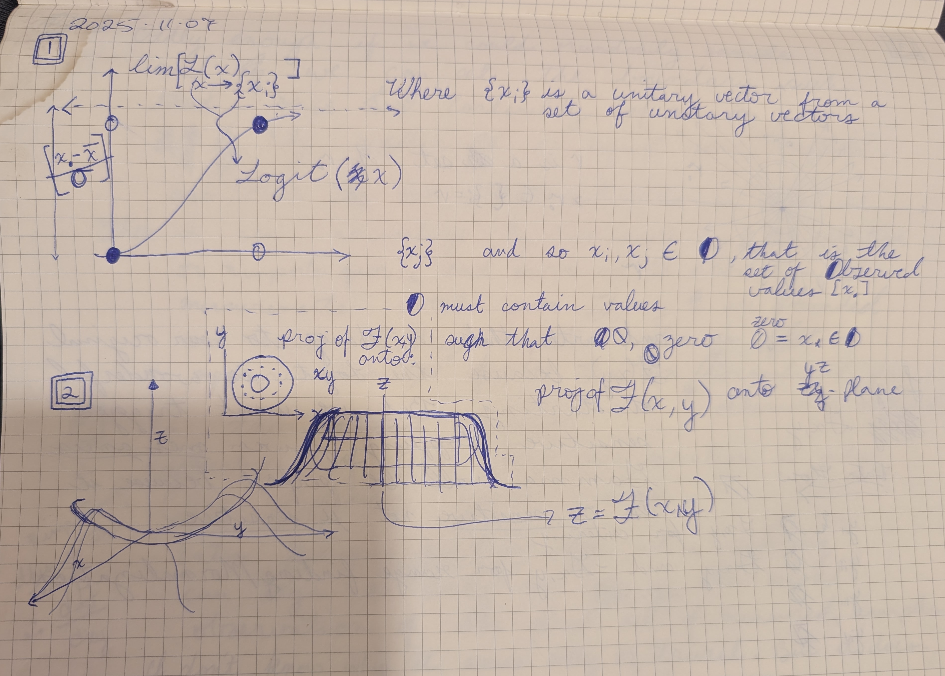
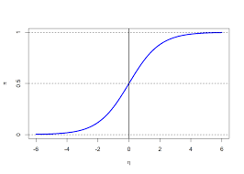
Introduction
This presentation summarizes the FieldChartOCR project proposal, focusing on extracting and digitizing handwritten charts and tables. It addresses the challenges faced in manual chart digitization and outlines a novel solution. The goal is to provide a clear overview for supervisory-level stakeholders on project motivation, approach, and evaluation plans.
DD/MM/YYYY
Feature Name/Product
Your Company Name

Slide 3
01
Project Introduction

Slide 4
FieldChartOCR
Hand-written Field Notes to Digital Charts
Presented by Chris Brechin
Date: November 12th, 2025
DD/MM/YYYY
Feature Name/Product
Your Company Name

Slide 5
Motivation and Problem Statement
Digitizing handwritten charts is difficult due to varied handwriting styles, inconsistent layouts, and noise in scanned images. Manual transcription is slow and error-prone, causing significant pain points for data accessibility and analysis. FieldChartOCR aims to automate this process, improving accuracy and efficiency in converting handwritten visual data into machine-readable formats.
DD/MM/YYYY
Feature Name/Product
Your Company Name

Slide 6
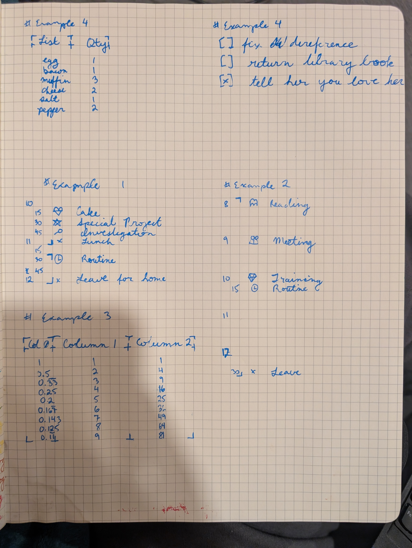
Key Challenges in Digitizing Handwritten Charts
Handwritten charts are challenging to digitize due to inconsistent handwriting, diverse chart formats, and image noise. These factors lead to difficulties in automated recognition and interpretation. The lack of standardization increases error rates, making manual transcription time-consuming and costly. Addressing these challenges requires robust preprocessing, classification, and OCR techniques tailored specifically for handwritten data.
Examples:
1. Coded Timesheet
2. Sparse, Coded Timesheet
3. Table with mixed, float and integer values
4. Table with mixed, string and integer values
5. Checklist
Your Company Name

Slide 7
02
Technical Approach and Planning

Slide 8
Overview of FieldChartOCR Solution
FieldChartOCR employs a modular approach combining preprocessing, classification, and detection models. It will integrate OCR tailored for handwriting, alongside semantic assembly modules that reconstruct charts and tables accurately. I aim to automate the extraction pipeline, significantly reducing manual effort while maintaining high accuracy in digitizing complex handwritten visual data.
Training
Validation
Photo Normalization
DD/MM/YYYY
Camera Images
Corresponding Digital Charts
Chart Type Classification
OCR
Comma Separated Lists with tabulated data
Element Recognition
Information Extraction

Slide 9
System Architecture and Processing Pipeline
The pipeline consists of four key stages:
1. preprocessing to enhance image quality;
2. classification to identify chart types;
3. detection and OCR to extract handwritten text and graphical elements; and
4. semantic assembly to organize extracted data into structured formats.
Each stage leverages machine learning models for the specific purposes.
Photo Normalization
Chart Type Classification
OCR
Element Recognition
Information Extraction
DD/MM/YYYY
Feature Name/Product
Your Company Name

Slide 10
Data Sources and Evaluation Metrics
Training
Validation
Data sources include annotated datasets of handwritten charts and synthetic data generated to augment training diversity. Success will be measured using classification F1 scores, detection accuracy, Character Error Rate (CER) for OCR, and runtime performance. These metrics will guide iterative improvements, ensuring the system meets practical usability and reliability standards.
DD/MM/YYYY
Camera Images
Corresponding Digital Charts
Corresponding
Comma Separated Lists with tabulated data
DD/MM/YYYY
Feature Name/Product
Your Company Name

Slide 11
Conclusions
FieldChartOCR targets the automated digitization of handwritten charts with a robust, multi-stage system architecture. Initial milestones focus on achieving an MVP with reliable extraction accuracy and efficiency. Future work will explore enhanced semantic analysis and broader dataset integration, aiming to deliver a scalable solution for diverse real-world applications.
DD/MM/YYYY
Feature Name/Product
Your Company Name

Slide 12
Thanks!
Do you have any questions?
chris@brechin.services
https://brechin.services
linkedin.com/in/chris-brechin/
Feature Name/Product

