Slide 1
DSL
Domain-specific language

Slide 2
What is DSL?
SQL
HTML
Hashicorp Configuration Language
Gradle

Slide 3

Fluent Interface
It is a way to create DSLs with a General-purpose programming language using method chaining
Domain-Specific Languages

Slide 4
Examples
SDLs for SQL in different languages
PHP Doctrine
C# LINQ
JAVA Jooq

Slide 5
Fluent Interface is not equal to Collection Pipeline
$collection = new ArrayCollection([1, 2, 3]);
$filteredCollection = $collection
->filter(function($element) {
return $element > 1;
})
->map(function($element) {
return $element * 2;
}); // 4, 9
Collection pipeline

Slide 6
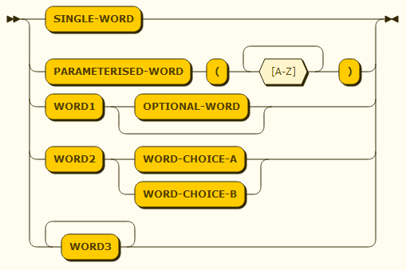
How to make a language?
Strategy 1
Rules
Every DSL “keyword” becomes a method
Every DSL “connection” becomes an interface
EBNF notation

Slide 7
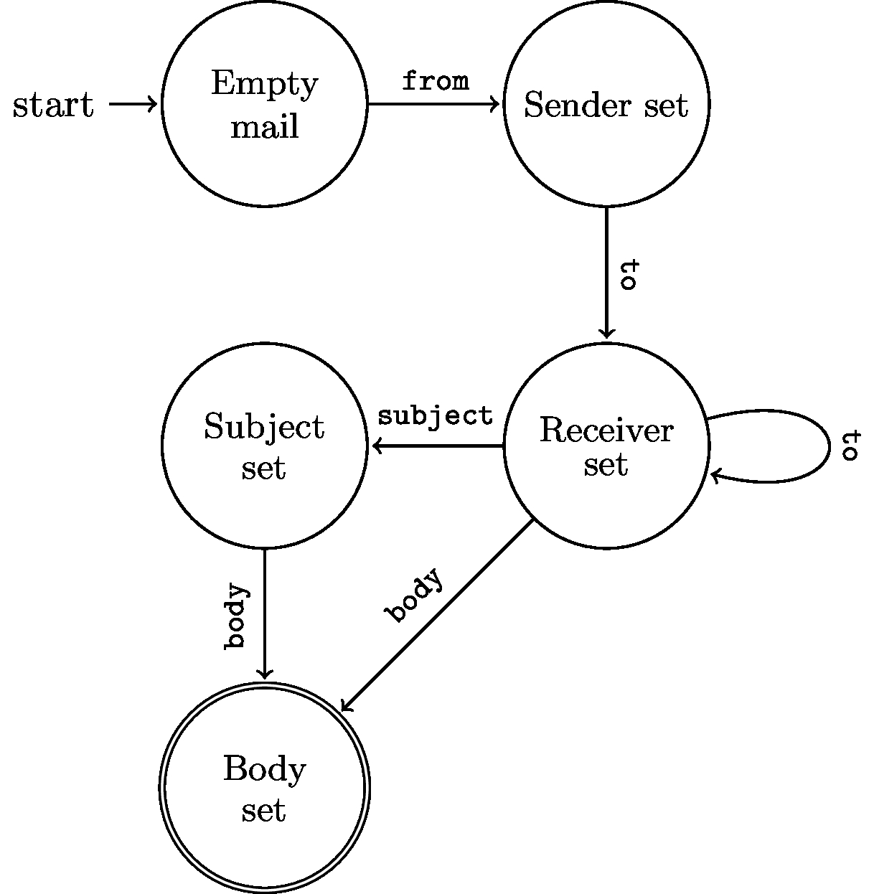
How to make a language?
Strategy 2
Rules
Every DSL “edge” becomes a method
Every DSL “state” becomes an interface
Finite State Machine

Slide 8
Cielo Configurators
#yaml file
constants:
…
parameter:
…
variables:
…
instructions:
- InstructionType: SingleBorder
profile: profile_code
edges: [‘top’]
…

Slide 9
Toy grammar
Grammar ::= (
'constants' ('add')*
'parameters' ('add')*
'variables' ('add')*
'instructions'
(
commands* |
('copy' commands+ 'endCopy')*
)*
)
commands ::= (
('singleBorder' 'setName' 'setProfile' 'setEdges' 'setColor'?) |
('fill' 'setType' 'setGlass') |
('dimension' ('setWidth' 'setHeight' | 'setHeight' | 'setWidth'))
)
https://www.bottlecaps.de/

