Slide 1
Errors & Exceptions in Java

Slide 2
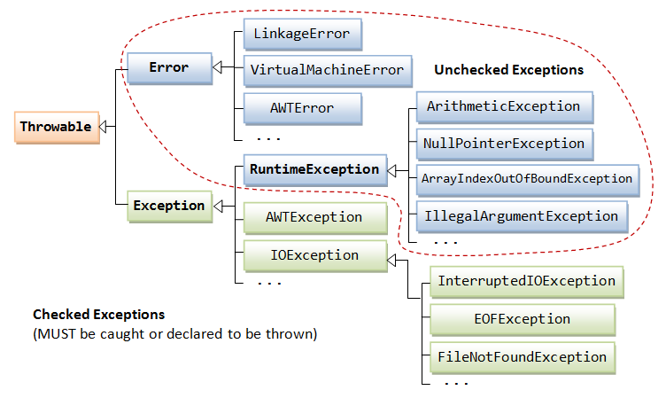
Exception Class Hierarchy

Slide 3
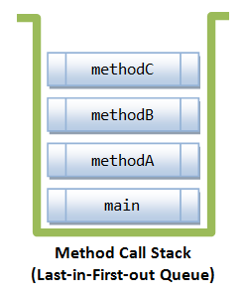
Call Stack

Slide 4
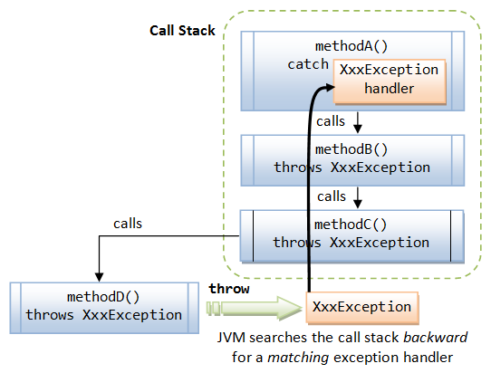
Exception Handling

Slide 5
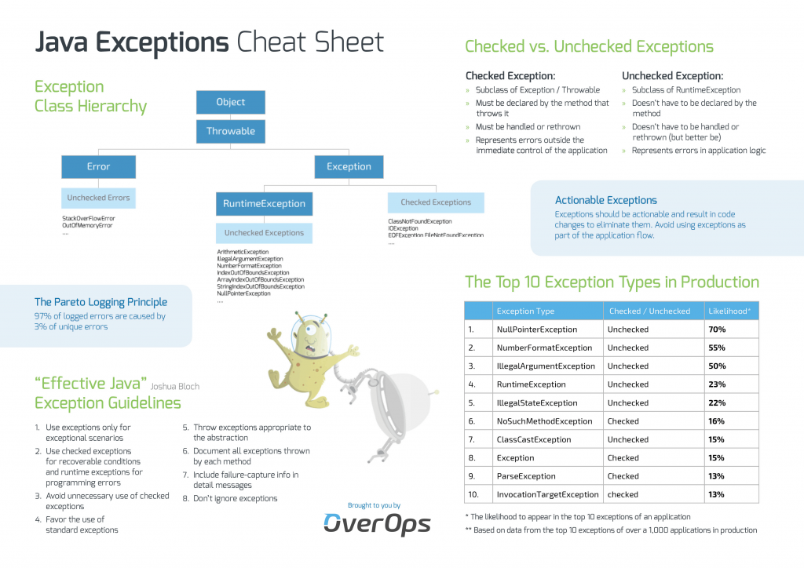

Slide 6
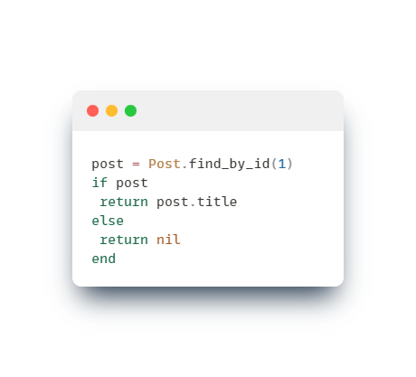
What is the problem with NullPointerException?

Slide 7
Why nothing does not return nothing?

Slide 8
