Slide 1
Resilience

Slide 2
Problem
I have a State Machine that reads records from a file and then sends them as messages to a queue. These messages are consumed by microservice A, which communicates with another microservice B through a Rest API. The problem occurs when microservice B is overwhelmed by the number of requests and does not have enough resources to respond to all of them. Although service B attempts to scale to meet the demand, this process takes approximately 1 minute, during which some of the records that were intended to be processed are lost.

Slide 3

Retry

Slide 4
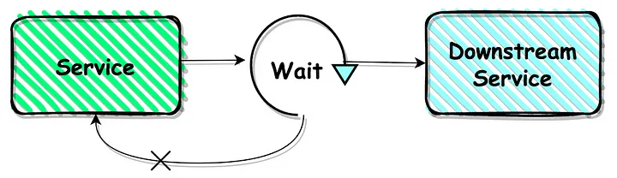
Timeout

Slide 5
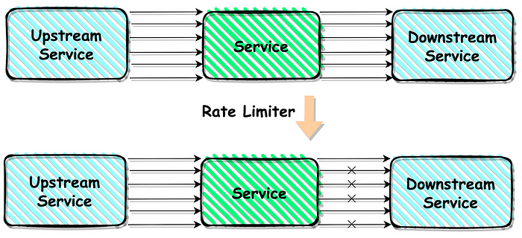
Rate Limiter

Slide 6
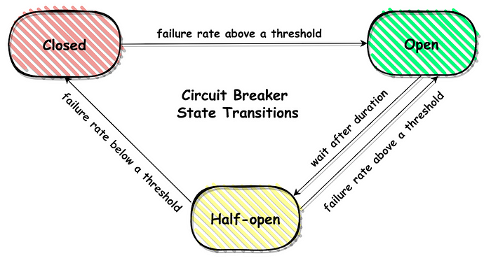
Circuit Breaker

Slide 7
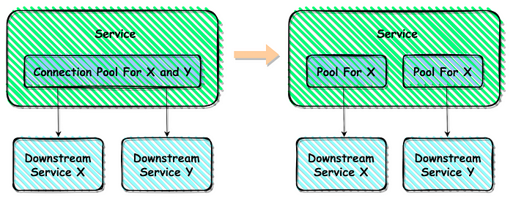
Bulkhead

Slide 8
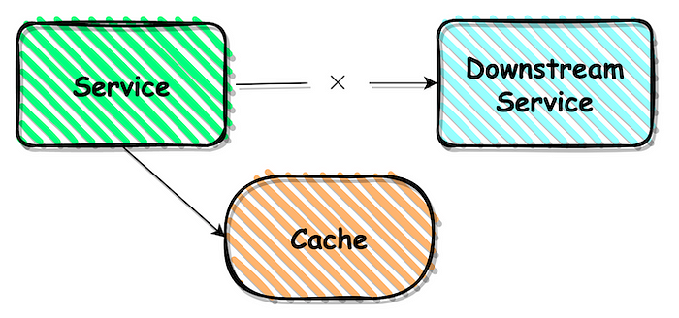
Cache

Slide 9
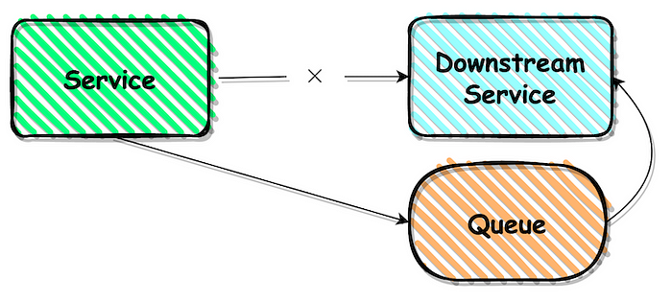
Asynchronous Processing

Slide 10
Reference
https://medium.com/paysafe-bulgaria/improving-microservice-resilience-with-resilience4j-ceda379505ff

