Slide 1
Software validation

Slide 2
Validation
The purpose of validation is to uncover problems in a program and thereby increase your confidence in the program’s correctness.
Code review
Testing

Slide 3
It’s very hard to achieve perfect quality in software. Here are some typical residual defect rates (bugs left over after the software has shipped) per kloc (one thousand lines of source code):
1 - 10 defects/kloc: Typical industry software.
0.1 - 1 defects/kloc: High-quality validation. The Java libraries might achieve this level of correctness.
0.01 - 0.1 defects/kloc: The very best, safety-critical validation. NASA and companies like Praxis can achieve this level.
This can be discouraging for large systems. For example, if you have shipped a million lines of typical industry source code (1 defect/kloc), it means you missed 1000 bugs!

Slide 4
Testing
Running the program on carefully selected inputs and checking the results

Slide 5
Unit test
A test that tests an individual module, in isolation if possible, is called a unit test.
Integration test
The opposite of a unit test is an integration test, which tests a combination of modules, or even the entire program.
Note:
A module is a method or a class

Slide 6
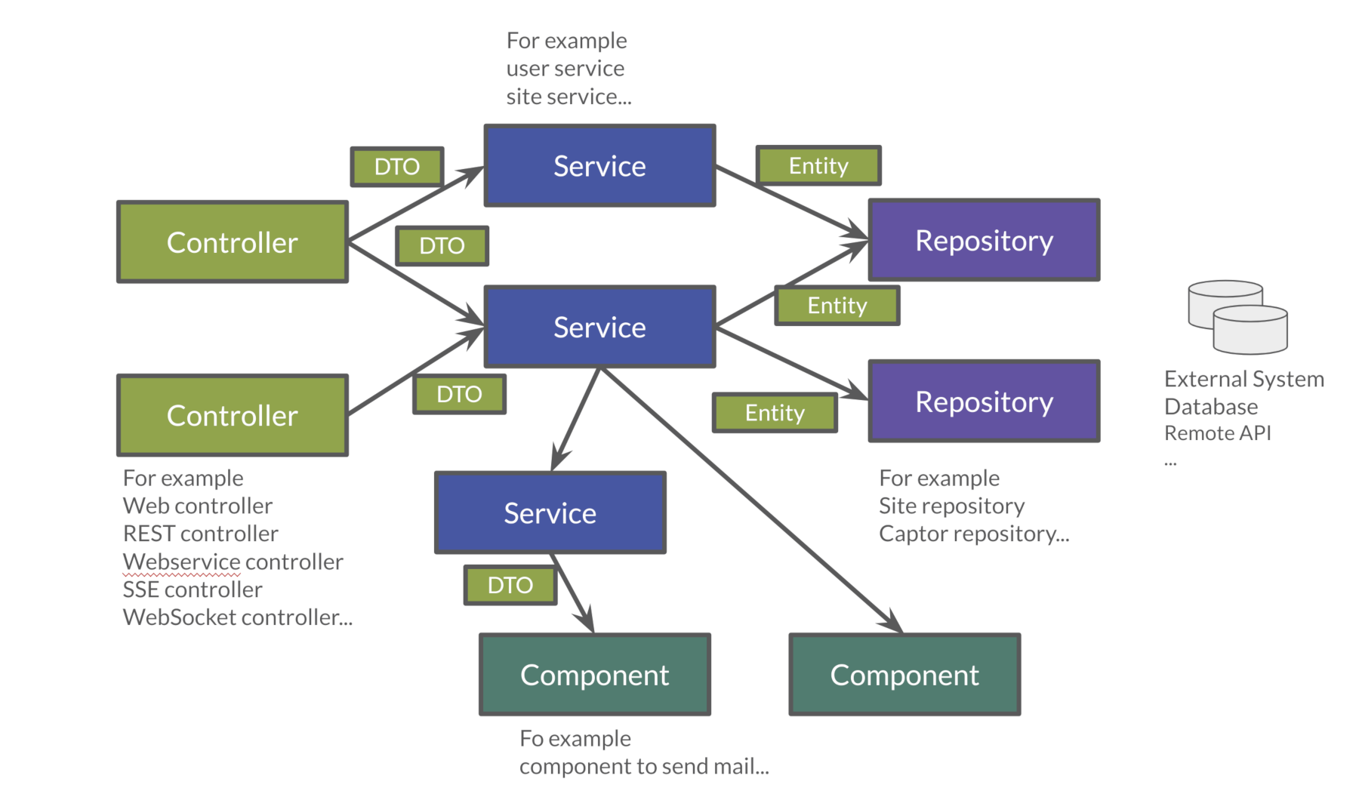
What can we test?

Slide 7
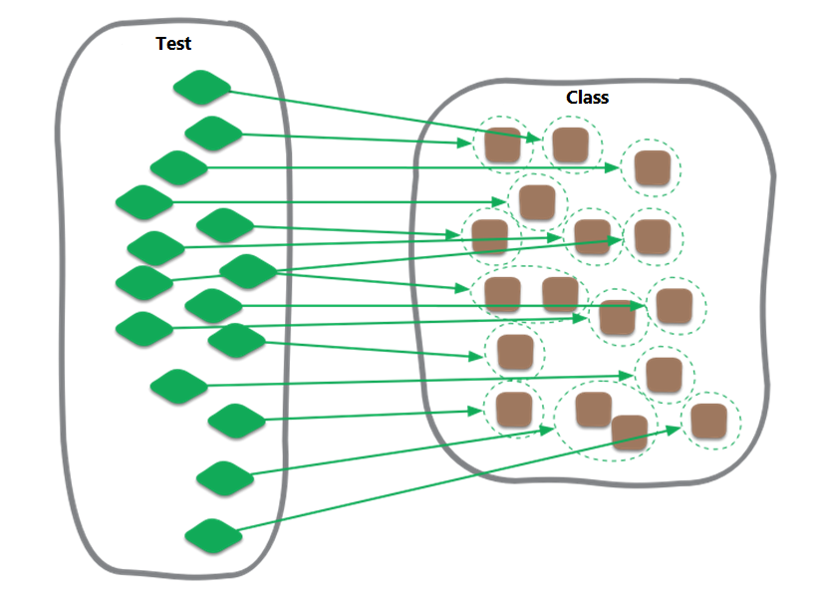

Slide 8
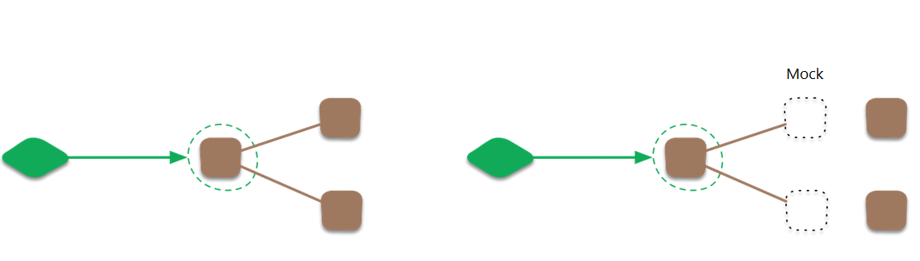
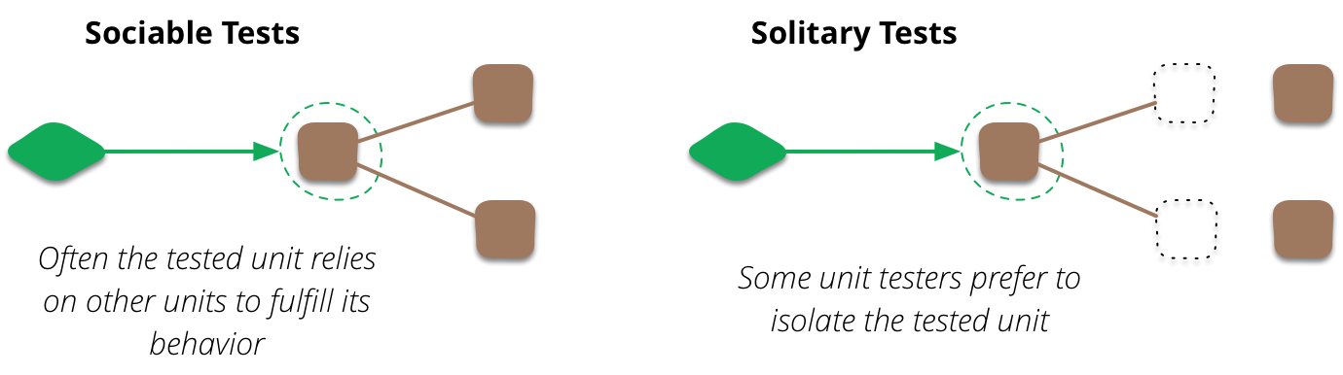
Test double

Slide 9
Principles to design tests
Unit tests should not affect each other.
Unit tests should be deterministic.
Unit tests should not depend on any external state.
Unit tests should run fast.

Slide 10
Reference
http://web.mit.edu/6.005/www/fa15/classes/03-testing/

