Slide 1
EDES 301
Inclusive, Low-Resource Pulse Oximeter Proposal
10/04/2026
Cristian Castillo

Slide 2
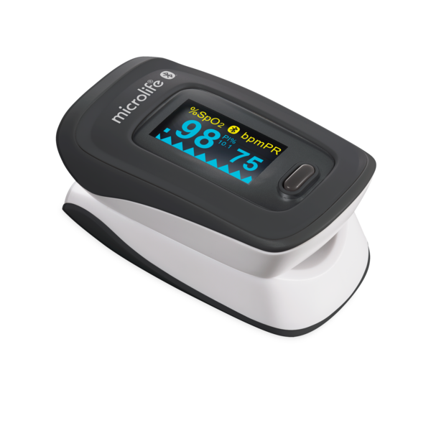
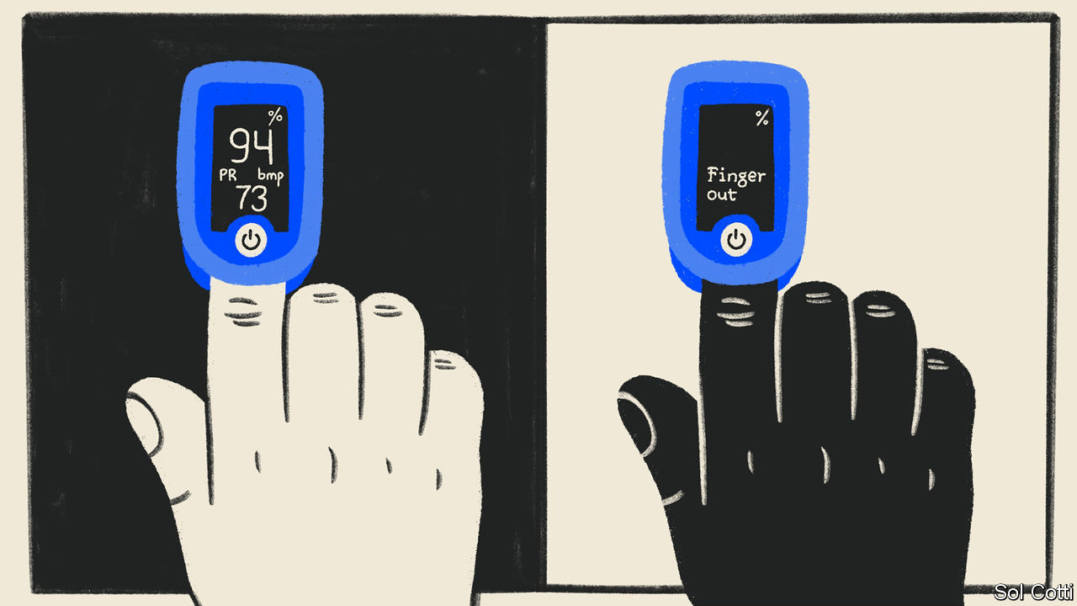
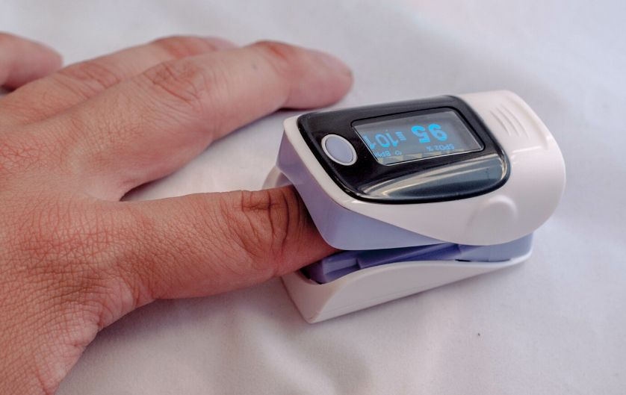
Background Information
  Blood oxygen level is a physiological stat that reports how much oxygen your red blood vessels are carrying from your lungs to every other tissue in your body.
  Low oxygen levels can be signs of hypoxia and report a greater issue in your body. Thus, a dropping blood oxygen level is a great sign for the need to receive treatment prior to organ failure
  Currently, there exists no pulse oximeter that is commercially available that eliminates racial bias. There exists a need to develop a low-cost oximeter that can be used across skin pigmentations.

Slide 3
System Block Diagram
Power (3.3 V) (PocketBeagle)
MAX30102 module
TCS34725
RGB color sensor
White LED, skin tone
LED’s
Red + IR
Photodiode
18-bit ADC
Finger
PocketBeagle (software pipeline)
Signal Filtering
(AC/DC Extraction)
Ratio of ratios
(R from red and IR)
Tone classifier
(RGB to tone score)
Reference Data
(Ground-Truth Pairs)
Calibration model
(corrected Sp02)
Display
Sp02, pulse rate
Data log
SD card

Slide 4
Power Block Diagram
Finger
IR LED
IR Photodiode
Power (3.3 V) (PocketBeagle)
Red LED
Photodiode
Skin tone sensor (TCS34725)
Display
Signal Conditioning

Slide 5
Components / Budget
Component | EDES301 to Buy? | Cost
2Pcs Heart Rate Sensor Module MAX30102 Blood Oxygen Sensor Pulse Detections (https://www.amazon.com/dp/B094JC48HQ?lv=shuf&channelId=500&plpRedirect=mhFallback) | Yes | 7.99
RGB Color sensor with IR filter and White LED – TCS34725 (https://www.adafruit.com/product/1334?srsltid=AU7gw4WtW3GIkzt8NsHEu7ddisuv012--SP7927BKlD0fxF_SfNch-74) | Yes ? | 7.95
3D printed casing for finger sensor | No | Print dependent
Wires, resistors, etc. | No | OEDK

