Slide 1
Review of ATACseq Data in article: “Dynamic chromatin regulatory landscape of human CAR T cell exhaustion”
Chris Clouser
Chang et al.; Proceedings National Academy of Sciences, July 20, 2021
https://doi.org/10.1073/pnas.2104758118

Slide 2
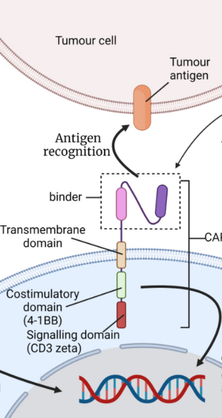
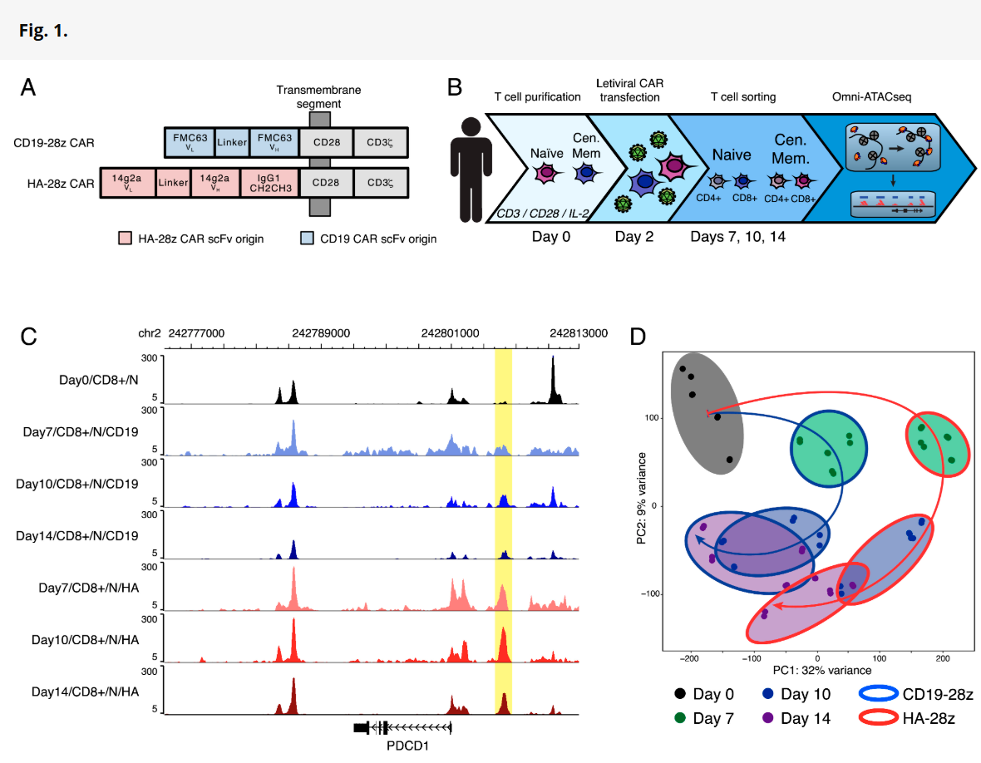
ATACseq Experimental Overview
40+ Samples Total
Two CAR-T molecules
GD2-targeting HA-28z
CD-19 targeting
Time Points
Day0
Day7
Day10
Day14
Cell Types
CD4 Naïve
CD4 Central Memory
CD8 Naïve
CD8 Central Memory

Slide 3
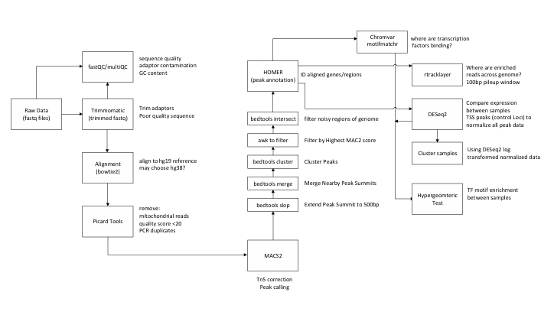
Analysis Methodologies
Methods in Paper:
Adaptor Sequences Trimmed/Aligned with Bowtie
Filtered with Picard Tools (Qual < 20, mito, PCR dups
Peak Calling with MACS2 (Tn5 corrected)
Extend/Merge Peak Summits (500bp) and select Peaks with Highest MACS score
Annotate Peaks with Homer
Find TF motifs with chromvar (Homer)
Genome tracks every 100bp with rtracklyer
Differential Peak calling with DESeq2
TF motf enrichment with motifmatcher
No GIT repository provided
Browsed Several GitHub repositories:
https://github.com/CebolaLab/ATAC-seq
Required stitching a lot of scripts together and some modules weren’t loaded into Xanadu
Ultimately found and used NextFlow ATACseq workflow

Slide 4
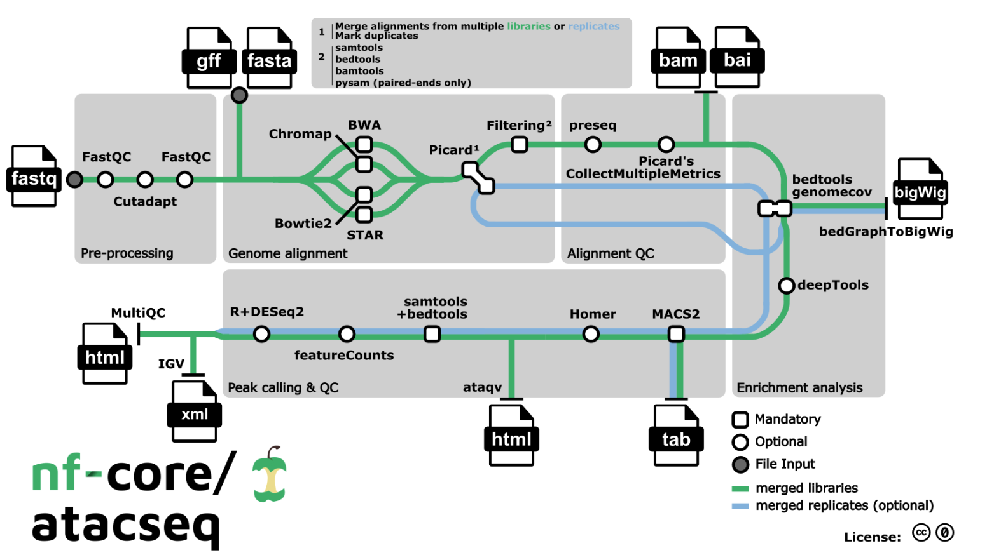
NextFlow (nf-core/ataqseq)
https://github.com/nf-core/atacseq

Slide 5
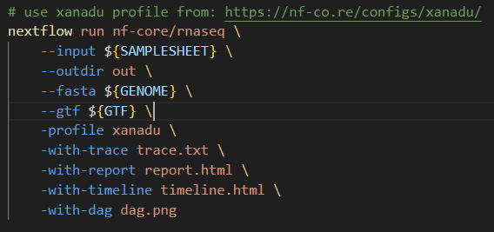
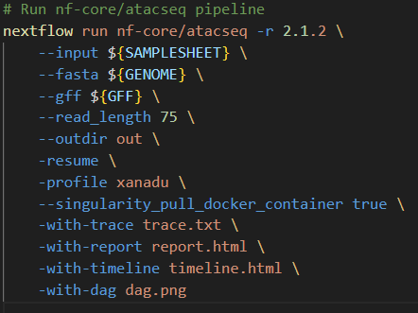
Modifications to Nextflow RNAseq script to Run Nextflow ATAC workflow

Slide 6
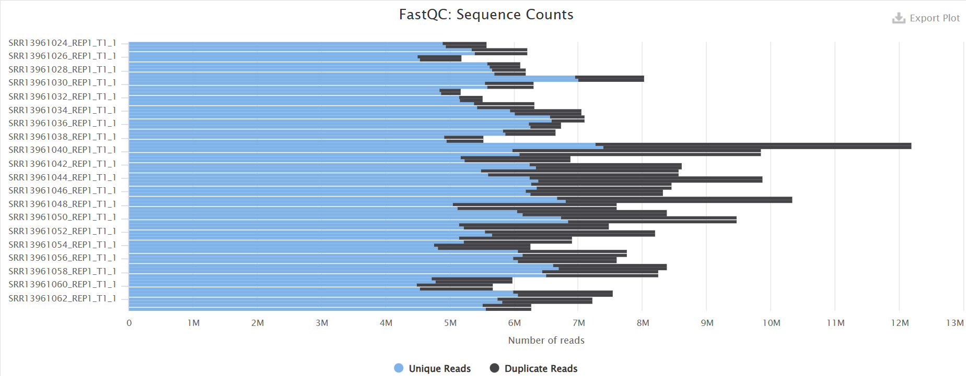
Total ATACseq reads significantly below recommended values
QC results showing 5-12M reads/sample, recommendations 50-100M reads
Nat Protoc. 2022 Apr 27;17(6):1518–1552. doi: 10.1038/s41596-022-00692-9

Slide 7
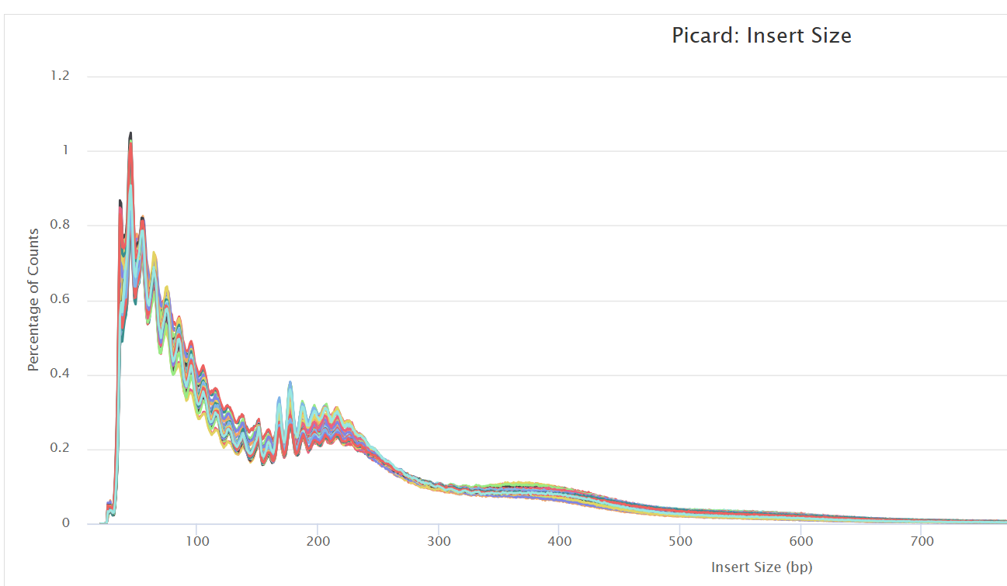
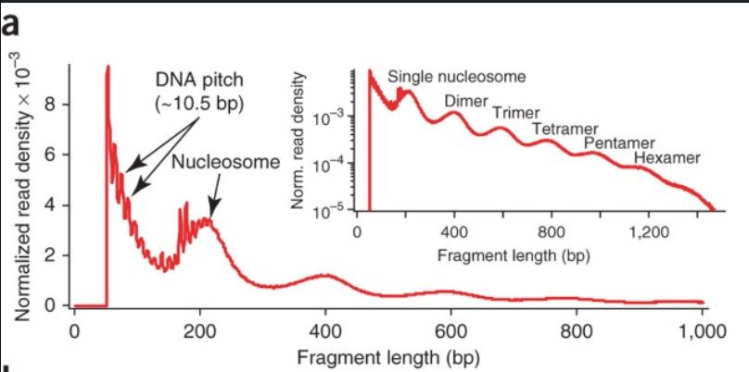
Clear nucleosomal periodicity
https://www.nature.com/articles/nmeth.2688

Slide 8
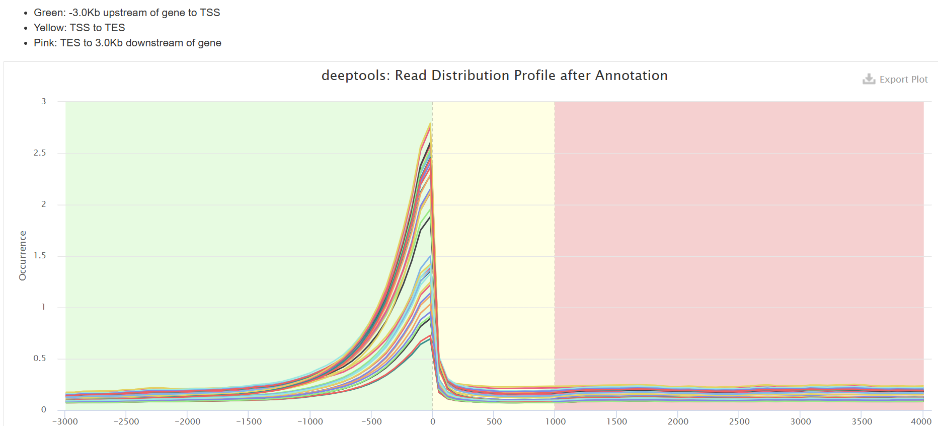
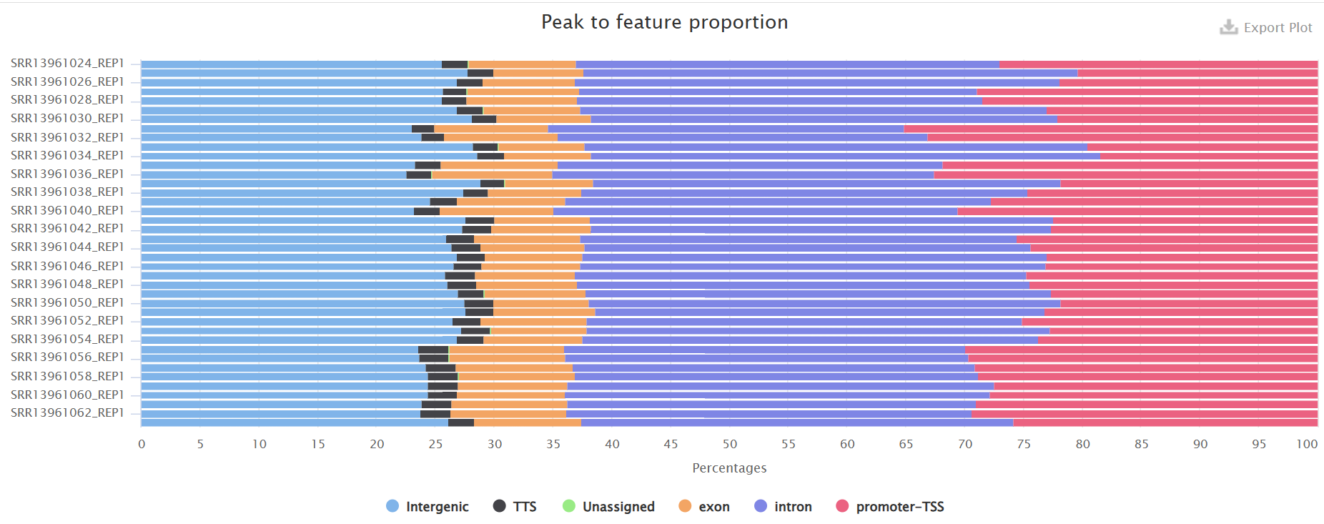
Good enrichment of Transcriptional Start Sites
TSS Values <3
https://www.encodeproject.org/atac-seq/
TSS enrichment score > accurate from 50K read-pairs
Value 5-7 acceptable, >7 Ideal

Slide 9
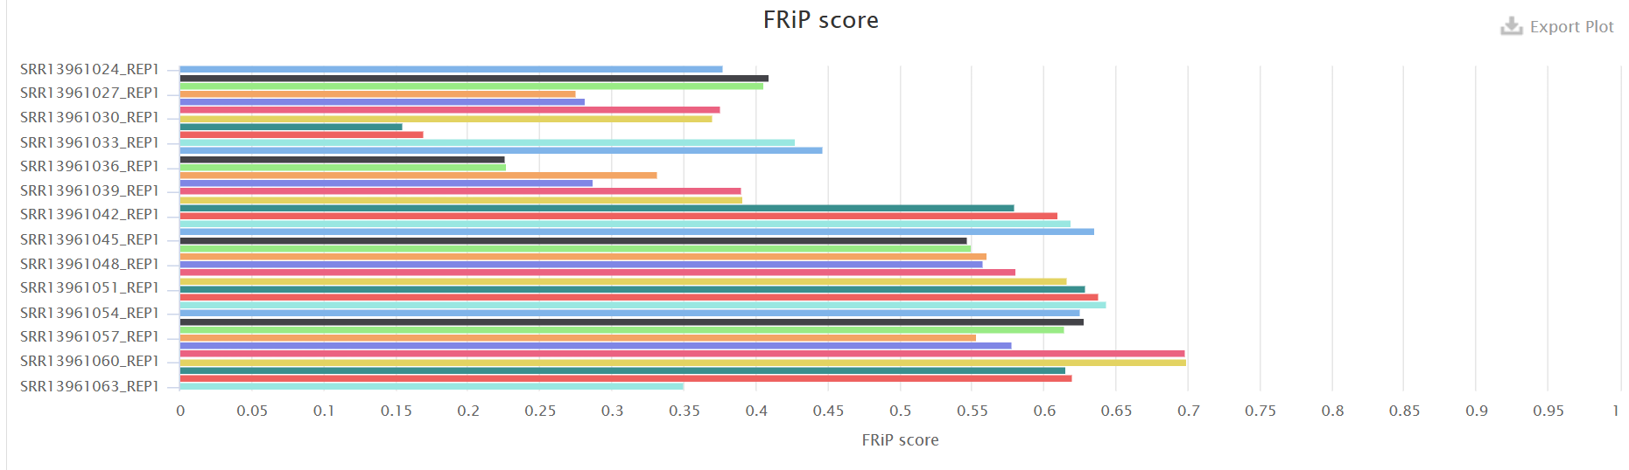
Fragment in Peaks - 25% fall below recommend threshold
FRiP > standard for ChIP assays where location of peaks is relatively well understood
FRiP score >.3 recommended, >.2 acceptable
https://www.encodeproject.org/atac-seq/

Slide 10
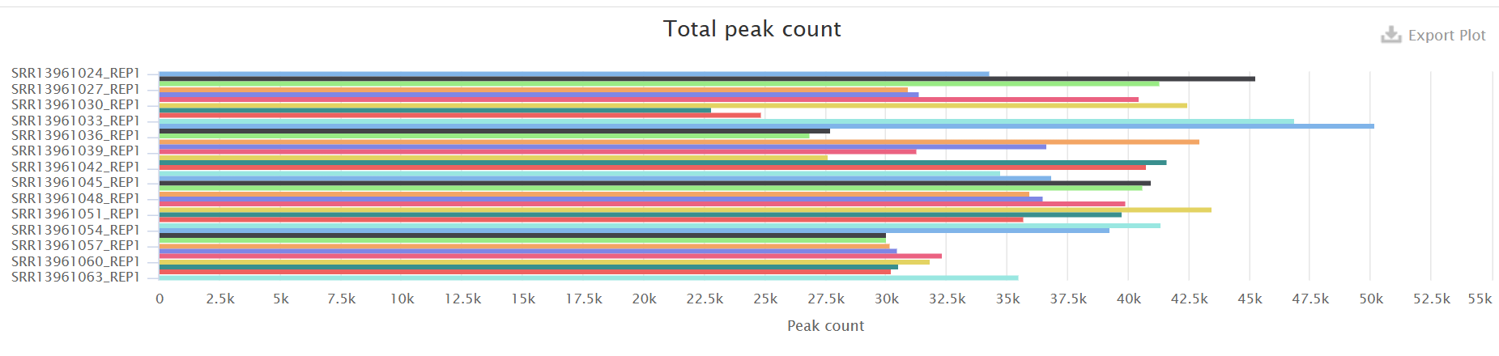
Total Peak Counts range from 20-50K
The number of peaks within a replicated peak file should be >150,000, though values >100,000 may be acceptable The number of peaks within an IDR peak file should be >70,000, though values >50,000 may be acceptable.
https://www.encodeproject.org/atac-seq/

Slide 11
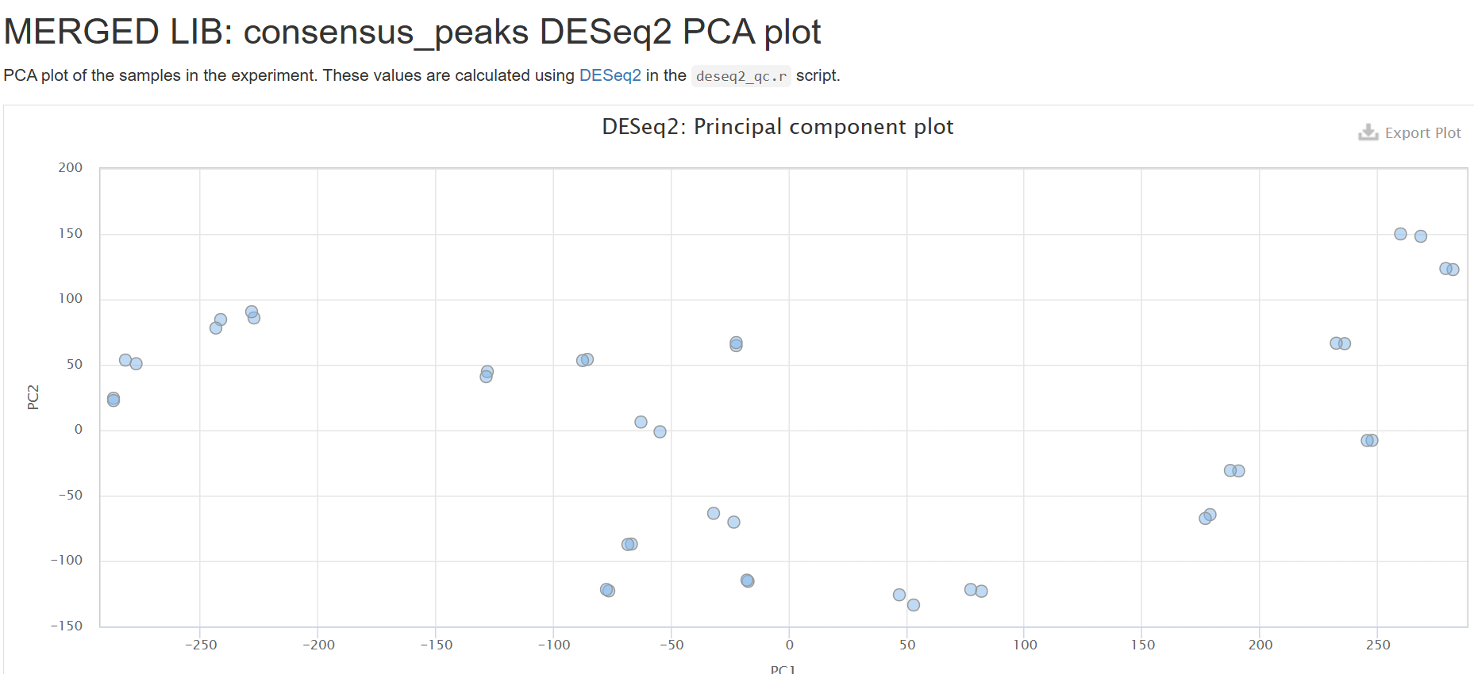
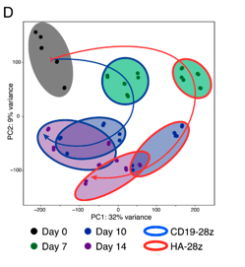
Samples Separate out by Day and Construct DESeq QC
Day 0
GD2
CD19
Day 7
CD19
GD2
Day 14

Slide 12
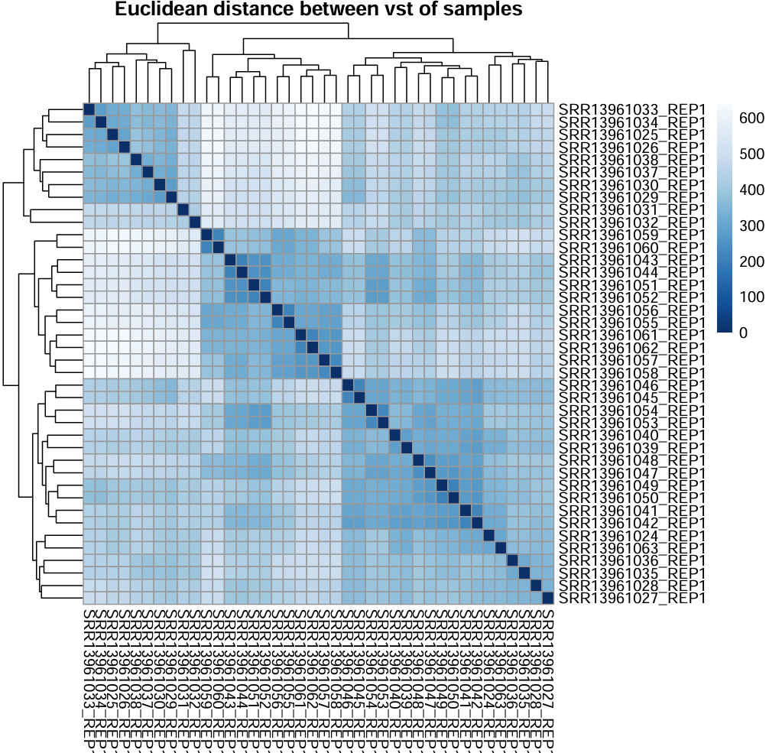
Heatmap with Nextflow DESeqQC
Day 7 GD2
0
14
CD19
Day 0
Day 14

Slide 13
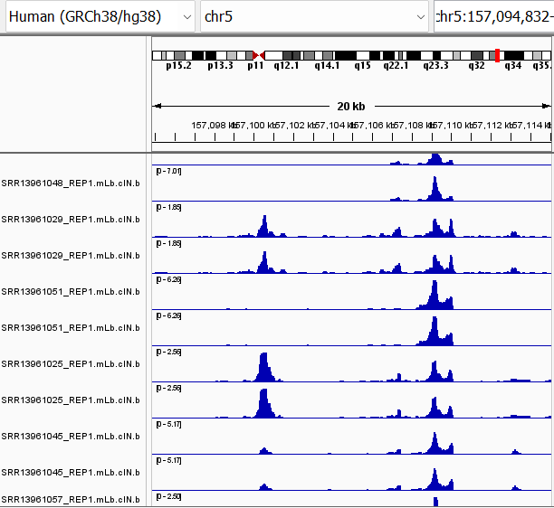
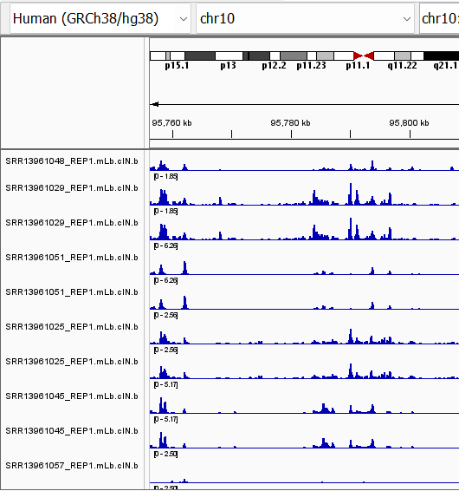
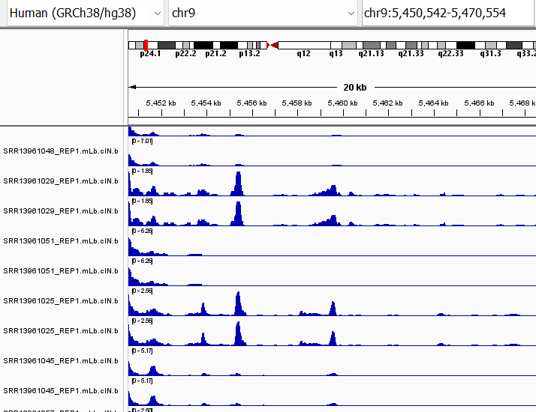
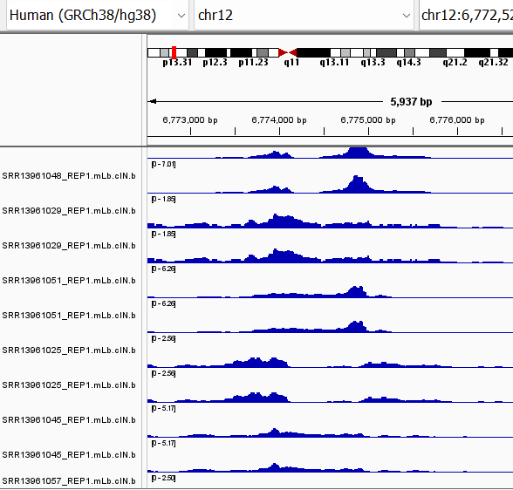
IGV – Differential Accessibility in genes associated with exhaustion in T Cells
HAVCR2 > TIM-3
ENTPD1 > CD-39
CD274 > PD-L1
LAG3
Day 7
Day 14
Day 7
Day 14
Inhibitory Surface Receptors

Slide 14
Learnings:
Nextflow is great, and a time saver for those without coding experience
Took several tries to figure out settings to make script work on HPC
Once running properly error reporting helped pinpoint problem in sample sheet
Couple of parameters to explore > % mitochondrial, blacklist filtering
In regard to data:
Overall sequencing depth was lower than recommended
Led to lower number of peaks found, and perhaps influenced low FRiP/TSS scores
PCA and IGC data seem to align with observations in paper and demonstrate the exhaustion signature they described

