Slide 1
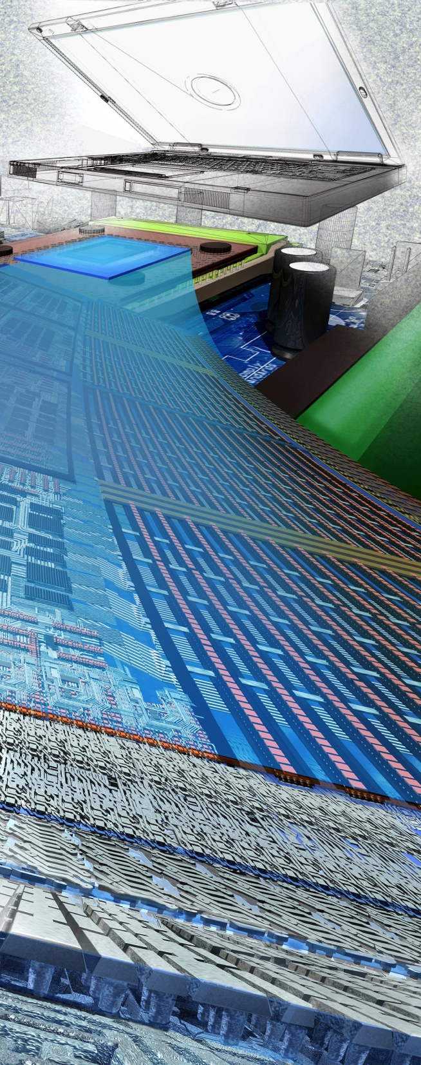

NSF’s Public Access Initiative overview and update
Amy Friedlander
(Acting) Deputy Division Director, NSF
Computer & Information Science & Engineering
Division of Advanced Cyberinfrastructure
Nov 19, 2015
Image Credit: Exploratorium.
With thanks to Jim Kurose and Gera Jochum!
Notes:
Thanks Henry Neeman

Slide 2
Overview
NSF public access: a brief history
NSF’s public access repository
Public access plan: publications
Public access plan: data
Looking forward

Slide 3
NSF Public Access: a brief history
2012
2013
2014
2015
Internal NSF WG

Slide 4
NSF Public Access: a brief history
2012
2013
2014
2015
Internal NSF WG
OSTP memo
NSF public comment
OSTP: directs federal agencies to develop plans to make publicly available to the “greatest extent and with the fewest constraints possible and consistent with law” the “direct results of federally funded scientific research.”

Slide 5
NSF Public Access: a brief history
2012
2013
2014
2015
Internal NSF WG
Architect,
Implement
NSF PAR
DOE/OSTI chosen PAR partner
OSTP memo
NSF public comment
2 cycles
public comment
12 PA
supplements
awarded

Slide 6
NSF Public Access: a brief history
2012
2013
2014
2015
Internal NSF WG
Architect,
Implement
NSF PAR
DOE/OSTI chosen PAR partner
NSF PA Plan
published
OSTP memo
PA Repository
live
NSF public comment
2 cycles
public comment
12 PA
supplements
awarded
PA WG
formed

Slide 7
Requirements: Public Access Repository
Provide public access to journal, juried conference papers
Minimize burden on PIs, NSF staff
Leverage existing systems and workflows:
Extensions to internal proposal and award management systems (research.gov; e-Jacket; Award Search; etc.)
External systems
DOE/OSTI infrastructure for publications
Publisher/library services, e.g., CrossRef
Potentially others (federated system engaging other Federal agencies, academic libraries, and publishers)
Extensible to other products of NSF-funded research
Minimize cost

Slide 8

NFS Public Access Plan: publications
Public Access Repository:
public access to journal, refereed conference publications
soft launch scheduled Nov 23, 2015 (including extensions to research.gov)
2016 Proposal & Award Policies & Procedures Guide (PAPPG) revised, published
FAQ and website:
http://www.nsf.gov/news/special_reports/public_access/index.jsp
We will gain experience, learn best practices by doing
as the NSF Public Access Repository is used

Slide 9
NFS Public Access Plan: data
Data Management Plans:
“data management is dynamic and practices vary substantially across the broad range of scientific disciplines supported by NSF” [NSF 15-52]
“What constitutes reasonable data management and access will be determined by the community of interest through the process of peer review and program management. In many cases, these standards already exist, but are likely to evolve as new technologies and resources become available” [Data Management & Sharing Frequently Asked Questions (FAQs)]

Slide 10
NFS Public Access Plan: data
Individual directorates (e.g., BIO,CISE) have released updated DMP guidance (GEO underway)
per-directorate discussions of DMPs
Under discussion:
foundation-wide workshop?
pilots using persistent identifiers?
PA repository provides extensible mechanism for data, other research products
Longer term:
continued discussion, consultation with multiple agencies
roles, responsibilities, business models for data repositories

Slide 11
NFS Public Access: looking forward
Publications: gaining experience with public access repository, developing best practices
Data: data management plans
Longer term discussions:
additional research products
data repositories
NSF’s Public Access Plan: Today’s Data Tomorrow’s Discoveries [NSF 15-52] describes NSF’s current and future Public Access activities

Slide 12
Many thanks
To those who got us this far:
Steering committee, sub-committees, and Public Access Working Group
Requirements and usability working groups (c. 30 program officers, technical and administrative staff)
DOE partner
Technical team
To those who will take us farther. . .all of you!

Slide 13
BACKUP

Slide 14
Thanks to those who got us here!
Name | Affiliation | Name | Affiliation
Lance Vowell | DOE/OSTI | Akhilesh Mathur | DIS
Tim Stoner | DOE/OSTI | George Patch | DIS
Mark Martin | DOE/OSTI | Abhi Kulkarni | DIS
Brian Hitson | DOE/OSTI | Carlo Ilagan | DIS
Jeffrey Salmon | DOE/OSTI | Belen Awetahegne | DIS
Amy Northcutt | OIRM | Harry Burdick | DIS
Lisa Jackson | SBE | Aaron Corbett | DIS
Erika Rissi | BFA | Steve Downing | DIS
Elvi Solanes | BFA | Pam Reichers | DIS
Beth Strausser | BFA | Bala Krishnamoorthy | DIS
Jean Feldman | BFA | Elanchezhian Sivagnanam | DIS
Jeff Vieceli | BFA | Michelle Toombs | DIS
Joshua Lindsey | DIS

Slide 15
Program Officers and Staff
Name | Affiliation | Name | Affiliation | Name | Affiliation
Plan Working Groups (2013) |  | José Muñoz | OD | Deborah Livingston | SBE
Emily Grumbling | AAAS Fellow | Jong-on Hahm | OISE | Bob O’Connor | SBE
Erika Rissi | BFA | Jeri Mulrow | SBE | Cheryl Eavey | SBE
Sam Scheiner | BIO | Usability Working Group (2014) |  | Deborah Winslow | SBE
Frank Olken | CISE | Diane Okamuro | BIO | Shobhana Chelliah | SBE
Bob Chadduck | CISE | Melissa Cragin | BIO | Usability Team (2015)
Maureen Miller | DIS | Sam Scheiner | BIO | Roger Wareham | BFA
David Saunders | DIS | Thomasina Osborne | BIO | George Malanson | BIO
Finbarr Sloan | EHR | Sylvia Spengler | CISE | Amy Apon | CISE
John Cherniavsky | EHR | Niki Bennett | DUE | Brandy Smith | DGA
Sue Kemnitzer | ENG | Lee Zia | EHR | William Miller | CISE
Maria Burka | ENG | Sarah McDonald | EHR | Ece Yaprak | EHR
Eva Zanzerkia | GEO | Josh Abbott | ENG | Laura Namy | SBE
Tom Statler | MPS | Barbara Ransom | GEO | Maryann Feldman | SBE
James Whitmore | MPS | Paul Sokol | MPS | Mo Wang | SBE
Eduardo Misawa | MPS | Amnon Meir | MPS | All UAT/pilot participants!

Slide 16
What does the plan say? (consistent with OSTP policy objectives)
Requires deposit of journal articles and juried conference papers funded by awards resulting from proposals submitted in January 2016 (PAPPG) to be made publicly available no later than 12 months after publication in the NSF Public Access Repository, hosted by DOE/OSTI
Allows for a waiver to the 12-month embargo
Retains current DMP requirement, allowance for costs, and data citation and calls for community engagement to support consistent data management best practice
Supports public search through:
Existing award search mechanisms
Search capability on the NSF Public Access Repository, hosted by DOE/OSTI
Expose metadata to third party search systems (future)
Leverages current programs, policies, and systems
Calls for a Working Group to provide oversight
Establishes a website with the Plan, opportunity for feedback, and FAQs
Calls for regular updates to the NSB and OSTP/OMB
Allows for evolution to other products of NSF-funded research

Slide 17
What will/will not change?
Publication deposit in support of public access is a new requirement
Deposit is separate, but integrated with reporting in Research.gov to minimize burden and support post- award deposit including legacy articles
Builds on existing reporting requirements
Article Processing charges can be requested as a direct cost, as is current policy
Current DMP policies remain in place with activities intended to enable consistent identification, description, and management through the directorates/communities

Slide 18
Public Access Supplements, FY 2014
Mayernik, Matthew (UCAR) | 1449668 | GEO | EAGER: Repository Cross-Linking for Open Archiving and Sharing of Scientific Data and Articles
Lehnert, Kerstin | 1449298 | GEO | Geoinformatics Facilities Support: Integrated Data Collections for the Earth & Ocean Sciences: The Marine Geoscience Data System and the Geoinformatics for Geochemistry Program
O'Grady, Richard (AIBS) | 1449499 | BIO | A Proposal for Participant Travel Support to a Workshop to Identify Issues Related to Changing Practices Around the Publication of Data
Insight Policy Research Inc | E74979X | OIA
O'Grady, Richard (AIBS) | 1450894 | BIO | Proposal for a Workshop on Reducing Barriers for the Management, Integration, and Public Sharing of Large and Complex Data among Biologists Working at Genome-Phenome to Macrosystems Levels
Hovy, Eduard (CMU) | 1450545 | CISE | A Method to Retrieve Non-Textual Data from Widespread Repositories
Martins, Emilia | 1451110 | BIO | Evolution of integrated behavior (US-India collaboration)
Webster, Michael | 1451374 | BIO | Meeting: Advancing the Accessibility of Digital Media for Biological Research in the 21st Century
Ruggles, Steven | 1451112 | ACI/SBE | DataNet Full Proposal: Terra Populus: A Global Population/Environment Data Network (Supplement)
Attewell, Paul | 1455947 | EHR | Building an inter-disciplinary research community to prototype computationally-intensive analysis of large scale educational datasets
Hildreth, Michael | 1457413 | MPS | Workshop Series to Gauge Community Requirements for Public Access to NSF-Funded Resesarch

Slide 19
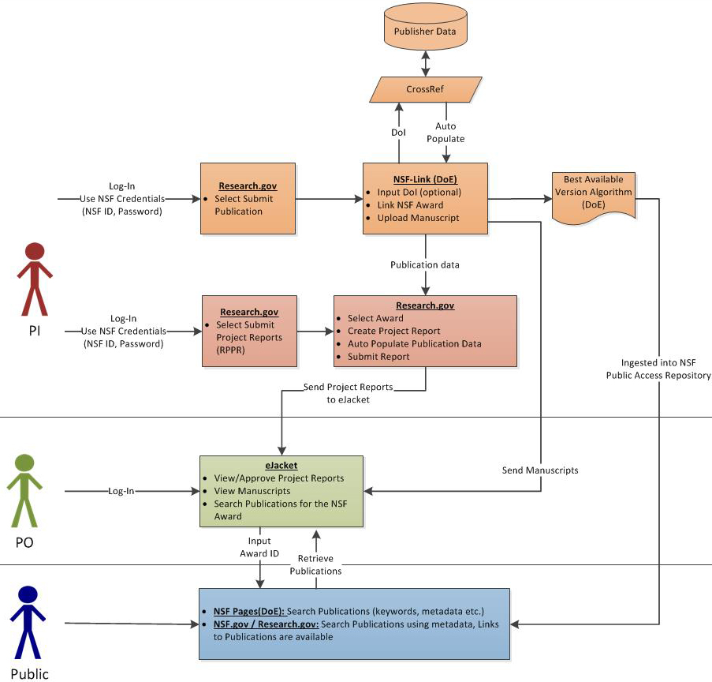
PI, PO, and Public: access to publications

