Slide 1

Supporting Information Review & Data Analysis at Organic Letters Angie Hunter Data Analyst, Organic Letters MPS Open Data Workshop – November 2015
American Chemical Society - Proprietary and confidential
Notes:
Overview of current process at OL:
Specifically:
At what points do I review SI/manuscripts
What details am I looking for
Share data/trends – reviewed over 7,000 paper
Goal – to have a consistent and accurate SI that benefits the author as well as the reader
With 24 hr turnaround

Slide 2
ACS Journals – Open Access
Supporting Information (SI) is freely available from the ACS journal homepages
ACS has several options to provide open access:
http://acsopenaccess.org
ACS Editors’ Choice
ACS is partnering with Digital Science’s Figshare
ACS will assign Digital Object Identifier (DOI) tags to SI files
ACS SI material searchable via multiple search engines
American Chemical Society - Proprietary and confidential
Notes:
Figshare is an open repository for archiving /accessing data sets

Slide 3
Data Analysis at Organic Letters
Scientist
DATA
Manuscript/SI
The Supporting Information (SI) for submitted manuscripts routinely contains numerous errors:
✓ Missing Data ✓ Incorrect Data
✓ Data Manipulation ✓ Inconsistency with Manuscript
Goals for Organic Letters data analysis:
✓ All information readily accessible and accurate
✓ Provide consistent quality
American Chemical Society - Proprietary and confidential
Notes:
All information readily accessible and accurate
Provide consistent quality

Slide 4
Supporting Information
What Is Reviewed
Data Consistency
Compound number, structure, yield in agreement - manuscript/SI
Experimental Procedures
Run data-checking software
Experimental procedure with details for each compound
Spectra
Image quality and completeness
Range • Integration • Size
Properly Labeled • Legible
Check for edited spectra
American Chemical Society - Proprietary and confidential
Notes:
READ REVIEWS from REVIEWERS
read the reviews prior to checking SI – helpful to have extra input…although the SI is mentioned only about 20-30% in the review
New Manuscripts
Author who has a previous SI/data issue
Manuscripts that will be unsubmitted
Recheck manuscripts that have been unsubmitted
Manuscripts at Revision
All manuscripts checked before a revision request
Revised Manuscripts
All are checked to verify that requested changes made
Published Papers
Verify SI correction prior to an Addition/Correction
Investigate issues reported by readers

Slide 5
Data Analysis – Trends
2012: 52%
2013: 45%
2014: 41%
Manuscripts with one SI issue
Increased inspection of experimental details:
Isolated amount
Physical description
Purification details
Rechecking more manuscripts:
✓ Unsubmitted manuscripts
Manuscripts requiring multiple revisions
American Chemical Society - Proprietary and confidential
Notes:
Inspect for increasing types of errors in SI
Rechecks up – more Ed asst sending back
- sometimes there are 2 or 3 revision requests or papers that are unsubmitted for
Last bullet : why the increase in spectra quality / spectra issues ??

Slide 6
Data Analysis – Trends
Missing Data
Formatting /Typo Issue
Experimental procedure
Spectra
Spectra not labeled
HRMS typos
American Chemical Society - Proprietary and confidential

Slide 7
Data Analysis – Trends
Data Consistency
Spectra Quality/Issues
Compound number
Structure
Sequence
Yield
7% (2013) vs. 1% (2014)
Less time to review
Faint/blurry or size
Compound purity
Edited spectra
American Chemical Society - Proprietary and confidential

Slide 8
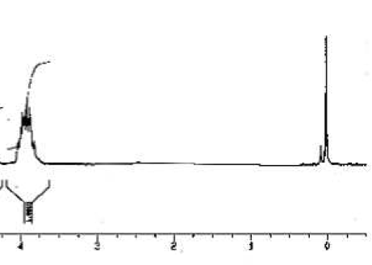
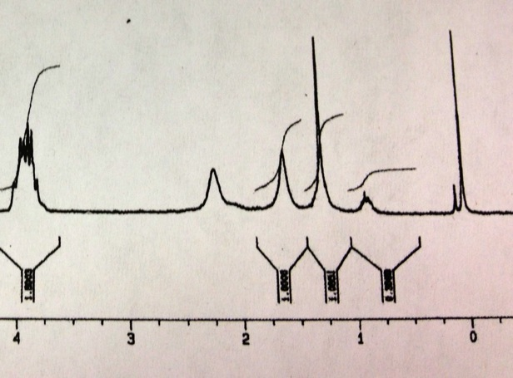
Example of an Edited Spectrum
Impurities
Published spectrum:
Wavy, uneven baseline
Original spectrum:
Submitted for correction
American Chemical Society - Proprietary and confidential

Slide 9
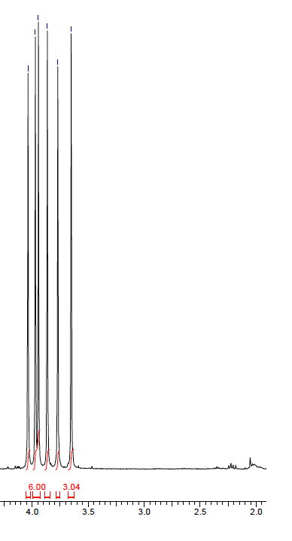
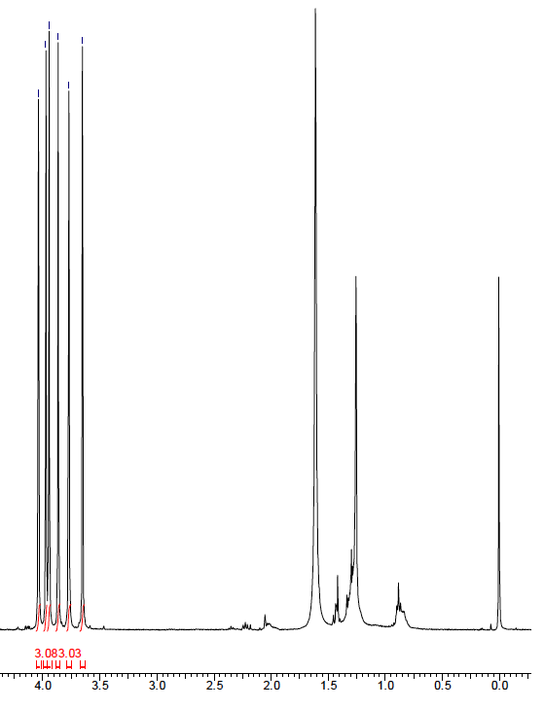
Example of Image Manipulation
Impurities
Original submitted spectrum
Requested an expanded
baseline showing 0-10 ppm
Submitted spectrum for revision
Authors identified impurities &
updated reported yield in manuscript
American Chemical Society - Proprietary and confidential

Slide 10
Data Analysis – Spectra Trends
Overall, spectra problems remained constant in 2014
Edited spectra cases increased
Dealing with edited spectra is time-consuming
Spectra Issues
2013 | 2014
2% | 3%
2% | 0%
2% | 3%
Faint/blurry or size ⬆
Compound Purity ⬇
Edited Spectra ⬆
American Chemical Society - Proprietary and confidential
Notes:
Optimistic that awareness would eliminate the problem
Spectra issues remained constant
✓ Replace spectra at revision ✓ Request expanded baselines
Rarely ask for compounds to be repurified
Last bullet : why the increase in spectra quality / spectra issues ??

Slide 11
Efforts to Assist Authors
Author guidelines vary between journals
Data requirements
Location of the data
Organic Letters - Published Editorial on SI Review - June ’15
http://pubs.acs.org/doi/abs/10.1021/acs.orglett.5b01700
✓ Improve data quality
✓ SI preparation checklist for authors
Feedback from authors has been overwhelmingly positive
American Chemical Society - Proprietary and confidential
Notes:
Improve data qualty
required data and image qualtiy

Slide 12
Managing Data – Issues
Required data
Missing or manipulated data
Who ensures all data is submitted?
Additional training for Peer Review
Is the data properly labeled for searching?
Manuscript/SI
Data files
What will be the process to upload missing data?
Who will request and verify new data?
American Chemical Society - Proprietary and confidential

