Slide 1

Linking Embargoed Datasets: A Plan for Improving How Research Data Can Be Shared, Linked and Tracked
Anita de Waard
VP Research Data Collaborations
Elsevier RDM Services
Arlington, VA, November 19, 2015

Slide 2
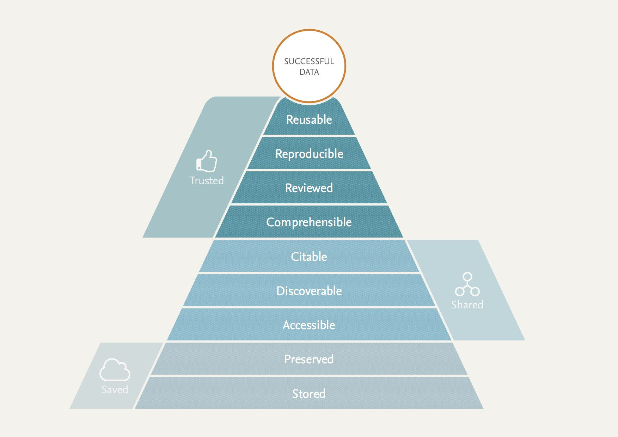
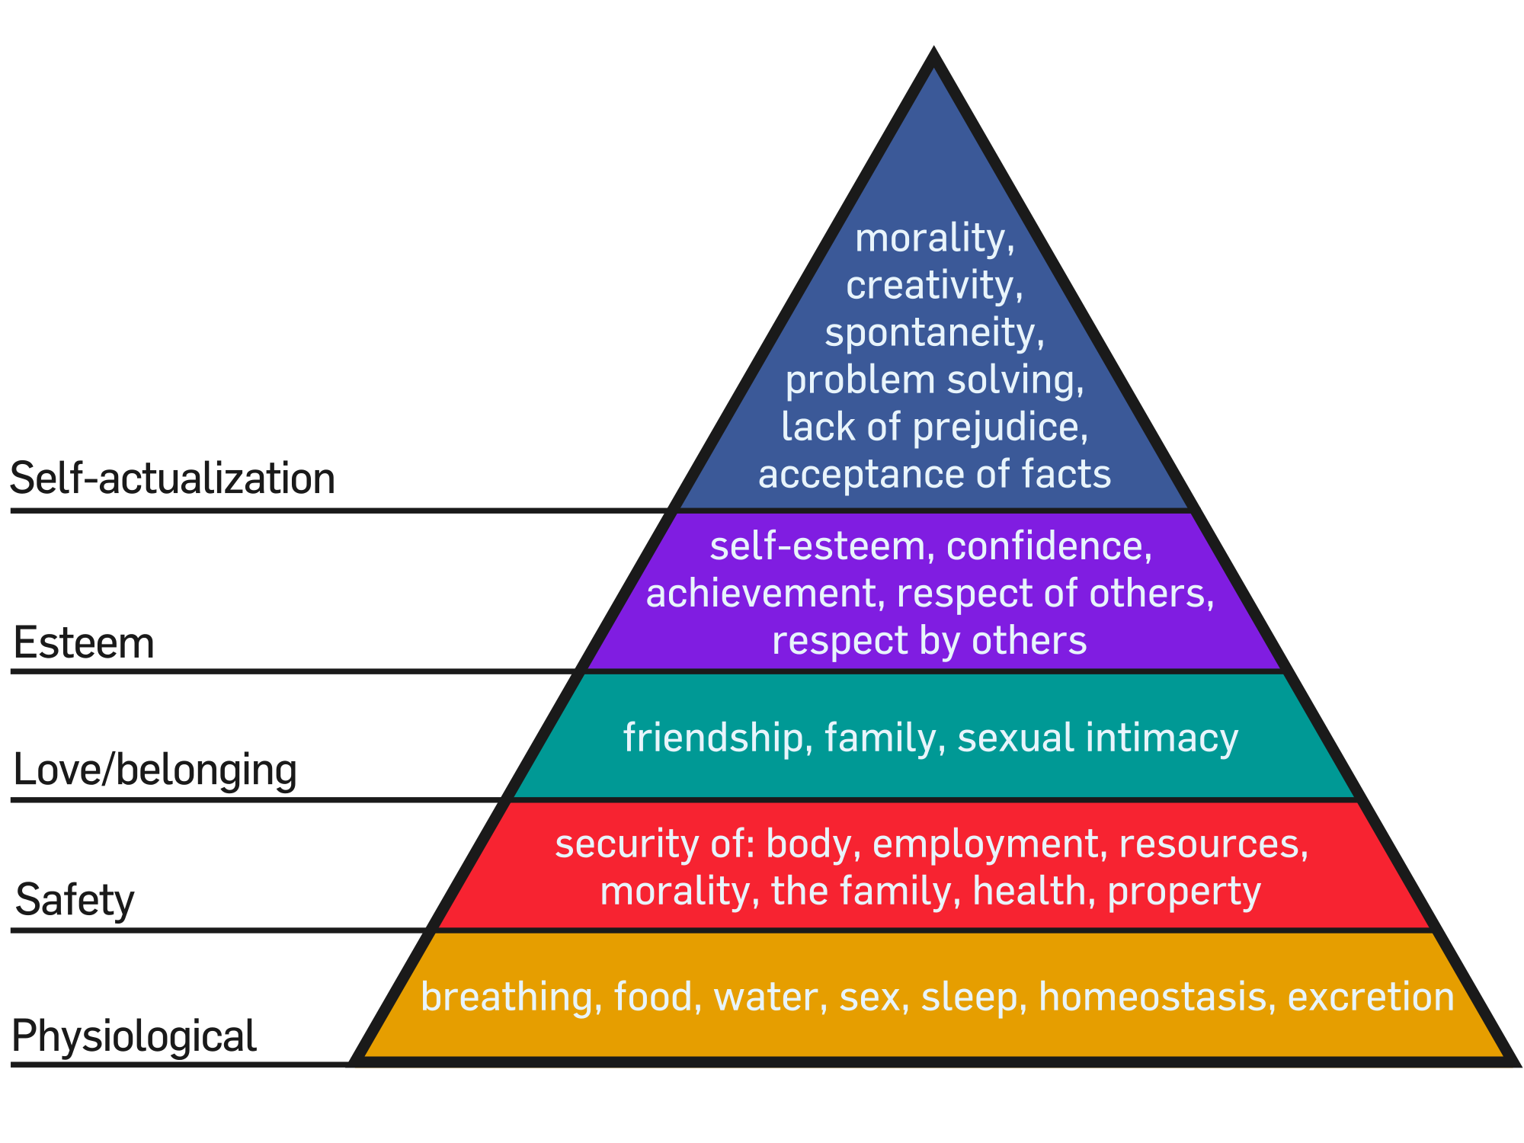
What makes data successful?
What makes people successful?
Collaborate between systems/domains/stakeholder

Slide 3







Current Situation:
Funding Agency
Researcher creates datasets
Researcher writes paper & publishes in journal
(Sometimes,) dataset gets posted to repository
Researcher reports (post-hoc) to Institution and Funder
Institution
4
4
2
2
Journal
Paper
Researchers
1
Dataset
3
Data Repository

Slide 4
Issues with the Current Situation:
iv. Funders/Institutions informed as an afterthought
Funding Agency
Institution
4
iii. No link between data and paper
4
2
2
Journal
Paper
Researchers
1
i. Too much work for researchers
Dataset
3
ii. Data posting not mandatory
Data Repository

Slide 5
A Way To Address Some of These Issues:
iv. Better Tracking!
4
Institution
Funding Agency
Researcher creates datasets and posts to repository (under embargo – not publicly viewable)
Funder is automatically notified of dataset posting
Researcher writes paper & publishes in journal; embargo is lifted and data linked
- NB this also allows release of non-used data for negative result and reproducibility
4. Funder and institution get report on publication and embargo lifting
3
iii. Better Linking!
Journal
3
4
3
2
i. Less Work!
Paper
Researchers
1
ii. More Data Stored!
Dataset
1
Data Repository

Slide 6
What is needed to get there?
4
Funding Agency
Institution
3
Journal
3
4
3
Paper
2
Researcher
1
Researcher posts data & adds grant nr/funder’s ID:
Q to Researchers: Are you able and willing to do this? Q to Funding agencies: Are there simple ways to access funder/fundee IDs?
2. Data repository feeds into funder’s reporting tool & enables embargoed access:
Q to Institutions: Is IT able to allow data deposition in external repository? Q to Institutions: Are local repositories able to act as embargo’ed repository?
3. Researcher identifies dataset related to journal publication:
Q to Researchers: Is that a good time to do this? Keep data you didn’t use?
Q to Repositories and Journals: Are there clear URI’s available to do this? Data Repository and Journal share information on embargo lift & link data:
Q to Repositories: Are you ready to do this?
Q to Publishers: Are you ready to do this?
Data Repository/Journal send reports to Institution and Funding Agency:
Q to Institutions: What type of reporting do you need?
Q to Funding Agencies: What would you like to see reported?
Dataset
1
Data Repository

Slide 7
Thank you! Anita de Waard VP Research Data Collaborations, Elsevier a.dewaard@elsevier.com http://www.elsevier.com/about/open-science/research-data

Slide 8
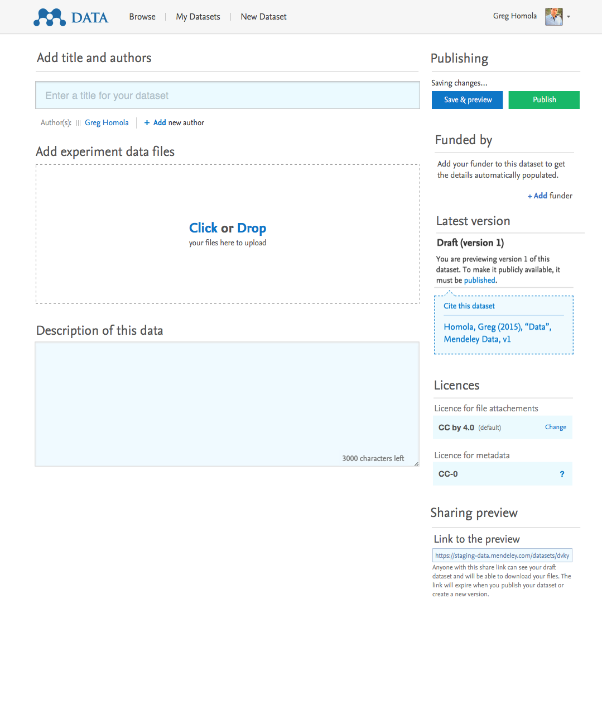

Slide 9
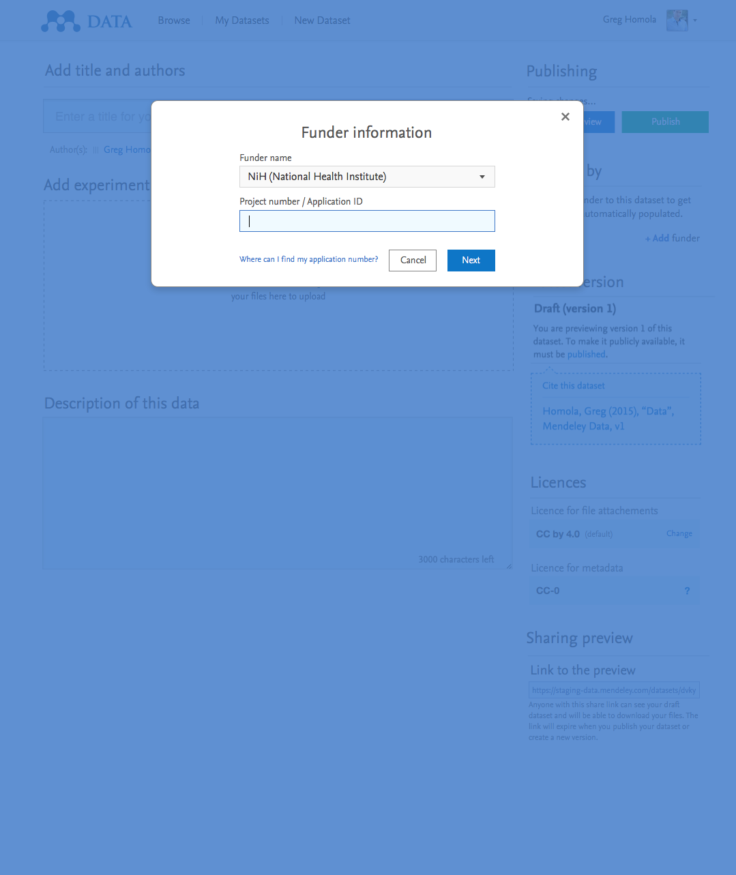

Slide 10
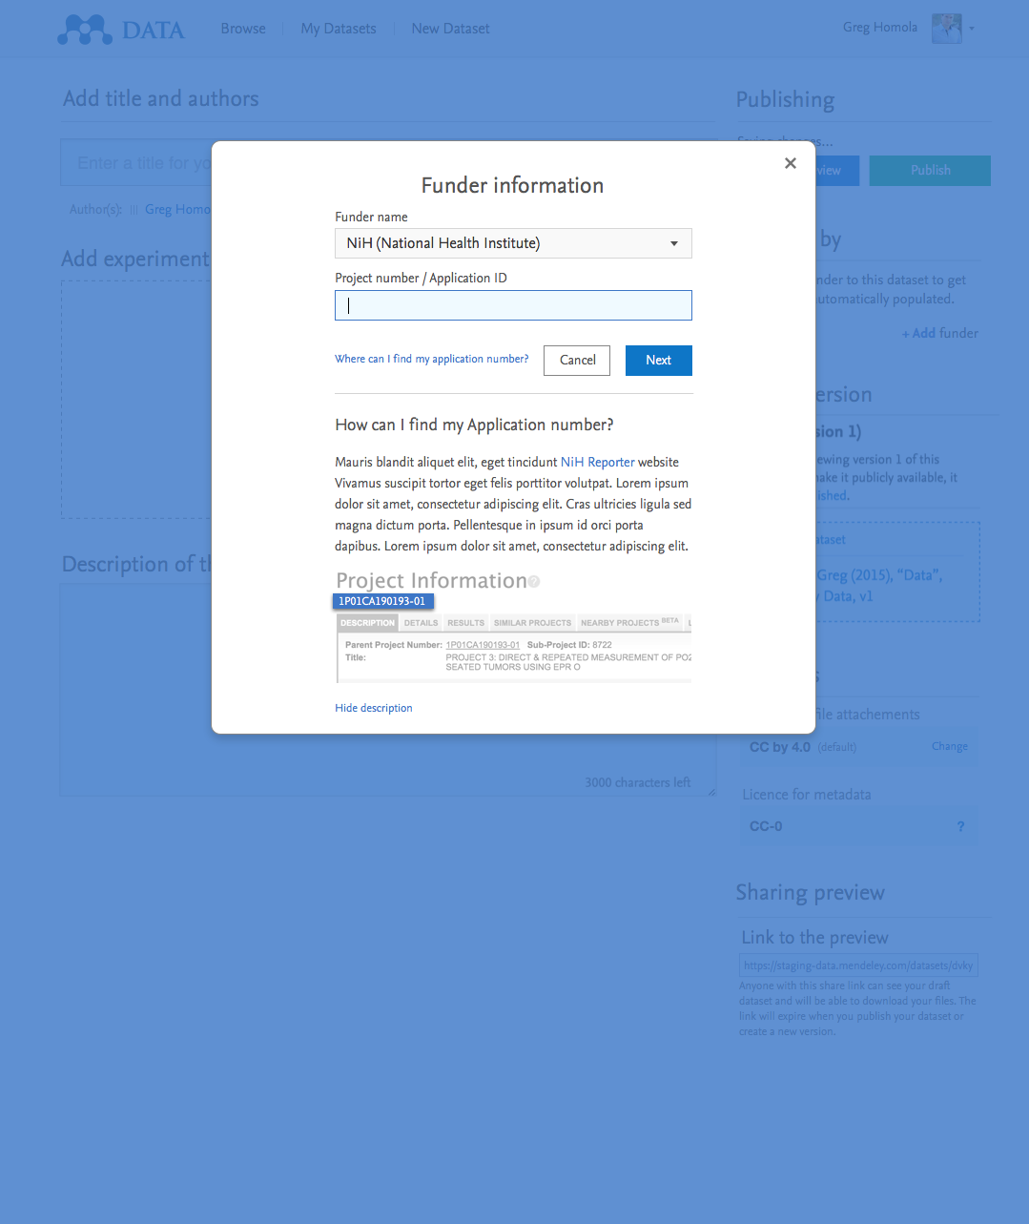

Slide 11
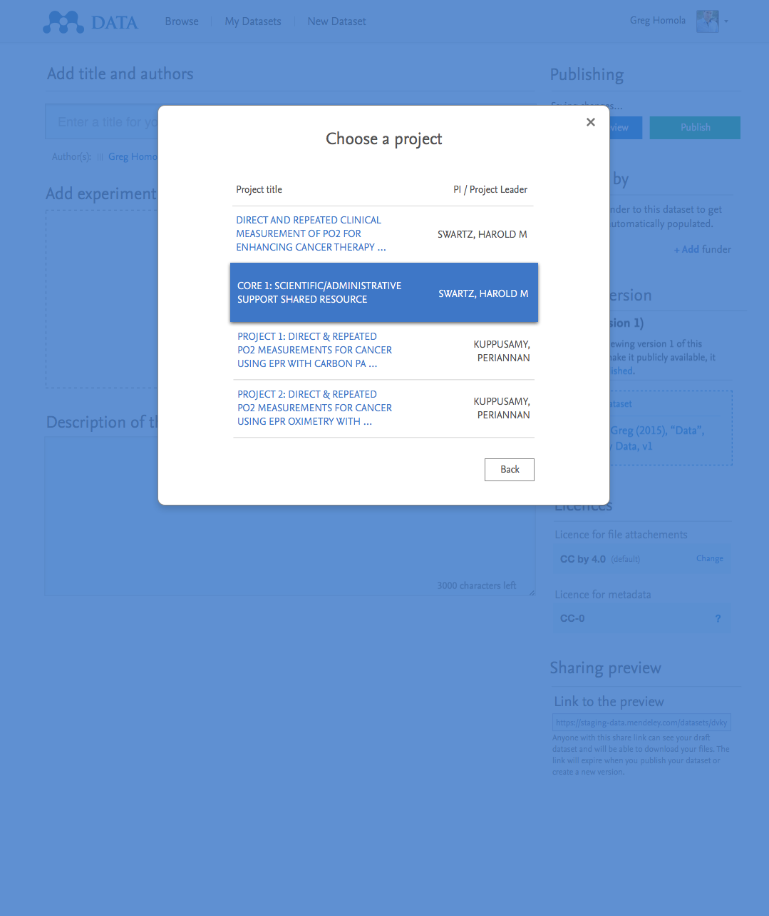

Slide 12
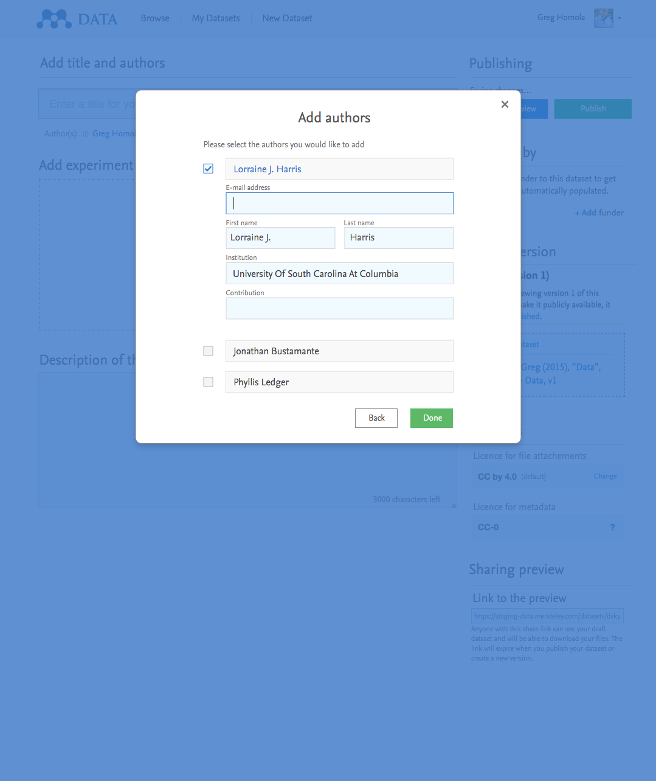

Slide 13
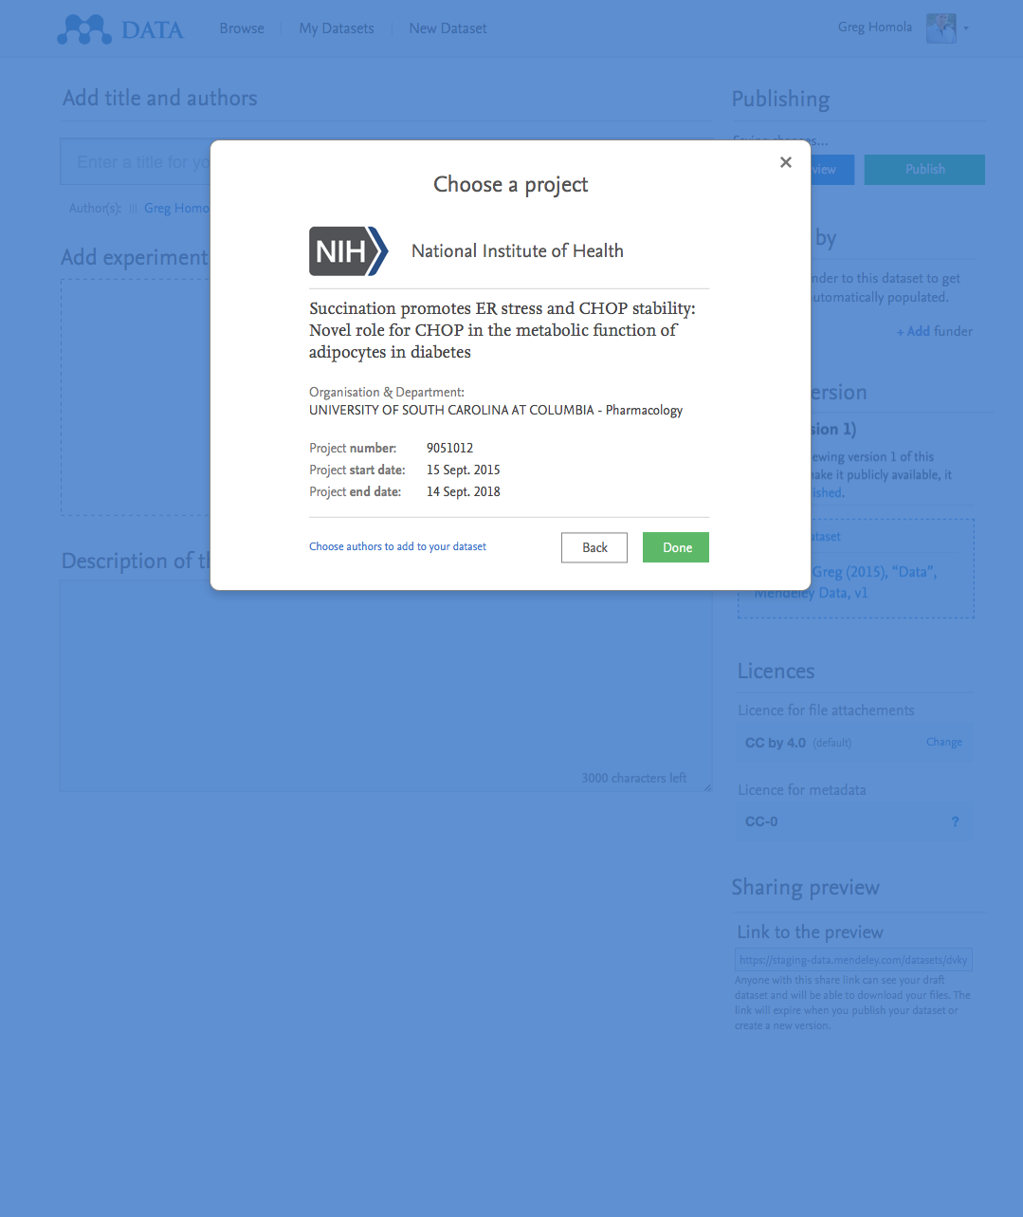

Slide 14
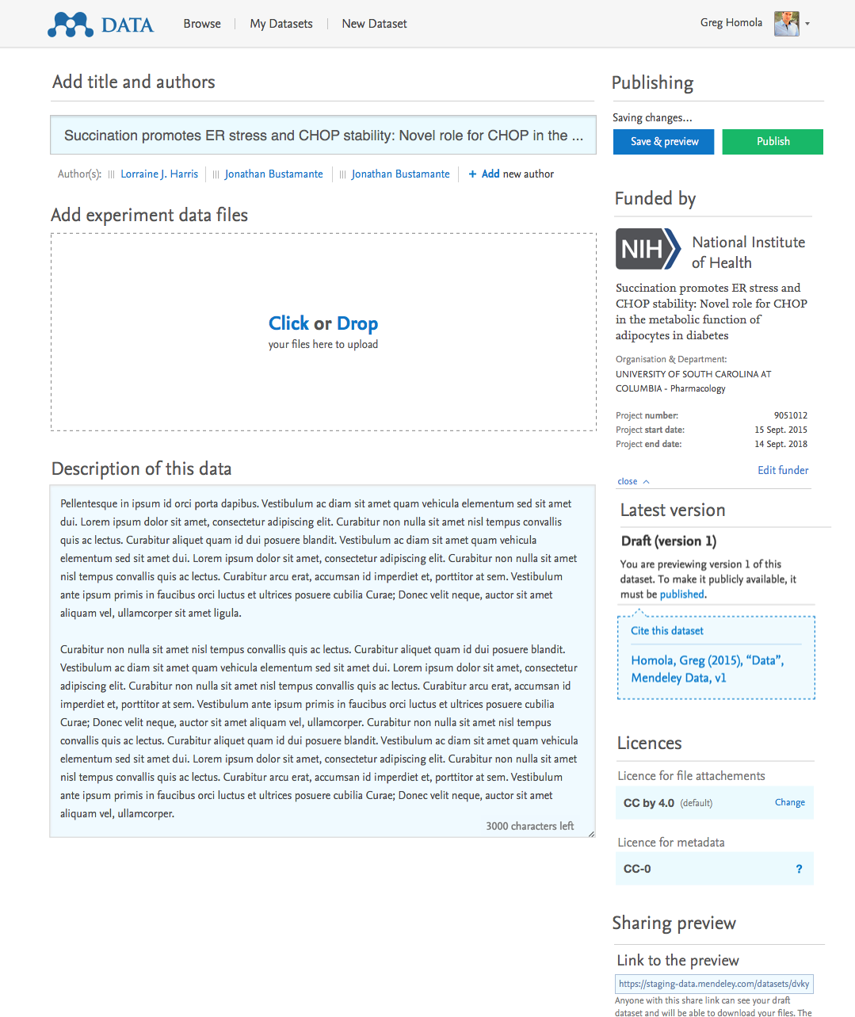

Slide 15
“Maslow Hierarchy to Enable Happy Data:”
9. Re-usable (allow tools to run it)
Executable Papers
8. Reproducible (rerun experiments/review observations)
10. Integrate upstream and downstream
– make metadata to serve use.
Data Journals
Use
7. Trusted (curated/reviewed)
Data Linking
6. Comprehensible (description / method is available)
Urban Legend
5. Citable (can point to and measure impact)
Force11 DCP
4. Discoverable (data can be found)
Data Search
Share
3. Accessible (data exists online)
Mendeley Data
2. Stored (long-term, format-independent)
Olive
Save
1. Preserved (existing in some form, somewhere)
Data Rescue

Slide 16
More about Elsevier RDM projects:
Preserve: Data Rescue Challenge: http://www.elsevier.com/physical-sciences/earth-and-planetary-sciences/the-2015-international-data-rescue-award-in-the-geosciences
Store: Olive Executable Archive: https://olivearchive.org/
Access: Mendeley Data: https://data.mendeley.com/ - email joseph.shell@mendeley.com for more details
Discover: Data Search: http://datasearch-demo.equalexperts.com/indexed#/ - email a.dewaard@elsevier.com for login details
Cite: Force11 data citation principles: https://www.force11.org/group/joint-declaration-data-citation-principles-final
Comprehend: Urban Legend project, see http://www.frontiersin.org/10.3389/conf.fninf.2014.18.00077/event_abstract and https://www.aaai.org/ocs/index.php/FSS/FSS13/paper/view/7517/7490 - email a.dewaard@elsevier.com for access to the demo
Trust: Data Linking: http://www.elsevier.com/books-and-journals/content-innovation/data-base-linking
Reproduce: Data Journals, e.g. ‘Data in Brief: http://www.journals.elsevier.com/data-in-brief
Use: Executable Papers, http://www.elsevier.com/physical-sciences/computer-science/executable-papers-improving-the-article-format-in-computer-science
Integrate: for more on Elsevier’s Research Data Management Program, see http://www.elsevier.com/about/open-science/research-data

Slide 17
Four Types of Data, Four Kinds of Repositories:
Methods
Software
Publication
Research Question
Raw Data
Object of Study
Processed Data
Data With Paper
Curated Record
Method
Analysis
Tables/ Figures
Curate
Deep Blue (Umich): 80k
MIT Dspace: 75 k
HAL (France): 60 k
D-Space Cambridge: 1.5 k Of which data: hundreds
Non-Domain Repositories
Institutional/Local Repositories
Figshare: 1.2 M
DataDryad: 3 k
Dataverse: 58 k
Domain Repositories
NOAA: 20 TB/
NASA streaming > 24 PB/day
NASA Reverb: 12 PB Data
NSSD: > 230 TB of digital data
NSIDC: 1 PB data, : 1 PB total
ALMA Telescope: 40 TB/day
Local Storage/
Instrument Repositories
PetDB: 6 k
PDB: 100 k
NIST ASD: 170 k
Size: kB
Nr of files: 100ks
Size: MB
Nr of files: Milliions
Size: GB
Nr of files: Billions
Size: PB
Nr of files: Trillions

Slide 18
The DESIRE Model of Data Search:
Enrichment
Manual
Automated
(user) Intent
Federated
Poor API
Rich API
FTP & Index
Federated
Poor API
Rich API
FTP & Index
Federated
Poor API
Rich API
FTP & Index
Ranking
Filtering (how to mix federated & indexed rich & poor)
Data
Rendering
Search all data
Faceted query/Results refinement
Store & Use results
Search
Evaluation
General
UI
Domain
UI
Filtering
Feeding user signals back into Search ranking

