Slide 1
DOE Data Management Plan Requirements
MPS Open Data Workshop Series:
Gauging the Impact of Requirements for Public Access to Data
November 19, 2015
Carly Robinson, PhD
Senior Science Advisor
Office of Scientific and Technical Information
U.S. Department of Energy
carly.robinson@science.doe.gov

Slide 2
Brief History – Data
COMPETES 2010 “Interagency Public Access Committee”
Office of Science Working Group on Digital Data
Office of Science FACA Reports (2011)
OSTP Request for Information (2012)
Office of Science User Facility Input (2013)
OSTP Memo “Increasing Access to the Results of Federally Funded Scientific Research” (Feb., 2013)
DOE Public Access Plan and Office of Science Statement on Digital Data Management (July, 2014)
DOE Policy for Digital Research Data Management (Sept, 2015)
Data Management Policies of other Agencies
Global Policy Context

Slide 3
DOE-wide tiered policy
DOE Policy for Digital Research Data Management
…
Office of Science Statement on Digital Data Management
…
Biological and Environmental Research
Advanced Scientific Computing Research
Office of Energy Efficiency and Renewable Energy
All sponsoring research offices are implementing DMP requirements by Oct 1, 2015. Some may have additional guidance and requirements online.
Some sub-office programs may have additional guidance and requirements online.

Slide 4
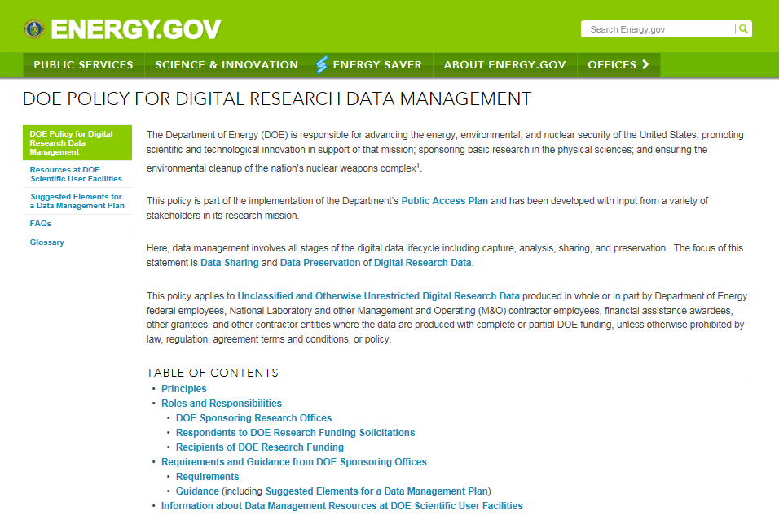
DOE Policy for Digital Research Data Management http://www.energy.gov/datamanagement/

Slide 5
DOE Policy for Digital Research Data Management
Principles
Effective data management has the potential to increase the pace of scientific discovery and promote more efficient and effective use of government funding and resources. Data management planning should be an integral part of research planning.
Sharing and preserving data are central to protecting the integrity of science by facilitating validation of results and to advancing science by broadening the value of research data to disciplines other than the originating one and to society at large. To the greatest extent and with the fewest constraints possible, and consistent with the requirements and other principles of this Statement, data sharing should make digital research data available to and useful for the scientific community, industry, and the public.
Not all data need to be shared or preserved. The costs and benefits of doing so should be considered in data management planning.

Slide 6
DOE Policy for Digital Research Data Management
Requirements apply to proposals for research funding
Requirements apply to proposals submitted for new, renewal, and some supplemental research funding
Requirements apply to proposals regardless of the PI’s institution
Requirements do not apply to applications to use DOE scientific user facilities.
DOE sponsored research activities at the DOE National Laboratories for which a DOE-approved DMP does not already exist will be required to develop a DMP. In most cases, the DMP will be requested as part of the next peer review organized by the DOE sponsoring research office.

Slide 7
DOE Policy for Digital Research Data Management
Requirements
DMPs should describe whether and how data generated in the course of the proposed research will be shared and preserved and, at a minimum, describe how data sharing and preservation will enable validation of results, or how results could be validated if data are not shared or preserved.

Slide 8
DOE Policy for Digital Research Data Management
DMPs should provide a plan for making all research data displayed in publications resulting from the proposed research open, machine-readable, and digitally accessible to the public at the time of publication. This includes data that are displayed in charts, figures, images, etc. In addition, the underlying digital research data used to generate the displayed data should be made as accessible as possible to the public in accordance with the Principles stated above. The published article should indicate how these data can be accessed.

Slide 9
DOE Policy for Digital Research Data Management
DMPs should consult and reference available information about data management resources to be used in the course of the proposed research. In particular, DMPs that explicitly or implicitly commit data management resources at a facility beyond what is conventionally made available to approved users should be accompanied by written approval from that facility. In determining the resources available for data management at DOE Scientific User Facilities, researchers should consult the published description of data management resources and practices at that facility and reference it in the DMP.

Slide 10
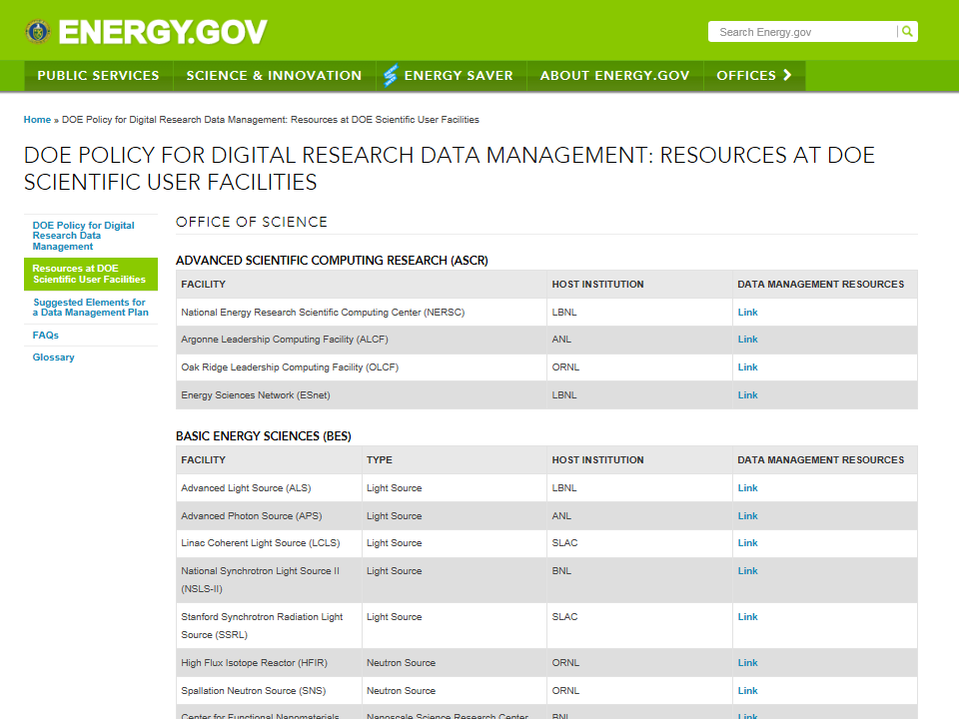

Slide 11
DOE Policy for Digital Research Data Management
DMPs must protect confidentiality, personal privacy, Personally Identifiable Information, and U.S. national, homeland, and economic security; recognize proprietary interests, business confidential information, and intellectual property rights; avoid significant negative impact on innovation and U.S. competitiveness; and otherwise be consistent with all applicable laws, regulations, agreement terms and conditions, and DOE orders and policies.
Additional requirements and review criteria for the DMP may be identified by the sponsoring research office, program, sub-program, or in the solicitation.

Slide 12
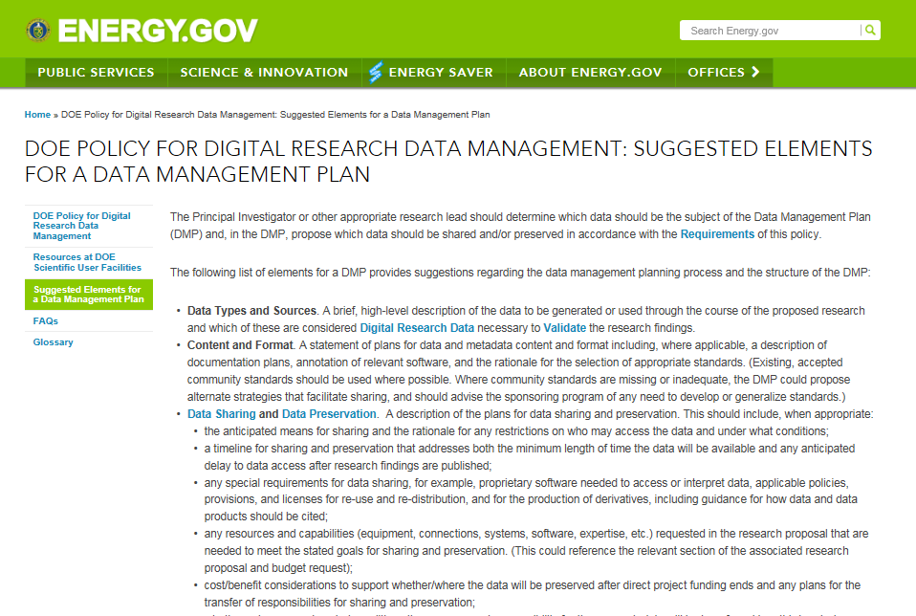
Suggested Elements for a Data Management Plan
Data Types and Sources
Content and Format
Sharing and Preservation
Protection
Rationale

Slide 13
Definitions
Digital Research Data: The term digital data encompasses a wide variety of information stored in digital form including: experimental, observational, and simulation data; codes, software and algorithms; text; numeric information; images; video; audio; and associated metadata. It also encompasses information in a variety of different forms including raw, processed, and analyzed data, published and archived data.
This statement focuses on digital research data, which are research data that can be stored digitally and accessed electronically. OMB Circular A110 defines research data as follows:
“Research data is defined as the recorded factual material commonly accepted in the scientific community as necessary to validate research findings, but not any of the following: preliminary analyses, drafts of scientific papers, plans for future research, peer reviews, or communications with colleagues. This 'recorded' material excludes physical objects (e.g., laboratory samples). Research data also do not include:
(A) Trade secrets, commercial information, materials necessary to be held confidential by a researcher until they are published, or similar information which is protected under law; and
(B) Personnel and medical information and similar information the disclosure of which would constitute a clearly unwarranted invasion of personal privacy, such as information that could be used to identify a particular person in a research study.”

Slide 14
DMP Requirements
DOE Policy for Digital Research Data Management | SC Statement on Digital Data Management
DMPs may be required as part of research proposal or later in the award process | DMPs required as part of research proposals
DMP requirements come into effect Oct 1, 2015 | DMP requirements came into effect Oct 1, 2014
Common principles and requirements for DMPs for all DOE offices
Common “Suggested Elements” for DMPs for all DOE offices
Common definitions for all DOE offices

Slide 15
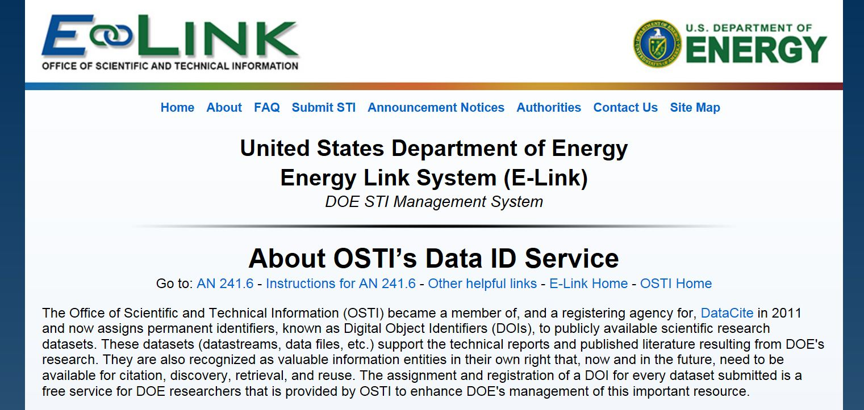
Data ID Service https://www.osti.gov/elink/aboutDataIDService.jsp
Provided through DOE’s Office of Scientific and Technical Information (OSTI)

Slide 16
Questions?

