Slide 1
NIH Data and Resource Sharing
MPS Workshop 1:
Gauging the Impact of Requirements for Public Access to Data
November 19, 2015
Jennie Larkin, Ph.D.
Office of the Associate Director for Data Science (ADDS), NIH
Vivien Bonazzi, Ph.D.
Office of the Associate Director for Data Science (ADDS), NIH
Office of the Director, National Institutes of Health (NIH)
U.S. Department of Health & Human Services (HHS)

Slide 2

A Culture of Sharing
White House Initiative
(2013 “Holdren Memo”)
Genome-wide Association (GWAS) Policy
Big Data to Knowledge (BD2K) Initiative
NIH Data Sharing Policy
Model Organism Policy
Genomic Data Sharing (GDS) Policy
Research
Tools Policy
NIH Public Access Policy (Publications)
Modernization of NIH Clinical Trials
1999
2003
2004
2007
2008
2012
2014

Slide 3
NIH Public Access Policy for Publications
Since 2005, public access to published results of all research funded by NIH (by law since 2008)
Recipients of NIH funds required to submit final peer-reviewed journal manuscripts to PubMed Central (PMC) upon acceptance for publication
Papers must be accessible to the public on PMC no later than 12 months after publication

Slide 4
A Culture of Sharing
White House Initiative
(2013 “Holdren Memo”)
Genome-wide Association (GWAS) Policy
Big Data to Knowledge (BD2K) Initiative
NIH Data Sharing Policy
Model Organism Policy
Genomic Data Sharing (GDS) Policy
Research
Tools Policy
NIH Public Access Policy (Publications)
Modernization of NIH Clinical Trials
1999
2003
2004
2007
2008
2012
2014

Slide 5
Purpose and Scope of the NIH Genomic Data Sharing (GDS) Policy
Purpose
Sets forth expectations and responsibilities that ensure the broad and responsible sharing of genomic research data in a timely manner
Scope
All NIH-funded research generating large-scale human or non-human genomic data and the use of these data for subsequent research
Data to be submitted to NIH-designated data repositories (e.g., dbGaP, GEO, GenBank, WormBase, FlyBase, Rat Genome Database)
Applies to all funding mechanisms (grants, contracts, intramural support) – Effective date was January 25, 2015
No minimum threshold for cost

Slide 6

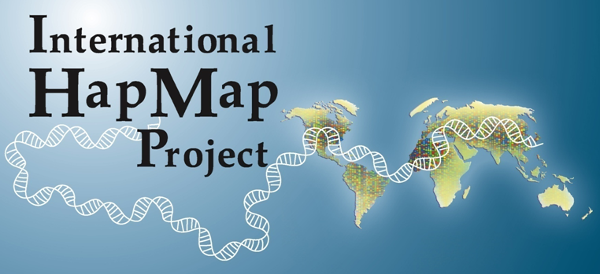
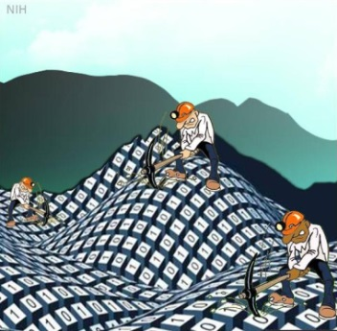


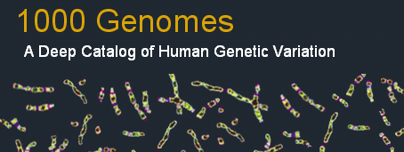
Data Sharing: An Essential Component

Slide 7
A Culture of Sharing
White House Initiative
(2013 “Holdren Memo”)
Genome-wide Association (GWAS) Policy
Big Data to Knowledge (BD2K) Initiative
NIH Data Sharing Policy
Model Organism Policy
Genomic Data Sharing (GDS) Policy
Research
Tools Policy
NIH Public Access Policy (Publications)
Modernization of NIH Clinical Trials
1999
2003
2004
2007
2008
2012
2014

Slide 8
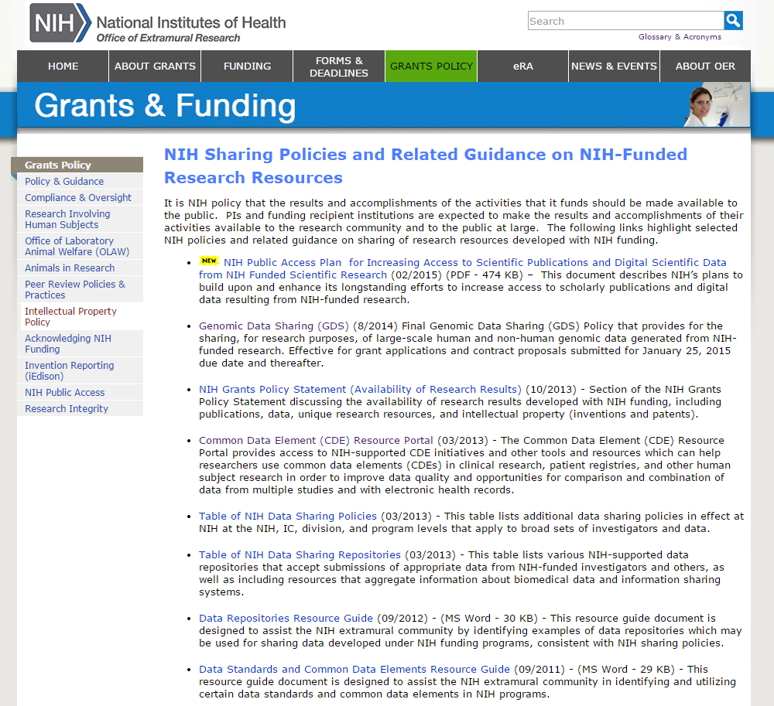
NIH Response to Administration Directives

Slide 9
NIH Plan on Digital Scientific Data
Protect privacy, proprietary interests, and preserve the balance between the benefits of access/preservation and the costs.

Slide 10
NIH Plan on Digital Scientific Data (continued)
Ensure that all NIH-funded researchers prepare data management and sharing plans
Ensure that plans are reviewed during peer review
Encourage use of established repositories and community-based standards

Slide 11
NIH Plan on Digital Scientific Data (continued)
Develop approaches to ensure discoverability of data
Implement the data commons

Slide 12
Considerations for Implementation
Timelines for implementation
For human data: privacy, confidentiality, informed consent issues
Developing NIH-wide approaches for sustaining data resources
Implementation costs within the constraints of existing budgets and resources

Slide 13
A Culture of Sharing
White House Initiative
(2013 “Holdren Memo”)
Genome-wide Association (GWAS) Policy
Big Data to Knowledge (BD2K) Initiative
NIH Data Sharing Policy
Model Organism Policy
Genomic Data Sharing (GDS) Policy
Research
Tools Policy
NIH Public Access Policy (Publications)
Modernization of NIH Clinical Trials
1999
2003
2004
2007
2008
2012
2014

Slide 14

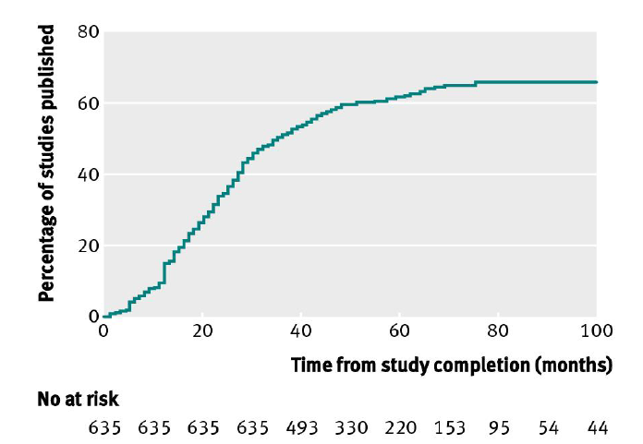
Modernizing NIH Clinical Trials Activities: The Need
NIH-Funded trials published within 100 months of completion
Less than 50% published within 30 months of completion
BMJ 2012;344:d7292
Notes:
Figure 2. Cumulative percentage of studies published in a peer reviewed biomedical journal indexed by Medline during 100 months after trial completion among all NIH funded clinical trials registered within ClinicalTrials.gov
Source: Ross JS, Tse T, Zarin DA, Xu H, Zhou L, Krumholz HM. Publication of NIH funded trials registered in ClinicalTrials.gov: cross-sectional analysis. BMJ 2012;344:d7292.

Slide 15
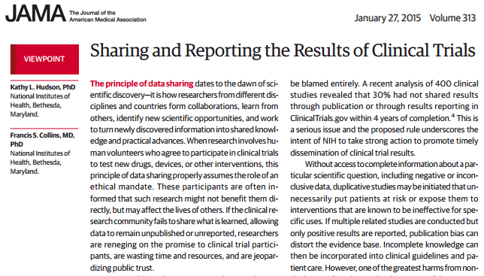
Modernizing NIH Clinical Trials Activities: Call to Action

Slide 16


Common Data Elements (CDEs)
Encouraging knowledge and adoption of CDEs in NIH-sponsored clinical research.
NIH CDE Workshop (September 30, 2015)
Facilitate harmonization of platforms, tools, and resources across NIH Institutes and Centers.
NCI caDSR: https://wiki.nci.nih.gov/display/caDSR/caDSR+CDE+Browser
BMIC CDE Portal: https://www.nlm.nih.gov/cde/

Slide 17
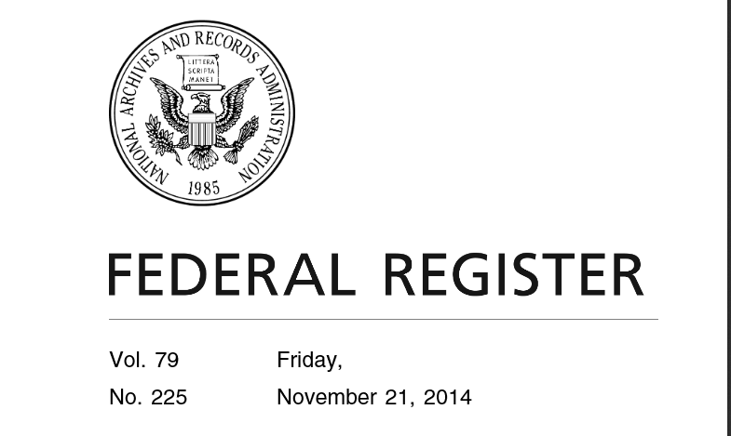
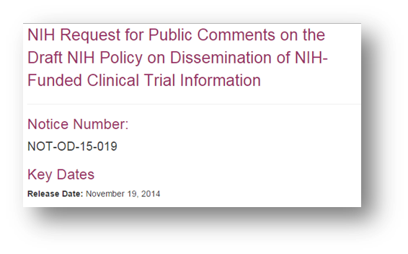
FDAAA and Clinical Trial reporting
FDAAA (2007) mandates results sharing through ClinicalTrials.gov for most FDA-regulated studies
NPRM and NIH Policy expanding this scope (2014 – 2016)
301.496.4299
301.496.4299

Slide 18
The Commons

Slide 19
What are the PRINCIPLES of The Commons?
Crucial component of a digital biomedical ecosystem
Treats products of research – data, software, methods, papers etc. as digital research objects
Digital research objects exist in a shared virtual space Find, Deposit, Manage, Share and Reuse data, software, metadata and workflows
Digital objects need to conform to FAIR principles:
Findable
Accessible (and usable)
Interoperable
Reusable

Slide 20
What is The Commons Framework?
Exploits new scalable computing technologies - Cloud
Provides physical or logical access to data
Simplifies access, sharing and interoperability of digital research objects such as data, software, metadata and workflows
Makes digital research objects indexable and findable: FAIR
Provides understanding and accounting of usage patterns
Is potentially more cost effective given digital growth
Gives currency to digital objects and the people who develop and support them

Slide 21



The Commons Framework
Software: Services & Tools
SaaS
App store/User Interface
scientific analysis tools/workflows
Services: APIs, Containers, Indexing,
PaaS
Digital Object Compliance
Data
“Reference” Data Sets
User defined data
IaaS
Compute Platform: Cloud or HPC

Slide 22
Commons: Digital Object Compliance
Attributes of digital research objects in the Commons
Initial Phase
Unique digital object identifiers resolvable to original authoritative source
Machine readable
A minimal set of searchable metadata
Physically available in a cloud-based Commons provider
Clear access rules (especially important for human subjects data)
An entry (with metadata) in one or more indices
Future Phases
Standard, community-based unique digital object identifiers
Conform to community-approved standard metadata for enhanced searching
Digital objects accessible via open standard APIs
Are physically and logical available to the Commons

Slide 23


International Efforts and Activities --Growing
Wellcome Trust -- Publications and datasets shared http://www.wellcome.ac.uk/stellent/groups/corporatesite/@policy_communications/documents/web_document/wtp053977.pdf.
See also Gates Foundation, etc.
European Medicines Agency – Proactively releasing datasets used in marketing applications.
Global Alliance for Genomics and Health (GA4GH) -- Establishing common framework of approaches to enable effective, responsible sharing of genomic and clinical data

Slide 24
Thank you!
NIH Sharing Policies Website: http://sharing.nih.gov
Email: Sharing@nih.gov
NIH Office of the Associate Director for Data Science (ADDS)
Data Science Blog – Input | Output https://datascience.nih.gov/blog
NIH Office of Extramural Research (OER)
OER Blog – Open Mike http://nexus.od.nih.gov/all/category/open-mike/
NIH Office of Science Policy (OSP)
OSP Blog - Under the Poliscope: http://osp.od.nih.gov/under-the-poliscope

