Slide 1
EVERLAND PROJECT
kopo19

Slide 2
Purchase Process

Slide 3
Purchase Class
Cons
Customer
Input
Output
Ticket
Constant values
Object that have data of single order
Use to get data from console
Use to print data to console and csv file
Work purchase process

Slide 4
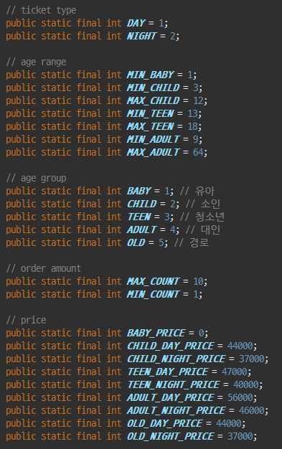
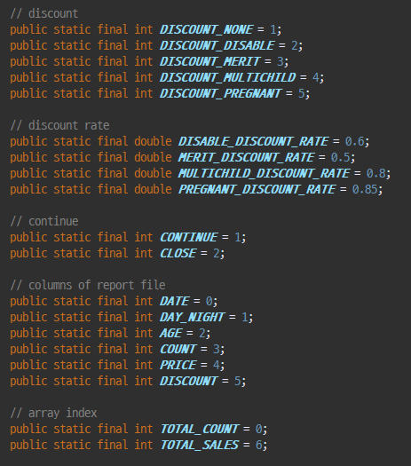
Constant Class

Slide 5
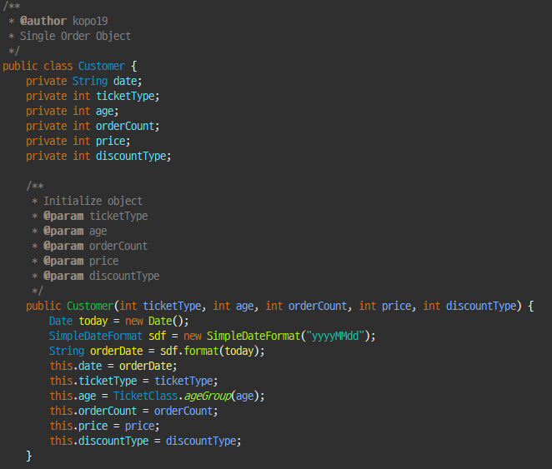
Customer Object Class

Slide 6
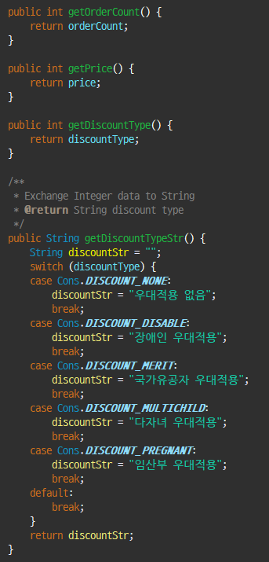
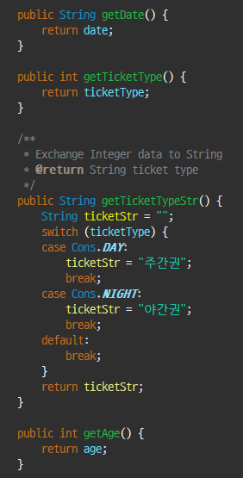
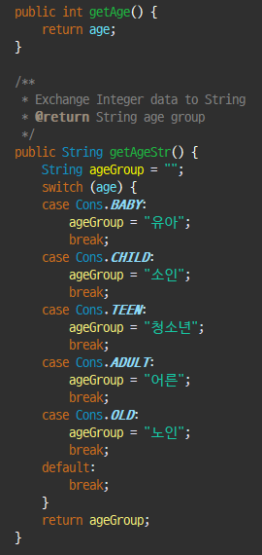
Customer Object Class

Slide 7
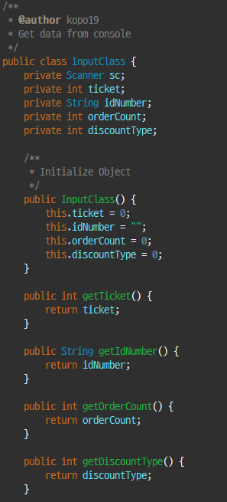
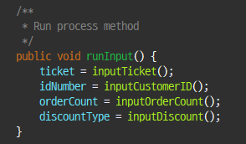
Input Class
runInput method will use in main

Slide 8
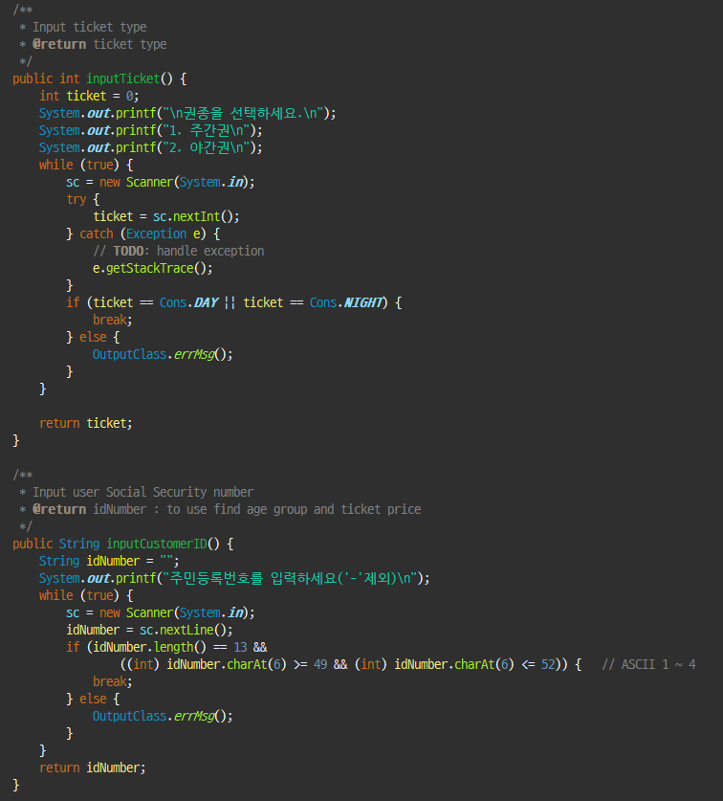
Input Class – method

Slide 9
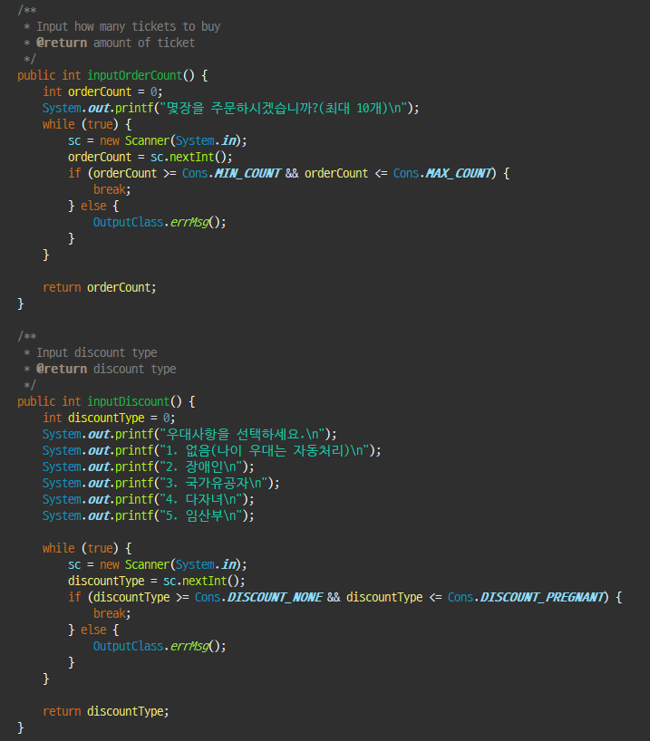
Input Class – method

Slide 10
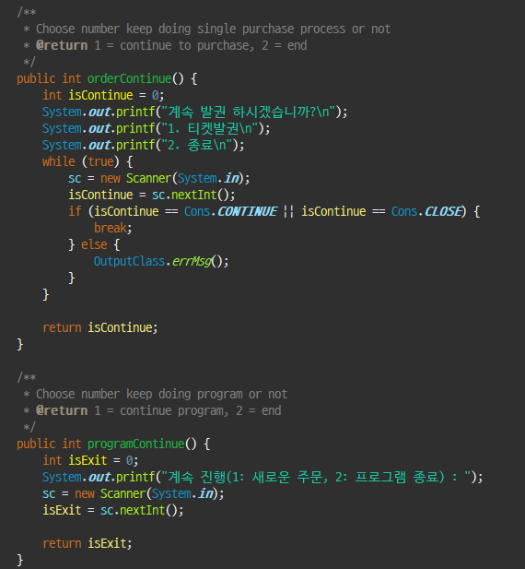
Input Class – method

Slide 11
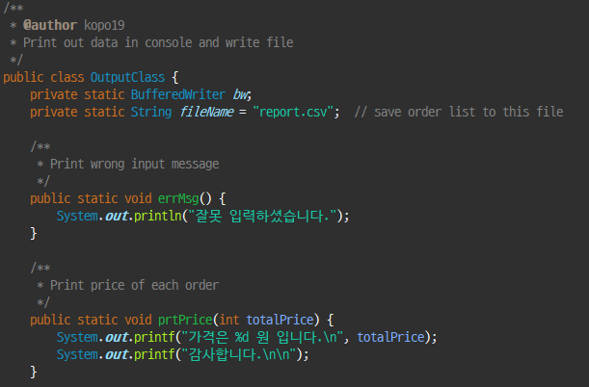
Output Class – method

Slide 12
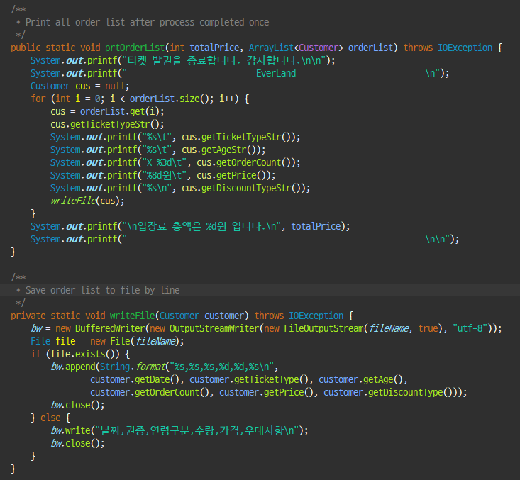
Output Class – method

Slide 13
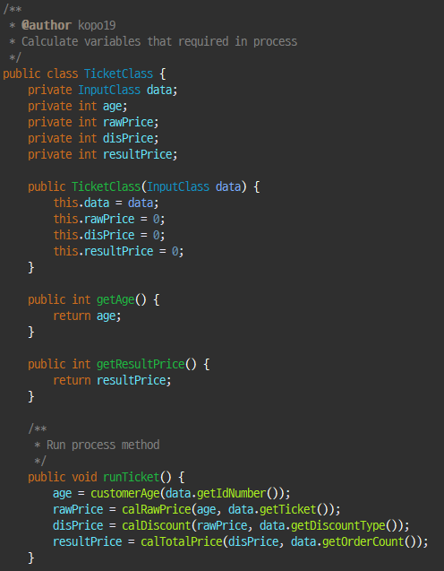
Ticket Class

Slide 14
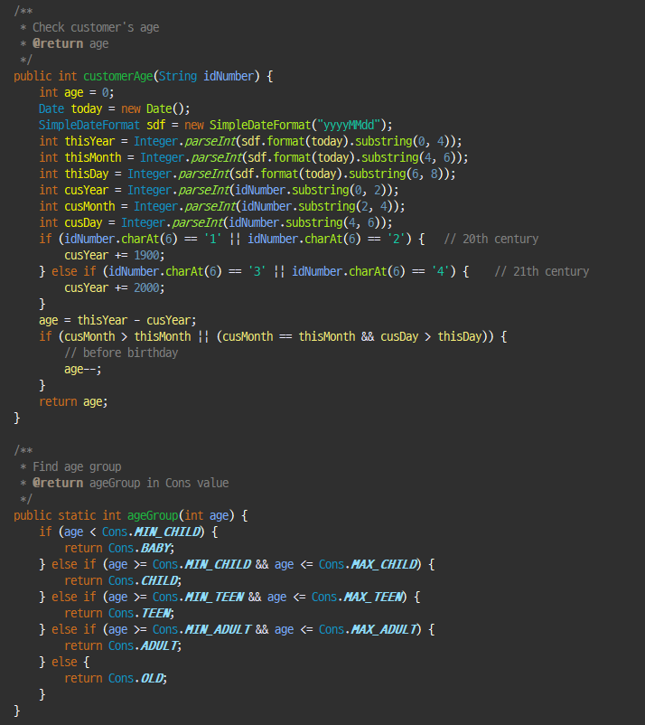
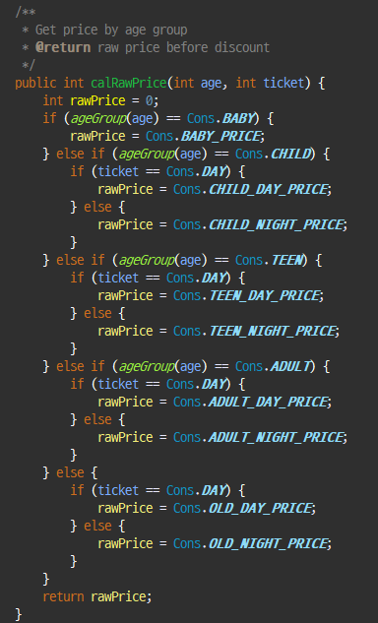
Ticket Class – method

Slide 15
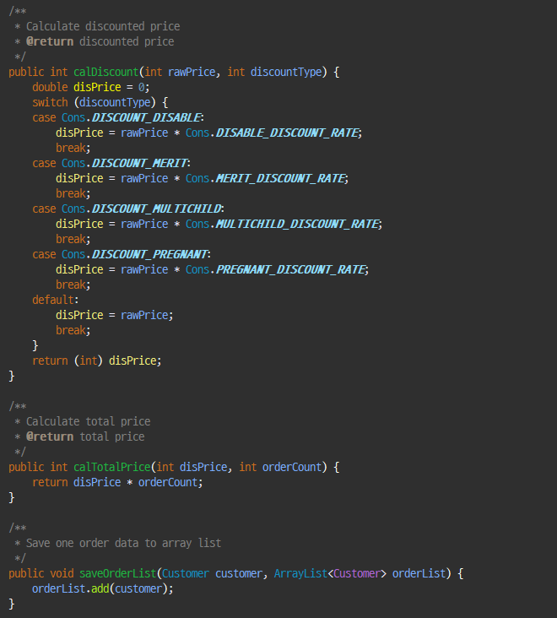
Ticket Class – method

Slide 16
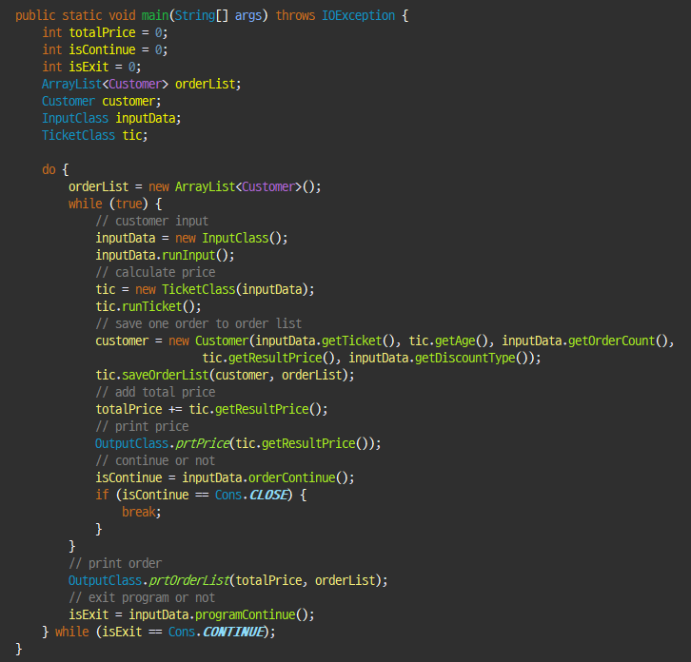
Main

Slide 17
Statistic Process

Slide 18
Statistic Class
OrderLine
ReadFile
PrintFile
Statistic
Object that have data of single line from file
Use to read data from csv file
Use to print data to console and csv file
Work statistic process

Slide 19
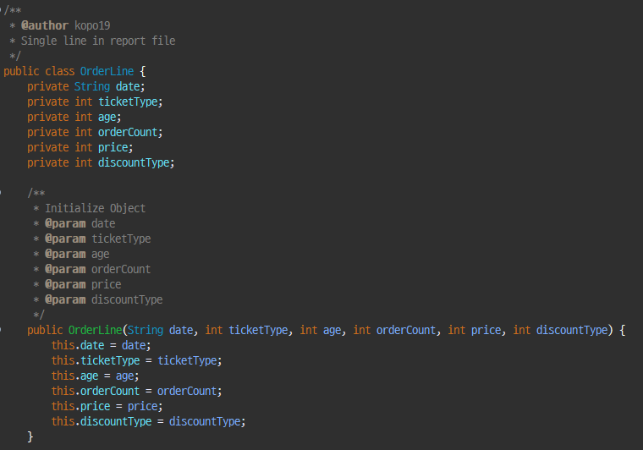
OrderLine Object

Slide 20
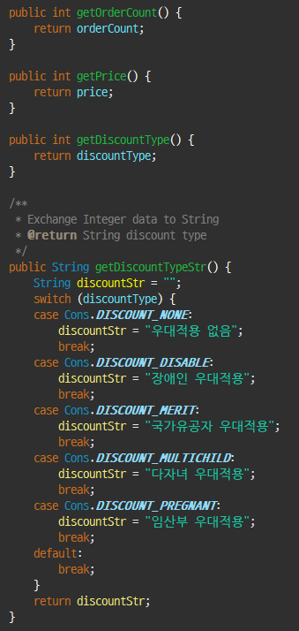
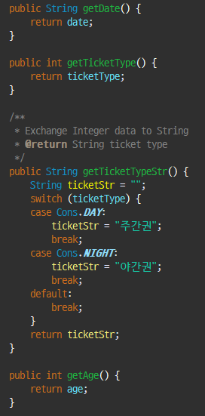
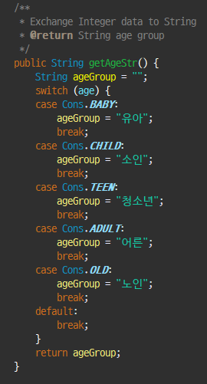
OrderLine Object

Slide 21
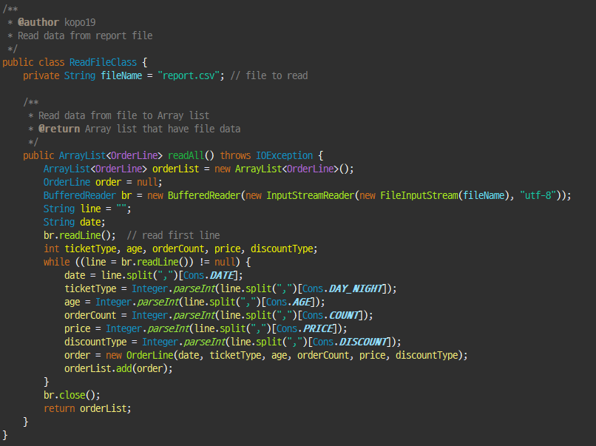
ReadFile Class

Slide 22
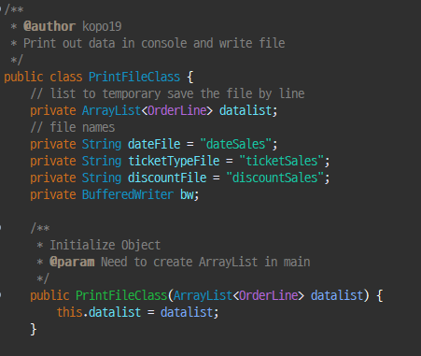
PrintFile Class

Slide 23
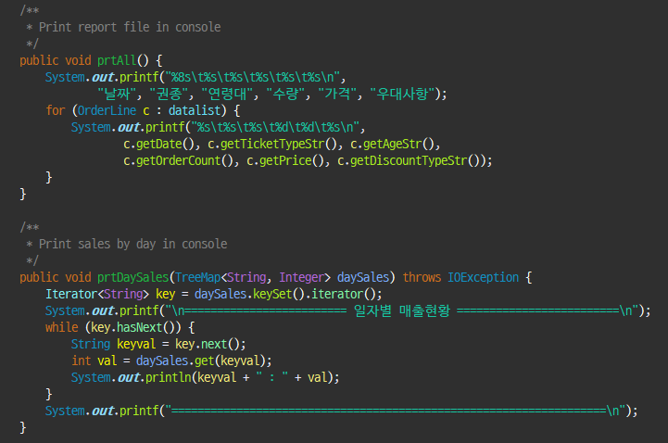
PrintFile Class – method

Slide 24
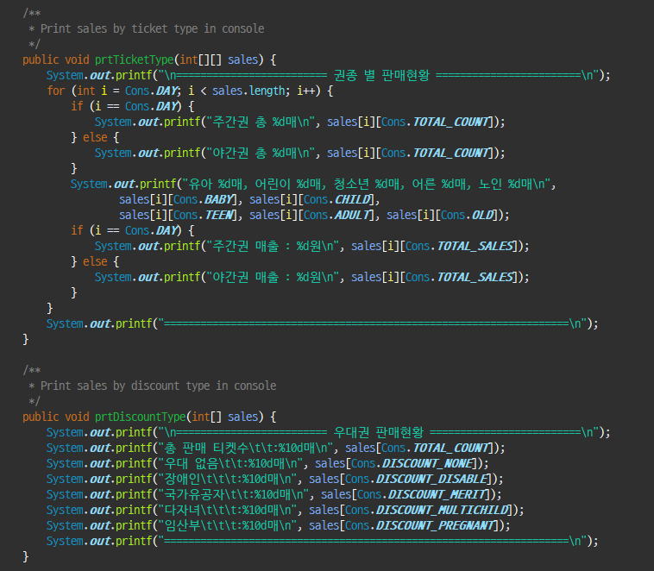
PrintFile Class – method

Slide 25
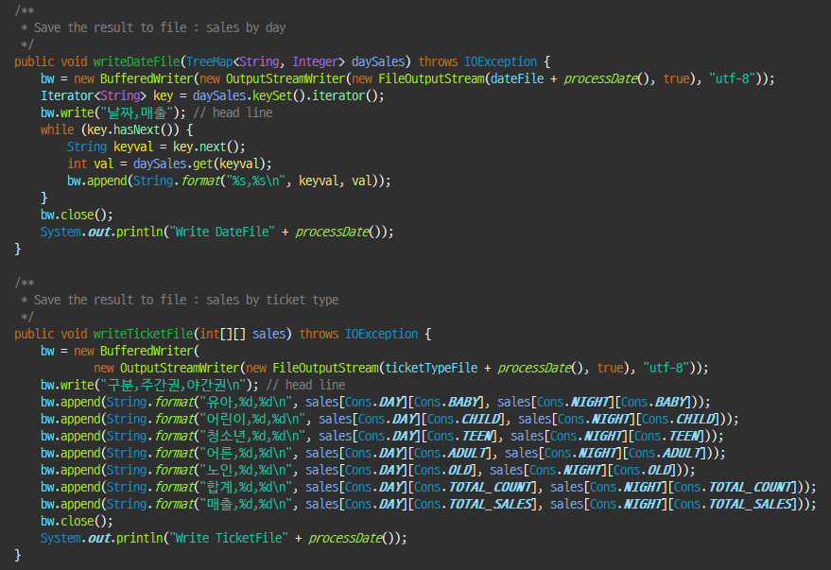
PrintFile Class – method

Slide 26
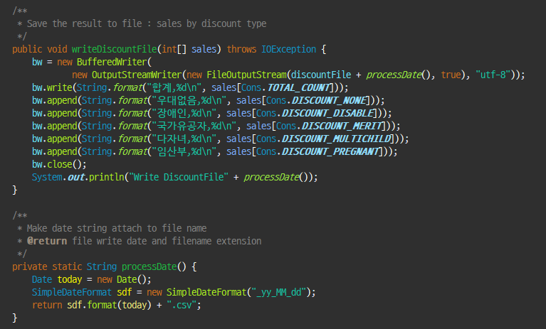
PrintFile Class – method

Slide 27
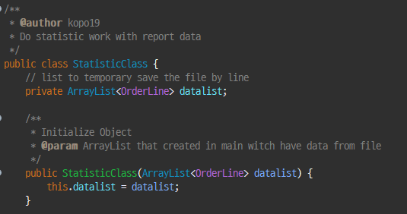
Statistic Class

Slide 28
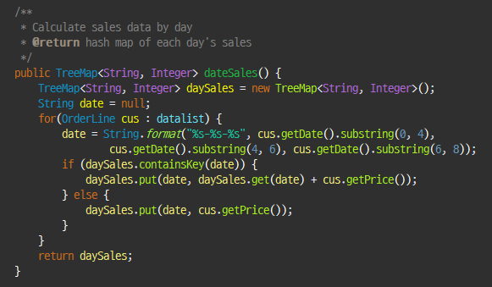
Statistic Class – method

Slide 29
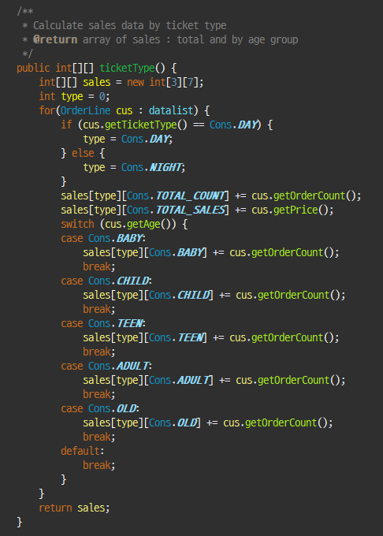
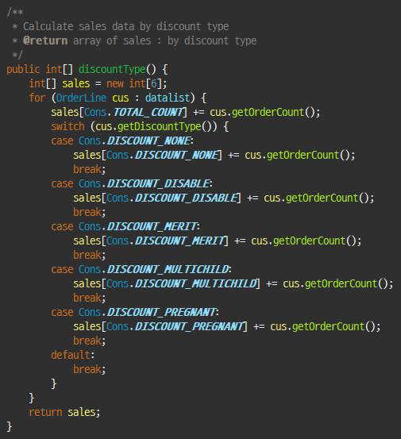
Statistic Class – method

Slide 30
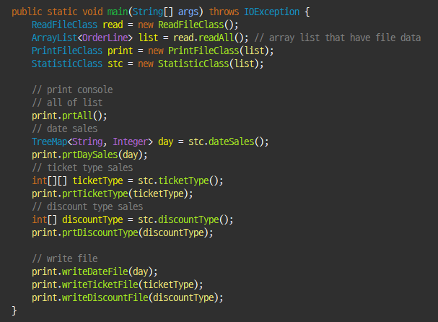
Main

