Slide 1
North Austin Golang Meetup
November 10th, 2016
Guillaume J. Charmes - Agrarian Labs, LLC
Twitter @charme_g
Github: @creack

Slide 2

Go Basics
7th Go birthday!
A quick retrospective.

Slide 3
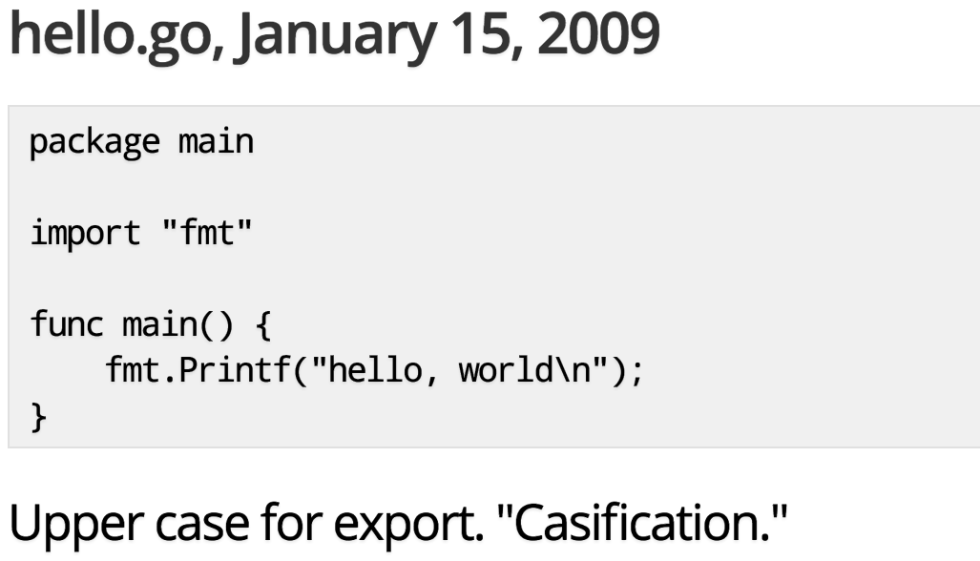
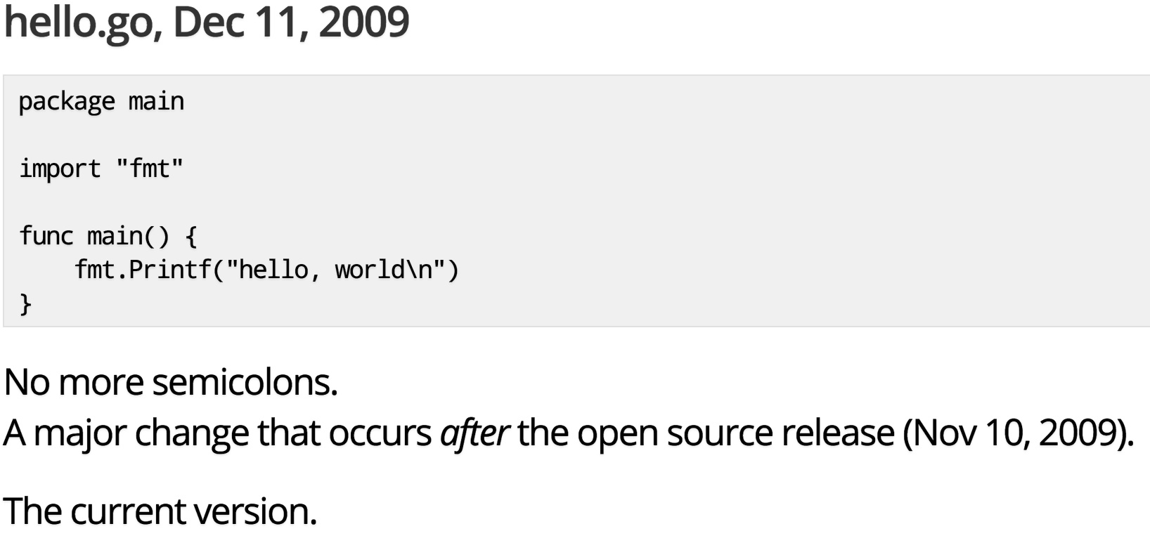
Go Basics - 7th Birthday Edition
Hello World
From Rob Pike’s talk: https://talks.golang.org/2014/hellogophers.slide

Slide 4

Go Basics - 7th Birthday Edition
Why Go?
- Curious, it’s new and backed by Google
- Start a thread with a simple keyword! - Simple syntax / grammar
- System programming / low level - Strongly type / Statically linked

Slide 5
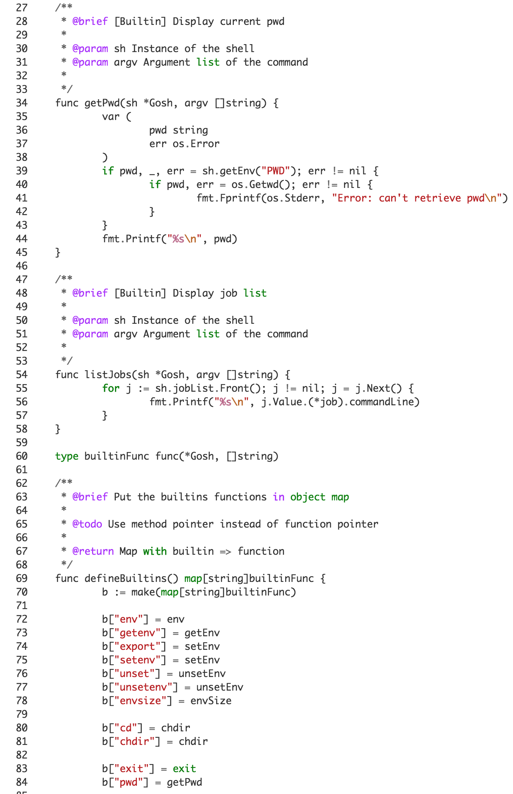

Go Basics - 7th Birthday Edition
Tools
(Before them)
- gofmt (-s!)
- goimports
- golint
- go vet
- go fix

Slide 6
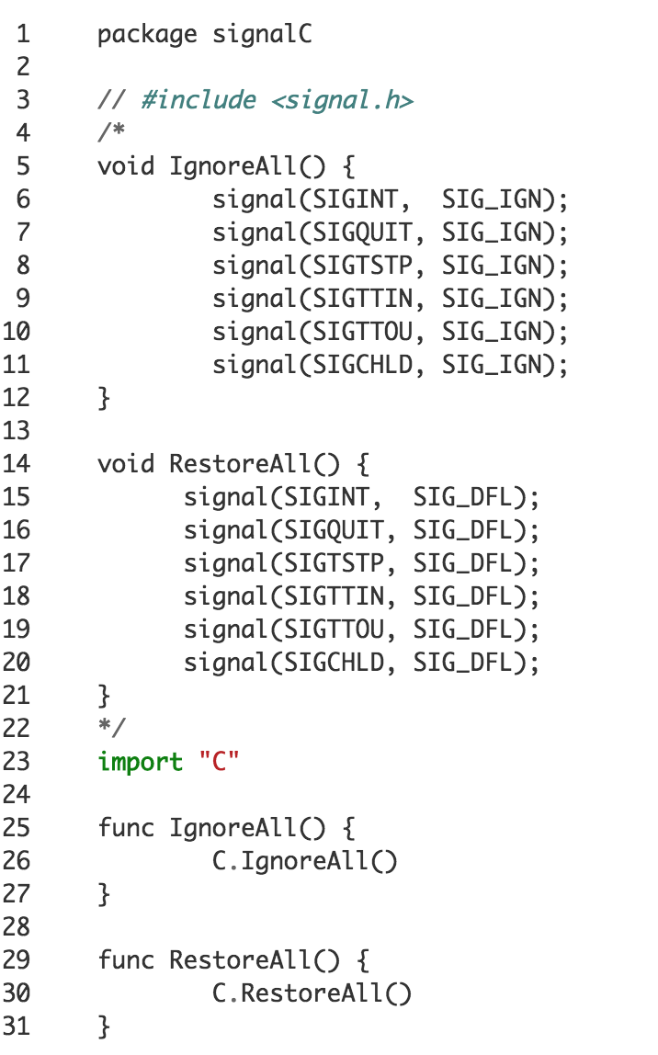
Go Basics - 7th Birthday Edition
Improvements
- Standard Library (Way, signals!)
- Garbage Collection
- Vendor tools
- Community - Plugins
- Much more!

Slide 7

Go Basics - 7th Birthday Edition
Future
- Garbage Collection (again!)
- Faster / Smaller binaries
- Use SSA for every architectures - Much more!
Guillaume J. Charmes - Agrarian Labs, LLC
Twitter @charme_g
Github: @creack

Slide 8
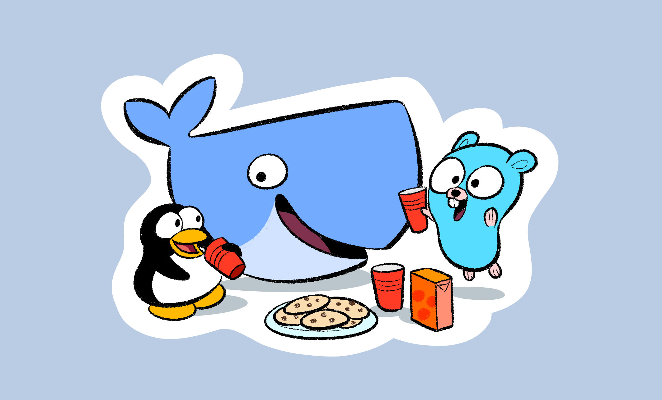
Deployment & Service Discovery
A production show case.

Slide 9

Deployment & Service Discovery
Docker everywhere
Local env same as production and CI
Everything self-contained and reproducible
Easy to deploy

Slide 10
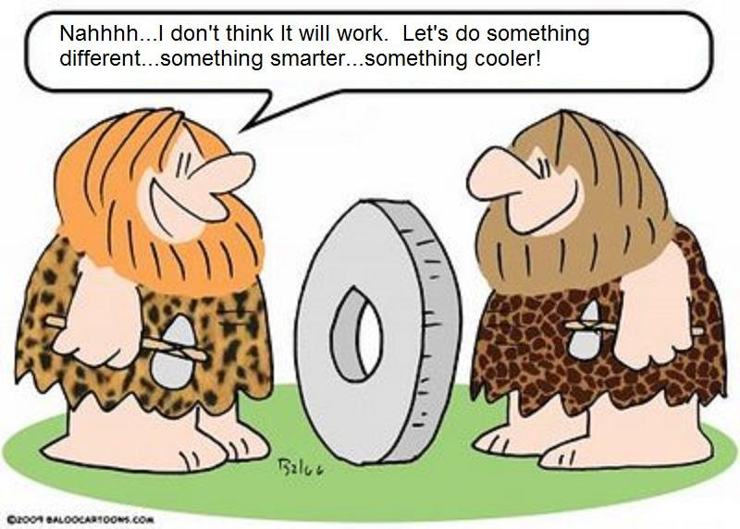
Deployment & Service Discovery
Don’t reinvent the wheel…
- Amazon AWS (but without handcuffs) - Docker Cloud / Docker Hub - Zookeeper - Jenkins / CircleCi / etc.

Slide 11
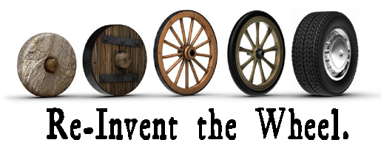
Deployment & Service Discovery
…But maybe a little
- Makefile to the rescue - “Custom” reverse proxy - Custom framework

Slide 12
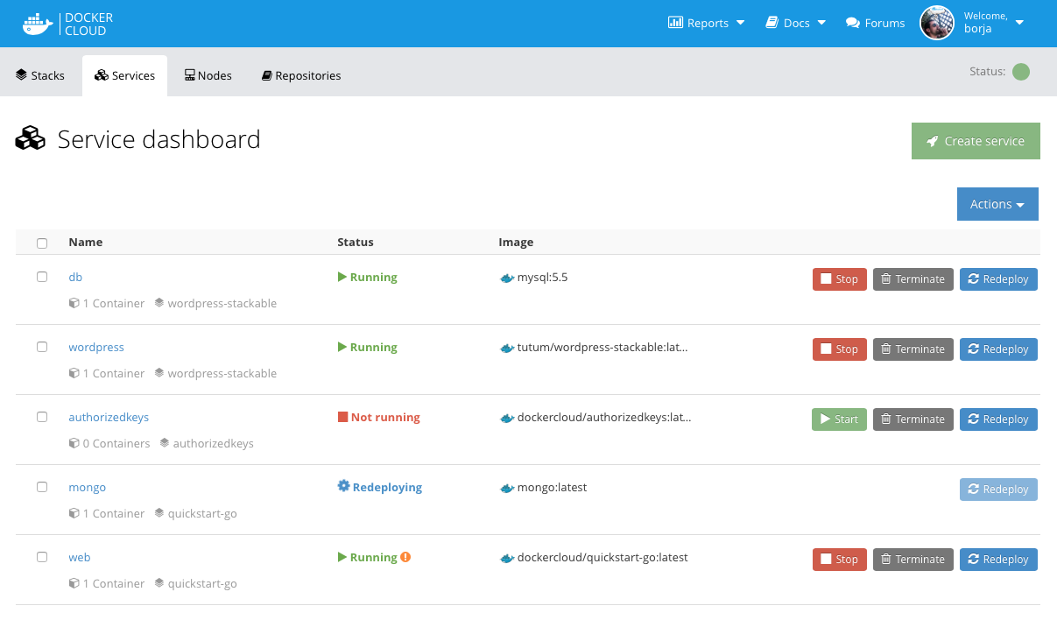
Deployment & Service Discovery
Docker Cloud
Dev op for $15/host/month
Easy support for multiple env
Direct integration with Docker Hub
Auto rolling deploy on push
Not the only solution: Rancher

Slide 13

Deployment & Service Discovery
Zookeeper
Java… But still good
Battle tested for decades
Scale easily
Ephemeral nodes!
Notifications

Slide 14

Deployment & Service Discovery
Customize
Build specific boiler plate
Fits custom needs
Ops in Makefile, logic in code
Reverse Proxy that fits your design

Slide 15
Deployment & Service Discovery
Conclusion
KISS!
Don’t use features for the sake of features.
Don’t be afraid to customize your infrastructure
We will open-source our ZK backed reverse proxy soon!
Guillaume J. Charmes - Agrarian Labs, LLC
Twitter @charme_g
Github: @creack

