Slide 1

A tool to look-up acronyms
Justin Luo
Flintridge Preparatory School
8th Grade
3/25 - 5/29
Advisor: Dr. Yutao He
https://github.com/creampuff3000/AcroSensei

Slide 2
Outline
Motivation (Why did I make this?)
Significance (Why is this important?)
Approach
Design (How it works)
Results / Demo
Conclusion
Future Work
References
Acknowledgements
Q&A

Slide 3


Why I Made AcroSensei
Sending messages have evolved from simply writing to each other through mail, sometimes taking months to arrive to its destination, to a bubble that gets zipped across handheld computers, only taking seconds to arrive.
The quick paced nature of messaging through iPhones had also shortened the amount of letters people needed to type to get their point across. I made AcroSensei to help older people who are new to texting to understand what their younger generations are talking about.

Slide 4
Why Does This Matter?
Every day, more and more people are getting confused on today’s internet slang / lingo. There are also new ones constantly being created every day. With this going on, how would somebody who’s less educated on the internet understand anybody while texting?
Abbreviations and acronyms like BRB, GTG, LOL, TBH, FYI, and many, many more, are all things that people use in regular conversations, and people might have a harder time understanding what they’re trying to say.
This would affect the quality of conversations, as well as cause misunderstandings amongst the people having a chat. AcroSensei was created to prevent this.

Slide 5
Technical Approach
Python based web-crawling technologies
Requests
BeautifulSoup4
RE
List of acronym definitions on the wikipedia page
https://en.wikipedia.org/wiki/Lists_of_acronyms
This works by using beautifulsoup to scrape a wikipedia page of a list of acronyms, finding the acronym based on the input, and then outputting it in alphabetical order.

Slide 6
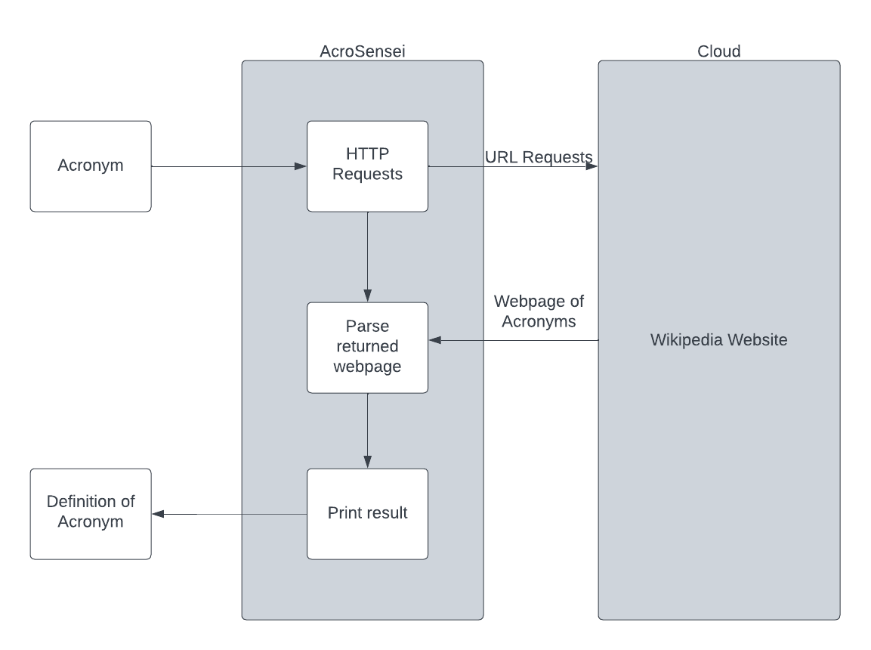
AcroSensei Architectural Block Diagram

Slide 7
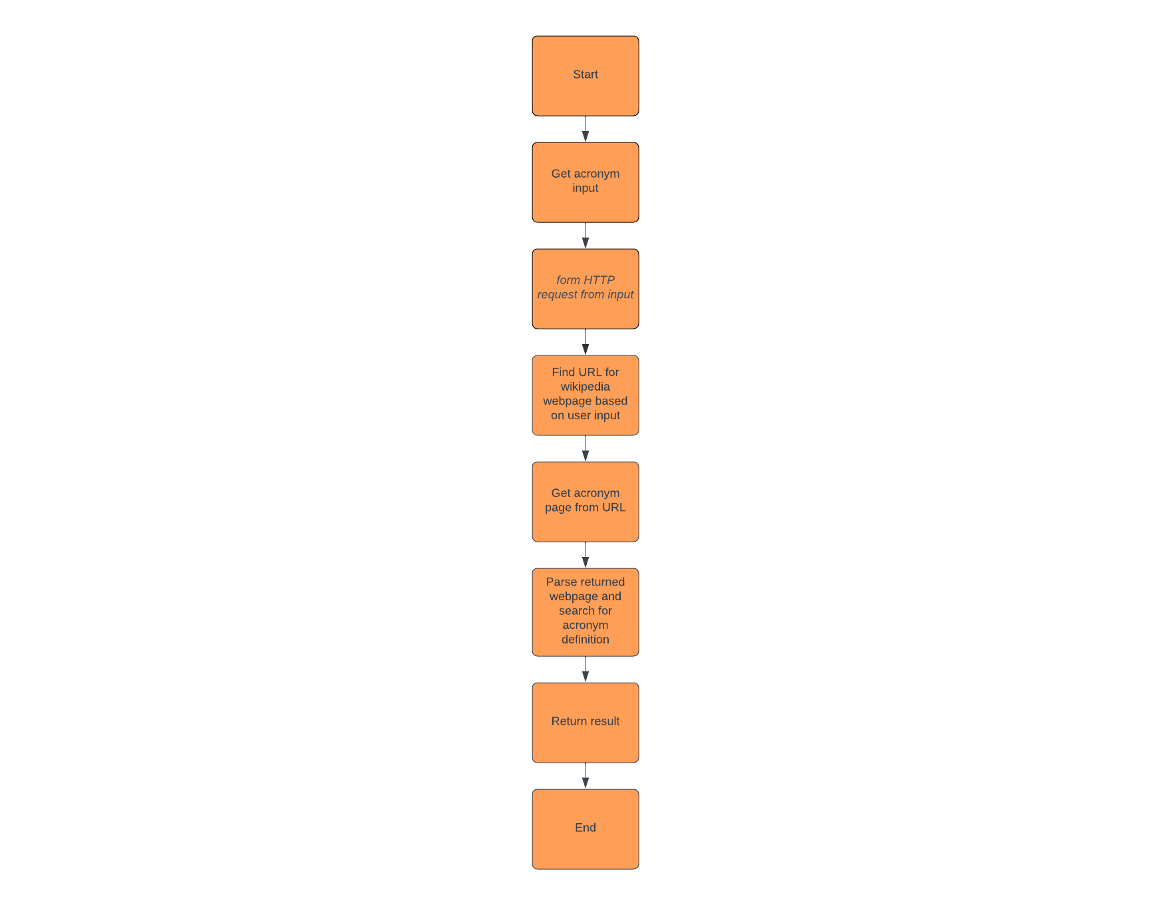
AcroSensei Flow Chart

Slide 8
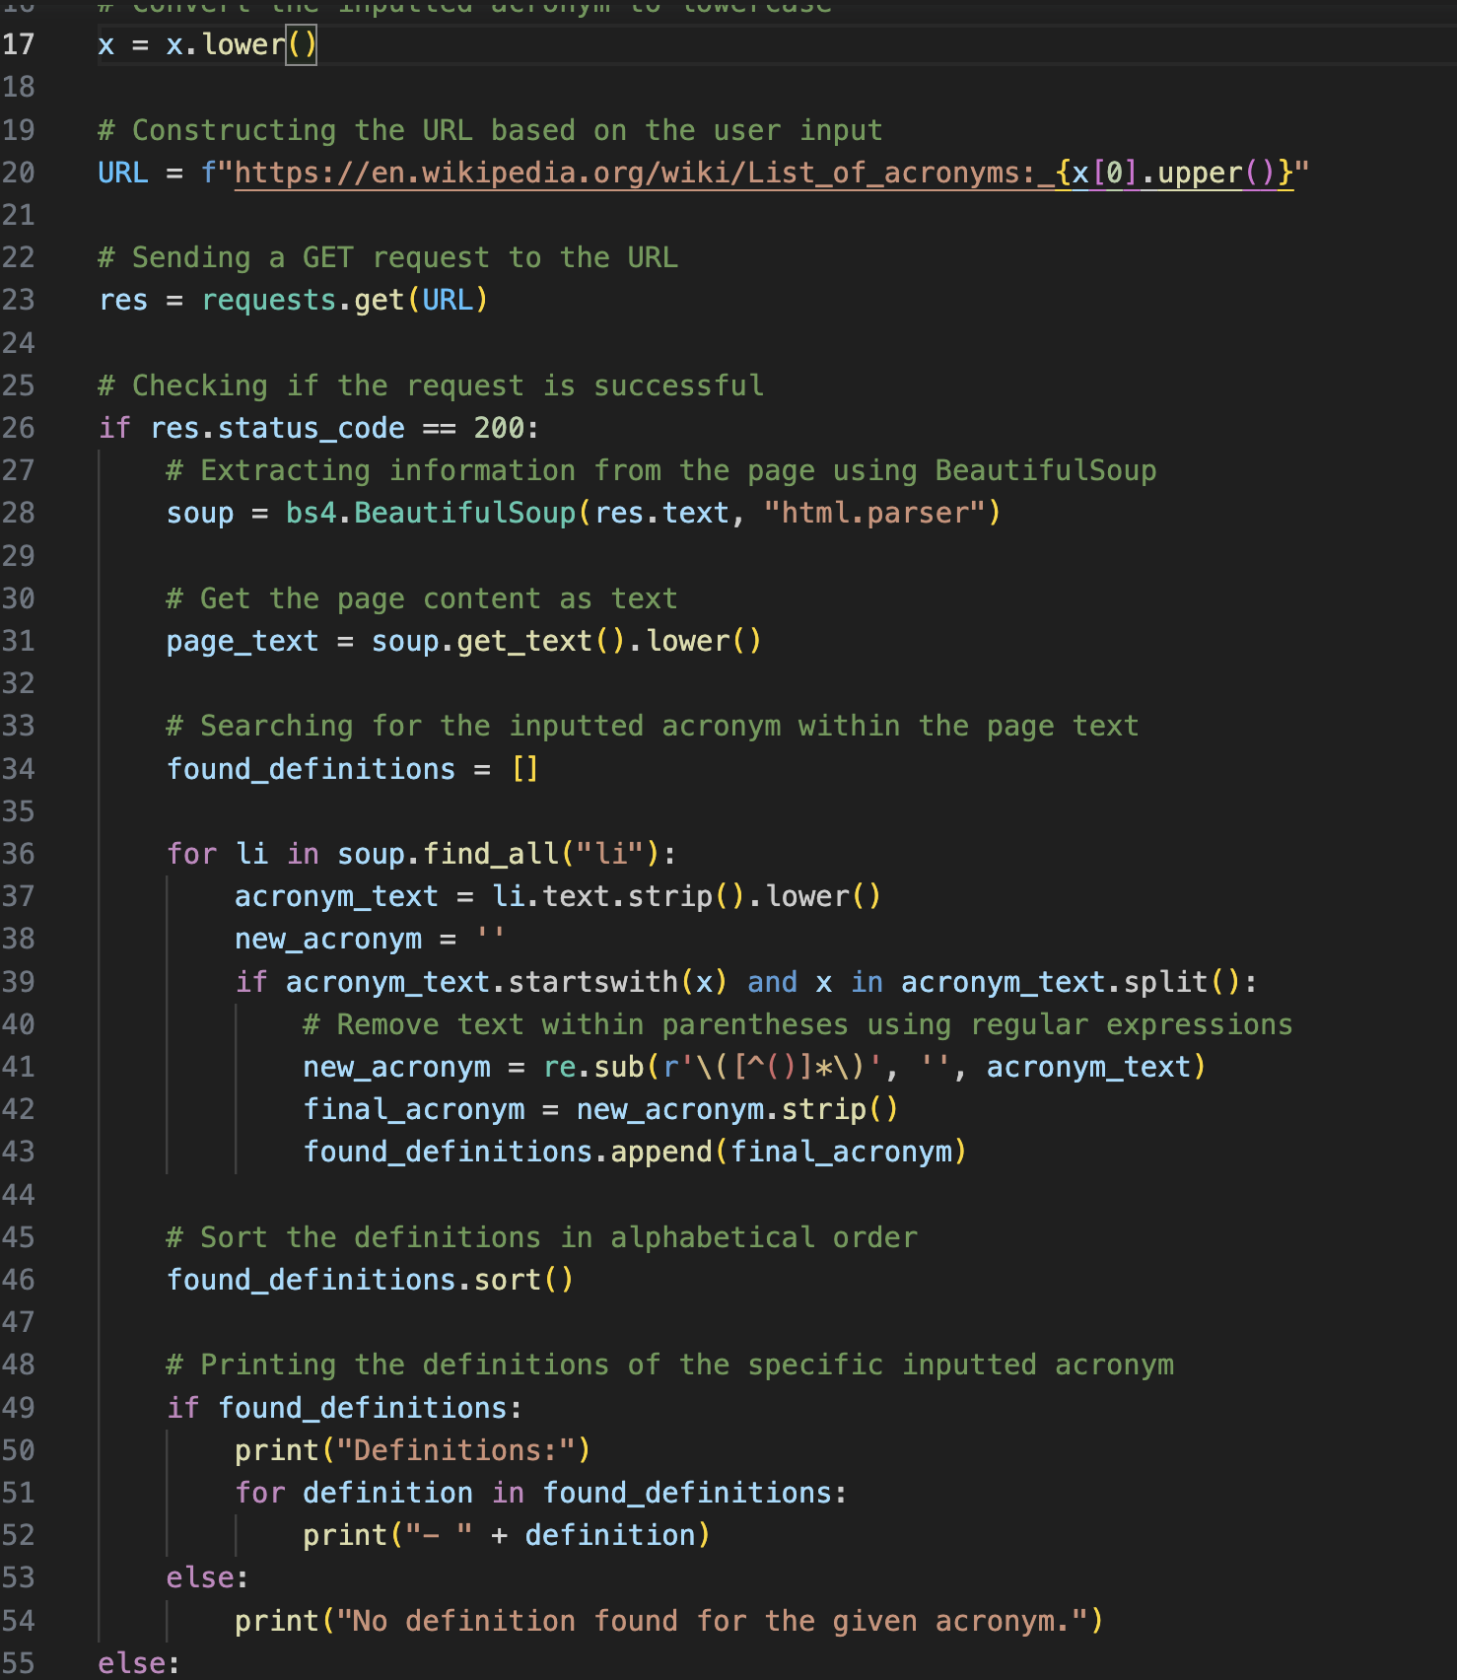
AcroSensei Code Snippet
AcroSensei is a file of code that outputs a list of definitions based on the given input. For example, if somebody wants to find out what YMCA means, they would input YMCA, and the code will output the acronym YMCA, and the definition. Since there’s only one acronym that’s YMCA, it will only output one item. If there are multiple acronyms that begin with the input, then it will output all acronyms with their respective definitions, sorted by alphabetical order.

Slide 9
Demo

Slide 10
Conclusion
Web scraping technologies are very important tools and are used everywhere on the internet
BeautifulSoup and Requests are easy to use, beginner friendly web crawling tools

Slide 11
What I’ve Learned
How to upload to GitHub from local files
How to web-crawl with beautifulsoup and requests
How to research effectively
How to debug code
How to design software with flow-chart and block diagrams
How to use google’s inspect element tool to find HTML information
How to use chatGPT effectively

Slide 12
Future Work
Sorting by popularity instead of alphabetical
Better formatting & spacing of the result
Multiple sources, not just wikipedia
Design a website based on the desktop app

Slide 13
References
https://www.studytonight.com/python-projects/web-crawler-application-python-project
https://beautiful-soup-4.readthedocs.io/en/latest/index.html?highlight=find_all#find-all
http://acronyms.silmaril.ie/#qform
https://www.w3schools.com/
https://en.wikipedia.org/wiki/Lists_of_acronyms

Slide 14
Acknowledgements
Thank you to:
Parents, grandparents, sister, dog, cats, fish
Dr. He

Slide 15

Questions & Answers

