Slide 1

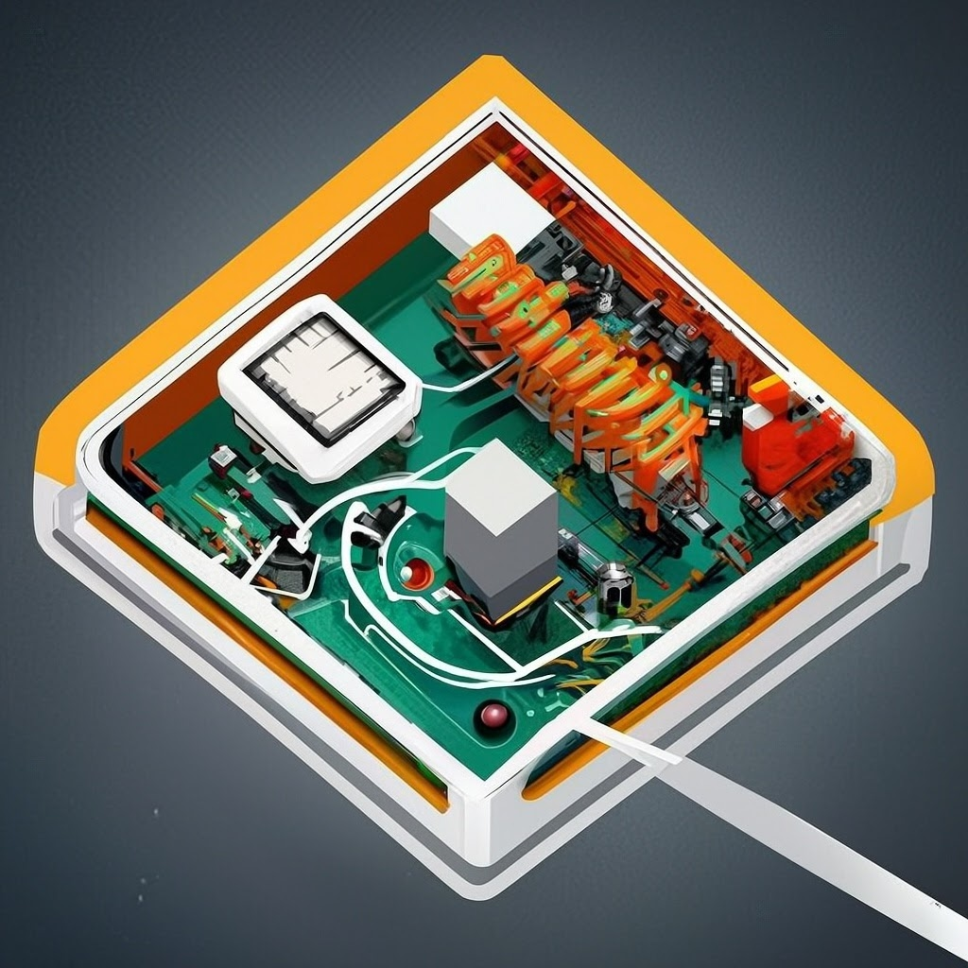
The Basics of an Arduino
By Justin Luo

Slide 2

What is Arduino?
Arduino is an open source electronics program based on easy to use hardware and software. These boards are able to read inputs and turn it into an output, in simplest terms. You can use the microcontroller on the board to perform many tasks, like simply turning on an LED, or activating a motor. You can also do more complicated things with it as well, like making a home automation system that controls air conditioning.

Slide 3
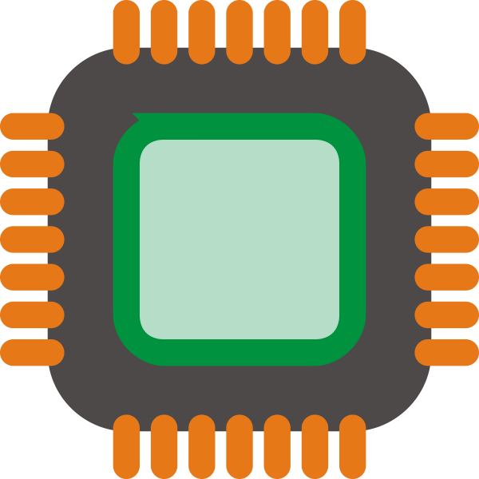
The Hardware
ATmega2560 chip
256 KB of ISP programmable flash memory, which is a type of nonvolatile memory that lets the buyer reprogram the internals of the chip to their liking.
It also has 8 KB of normal SRAM
4KB of EEPROM (electrically erasable programmable read only memory, which is little bytes of memory that can be erased and reprogrammed).
86 I/O lines, which are input output lines that allow the CPU to take inputs and return outputs at a high rate.
It operates at around 5 volts.

Slide 4
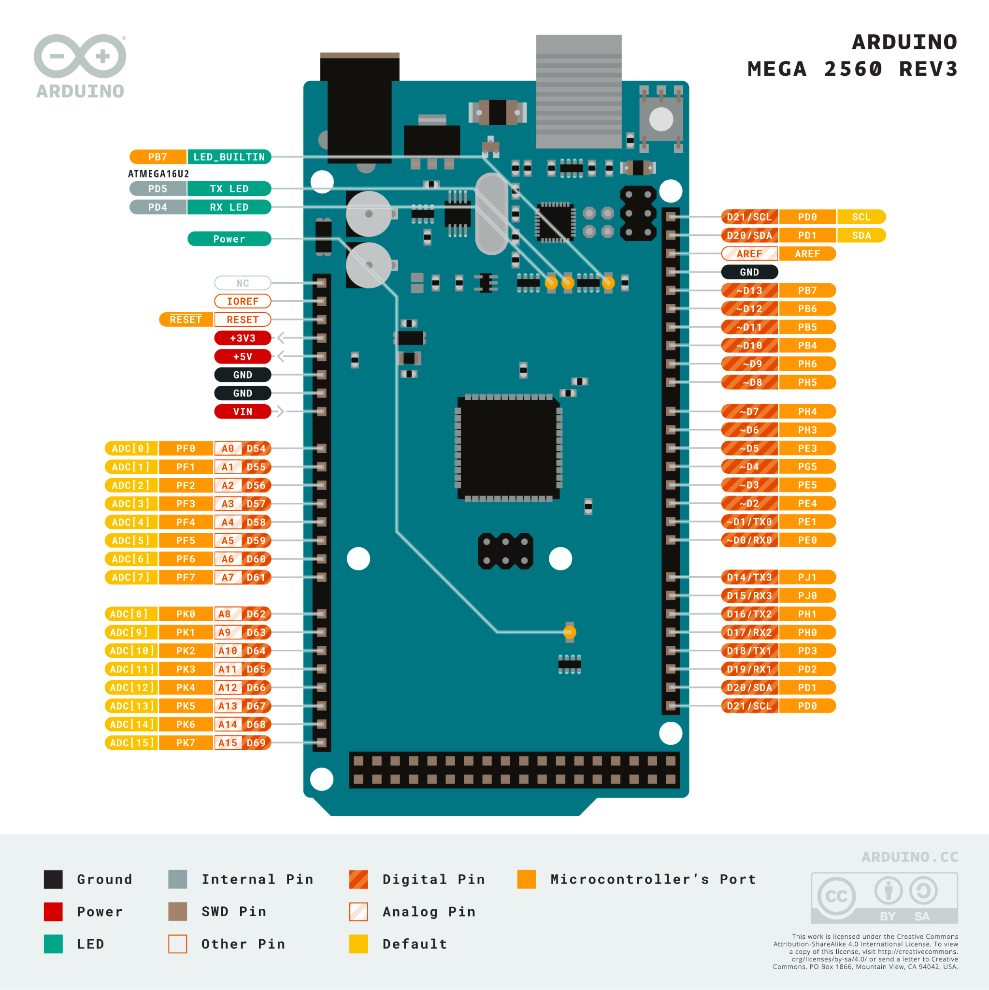
What does everything do?
Digital pins read data from sensors and write to actuators
Analog pins detect the voltage on a single input
LED slots are where you plug in an external LED
Ground pins are to stop extra power from coming out, without ground, LEDs will burn up and there will be power overflowing.
SWD pins are little passages into the board’s memory, where you can plug things into to program it.

Slide 5
Price
The Arduino Mega 2560 kit’s retail price is $48.40 and most listings come with a power cable to power it, or, you can use a usb connection as well.

Slide 6
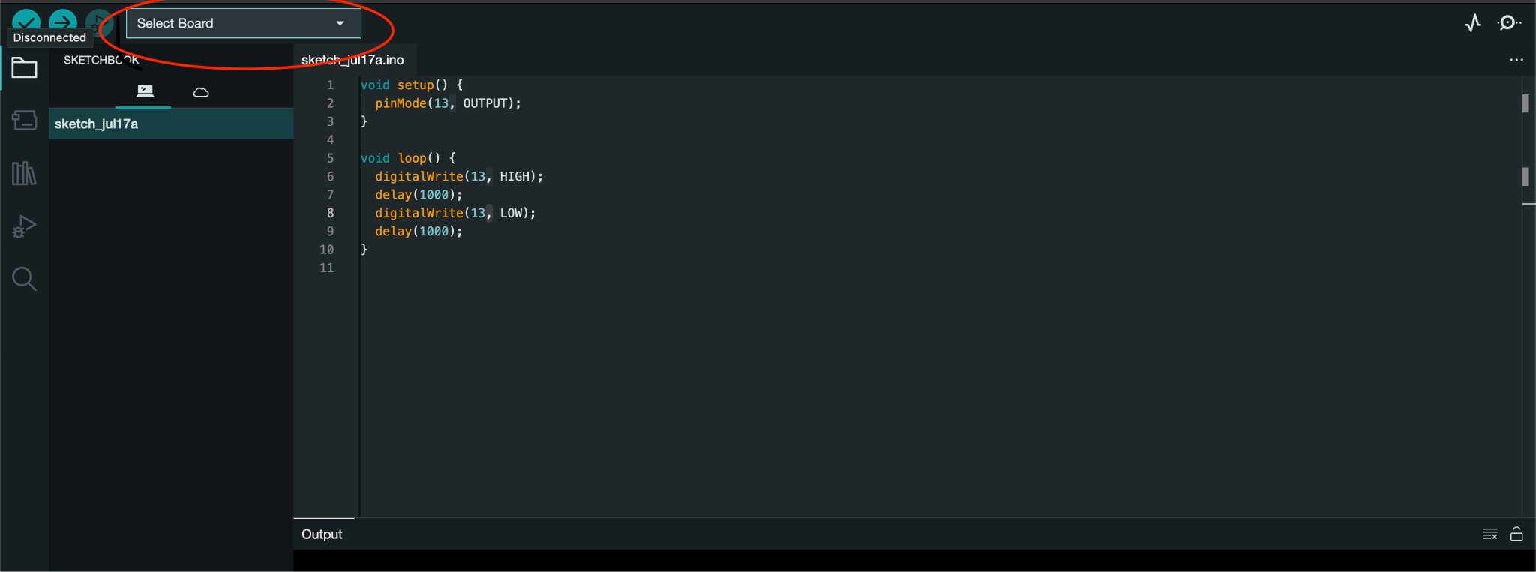
How to use?
To program an arduino board, you have to download arduino IDE, a free application. Then, you want to connect the board to the device with arduino IDE via USB. Once you boot up the app with the board plugged in, you should see “select board” in the top right. After you select your board, you can start programming. Remember to always upload and save your code.

Slide 7
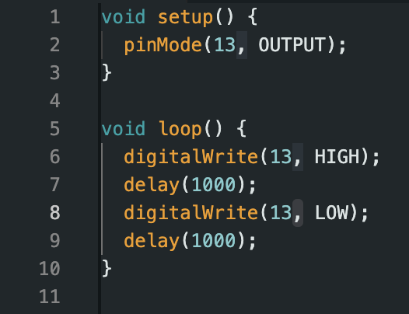
Sample code
To make the built-in LED blink, all you have to do is set the value of it to high, pause, and set it to low again, and pause again. The slot for the built in LED will always be 13.

Slide 8
Conclusion
In conclusion, The arduino is an extremely versatile high performance mini-computer with many customizable options, that has a million different possibilities, and no limits.

Slide 9
Thank you!

