Slide 1
Ultrasonic Sensor Basics
Justin Luo

Slide 2
How an Ultrasonic sensor works
An ultrasonic sensor works by having the arduino board send a signal to the sensor. Then, the sensor shoots out a sound wave directly in front of it, and calculates how far something is away from it by measuring the amount of time it takes for the soundwave to bounce back.
Equation that it uses:
Distance (in meters) = (Time taken by sound to travel round trip * Speed of sound in air) / 2

Slide 3
How do I use it to measure distance?
To use the ultrasonic sensor to measure distance, you have to connect it to the arduino and have the arduino connected to the computer. Then, code it so that it can actually send a high frequency sound wave, and calculate how far it went based on the time it took to come back. The output of the sensor will be in the “serial monitor” tab in arduino IDE.

Slide 4
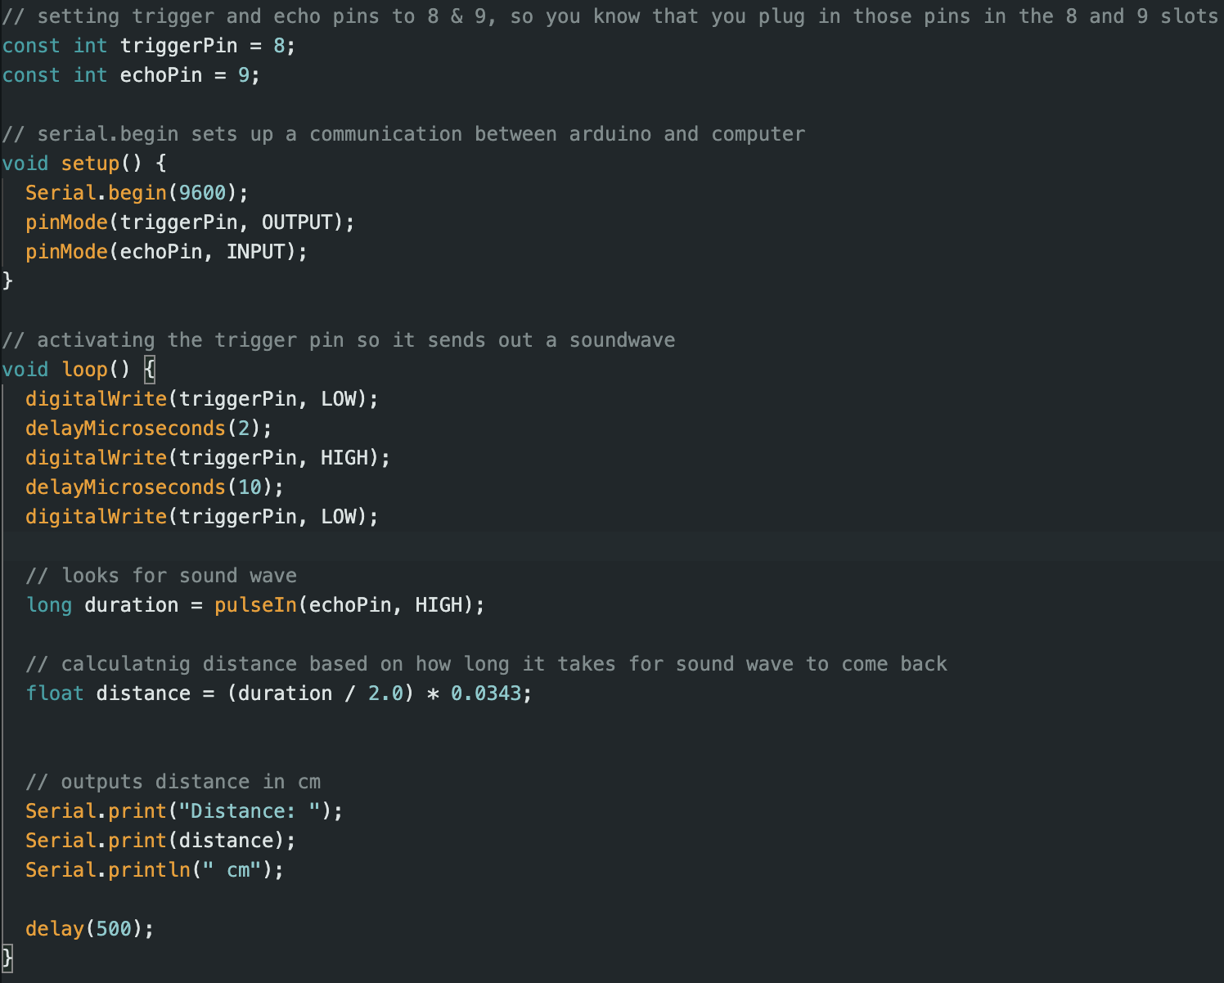
The code

Slide 5
How do I use it for obstacle avoidance?
To use it for obstacle avoidance, you would have to implement a code that checks the output of the ultrasonic sensor every time it outputs something, and when the output is below 20 cm (or however low you want it), you make the motors turn the wheels on the car.

Slide 6
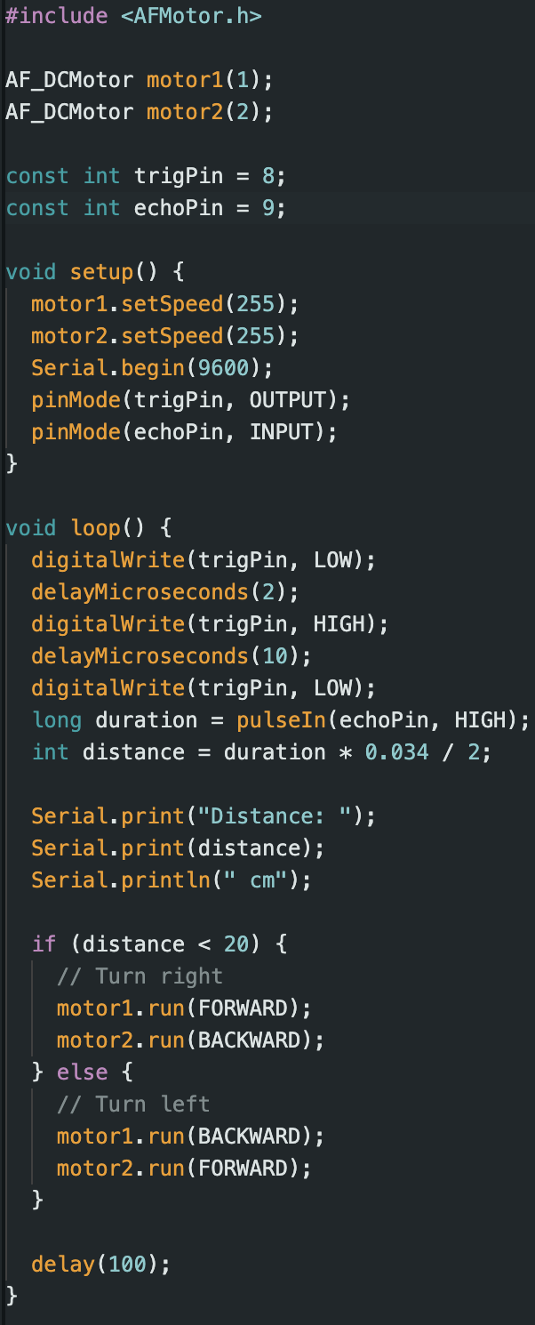
Code example with DC motors

Slide 7

Demo

Slide 8
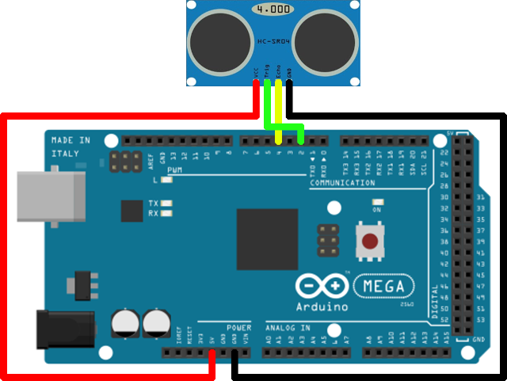
Wiring diagram

