Slide 1
Arduino LEDs
By Justin

Slide 2
Built in LED
The built in LED in the arduino mega has only one color, and can flash depending on the code you upload. This works because the LED is connected to pin 13 on the arduino’s microcontroller, and the microcontroller illuminates the LED.

Slide 3
Wiring Diagram
There is no wiring diagram, since the LED is internal, you only have to connect the cable to your computer.

Slide 4

Code

Slide 5

Demo

Slide 6
External LED
The external LED can come in multiple different colors, but they all work the same way. Electricity goes up the pin, into the microchip, which illuminates the LED. It can be connected to the arduino with a breadboard and jumper wires.

Slide 7
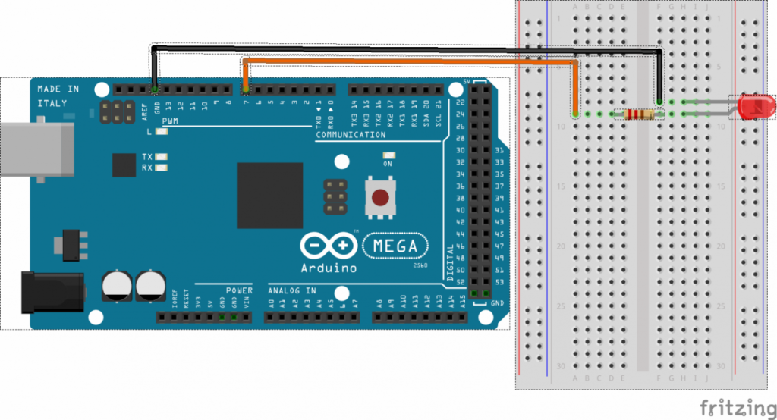

Slide 8
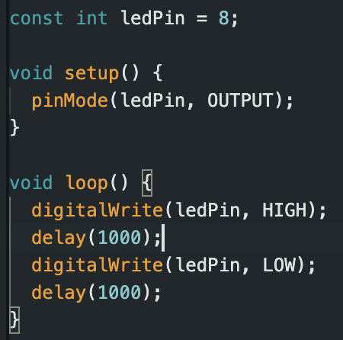
Code

Slide 9
Demo

