Slide 1

Outland adventures case study
Group 4:
Christopher Reaney
Noel Miranda
Kevin Ramirez
Korbyn Mock

Slide 2

Case Study Summary
Blythe Timmerson and Jim Ford, two outdoor enthusiasts, founded Outland Adventures. The business was originally intended to be a ‘side job’ to go along with their primary careers.
They have a few employees to act as guides, another for marketing, one for supplies, and another that developed an online shop.
The owners are working to find a means to organize their inventory so that they can ensure sales are maintained.
Some items may have been hanging around the shop for a while, and there is likely some room to ensure that trip bookings don’t start to dwindle.

Slide 3
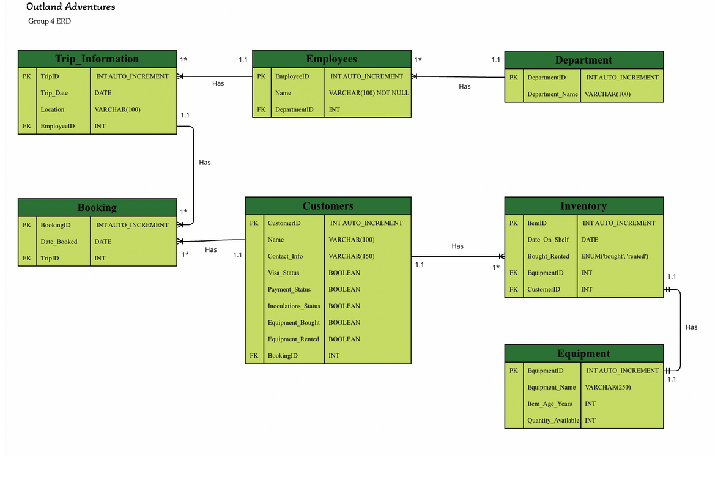
ERD

Slide 4
Report one
Business Challenge:
Do enough customers buy equipment to keep sales steady?
Objective:
The objective of this script is to analyze the MySQL database and determine whether it is more profitable for the business to continue selling equipment or focus on renting. The comparison will be made by examining customer decisions to either buy or rent equipment, which can be identified through their booking information.
Description:
The report is generated by querying the MySQL database (Outland_Adventures) using a stored procedure. This procedure retrieves the total number of distinct customers, the total number of equipment purchases (including customers who made multiple purchases across different bookings), and the total number of equipment rentals (including customers who rented equipment multiple times). These figures are derived from the customers table and linked to the BookingID from the Booking table. The booking table also provides the year of each booking, allowing the information to be grouped by year as specified by the user.

Slide 5

Business Value
Business Value:
The data retrieved from report one consists of integers that can be used to create comparison graphs, providing a more visually engaging analysis of equipment sales versus rentals. Since Outland Adventures is a relatively new business, the database currently holds bookings only for the year 2024, limiting the analysis to that year. However, this data is sufficient to determine whether enough customers are purchasing equipment to maintain steady sales for 2024. At present, if a year beyond 2024 is entered, the results for each category will be zero, as no bookings have been made for those years yet. Once future bookings are added to the database, the script within the stored procedure will efficiently retrieve and analyze data for those years, and even allowing for comparisons across different years. Overall, this brings value to the business by enabling more efficient management of sales strategies based on customer demand.

Slide 6
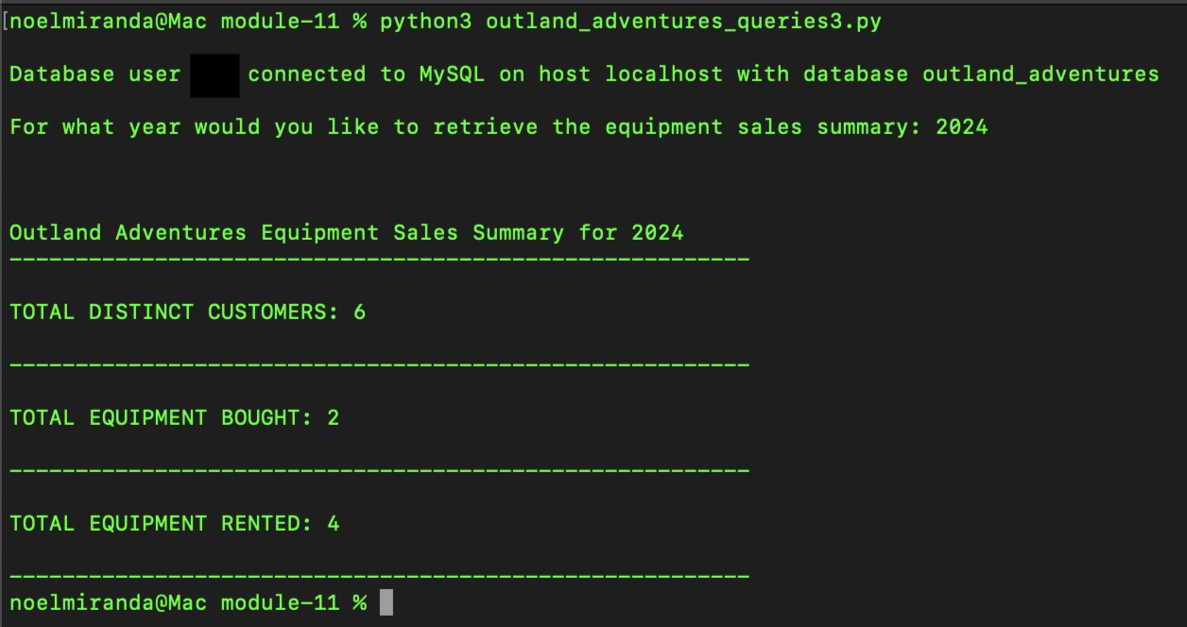
Script output

Slide 7
Report one Data Chart
After running the script with Outland Adventures' database, we can see that around 33% of the total customers that booked for the year 2024 bought equipment.
On the other hand, we can see that 66% of the customers that booked rented out equipment.
Based on this information, the owners can decide their threshold on when to pull the plug on continuing to sell their equipment because the customers are not buying enough to keep sales steady. I would say anything less than 50% is not good for the business, therefore I would probably put a high emphasis on just renting equipment since it is making the most profit, or I can decide to enhance my advertising for selling my equipment to improve such numbers. The owners have many possibilities of deciding what to do with this information.

Slide 8
Report one Assumptions
The owners want a report to analyze yearly equipment sales made by their customers.
The owners also want to analyze the equipment rented by their customers yearly.
The owners want a stored procedure with their database to make this type of report.
The owners would like to input the year for their analysis of the equipment bought.
The owners want the report to display zero sales if there are zero sales for that year.
The database would be private.
The owners do not want a validation to the input feature since this will be a private database.
The owners want to keep track of distinct customers instead of tracking the same customers multiple times.
The owners want to keep track of the equipment sold or rented even if it is by the same customer at a later time (a different booking).

Slide 9
Report Two
Business Challenge:
Is there a specific location (like treks in Africa, Asia, or Southern Europe) where bookings are trending down?
Objective:
The objective of this report is to help Outland Adventures identify trending destination locations in their data; it will also help identify which destinations are waning in popularity. These destinations include continents such as Africa, Asia, and Southern Europe.
Description:
The Python script retrieves booking data from Outland Adventures' MySQL database using a stored procedure, focusing on categorizing bookings by continent. It prompts the user to input a specific year, allowing for an analysis of booking trends within that period. This script offers insights into destinations that are gaining or losing popularity in various regions for the selected year. As more data is collected over time, Outland Adventures can leverage this information to refine its offerings and further its mission.

Slide 10

Having an overview of this data year after year enables the business to make informed predictions about profitable and scalable destinations that their customers frequently visit. The user has the ability to select a specific year for analysis, comparing different regions based on customer demand, measured by the number of bookings per location. As Outland Adventures continues to populate the database with more booking data over the years, they will be able to analyze trends across different years, identifying which locations should be removed from their offerings and which are gaining popularity. These insights can be used to strengthen areas experiencing significant growth, providing valuable information for the long-term success of the company.
Business Value

Slide 11
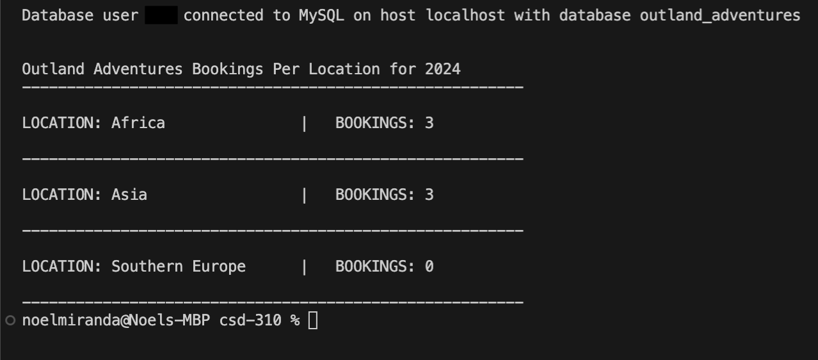
Script output

Slide 12
Report two Data Chart
After running the script with Outland Adventures’ database, this graph was generated based on data from the 2024 calendar year. The y-axis represents the number of bookings made by customers at various Outland Adventures locations.
The graph clearly shows that Southern Europe has experienced low demand. As a result, the owners may consider removing it from their offerings or increasing marketing efforts to boost its popularity.
As more bookings are made and data from multiple years become available, this script will be a valuable tool for analyzing booking trends across different locations.

Slide 13
Report two Assumptions
The owners want a report to analyze yearly trends.
The owners want a report to analyze the bookings per continent locations.
The owners want a stored procedure with their database to make the reports.
The owners would like to input the year of analyzing bookings, therefore the stored procedure allows an input of the year.
The owners want the report to display zero bookings if there are zero bookings.
The database would be private.
The owners do not want a validation to the input feature since this will be a private database.

Slide 14
Report Three
Business Challenge:
Are there any items in the inventory that have been stored for over five years?
Objective:
The objective of this script is to analyze the MySQL database and identify the equipment and inventory Outland Adventure has had on the shelf for more than 5 years. The current script will retrieve the information from item with their matching identifiers and print the results. This script ensures that equipment and inventory within the business is up to industry standards, and it will ensure the safety of the customers that buy or rent items from Outland Adventure.
Description
The report is generated by querying the MySQL Database (Outland_Adventures) for the inventory based on the data table “Inventory”. This information will be relative to the current date and for the sake of comparison some data may be subject to change to output proper results. Each item in the table is analyzed for its age and will display the following information:
Item ID: The identification number to be able to distinguish the exact number of each item
Date_On_Shelf: The date the item was placed in inventory
Equipment_Name: The name of the type of item stored
Age: The current age of the item printed in years and days

Slide 15

Business Value
Business Value:
The information provided by running the Python script detailed on the next page will help managers and employees make informed decisions on inventory lifecycles. Over time, equipment wear and tear will cause problems and replacing them will reduce costs; it comes down to an efficiency vs. maintenance trade-off. Oftentimes, improper tracking of maintenance or equipment replacement will cause downtime for a business, causing underperformance in revenue. This script aims to combat this issue by supplying data on equipment subject to replacement. It will also aim to keep inventory turnover at a healthy pace.

Slide 16
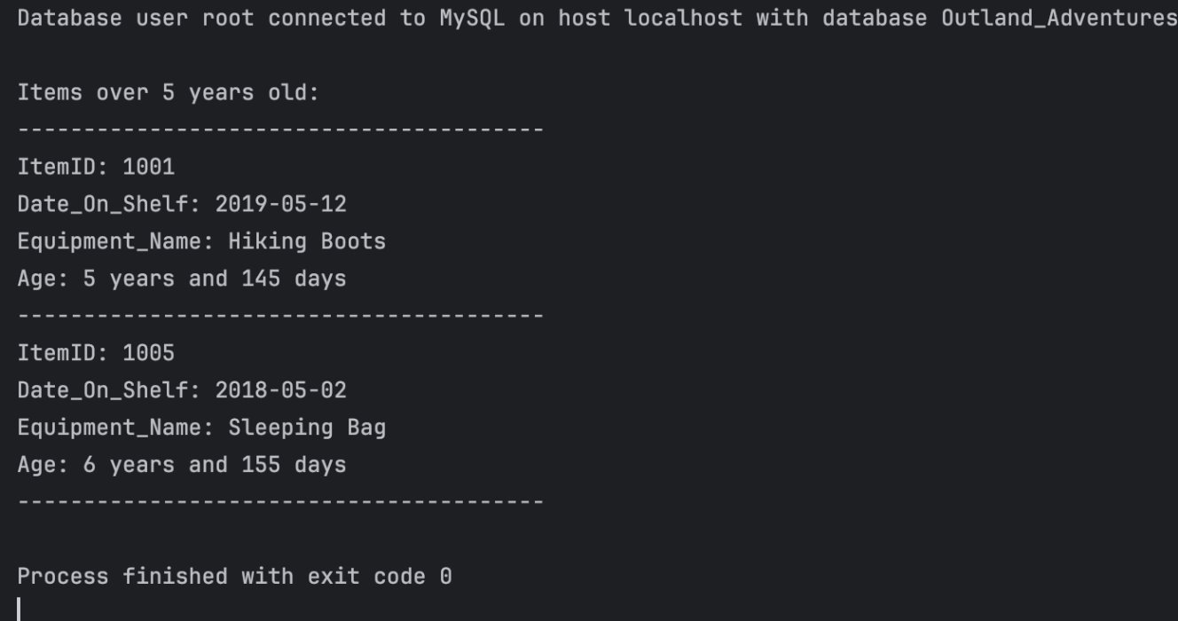
Script output

Slide 17
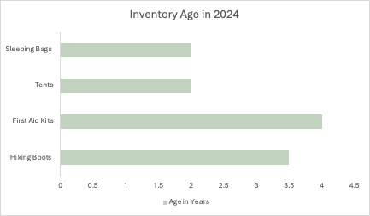
Report three Data Chart
After running the script with the Outland Adventures' database, we can see the average age of items displayed in the graph.
Based on this information, the owners can have an insight of any upcoming inventory changes. The visualization can also help the shareholders prepare their budgets to supplement the replacement of equipment.

Slide 18
Report 3 Assumptions
The owners want to analyze the items stored over 5 years because they may no longer meet industry standards
The owners struggle with balancing costs of maintaining older inventory versus replacing it
The Business aims to prioritize safety and a positive customer experience
The owners believe inventory turnover is a key metric for the growth of the business
The data is stored in a privatized database

Slide 19

The Adventure Awaits!

