Slide 1
Security Controls in Shared Source Code Repositories
Name: Christopher Reaney
Date: 07/11/2025
Assignment: Module 11.2

Slide 2

Why Security in Repos Matters
Repositories hold sensitive data and intellectual property
“Code repositories are increasingly targeted by cybercriminals aiming to exploit vulnerabilities or inject malicious code” (Harness, 2025)
Breaches can lead to data theft, compromised apps, and reputational damage

Slide 3
Access Control & Authentication
Use Role-Based Access Control (RBAC) to restrict access
“RBAC restricts repository access based on user roles, ensuring only authorized personnel can modify or view sensitive code” (Harness, 2025)
Require Multi-Factor Authentication (MFA) for all users

Slide 4
Vulnerability Scanning & Code Signing
Run SAST tools like SonarQube to catch bugs early
Use SCA tools to monitor open-source dependencies
“Enforce code signing for commits to ensure code integrity and authenticity” (Snyk, n.d.)

Slide 5
Secrets Management
Avoid hardcoding secrets like API keys or passwords
“Secrets or sensitive information can be inadvertently committed to repositories and made accessible to anyone with read access” (SecurityPatterns.io, n.d.)
Use tools like HashiCorp Vault or GitHub’s secret scanning

Slide 6


Monitoring & Alerts
Set up alerts for unusual repo activity
“Automated alerts for unexpected changes in critical files help detect unauthorized access attempts” (Harness, 2025)
Use centralized logging and tools like Dependabot

Slide 7
Developer Education & Policy
Create a clear Security.md policy with reporting instructions, supported versions, and response expectations
Train devs on secure coding and repo hygiene
“Educate developers and team members about security best practices and the importance of code protection” (Snyk, n.d.)

Slide 8
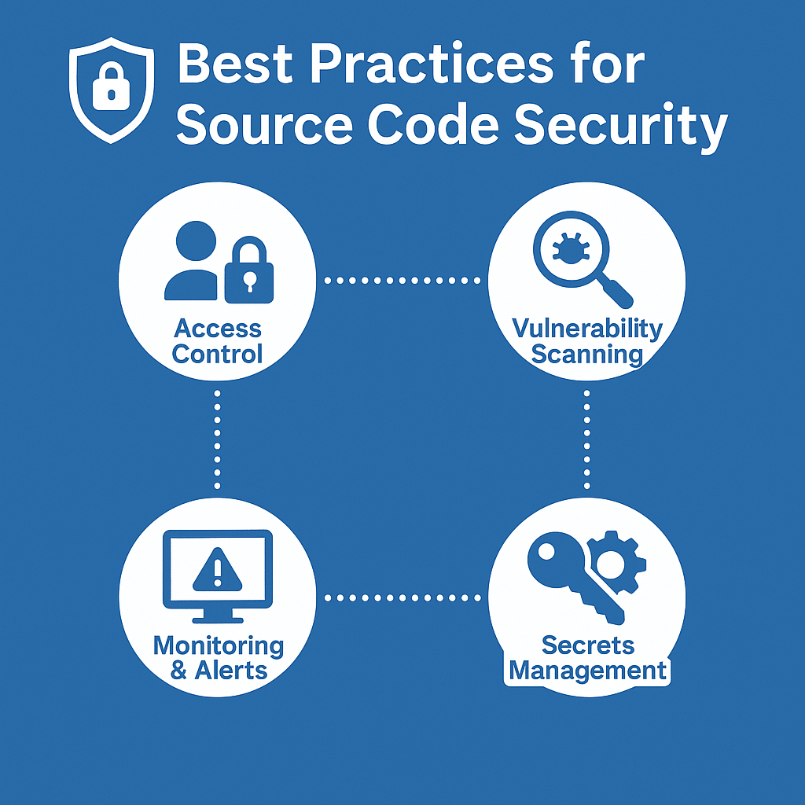

Slide 9
Final Thoughts
Security is a shared responsibility
Repos are collaborative spaces, but they need boundaries
“Securing your code repositories is essential to protecting intellectual property, preventing data breaches, and ensuring the integrity of your software supply chain” (Harness, 2025)

Slide 10
Works Cited
Harness. (2025). Best Practices for Securing Code Repositories. Harness DevOps Academy
Snyk. (n.d.). Securing Source Code in Repositories is Essential: How To Get Started. Snyk Security Guide
SecurityPatterns.io.. (n.d.). How to Write A Security Pattern: Source Code Management. Security Patterns

