Slide 1

Barriers to Implementing a Just, Learning Culture
Name: Christopher Reaney
Date: 07/04/2025
Assignment: Module 9.2

Slide 2


What is a Just, Learning Culture?
A just culture is a learning-focused environment where people are encouraged to report incidents without fear of punishment.
Encourages transparency and improvement
Balances accountability with safety
“A just culture is one where we don't punish people for making mistakes. Instead, we learn from them.” (Allspaw, 2012)

Slide 3
Barrier #1: Fear of Punishment
Fear of blame discourages honesty.
People hide or underreport errors.
Fear blocks organizational learning.
“An engineer who thinks they’re going to be reprimanded is disincentivized to give the details necessary to understand the failure” (Allspaw, 2012).

Slide 4
Barrier #2: Leadership Resistance
Leaders shape culture, but not all leaders are ready to support a just culture.
Some fear losing authority or control
Others confuse “just culture” with “no accountability”
Without leadership modeling trust, teams will often stay silent.
Google SRE highlights that cultural transformation “starts at the top” (Google SRE, 2023).

Slide 5
Barrier #3: Lack of Training
A just culture takes skill, and many teams lack that foundation.
Teams may not know how to run blameless postmortems after an issue occurs.
Lack of shared understanding around accountability
Bad habits return without guidance
DORA research stresses that “high-performing teams are those who consistently review failures and act on them” (DORA, 2023).

Slide 6
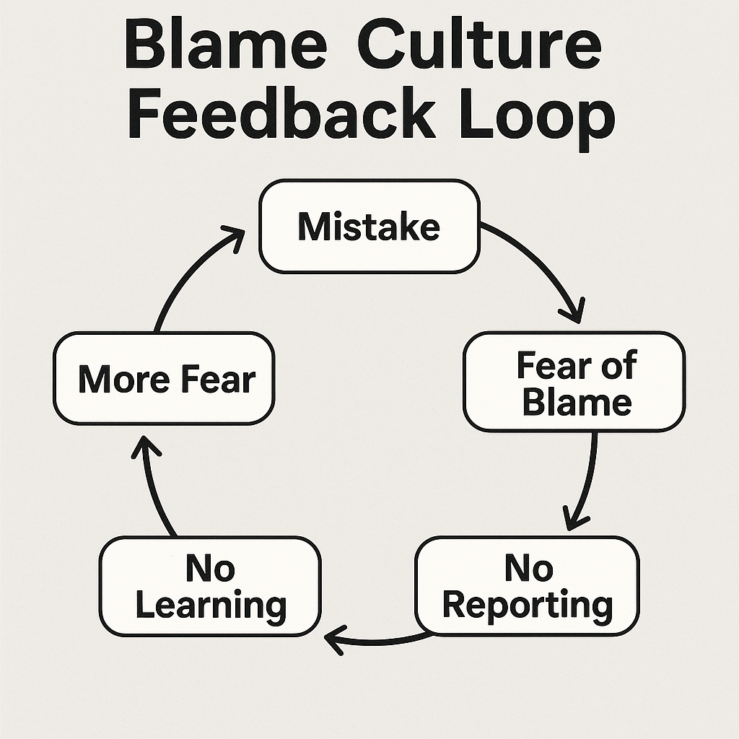
The Vicious Cycle of Blame Culture
This diagram illustrates a destructive feedback loop that often takes root in organizations with a strong blame culture. It begins with a simple mistake, but instead of it becoming a learning opportunity, fear of being blamed sets in. That fear discourages people from reporting the issue, which means no one learns from it. As a result, the same mistake gets repeated. Over time, the fear intensifies, reinforcing the cycle.

Slide 7
How to Resolve This Issue?
Key strategies to overcome cultural barriers:
Hold blameless postmortems (Google SRE, 2023).
Train leaders and teams on second-story thinking.
This is the mindset that encourages leaders to look beyond the surface of a mistake and explore what the actual cause was.
Clearly distinguish human error from negligence.
Encourage transparency and reward learning.

Slide 8
Real-World Example: Etsy’s Blameless Postmortems
Etsy uses a just culture model focused on learning, not punishment
Outages are followed by blameless postmortems
Engineers share what happened without fear
This transparency leads to deeper system improvements
“We want the engineer who made the error to explain why it made sense to them at the time” (Allspaw, 2012).

Slide 9
References
Allspaw, J. (2012, May 22). Blameless PostMortems and a Just Culture. Etsy Code as Craft Blog. https://codeascraft.com/2012/05/22/blameless-postmortems/
DORA. (2023). 2023 State of DevOps Report. Google Cloud. https://cloud.google.com/devops/state-of-devops
Google SRE. (2023). Postmortem Culture: Learning from Failure. https://sre.google/workbook/postmortem-culture/

