Slide 1
Short-Range Wireless IoT Network
802.15.4, 6LoWPAN & RPL
Huawei nStack IoT solution

Slide 2
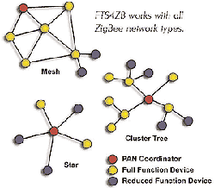
Why use 802.15.4/6LoWPAN and RPL?
IEEE 802.15.4
802.15.4 is designed for low cost-power-throughput for short range LR-WPAN. Enables multi-hop communication mode allowing coverage of longer distances by forming a mesh network. Supports sub-GHz, 2.4GHz RF bands.
6LoWPAN
6LoWPAN (IPv6 Low Power Wireless Personal Area Network) 6LoWPAN enables IPv6 connectivity over low rate WPANs by using stateless compression of IPv6/UDP header. Supports optimized neighbor discovery, fragmentation/reassembly methods.
RPL
RPL(IPv6 Routing Protocol for Low-Power and Lossy Networks): Distance vector proactive routing protocol designed especially for low power and lossy networks. RPL allows creating routing topologies based on different metrics and constraints.

Slide 3
Comparison of 802.15.4 with other wireless communication technologies
 | 802.15.4 | WiFi | Bluetooth | GPRS/LTE | NB-IoT | LoRa
Spectrum | 915/868MHz 2.4GHz | 2.4GHz | 2.4GHz | Licensed | Licensed | 433/470MHz
Multi-hop support | Yes | No | No | No | No | No
Network Throughput | 50-250kbit/s | 11-54Mbit/s | 1Mbit/s | GPRS: 171.2Kbit/s LTE: Uplink 50Mbit/s, Dnlink 100Mbit/s | 200kbit/s | 50kbit/s
Coverage Distance | 500m | <100m | <50m | 500-15KM | 15KM | 15KM

Slide 4
Challenges with short-range wireless networking technology
 | Security | Multicast | Mesh topology
 | Frame Size | Internet integration | Self healing
 | Power | Limited bandwidth | Transmission distance

Slide 5



Key technology of 6LoWPAN application
IPv6
App
Core Router
Firewall
Border Router
NAT64
Lossy link
Frame Size, Bandwidth
App security
R
Multi-hop network
Sleepy nodes
Multicast
H
mobility
Lightweight, low power

Slide 6
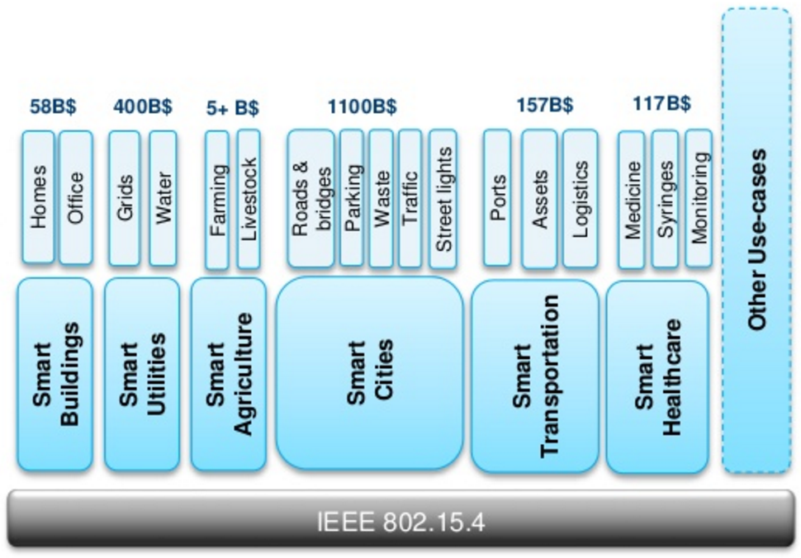
802.15.4 application scenarios
Building Automation
Water Meter
Agriculture
Smart City
Logistics
Smart Health

Slide 7
Analysis of key technologies in 6LoWPAN
Addressing
Forwarding & Routing
Packet Compression
Fragmentation/Reassembly
Multicast
Internet
App Server
Core Router
Border Router
Border Router
Down
R
R
R
R
Up
R
H
H
H
H
H

Slide 8
Huawei nStack middleware optimizations
Ad-hoc routing improvements
E2E-ACK mechanism for improved network convergence time.
Improved route invalidation using optimized No-Path DAO signaling <ongoing work on IETF>
RPL integrated management layer
Centralized topology monitoring
Path selection optimizations integrated with link quality parameters.
Domain tools
Scalable simulation test env
Realistic RF characteristics
Link Asymmetry
Nonlinear interference
Extends to 1000+ nodes, 50+ hops simulation env
Reuse development code base in simulation env
Clear segregation of PHY/MAC and system adaptation layer
Centralized monitoring of statistics across nodes.
Visualization
Integrated Graphviz for toplogy monitoring
Integrated network sniffer
Light Weight Security protocol stack
Key management protocol
Key distribution & Authentication using EAP-PANA
PANA protocol compression
Relay element for multi-hop networks
Security
Support SHA-2 suite
Adhoc formation coupled with security signaling

Slide 9
Chip solutions for IoT
Single Chipset | On-chip RF tech, RF front-end, transmitter and microcontroller with flash memory and other peripherals integrated
Double chipset | Decoupled app processor and RF chipset. Internal communication through UART/SPI
Network Processor | Built-in network stack with RF chipset. App processor is independent of network stack.
App
RF chipset
6LoWPAN stack
App
UART/SPI
RF chipset
6LoWPAN stack
6LoWPAN stack
App
UART/SPI
RF chipset

Slide 10

基于华为AR502E+AC-IoT平台打造更广泛的IoT生态圈
应用软件开发者允许调用AC-IoT平台北向Restful API快速实现业务应用
平台中间件开发者可以在AC-IoT中打造类似能效管理EEM的特定领域中间件（插件）
网关二次开发者（Docker容器开发应用）可以充分利用AR502边缘计算能力实现诸如接入策略控制，工控管理等应用
嵌入式应用开发者可依托nStack互联互通中间件或直接使用华为RF通信扣板，实现嵌入式设备快速无缝接入到云端
系统集成商可在华为AR502E+AC-IoT平台上快速打造适合短距无线技术IoT应用
Web Apps(HTML/JS)
标准Restful API
AC-IoT(EEM/JSON)
AR502E (DCU-BR)
无缝网络集成
RF通信扣板(6LoWPAN)
传感器/控制器

