Slide 1
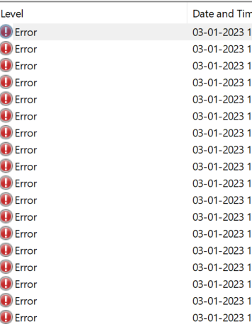
Log-Based Anomaly detection
Smit Shah
AU1920088

Slide 2
Index
1
2
3
4
5
Introduction
Types of Anomalies
&
Contemporary
Methods to detect it
Deep learning
Methods and their effectiveness
My Research
Summary

Slide 3

Anomaly
Anomalies are unusual occurrences, objects, or observations that are suspicious because they diverge dramatically from expected patterns or behaviors. Other names for data anomalies
include standard deviations, outliers, noise, novelty, and exceptions..

Slide 4
Why anomaly detection?
Anomaly detection identifies items or events that do not conform to an expected pattern. Anomaly detection is a significant problem researched within various research and application domains. It is widely used across multiple applications, including military surveillance for enemy activity, fraud detection for credit cards, insurance, or healthcare, intrusion detection for cyber-security, fault detection in safety-critical systems, and fraud detection for credit cards, insurance, or Healthcare.

Slide 5
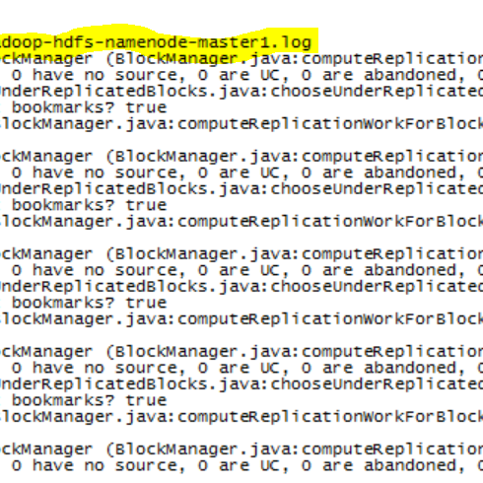


Problem
5
Notes:
Big data systems (e.g., Hadoop and Spark) are being widely adopted by many domains
for offering effective data solutions, such as manufacturing, healthcare, education, and media. A
common problem about big data systems is called anomaly, e.g., a status deviated from normal execution,
which decreases the performance of computation or kills running programs. It is becoming
a necessity to detect anomalies and analyze their causes. An effective and economical approach is
to analyze system logs. Big data systems produce numerous unstructured logs that contain buried
valuable information. However manually detecting anomalies from system logs is a tedious and
daunting task.
Human-based manual detection methods are time-consuming with low accuracy. To identify anomalies from different logging frameworks, it requires that users are very familiar with the whole systems. Moreover, some unexpected events happening during the program execution might cause big performance degradation, or failures, even some worst scenarios such as programs keep quit, and stragglers happened without error message. Those scenarios are hard to be detected manually, even for system experts. Therefore, to effectively detect anomalies from such huge and unstructured logs is a big challenge for system operators.

Slide 6
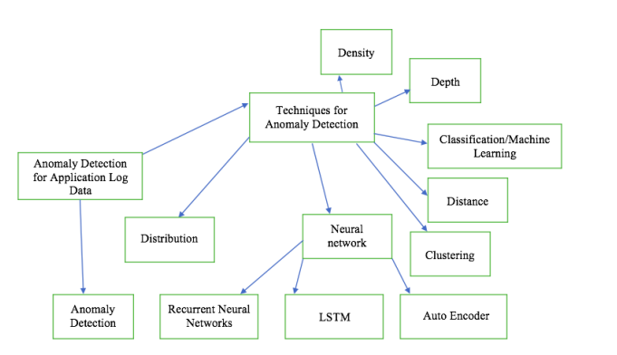
Contemporary Techniques to Detect Anomalies
Grover, A. (n.d.). Anomaly Detection for Application Log Data . SJSU ScholarWorks . Retrieved January 1, 2023, from https://scholarworks.sjsu.edu/cgi/viewcontent.cgi?article=1640&context=etd_projects

Slide 7
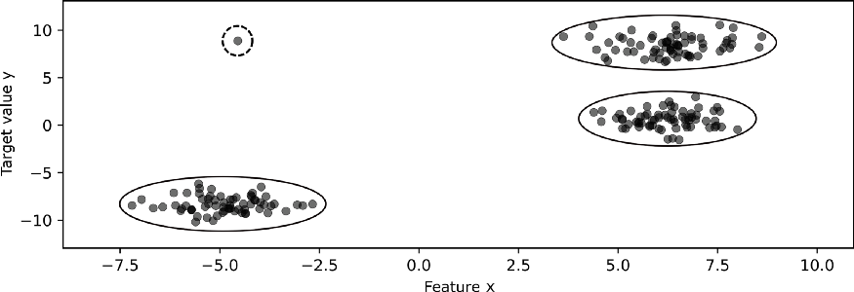
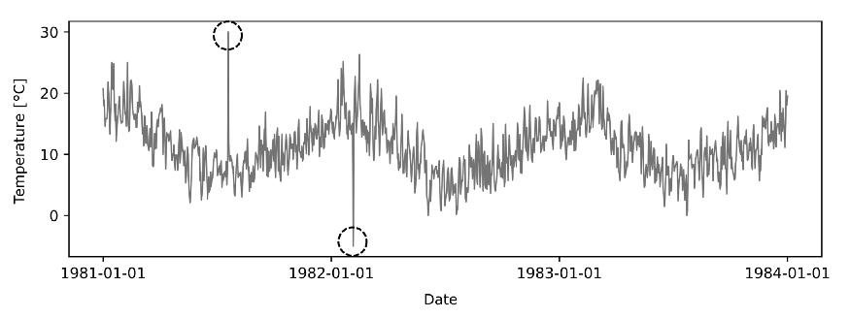
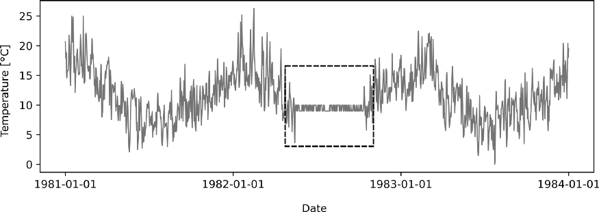
Types of Anomalies
Point
Contextual
Collective
Polzer, D. (2022, February 8). A comprehensive beginners guide to the diverse field of anomaly detection. Medium. Retrieved January 5, 2023, from https://towardsdatascience.com/a-comprehensive-beginners-guide-to-the-diverse-field-of-anomaly-detection-8c818d153995
Notes:
Pointwise: One log which has a rare error.
Contextual : One

Slide 8
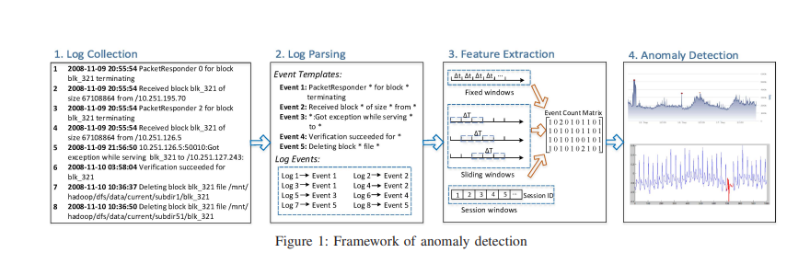
Framework of anomaly detection
S. He, J. Zhu, P. He and M. R. Lyu, "Experience Report: System Log Analysis for Anomaly Detection," 2016 IEEE 27th International Symposium on Software Reliability Engineering (ISSRE), 2016, pp. 207-218, doi: 10.1109/ISSRE.2016.21.

Slide 9
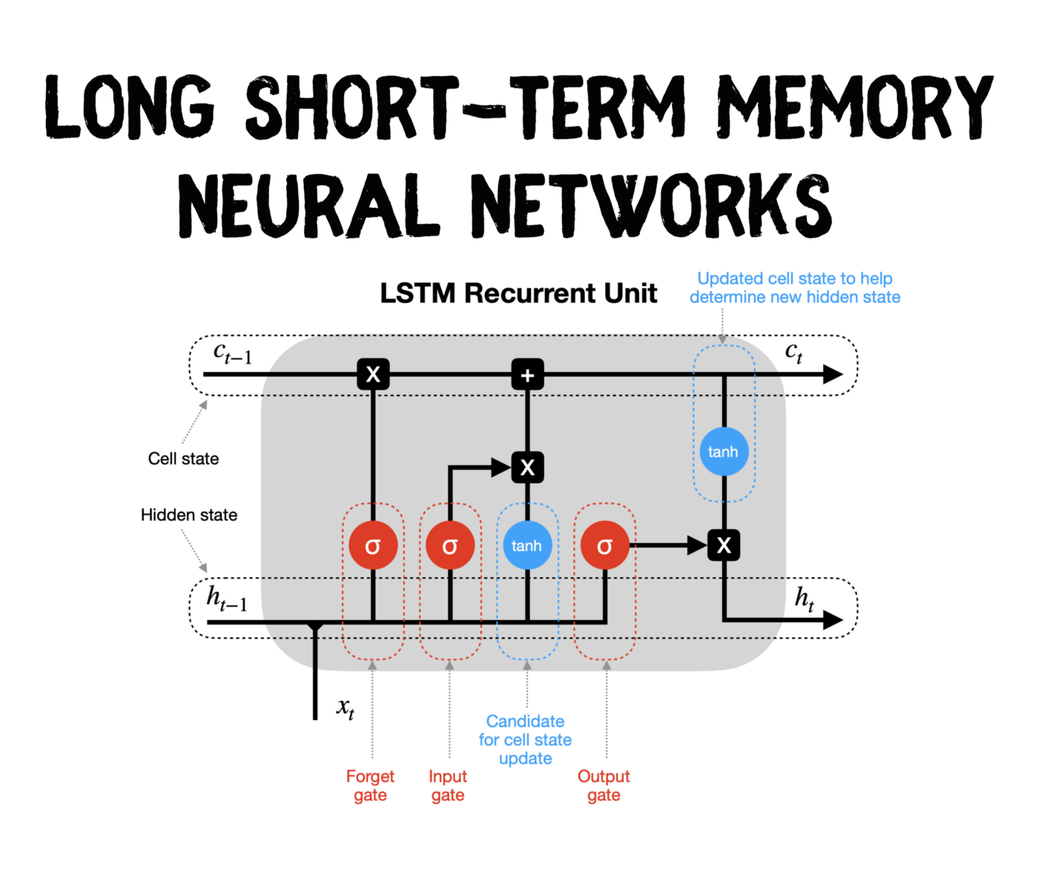
LSTM
Dobilas, S. (2022, March 5). LSTM recurrent neural networks - how to teach a network to remember the past. Medium. Retrieved January 5, 2023, from https://towardsdatascience.com/lstm-recurrent-neural-networks-how-to-teach-a-network-to-remember-the-past-55e54c2ff22e

Slide 10
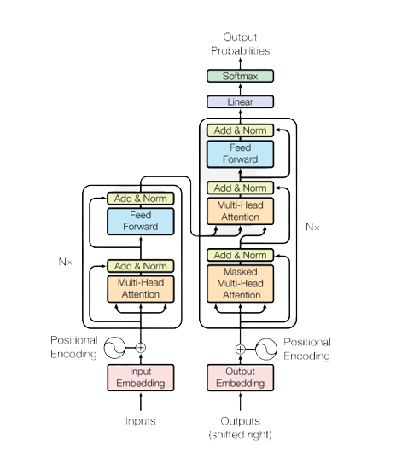
Transformers
A transformer model is a deep learning model designed to process sequential data, such as natural language, more efficiently than traditional recurrent neural networks (RNNs). It does this using an attention mechanism, which allows the model to focus on specific parts of the input sequence as needed rather than processing the entire sequence from start to finish.
The critical innovation of transformer models is the use of self-attention mechanisms, which allow the model to weigh the importance of each input element differently when making predictions. This allows the model to capture dependencies between components in the input sequence and produce more accurate outputs.
Vaswani, A., Shazeer, N., Parmar, N., Uszkoreit, J., Jones, L., Gomez, A. N., ... & Polosukhin, I. (2017). Attention is all you need. Advances in neural information processing systems,

Slide 11
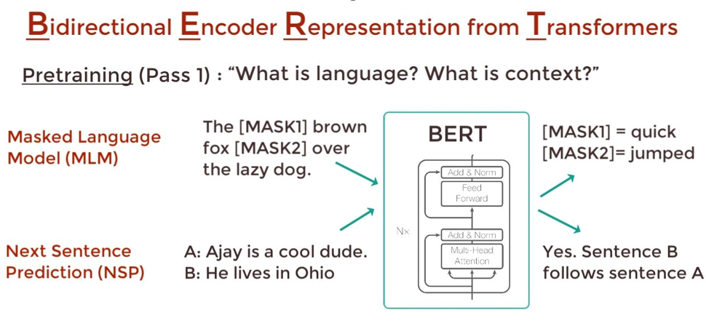
BERT
YouTube. (2020). Bert Neural Network - Explained! YouTube. Retrieved January 13, 2023, from https://www.youtube.com/watch?v=xI0HHN5XKDo&t=254s.

Slide 12
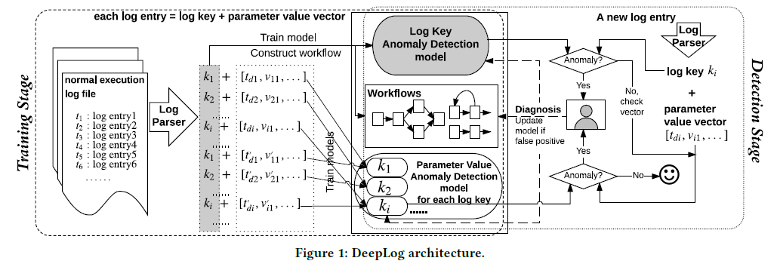
DeepLog
Li, F., Zheng, G., Srikumar, V., & Du, M. (n.d.). DeepLog: Anomaly Detection and Diagnosis from System Logs through Deep LearningFeifei. Retrieved January 12, 2023, from https://www.cs.utah.edu/~lifeifei/papers/deeplog.pdf

Slide 13
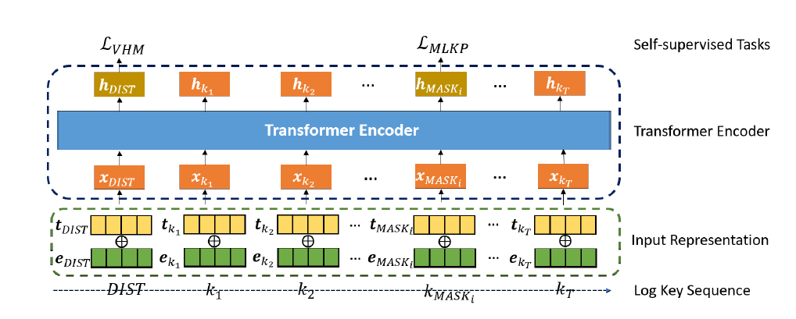
LogBERT
Guo, H., Yuan, S., & Wu, X. (2021, March 7). Logbert: Log Anomaly detection via bert. arXiv.org. Retrieved January 11, 2023, from https://arxiv.org/abs/2103.04475v1

Slide 14
Challenges and Limitations
Data Representations
Data Instability
Class imbalance
Anomalous artifact diversity
Label Availability
Stream Processing
Data Volume
Interleaving Logs
Model explainability

Slide 15
My research
Understanding Methods of log parsing
Identifying Limitations of existing methods
Application of text-davinci-3 for log parsing

Slide 16
Log parsing
The goal of log parsing is to convert each log
message into a speciﬁc event template (e.g., “Received
block <*> of size <*> from /<*>”) associated with
key parameters (e.g., [“blk_-562725280853087685”,
“67108864”, “10.251.91.84”]). Here, “<*>” denotes the
position of each parameter.
Zhu, J., He, S., Liu, J., He, P., Xie, Q., Zheng, Z., & Lyu, M. R. (2019). Tools and benchmarks for
automated log parsing.
Notes:
Log parsing typically serves as the ﬁrst step towards down-
stream log analysis tasks include anomaly detection, usage analysis, duplicate issue identification, performance modeling, and failure diagnosis.
Parsing textual log messages into a
structured format enables efﬁcient search, ﬁltering, grouping,
counting, and sophisticated mining of logs. To illustrate, we
provide a list of sample industrial applications here, which
have been widely studied by researchers and practitioners.
The downstream models show an improvement in performance with appropriately extracted
semantics. Anomaly detection datasets show improvement by 1.2%-11.7%, while failure identification
datasets improve by 8.65%. This improvement indicates that better log parsing can lead to
more accurate identification of anomalies and failures, which can help in improving system performance
and preventing downtime. Therefore, the impact of better log parsing is significant in
enhancing the overall efficiency and reliability of complex systems

Slide 17
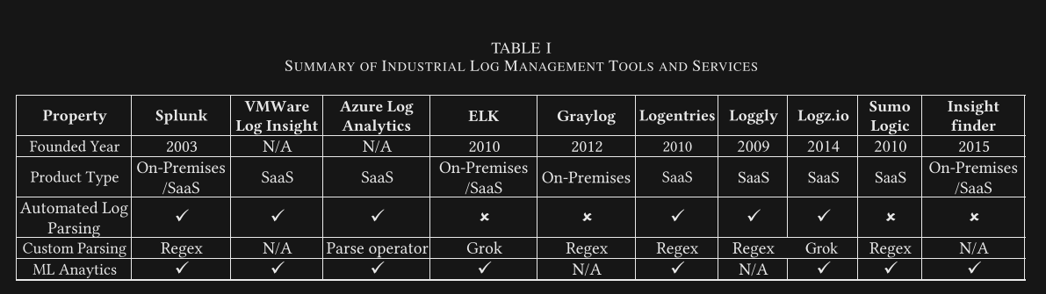
Log management tools
Zhu, J., He, S., Liu, J., He, P., Xie, Q., Zheng, Z., & Lyu, M. R. (2019). Tools and benchmarks for automated log parsing.

Slide 18
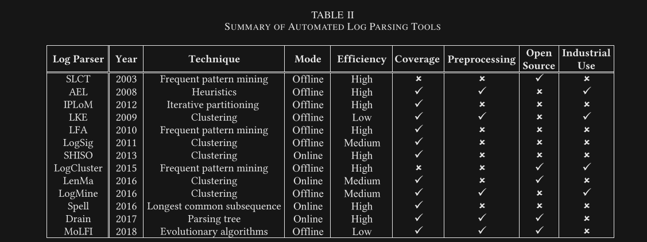
Automated log parsing tools
Zhu, J., He, S., Liu, J., He, P., Xie, Q., Zheng, Z., & Lyu, M. R. (2019). Tools and benchmarks for automated log parsing.

Slide 19
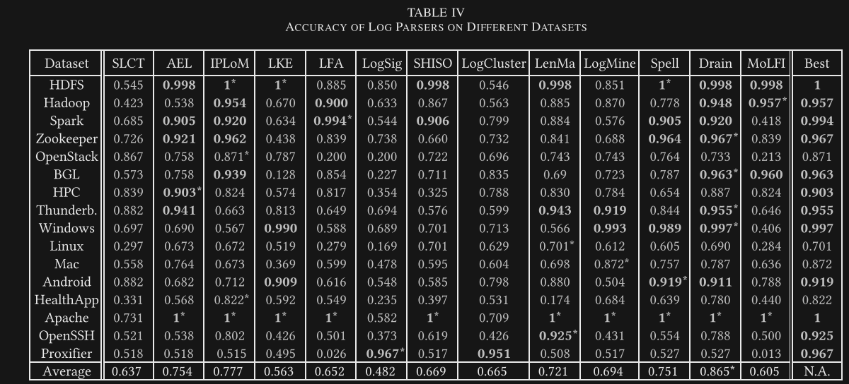
Accuracy of log parsers and insights

Slide 20
Experiment
Write prompt and set hyperparameters for LLM
Model Processes logs and Gives Output
Pre-process Log data and write it to output file

Slide 21
Experiment
Compare Pre-Processed Logs with Ground Truth File
Analyse the Results and understand model behaviour
Modify/ Update the process

Slide 22
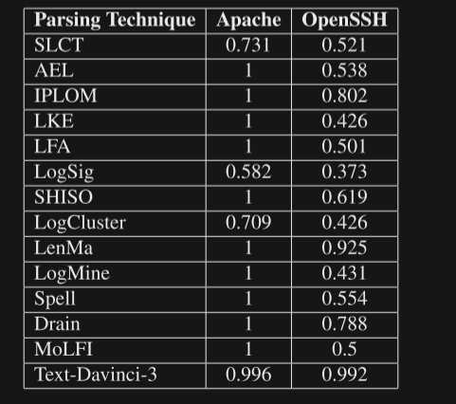
Results

Slide 23
Analysing Model Behaviour
{
"Time": "Sun Dec 04 04:51:14 2005",
"Level": "notice",
"Content": "workerEnv.init() ok /etc/httpd/conf/workers2.properties Parse the following Parse the following Apache log entry."
}
Parsed Logs
Date: Sun Dec 04 2005 Time: 04:51:14
Log Level: notice Module: workerEnv
Client IP Address: N/A (not present in log entry)
HTTP Request Method: N/A (not present in log entry)
HTTP Request Path: N/A (not present in log entry)
Message: workerEnv.init() ok /etc/httpd/conf/workers2.properties
Modifying format

Slide 24
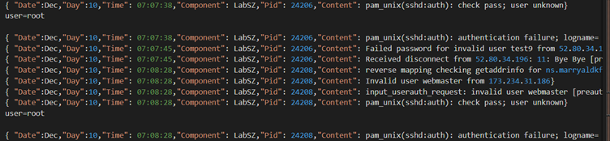
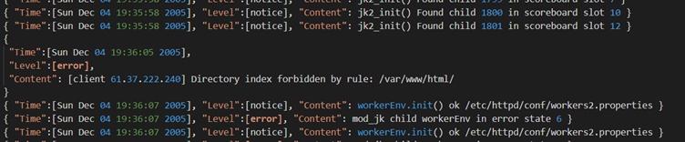
Analysing Model Behaviour
Unnecessary Inference
Deviation in Log Format

Slide 25
References
Guo, H., Yuan, S., & Wu, X. (2021, March 7). Logbert: Log Anomaly detection via bert. arXiv.org. Retrieved January 11, 2023, from https://arxiv.org/abs/2103.04475v1
Li, F., Zheng, G., Srikumar, V., & Du, M. (n.d.). DeepLog: Anomaly Detection and Diagnosis from System Logs through Deep LearningFeifei. Retrieved January 12, 2023, from https://www.cs.utah.edu/~lifeifei/papers/deeplog.pdf
Grover, A. (n.d.). Anomaly Detection for Application Log Data . SJSU ScholarWorks . Retrieved January 1, 2023, from https://scholarworks.sjsu.edu/cgi/viewcontent.cgi?article=1640&context=etd_projects
Vaswani, A., Shazeer, N., Parmar, N., Uszkoreit, J., Jones, L., Gomez, A. N., ... & Polosukhin, I. (2017). Attention is all you need. Advances in neural information processing systems, 30.
YouTube. (2020). Bert Neural Network - Explained! YouTube. Retrieved January 13, 2023, from https://www.youtube.com/watch?v=xI0HHN5XKDo&t=254s.
(n.d.-b). Machine Learning: What Is Ablation Study? Baeldung. https://shorturl.at/fnzMV
Dobilas, S. (2022, March 5). LSTM recurrent neural networks - how to teach a network to remember the past. Medium. Retrieved January 5, 2023, from https://towardsdatascience.com/lstm-recurrent-neural-networks-how-to-teach-a-network-to-remember-the-past-55e54c2ff22e
Polzer, D. (2022, February 8). A comprehensive beginners guide to the diverse field of anomaly detection. Medium. Retrieved January 5, 2023, from https://towardsdatascience.com/a-comprehensive-beginners-guide-to-the-diverse-field-of-anomaly-detection-8c818d153995

Slide 26
Thank you

