Slide 1

XYRA Studio
Private AI for EPC Engineering
P&ID Intelligence
Piping MTO
Centralized Database
On-Premise
P&ID extraction · Piping MTO · PDF review · Centralized project database
Prepared for [ EPC Client ] · 2026
Confidential

Slide 2
THE PEOPLE
THE PEOPLE
Meet the people XYRA was built for.
Instrumentation and piping engineers who spend most of their day on data — not decisions.
WHERE THE HOURS ACTUALLY GO
Manual P&ID take-off
3.5 hrs
Data re-entry across systems
2.5 hrs
Cross-discipline file transfers
1.5 hrs
Instrumentation
Engineer
Piping
Engineer
Review & re-checking same data
1.2 hrs
Actual engineering decisions
0.8 hrs
Less than 1 hour of an 8-hour workday is spent on actual engineering decisions.
2 / 13
2 / 13

Slide 3
THE PROBLEM
THE PROBLEM
This is how engineering data moves today.
From the moment a P&ID is issued to the moment a deliverable is produced.
1
2
3
4
5
6
P&ID
Issued
›
Manual
Extraction
›
Spreadsheet
Created
›
Email to
Piping Team
›
Re-entered
into PDMS
›
Review
Meeting
Drawing arrives
2–4 hrs per sheet
System A
Last week's file
System B — manual
Checks what
was checked
2–4 hrs of
specialist time
Wrong version
sent
Re-keyed
manually
Already checked
last phase
The same instrument tag is entered 4–6 times across a single project.
Discipline-to-discipline data transfer happens through disconnected files — no traceability, no version control.
"We'll use ChatGPT."
AI
Doesn't know ISA-5.1 ✕
Can't reliably read P&IDs ✕
Client drawings can't go to a public AI ✕
3 / 13
3 / 13

Slide 4
THE COST
THE COST
Where it goes
Breakdown of wasted engineering capacity on a typical EPC project:
30–50%
Manual take-off
2–4 hrs per P&ID drawing, repeated across hundreds of drawings
Data re-entry
Same instrument tag entered 4–6× across systems by different teams
of your engineering budget
goes to clerical work.
Discipline handoffs
Emailed spreadsheets, wrong versions, no audit trail between teams
Not engineering.
Review & re-checking
Review phases repeat checks already done — no shared engineering record
4 / 13
4 / 13

Slide 5
THE SOLUTION
THE SOLUTION
There is a better way.
XYRA Studio
Private AI for EPC Drawing Deliverables
01
02
03
04
InstruMap
Piping MTO
PrecisionPDF
Centralized DB
Extract instrument tags, classify with ISA-5.1, map to lines, generate Index / IO List / Verification Log.
User-built component library + computer-vision detection across all drawings. EPC-style Excel output.
Full PDF viewer with annotation tools, text search, minimap, and thumbnail navigation built in.
PostgreSQL-backed engineering records — instruments, loops, piping, IO — shared across all disciplines.
5 / 13
5 / 13

Slide 6
HOW IT WORKS
HOW IT WORKS
This is how it works with XYRA.
One upload. Every tool. One structured output to all disciplines.
1
2
3
4
Upload P&ID
XYRA Extracts
Engineer Reviews
Download Outputs
Drag & drop
PDF — any quality
›
ISA-5.1 decode
Line mapping
Service inference
›
Confidence flags
QA notes
One-click remove
›
Index · IO List
MTO · Line List
ZIP package
Drop PDFs
no prep needed
LLM + OCR
runs locally
Full audit trail
QA flagged
Excel + ZIP
review-ready
BEFORE XYRA
WITH XYRA
Manual take-off → 5 systems re-entered → email → wrong version → re-check
Upload → XYRA reads → engineer reviews → structured outputs to all disciplines
6 / 13
6 / 13

Slide 7
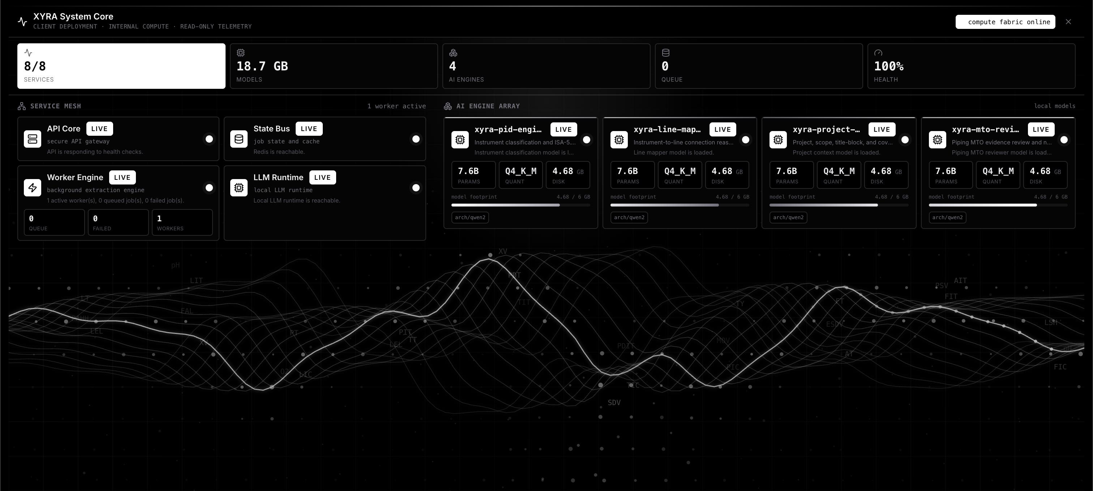
XYRA STUDIO · LIVE SYSTEM
Compute fabric online.
8 / 8 services live · 4 custom AI engines · 18.7 GB models loaded · 100% health · 0 queue
7 / 13

Slide 8
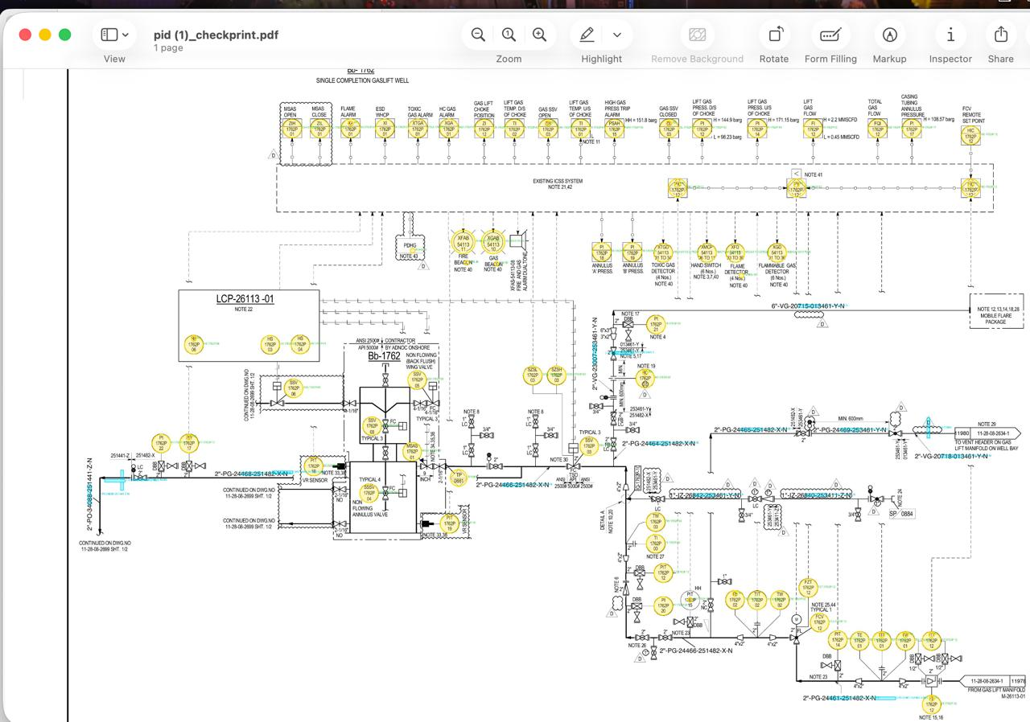
P&ID INTELLIGENCE
XYRA reads the drawing.
Every instrument tag identified, classified, and linked to its pipe line number.
8 / 13

Slide 9
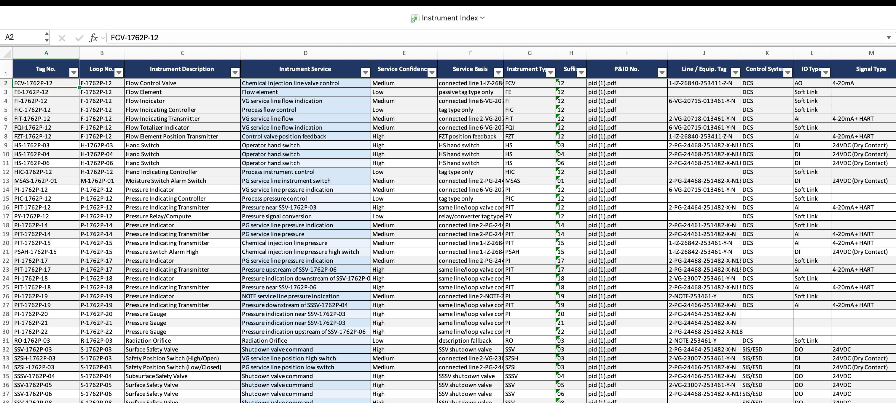
INSTRUMENTATION OUTPUT
Every instrument.
Structured.
Instrument Index — tags · loops · ISA type · service description · IO type · P&ID reference · QA review flags
9 / 13

Slide 10
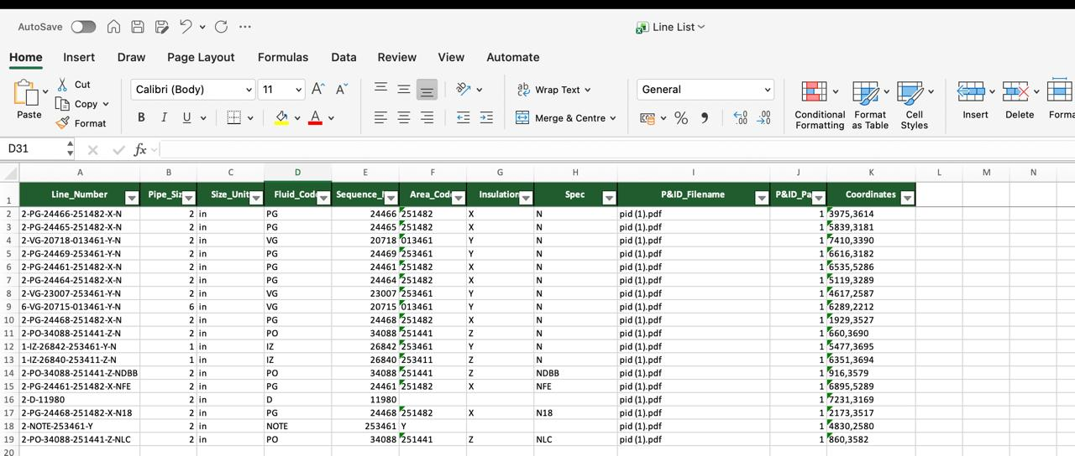
PIPING OUTPUT
Every line number.
Mapped.
Line List — pipe numbers · sizes · fluid codes · insulation spec · area codes · coordinates · P&ID source
10 / 13

Slide 11
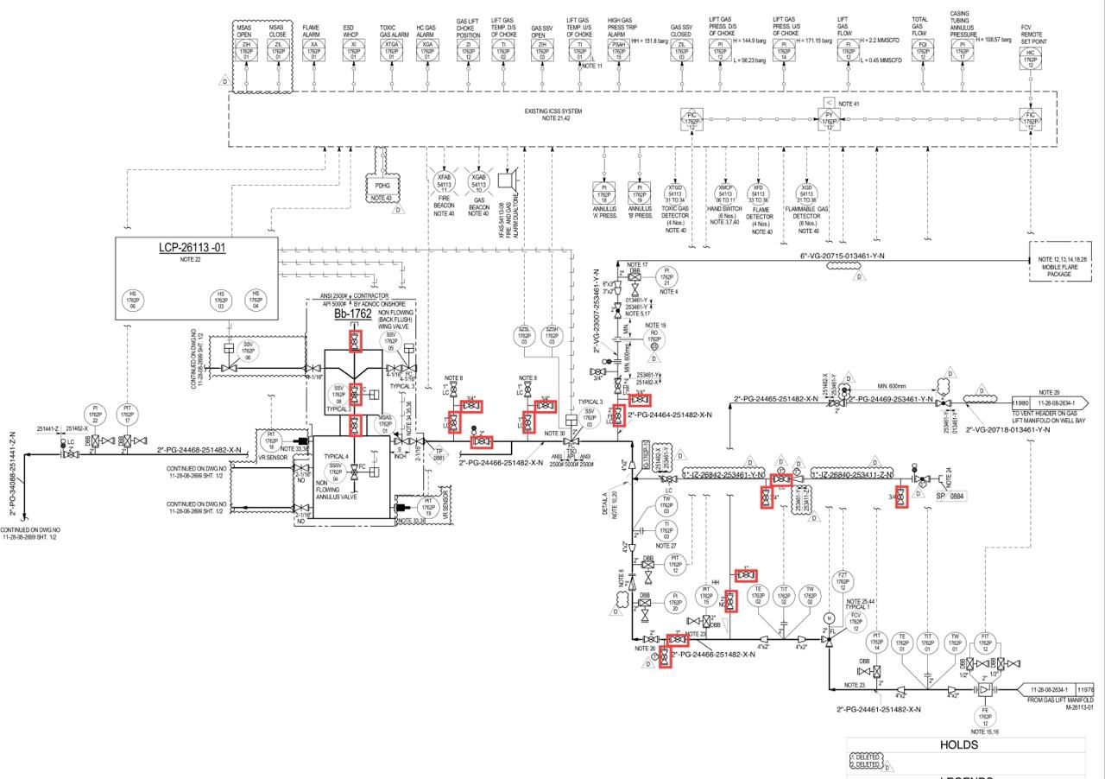
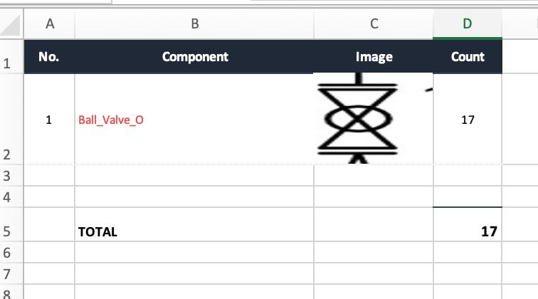
PIPING MTO
PIPING MTO
Select once.
XYRA finds every instance — across every page, every rotation, with size extraction.
1
2
3
4
5
Select
Component
›
Save to
Library
›
Run
Detection
›
Review
Results
›
Export
Package
Draw a box
around any symbol
Auto-trimmed
thumbnail stored
Computer vision
across all pages
Remove false
positives
MTO · Register
QA · Excel ZIP
OUTPUT
17
components detected
1
drawing processed
1
component type
11 / 13
11 / 13

Slide 12
THE PILOT
THE PILOT
Two weeks. One answer.
A structured pilot gives your team a clear decision: time saved, output quality, and deployment fit.
WEEK 1
WEEK 2
DECISION PACK
Configure & Load
Validate & Compare
Delivered at Close
Deploy on client server or test VM
Process 20–50 representative P&IDs
Coverage summary + exception log
Load project legend + title block context
Compare XYRA output vs manual workflow
Time-saving estimate vs manual baseline
Configure instrument model + MTO library
Review Instrument Index, IO List, MTO
Deployment checklist for production
Run first extraction pass — calibrate output
Identify gaps — tune detection settings
Monthly license proposal
12 / 13
12 / 13

Slide 13
Ready to see XYRA
on your drawings?
We deploy inside your network, run XYRA on your drawing package,
and deliver structured outputs your team evaluates against the manual baseline.
Schedule a Pilot Run →
prashanth.thipparthi@outlook.com
www.xyra-ai.com
Instrumentation
Piping
Management

