Slide 1

XYRA AI Studio
Private AI for EPCs
P&ID Intelligence
Piping MTO
Centralized Database
On-Premise
Confidential

Slide 2
THE PROBLEM
THE PROBLEM
This is how engineering data moves today.
From the moment a P&ID is issued to the moment a deliverable is produced.
1
2
3
4
5
6
P&ID
Issued
›
Manual
Extraction
›
Spreadsheet
Created
›
Emails to
Different Teams
›
Re-entered
Into system
›
Review
Meeting
Drawing arrives
2–4 hrs per sheet
System A
Last week's file
System B - manual
Checks what
was checked
2–4 hrs of
specialist time
Wrong version
sent
Re-keyed
manually
Already checked
last phase
The same instrument tag is entered 4–6 times across a single project.
Discipline-to-discipline data transfer happens through disconnected files - no traceability, no version control.
"We'll use ChatGPT."
AI
Doesn't know ISA-5.1 ✕
Can't reliably read P&IDs ✕
Client drawings can't go to a public AI ✕
Confidential

Slide 3
THE COST
THE COST
Where it goes
Breakdown of wasted engineering capacity on a typical EPC project:
30–50%
Manual take-off
2–4 hrs per P&ID drawing, repeated across hundreds of drawings
Data re-entry
Same instrument tag entered 4–6× across systems by different teams
of your engineering budget
goes to clerical work.
Discipline handoffs
Emailed spreadsheets, wrong versions, no audit trail between teams
Not engineering.
Review & re-checking
Review phases repeat checks already done - no shared engineering record
Confidential

Slide 4
THE SOLUTION
THE SOLUTION
There is a better way.
XYRA AI Studio
Private AI for EPC Drawing Deliverables
01
02
03
04
InstruMap
Piping MTO
Centralized DB
Custom AI Solutions
Extract instrument tags, classify with ISA-5.1, map to lines, generate Index / IO List / Verification Log.
User-built component library + computer-vision detection across all drawings. EPC-style Excel output.
PostgreSQL-backed engineering records - instruments, loops, piping, IO - shared across all disciplines.
Build custom engineering applications, automate project-specific workflows, fine-tune private AI models, and train systems using client standards, specifications, and historical project data.
Confidential

Slide 5
HOW IT WORKS
HOW IT WORKS
This is how it works with XYRA.
One upload. Every tool. One structured output to all disciplines.
1
2
3
4
Upload P&ID
XYRA Extracts
Engineer Reviews
Download Outputs
Drag & drop
PDF - any quality
›
ISA-5.1 decode
Line mapping
Service inference
›
Confidence flags
QA notes
One-click remove
›
Index · IO List
MTO · Line List
ZIP package
Drop PDFs
no prep needed
LLM + OCR
runs locally
Full audit trail
QA flagged
Excel + ZIP
review-ready
BEFORE XYRA
WITH XYRA
Manual take-off → 5 systems re-entered → email → wrong version → re-check
Upload → XYRA reads → engineer reviews → structured outputs to all disciplines
Confidential

Slide 6
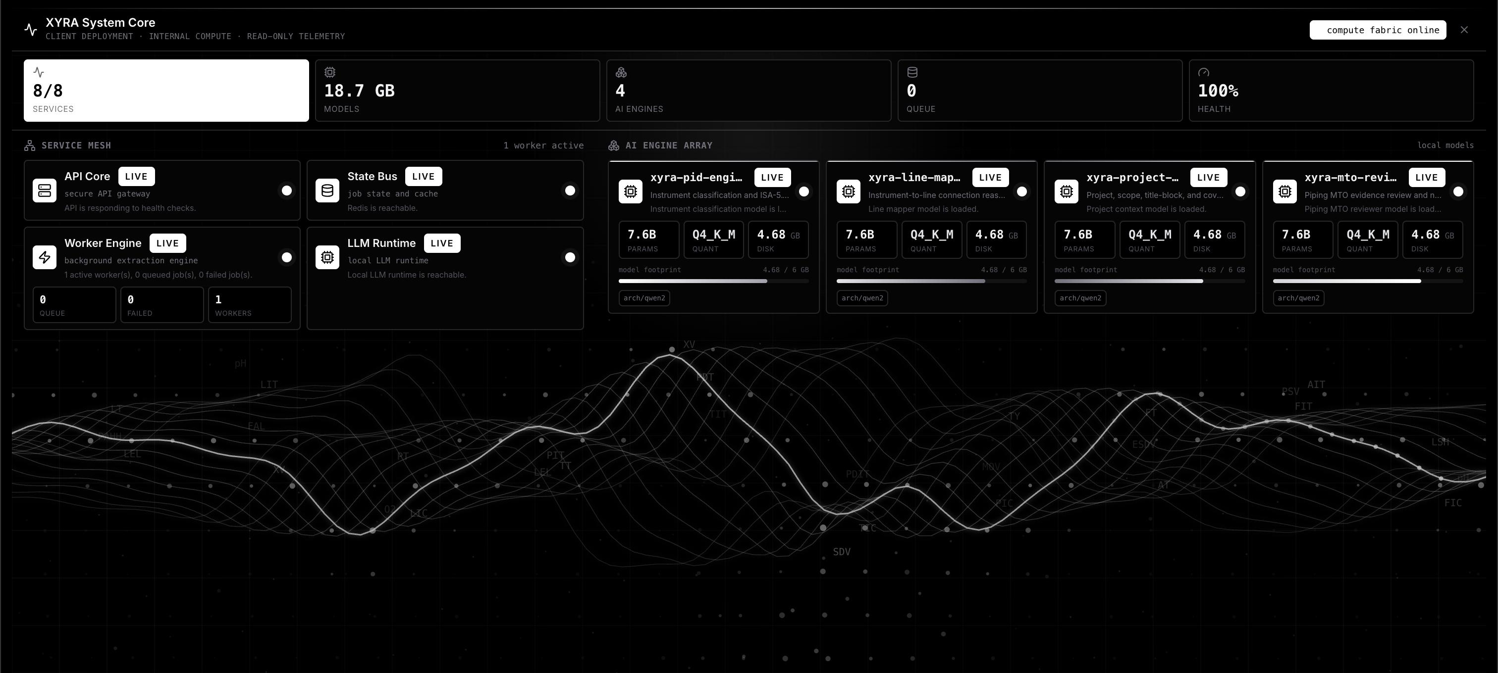
XYRA STUDIO · LIVE SYSTEM
Compute fabric online.
8 / 8 services live · 4 custom AI engines · 18.7 GB models loaded · 100% health · 0 queue
Confidential

Slide 7
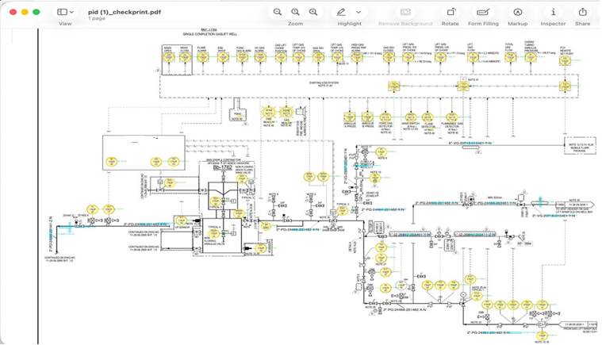
P&ID INTELLIGENCE
XYRA reads the drawing and prepares check print
Every instrument tag identified, classified, and linked to its pipeline number.
Confidential

Slide 8
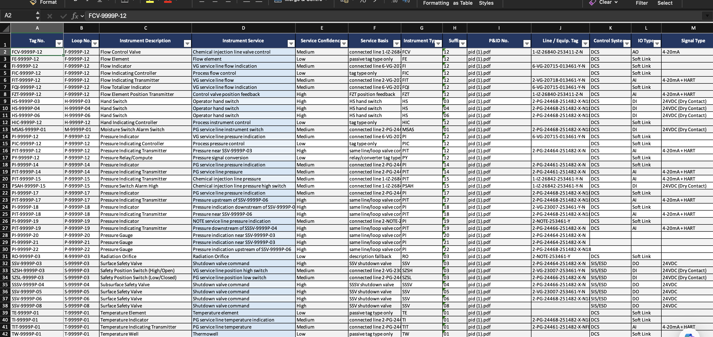
INSTRUMENTATION OUTPUT
Every instrument.
Instrument Index - tags · loops · ISA type · service description · IO type · P&ID reference · QA review flags
Confidential

Slide 9
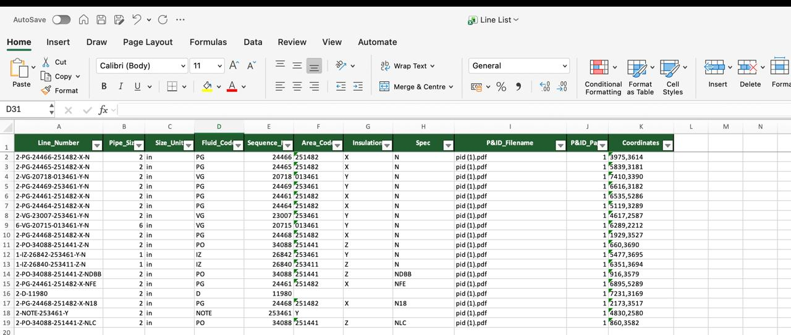
PIPING OUTPUT
Every line number.
Line List - pipe numbers · sizes · fluid codes · insulation spec · area codes · coordinates · P&ID source
Confidential

Slide 10
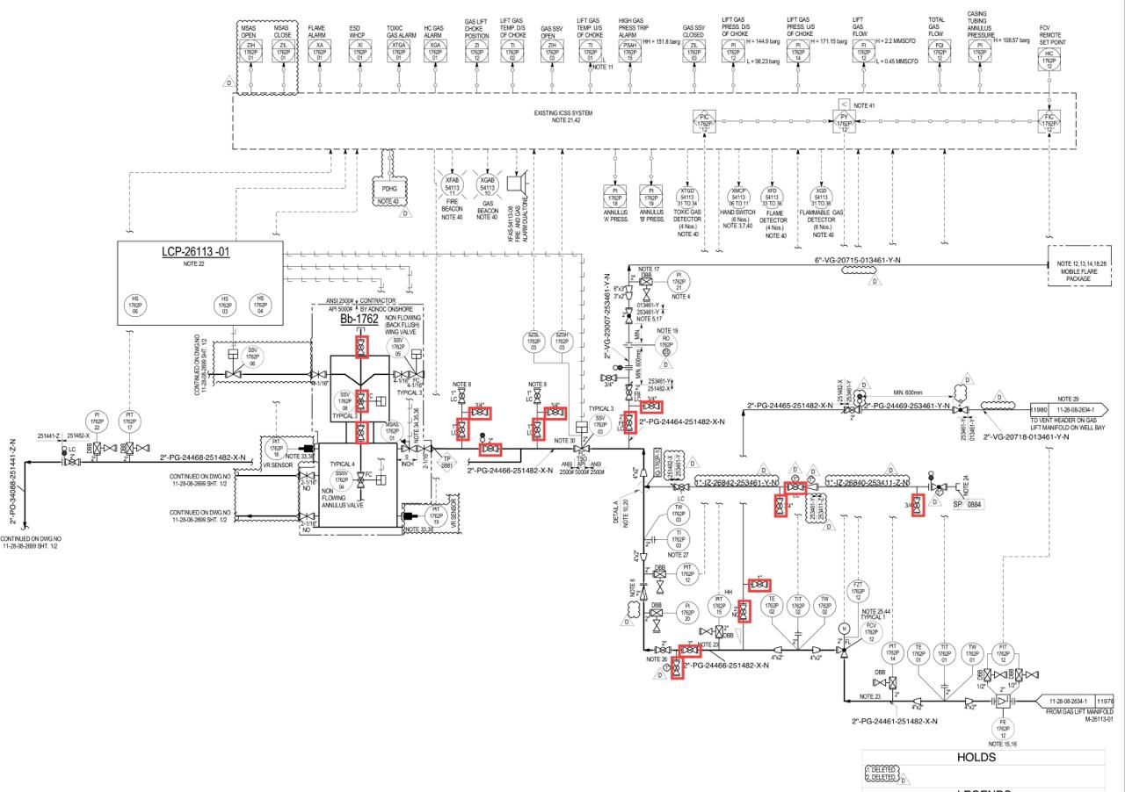
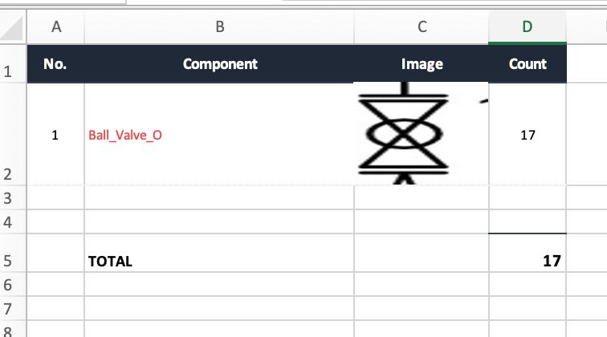
PIPING MTO
PIPING MTO
Select once.
XYRA finds every instance - across every page, every rotation, with size extraction.
1
2
3
4
5
Select
Component
›
Save to
Library
›
Run
Detection
›
Review
Results
›
Export
Package
Draw a box
around any symbol
Auto-trimmed
thumbnail stored
Computer vision
across all pages
Remove false
positives
MTO · Register
QA · Excel ZIP
OUTPUT
17
components detected
1
drawing processed
1
component type
Confidential

Slide 11
THE PILOT
THE PILOT
Beyond Products – Engineering Automation Services
Engineering Tool Automation
Engineering Data Management
AI-Powered Engineering Solutions
Custom DLLs and add-ins for Hexagon SmartPlant tools
SmartPlant Instrumentation (SPI) automation
Smart 3D (S3D) workflow automation
Smart P&ID data extraction and validation
Custom engineering productivity tools
Engineering database migration and cleansing
Bulk data loading and validation
Legacy data digitization
Intelligent document processing
Private/on-premise AI assistants
Custom AI models trained on engineering data
Drawing intelligence and knowledge extraction
Engineering document search and Q&A
Confidential

Slide 12
THE PILOT
THE PILOT
Two weeks. One answer.
A structured pilot gives your team a clear decision: time saved, output quality, and deployment fit.
WEEK 1
WEEK 2
DECISION PACK
Configure & Load
Validate & Compare
Delivered at Close
Deploy on client server or test VM
Process 20–50 representative P&IDs
Coverage summary + exception log
Load project legend + title block context
Compare XYRA output vs manual workflow
Time-saving estimate vs manual baseline
Configure instrument model + MTO library
Review Instrument Index, IO List, MTO
Deployment checklist for production
Run first extraction pass - calibrate output
Identify gaps - tune detection settings
Monthly license proposal
Confidential

Slide 13
Ready to see XYRA
on your drawings?
We deploy inside your network, run XYRA on your drawing package,
and deliver structured outputs your team evaluates against the manual baseline.
Schedule a Pilot Run

