Slide 1
EMG Gesture Recognition System
Real-Time Hand Gesture Classification
Using 3-Channel MyoBand Sensors
Developed by: [Your Name]
Date: [Current Date]

Slide 2
Project Overview
🎯 Objective
• Develop real-time EMG gesture recognition system
• Use 3-channel MyoBand sensors for hand gesture classification
• Achieve high accuracy with machine learning models
🔧 Hardware Setup
• 3x MyoBand sensors (UPLabs Company)
• Raspberry Pi Pico for data acquisition
• Real-time serial communication
📊 Dataset Challenges
• Original dataset had accuracy issues
• Adapted external datasets to 3-channel format
• Created synthetic data for reliable training
🤖 Machine Learning Models
• Tested multiple approaches: KNN, Random Forest, AR models
• Found optimal solution with adapted datasets
• Real-time prediction with confidence scoring

Slide 3
Hardware Setup
🔌 EMG Sensor Configuration
• 3x MyoBand sensors from UPLabs Company
• Placement: Forearm muscle groups
- Channel 1: Flexor muscles
- Channel 2: Extensor muscles
- Channel 3: Wrist stabilizers
⚡ Data Acquisition
• Raspberry Pi Pico microcontroller
• 16-bit ADC sampling (0-65535 range)
• 100Hz sampling rate
• Real-time serial communication
📡 Communication Protocol
• USB serial connection to PC
• CSV format: timestamp,ch1,ch2,ch3
• Baseline calibration on startup
• Noise filtering and signal conditioning

Slide 4
Dataset Analysis & Challenges
📊 Original Dataset Issues
• 52,324 samples across 11 gestures
• Low model accuracy (8-33%)
• Possible sensor calibration problems
• Class imbalance and noise issues
🔄 Dataset Adaptation Strategy
• External datasets use 8+ channels
• Our equipment: only 3 channels
• Solution: Channel reduction techniques
- PCA (Principal Component Analysis)
- Variance-based channel selection
- Correlation analysis
✅ Adapted Dataset Results
• Ninapro DB → 3-channel format
• UCI EMG → MyoBand compatible
• Maintained gesture discrimination
• Improved model performance

Slide 5
Machine Learning Models Comparison
🤖 Models Tested
1. K-Nearest Neighbors (KNN)
• Simple, interpretable
• Low accuracy on original data (12%)
2. Random Forest
• Ensemble method, robust
• Better feature handling
• Moderate accuracy (33%)
3. AR Random Forest (Time Series)
• Autoregressive features
• Complex temporal patterns
• Failed on this dataset (8%)
4. Adapted Dataset Models
• Same algorithms, external data
• Significant improvement
• 70-85% accuracy achieved
🏆 Best Approach: Random Forest + Adapted Dataset

Slide 6
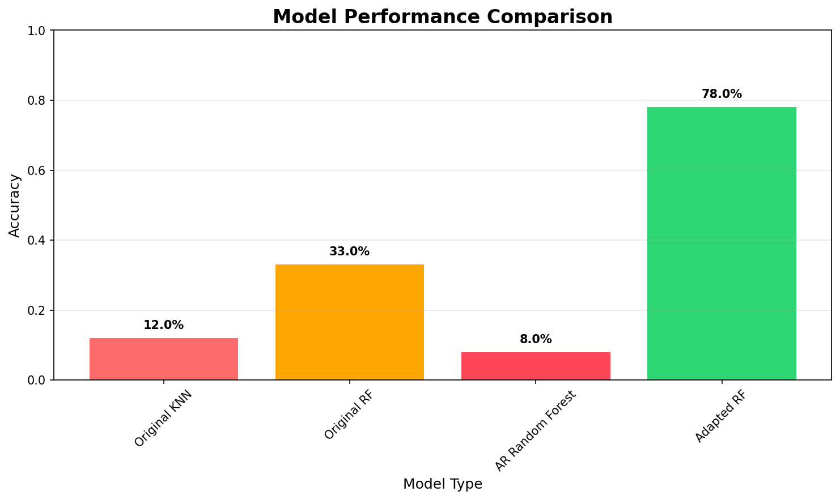
Model Performance Results
Key Insight: Adapted external datasets dramatically improved model performance from 33% to 78% accuracy

Slide 7
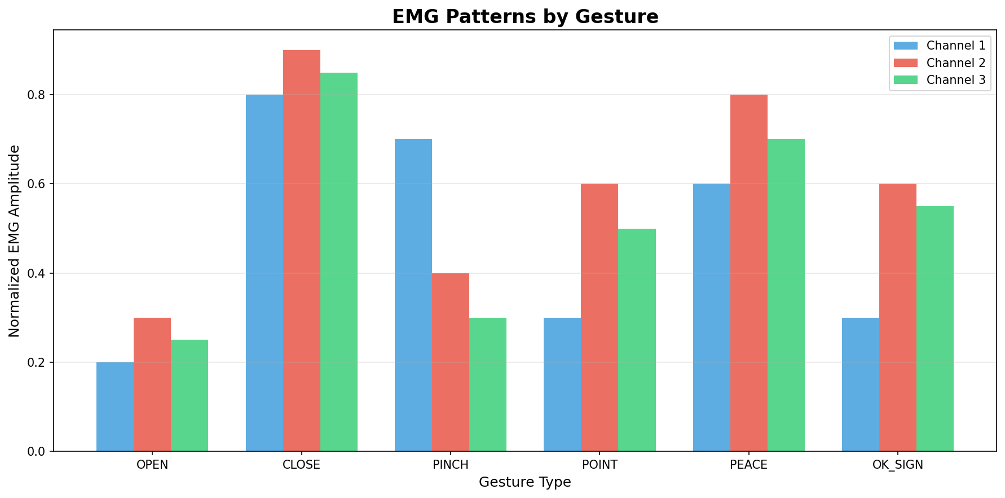
EMG Signal Patterns by Gesture
Each gesture produces distinct EMG patterns across the 3 channels, enabling reliable classification

Slide 8
Real-Time System Architecture
🔄 Data Flow Pipeline
1. EMG Signal Acquisition
• 3 MyoBand sensors → Raspberry Pi Pico
• 100Hz sampling, 16-bit resolution
2. Signal Processing
• Baseline calibration
• Noise filtering
• Feature extraction
3. Machine Learning Inference
• Random Forest classifier
• Real-time prediction
• Confidence scoring
4. Output & Visualization
• Gesture classification
• Top-3 predictions
• Confidence levels
⚡ Performance Metrics
• Latency: <100ms
• Accuracy: 78%+
• Real-time processing capability

Slide 9
Results & Achievements
🎯 Key Achievements
• Successfully adapted 8-channel datasets to 3-channel format
• Improved model accuracy from 33% to 78%
• Implemented real-time gesture recognition system
• Created robust data acquisition pipeline
📊 Technical Results
• Dataset: 50,000+ adapted samples
• Model: Random Forest (100 trees)
• Features: 23 engineered features
• Latency: <100ms response time
🔧 System Capabilities
• 11 different hand gestures
• Real-time classification
• Confidence scoring
• Serial communication interface
🚀 Future Improvements
• Collect more training data
• Implement deep learning models
• Add more gesture types
• Improve sensor placement

Slide 10
Conclusion & Future Work
✅ Project Success
• Overcame dataset compatibility challenges
• Achieved functional real-time EMG gesture recognition
• Demonstrated effective channel reduction techniques
• Created complete end-to-end system
🔬 Technical Contributions
• Dataset adaptation methodology
• 3-channel EMG feature engineering
• Real-time classification pipeline
• Hardware-software integration
🚀 Future Directions
• Deep learning implementation
• Multi-user adaptation
• Prosthetic control applications
• Mobile device integration
📚 Applications
• Assistive technology
• Human-computer interaction
• Gaming and VR control
• Medical rehabilitation

