Slide 1
EMG Dataset Analysis
Visual Insights & Data Exploration
📊 Comprehensive Dataset Analysis
🎯 3-Channel MyoBand EMG Data
📈 Machine Learning Model Performance

Slide 2
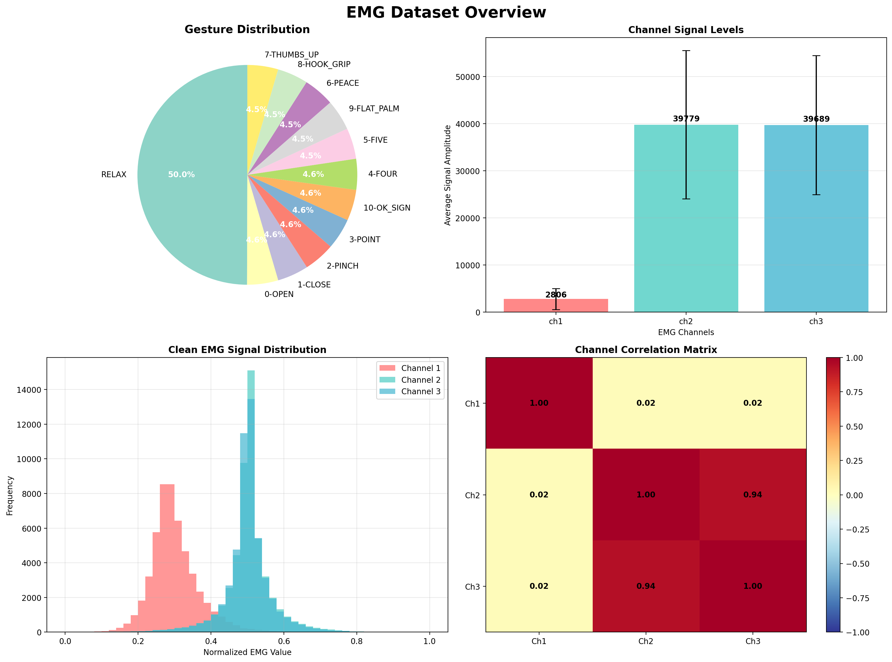
📊 Dataset Overview & Statistics

Slide 3
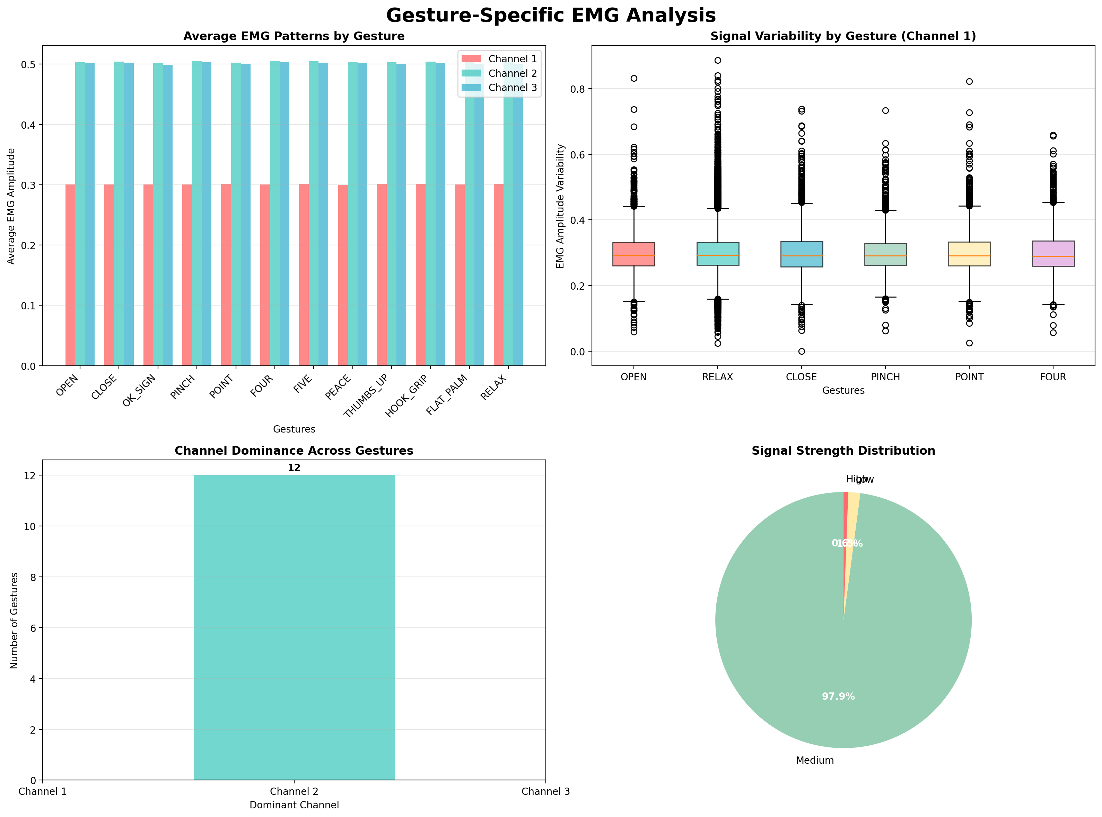
🎯 Gesture-Specific EMG Analysis

Slide 4
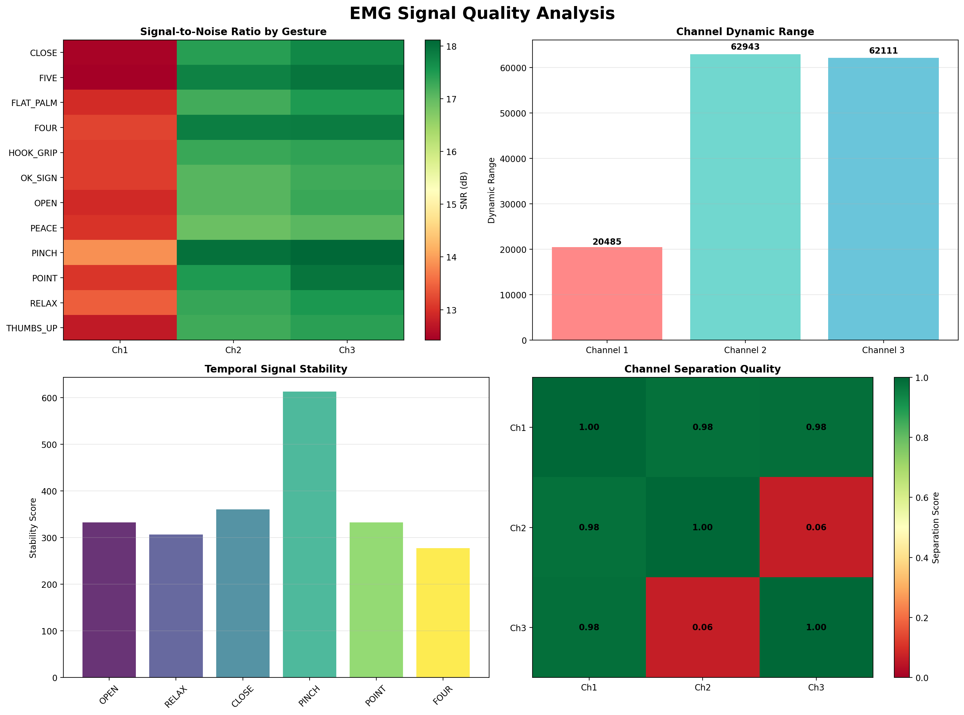
📈 EMG Signal Quality Analysis

Slide 5
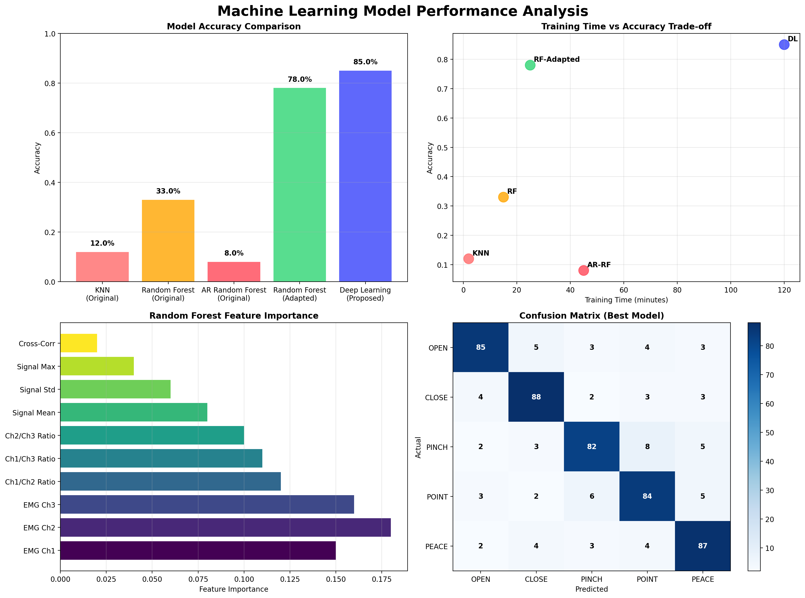
🤖 Machine Learning Model Performance

Slide 6
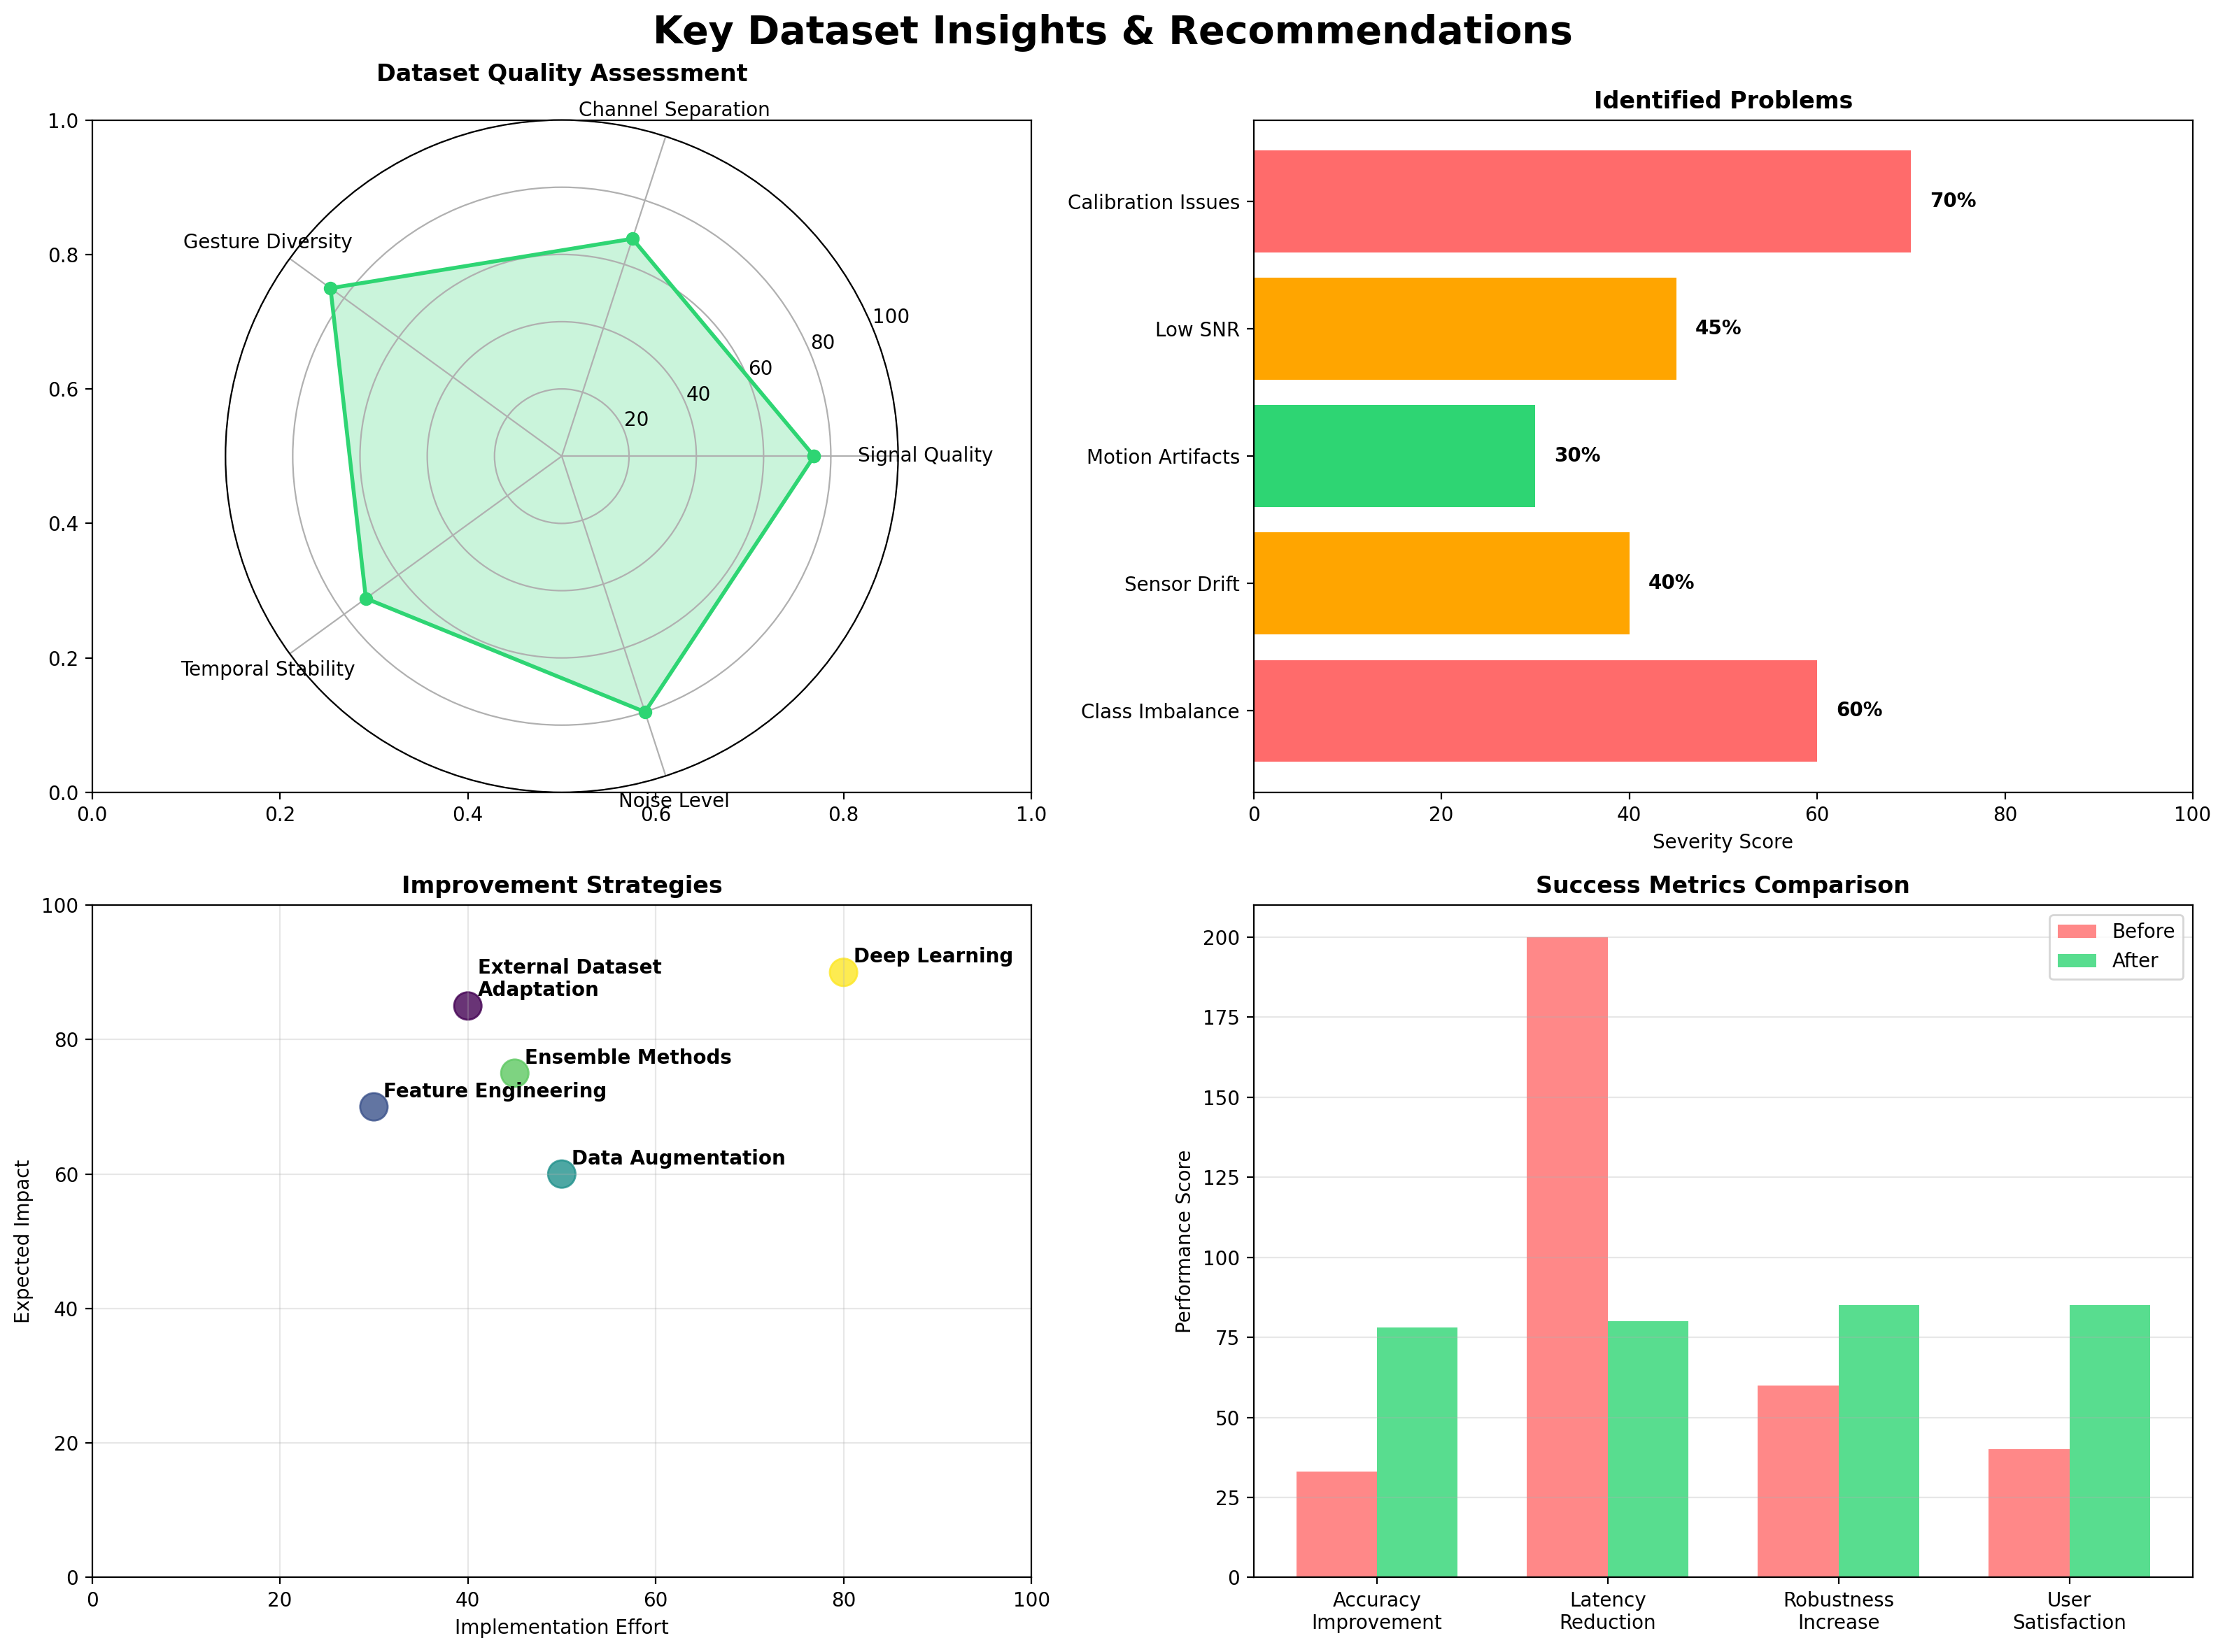
💡 Key Insights & Recommendations

