Slide 1
Multi-lens ultrasound arrays enable large scale three-dimensional micro-vascularization characterization over whole organs
Nabil Haidour , Hugues Favre , Philippe Mateo, Juliette Reydet , Alain Bizé , Lucien Sambin , Jianping Dai , Paul-Matthieu Chiaroni, Bijan Ghaleh , Mathieu Pernot , Mickael Tanter & Clement Papadacci
1 Institute Physics for Medicine Paris – INSERM, ESPCI Paris-PSL, CNRS, Paris, France.
2 INSERM U955-IMRB, University Paris-Est Creteil, National Veterinary School of Alfort, Paris, France.
3 Interventional Cardiology Department, Henri Mondor Hospital, Creteil, France. e-mail: clement.papadacci@espci.fr

Slide 2
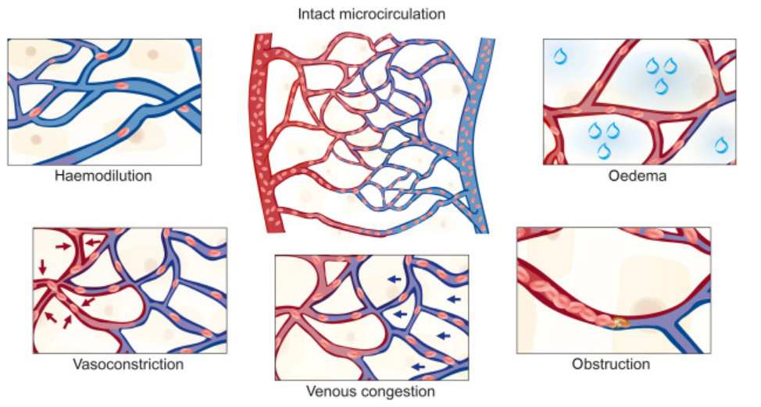
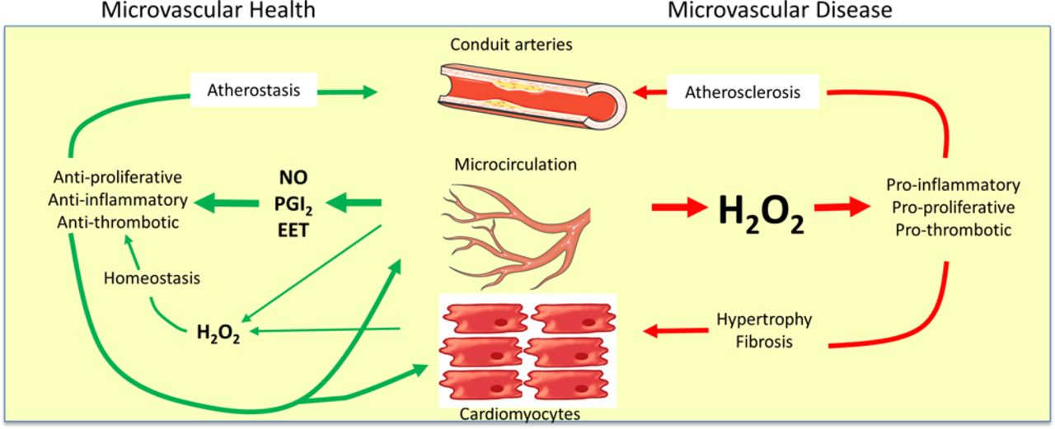
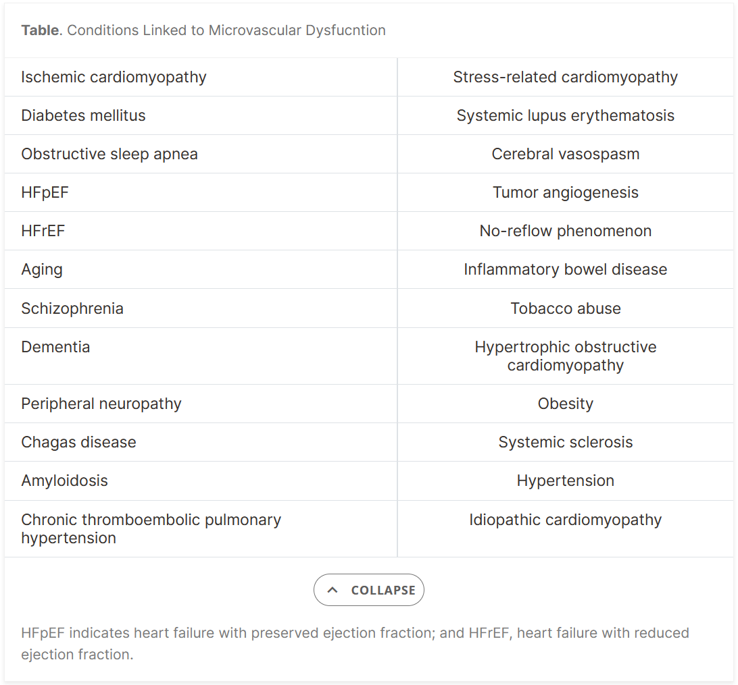
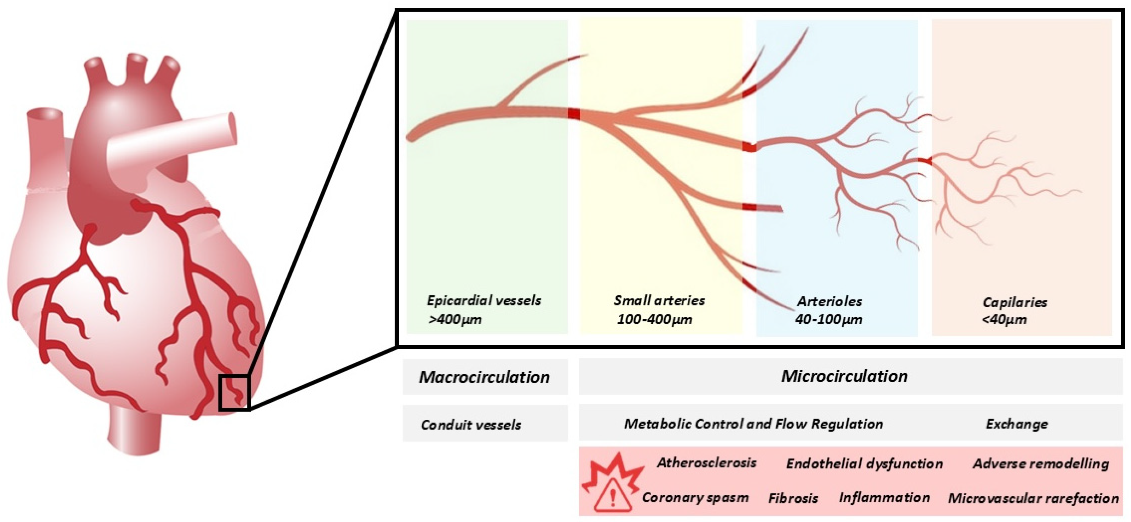
Clinical motivation
Microcirculation is critical for :
Tissue oxygenation & nutrient exchange
Optimal organ function (heart, kidney, liver)
Structural or functional alteration in these networks :
Heart failure
Renal failure
various chronic diseases
Early detection of :
Tumor angiogenesis
Renal failure
Ischemia

Slide 3
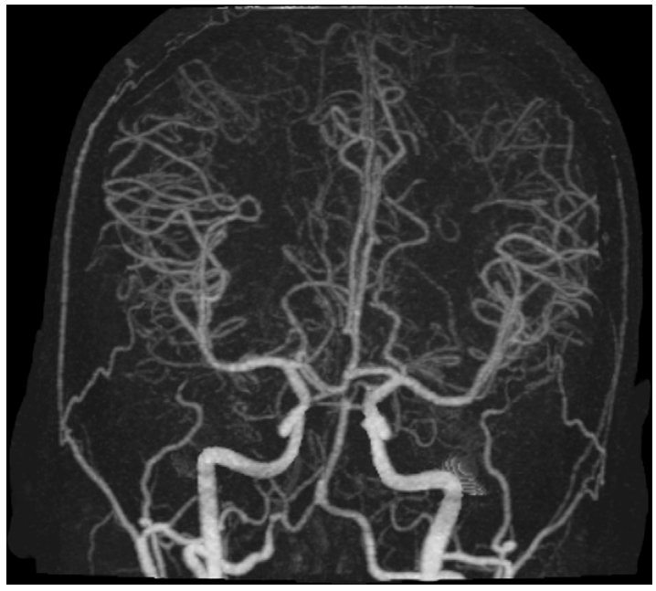
Limitations of existing modalities
CT angiography
✅ Clinical gold standard
✅ Whole organ
✅ Detailed anatomical insights
❌ Static nature
❌ Radiation

Slide 4
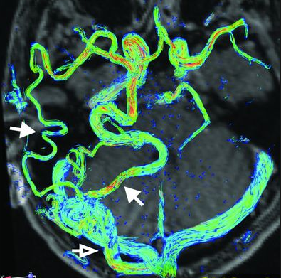
Limitations of existing modalities
4D Flow MRI
CT angiography
✅ Clinical gold standard
✅ Whole organ
✅ Detailed anatomical insights
❌ Static nature
❌ Radiation
✅ Whole-organ or whole-body visualization
✅ Dynamic
❌ Limited spatial resolution : tenths of a millimeter
❌ Acquisition time
❌ Expensive

Slide 5
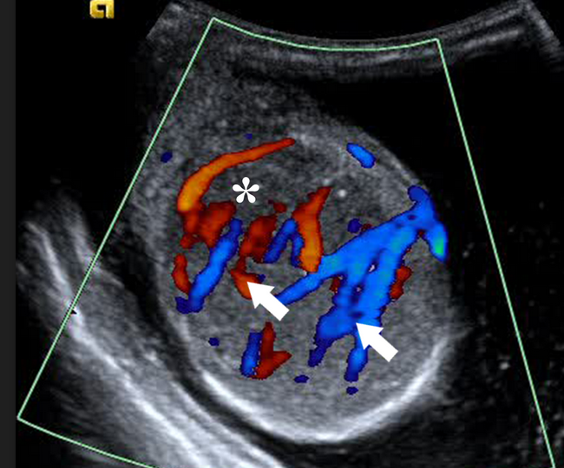
Limitations of existing modalities
4D Flow MRI
CT angiography
✅ Clinical gold standard
✅ Whole organ
✅ Detailed anatomical insights
❌ Static nature
❌ Radiation
✅ Whole-organ or whole-body visualization
✅ Dynamic
❌ Limited spatial resolution : tenths of a millimeter
❌ Acquisition time
❌ Expensive
Doppler Ultrasound imaging
✅ Real time
✅ Blood flow assessment
✅ No radiation
❌ Low resolution
❌ Mainly 2D

Slide 6
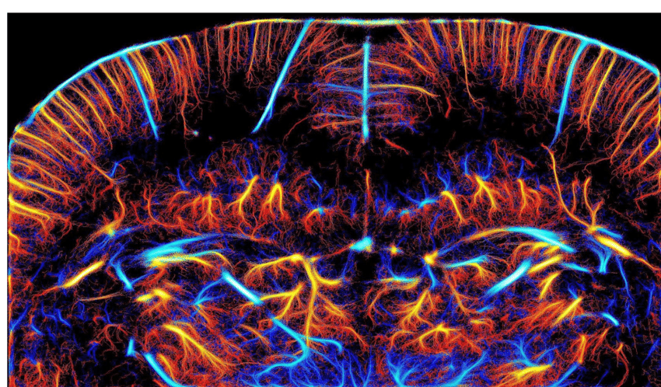
Limitations of existing modalities
4D Flow MRI
CT angiography
✅ Clinical gold standard
✅ Whole organ
✅ Detailed anatomical insights
❌ Static nature
❌ Radiation
✅ Whole-organ or whole-body visualization
✅ Dynamic
❌ Limited spatial resolution : tenths of a millimeter
❌ Acquisition time
❌ Expensive
Doppler Ultrasound imaging
✅ Real time
✅ Blood flow assessment
✅ No radiation
❌ Low resolution
❌ Mainly 2D
Ultrasound Localization Microscopy

Slide 7
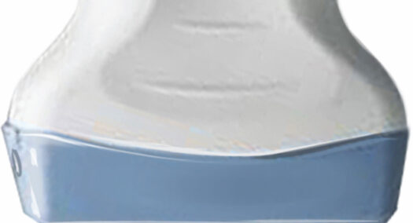
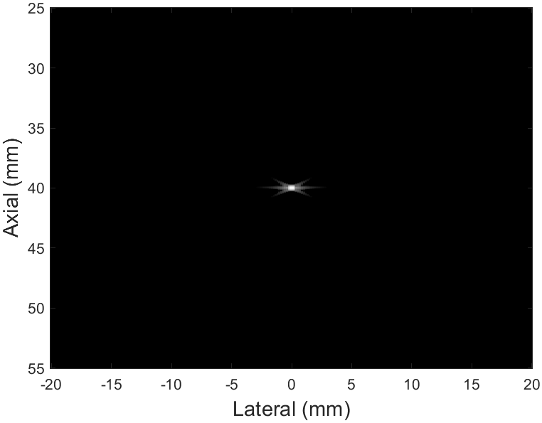
Some Basics before ULM
B-Mode Image
Point Spread Function
(PSF)
●

Slide 8

Some Basics before ULM
B-Mode Image
2 PSFs are separable
●
●

Slide 9

Some Basics before ULM
B-Mode Image
2 PSFs are Undistinguishable
Diffraction limit
●
●

Slide 10
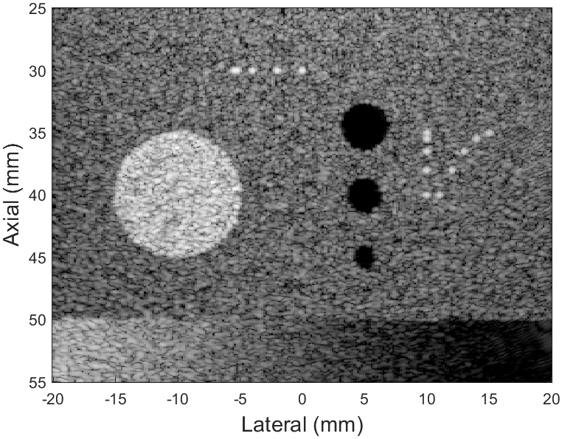
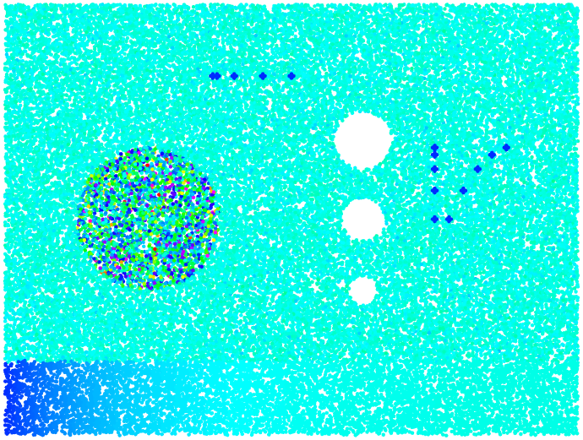
Some Basics before ULM
B-Mode Image
That is speckle
Interference of scattered waves

Slide 11
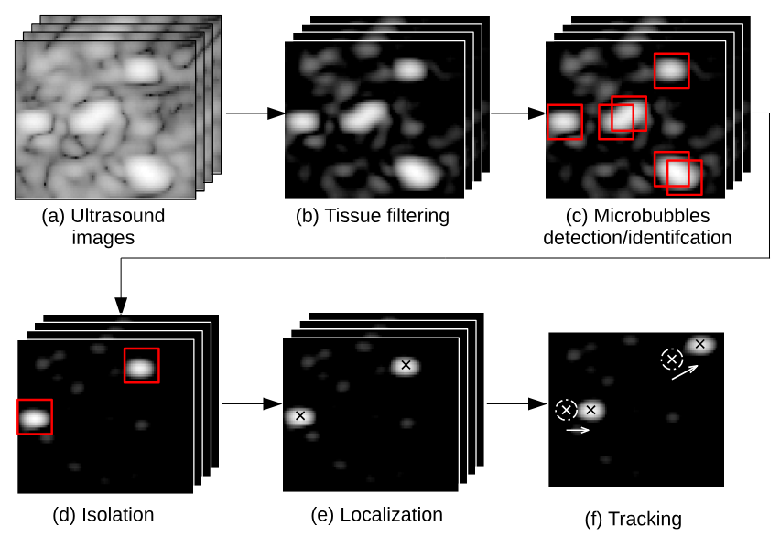
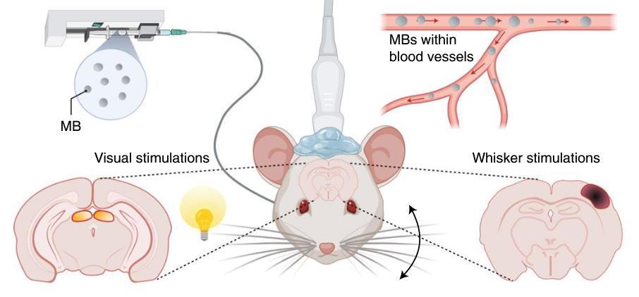
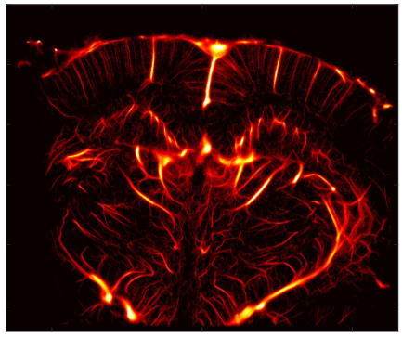
Ultrasound Localization Microscopy
2) ULM processing pipeline
1) experimental setup
3) ULM Maps

Slide 12




Ultrasound Localization Microscopy
2) ULM processing pipeline
1) experimental setup
3) ULM Maps
Why microbubbles?
✅ They stay in the blood pool
✅ Very strong ultrasound scatterers
✅ Tiny size (~1–5 µm radius) : behave like point scatterers at MHz frequencies
✅ Gas-filled core : huge acoustic impedance mismatch with Blood/tissue
Acoustic impedance:
$$Z=ρ.c$$
ρ = density, c = speed of sound
Soft tissue :
ρ ≈ 1000 kg/m³, c ≈ 1540 m/s
$Z_{tissue}$​≈1.5MRayl
Reflection coefficient
$$R=\frac{Z_{air}−Z_{tissue}}{Z_{air}+Z_{tissue}}$$
Bubble–tissue interface : ∣R∣≈1
≈99.9% of the intensity is reflected
Bubbles :
ρ ≈ 1.2 kg/m³, c ≈ 340 m/s
$Z_{air}$​≈0.0004MRayl
Bubbles look extremely bright in ultrasound images.

Slide 13
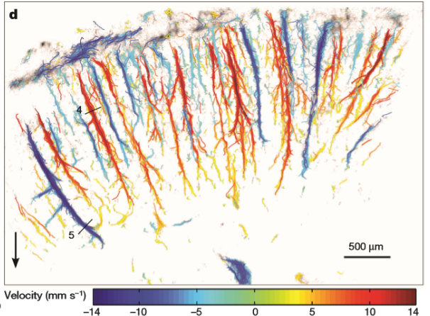
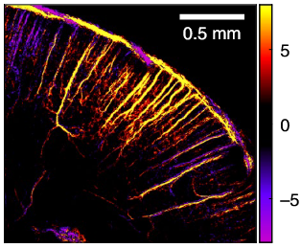
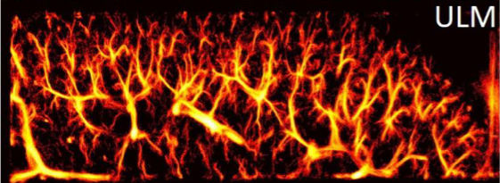
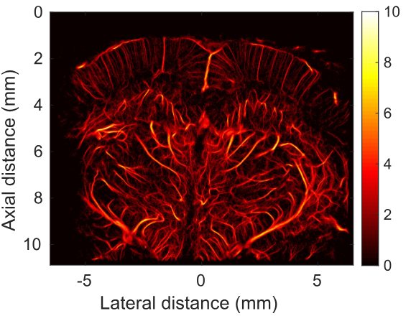
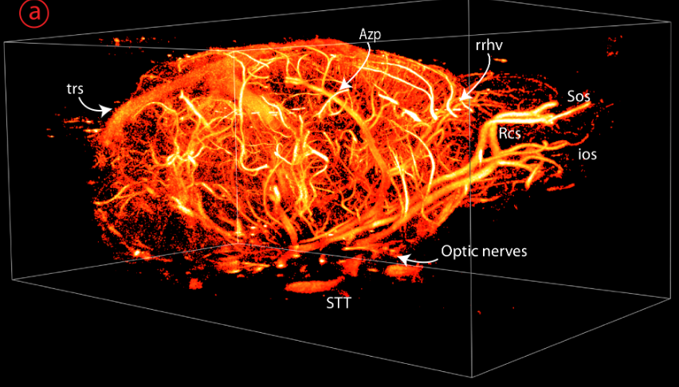
Ultrasound Localization Microscopy
Errico et al,
J. Foiret et al,
Noémi Renaudin et al,
❌ Used mainly in small animals
❌ Typically 2D or small 3D volumes
Alexandre Corazza et al,
Baptiste HEILES et al,

Slide 14
Ultrasound Localization Microscopy
Errico et al,
J. Foiret et al,
Noémi Renaudin et al,
❌ Used mainly in small animals
❌ Typically 2D or small 3D volumes
Alexandre Corazza et al,
Baptiste HEILES et al,
Scientific approach
✅ Map whole-organ microcirculation in 3D at high resolution
✅ 100 × 100 × 100 mm³ @ 100 µm resolution @ 300 Hz ❌ Impossible with traditional probes
✅ Multi-lens array + 3D ULM
✅ Up to 120 × 100 × 82 mm³ volume
✅ 125–200 µm resolution at 312 Hz
✅ Low-cost, scalable system

Slide 15
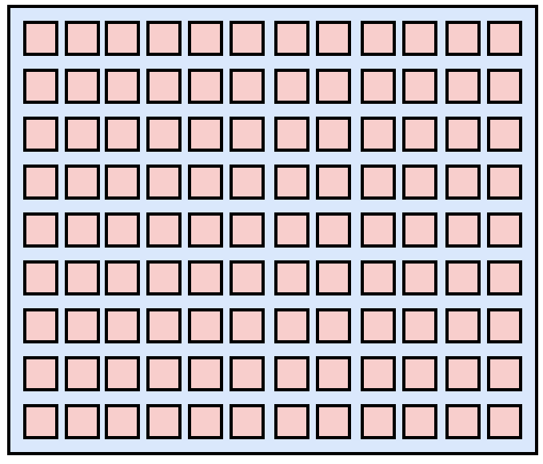
3D ultrasound imaging
2D Matrix Arrays
Example :
❌ Respect pitch=half wavelength
❌ Small Transducer elements
❌ Large number of elements (>1024)
❌ Complex connectivity
❌ Cable size
❌ Data transfer/storing problem
Consider a 128 element linear array (38mm aperture)
The same array in 2D have 128x128 element
64 Verasonics systems are needed
Paper needs : around 100mm wide aperture

Slide 16
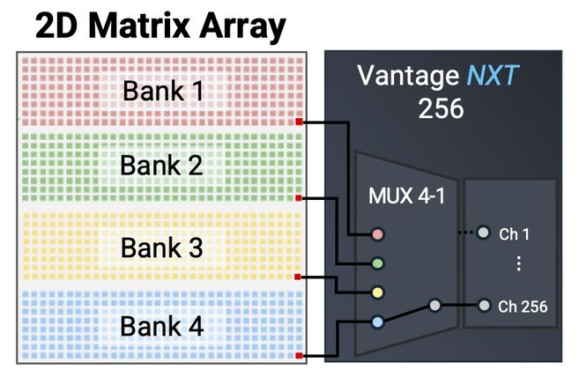
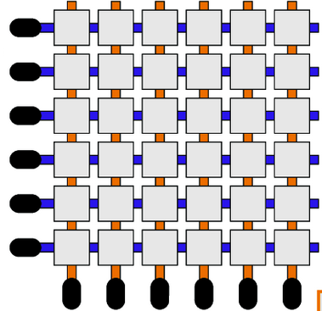
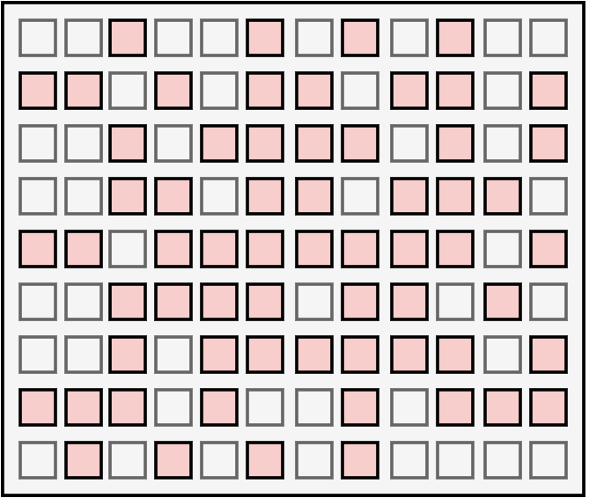
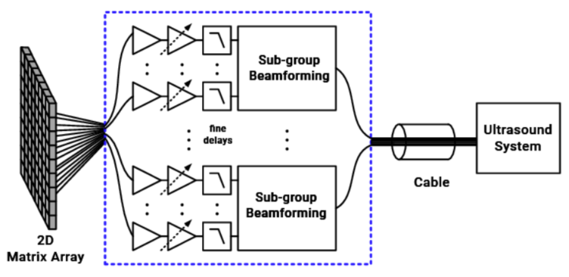
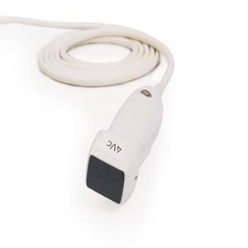
3D ultrasound imaging
2D Matrix Arrays
Example :
❌ Respect pitch=half wavelength
❌ Small Transducer elements
❌ Large number of elements (>1024)
❌ Complex connectivity
❌ Cable size
❌ Data transfer/storing problem
Consider a 128 element linear array (38mm aperture)
The same array in 2D have 128x128 element
64 Verasonics systems are needed
Paper needs : around 100mm wide aperture
Channel multiplexing
RCA Arrays
Sparse Arrays
Micro-Beamforming
We can still do 2D matrix array
Not multiplex & not micro-beamformed
Low number of elements
Large elements
GE 4Vc-D XDclear

Slide 17
3D ultrasound imaging
Small Elements
Large Elements
✅ Good divergence
❌ High Impedance
✅ Low Impedance
❌ Highly Directive

Slide 18
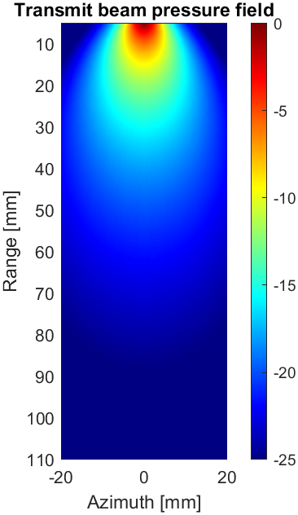
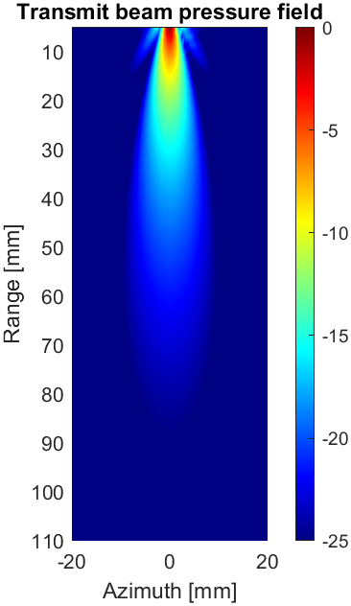
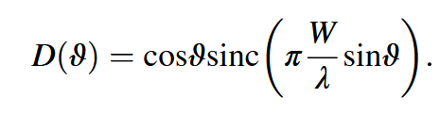
3D ultrasound imaging
Small Elements
Large Elements
✅ Good divergence
❌ High Impedance
✅ Low Impedance
❌ Highly Directive
Element width = λ
Element width = 3λ

Slide 19
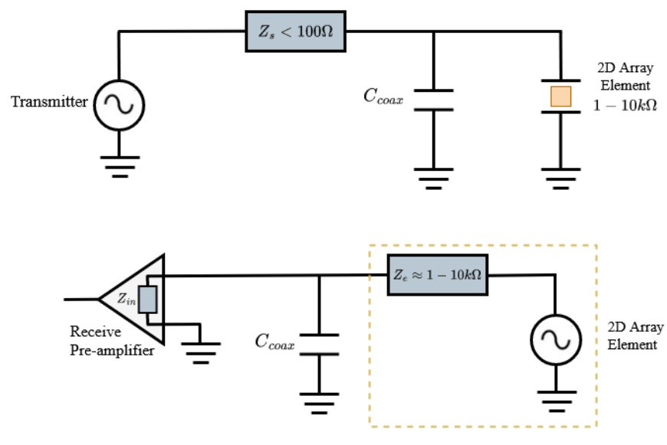

3D ultrasound imaging
Small Elements
Large Elements
✅ Good divergence
❌ High Impedance
✅ Low Impedance
❌ Highly Directive
Simplified electrical circuit
including small element
Element capacitance :
$$C_{0}=\frac{ε_{0}ε_{r}A}{T}$$
Element width = λ
Element width = 3λ
The winning combination
Few Elements + Large Elements + Diverging Elements

Slide 20
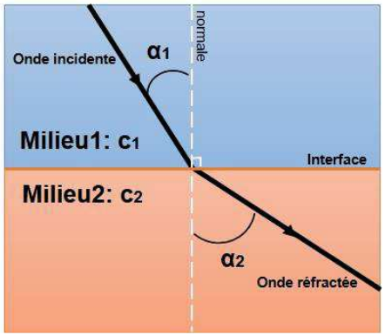
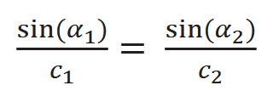
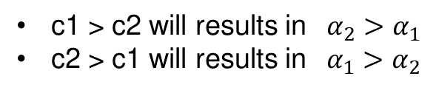
Making Large Elements Diverging
Refraction
c1 > c2 will results in $α_{2}>α_{1}$
c2 > c1 will results in $α_{1}>α_{2}$
Snell’s low
✅ We can use this to create a lens to diverge the acoustic wave of a large element

Slide 21
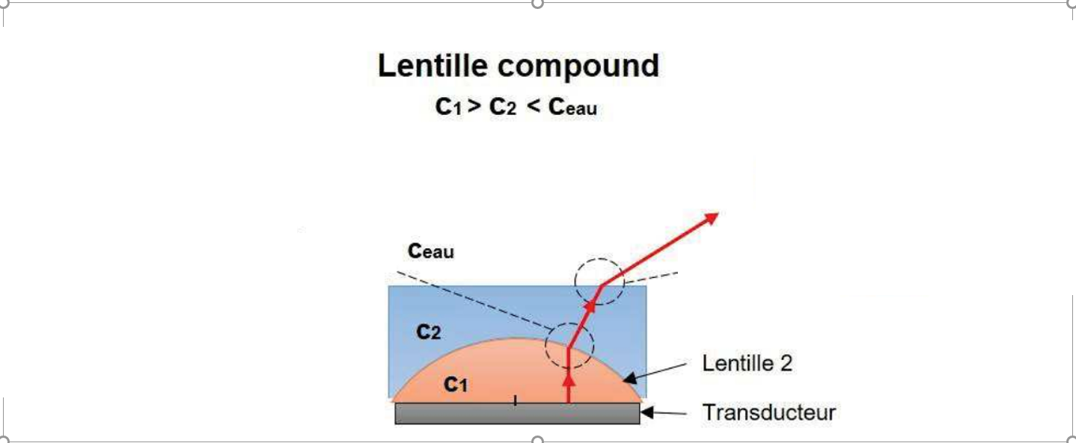
Making Large Elements Diverging
Refraction
c1 > c2 will results in $α_{2}>α_{1}$
c2 > c1 will results in $α_{1}>α_{2}$
Snell’s low
✅ We can use this to create a lens to diverge the acoustic wave of a large element
Plano-convex lens (c1 = 2570 m/s) combined to plano-concave lens (c2 = 1015 m/s)

Slide 22
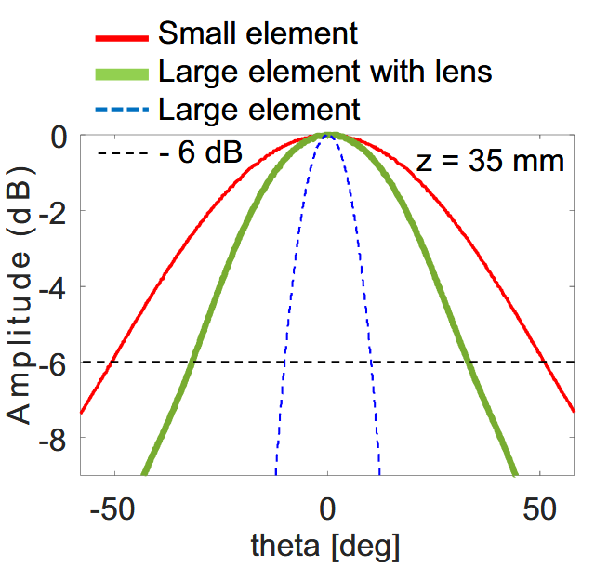
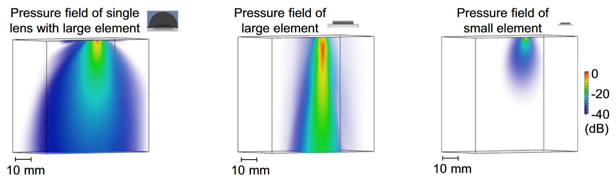
Element Directivity
✅ 3D maps of maximum transmitted acoustic pressure field
✅ Volume of 60 × 60 × 60 mm³
✅ The size of an element was 4.5 × 4.5 mm² representing 3 times the acoustic wavelength
✅ Acoustic lens increase divergence
✅ The -6db directivity : large element with lens (33.17°), the large element (10.27°) and the small element (51.13°).
✅ Large element increase the transmitted energy

Slide 23
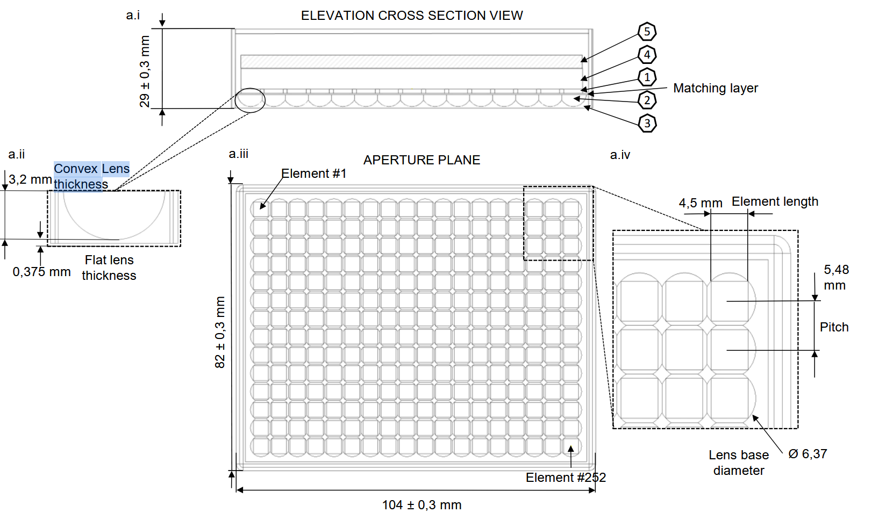
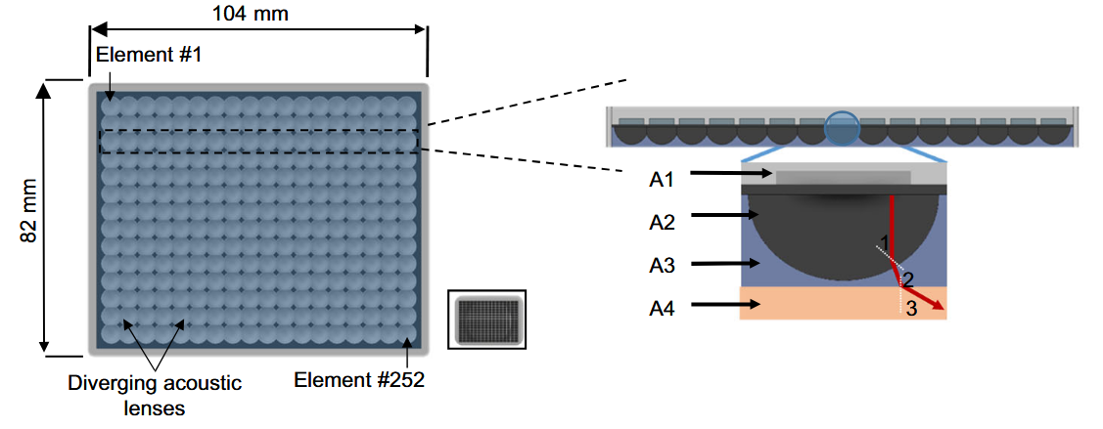
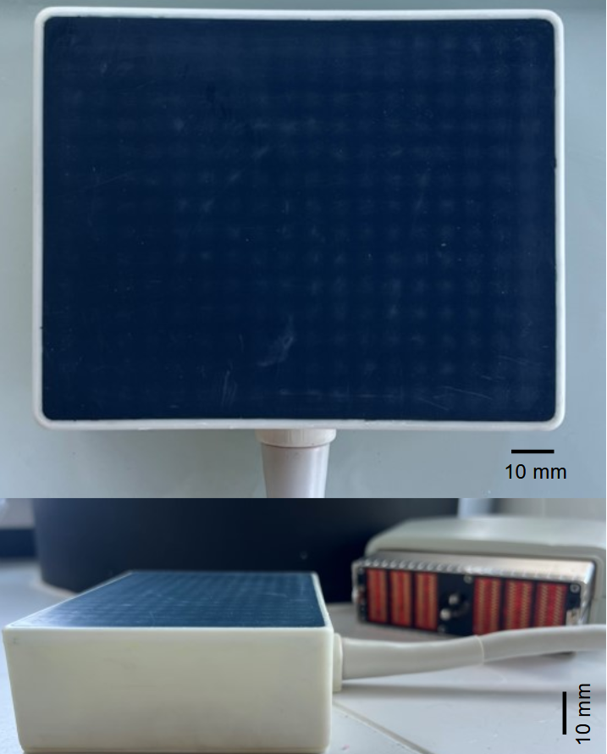
The Multi-Lens Array
Aperture size of the probe was 104 × 82 mm²
Central frequency of 1MHz (60% BW)
Three acoustic principal layers :
252 large transducer matrix piezocomposite elements (14 × 18, 4.5 × 4.5 mm, pitch 3.65λ)
Diverging acoustic lenses (plano-convex lenses), also arranged in 14 × 18 configuration.
Flat lens layer (silicon plano-concave lens) was molded above the diverging lens layer

Slide 24
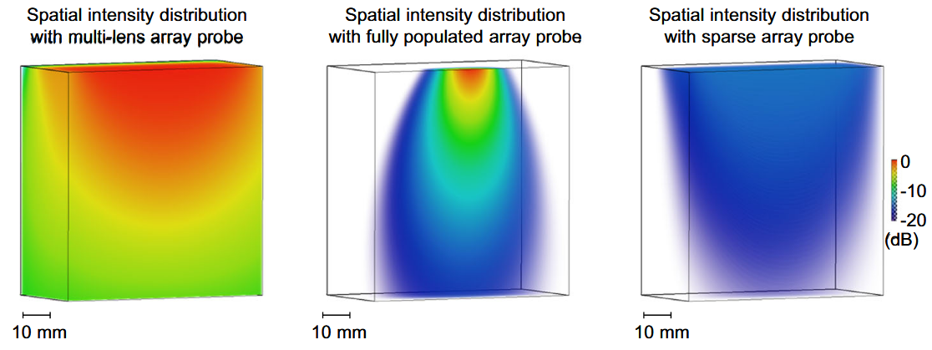
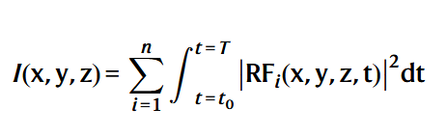
Array sensitivity
Dense array ( element size : λ/2 × λ/2, aperture size : 14 × 11 mm)
Sparse array : no information given
Sensitivity (105 × 100 × 100 mm volume):

Slide 25
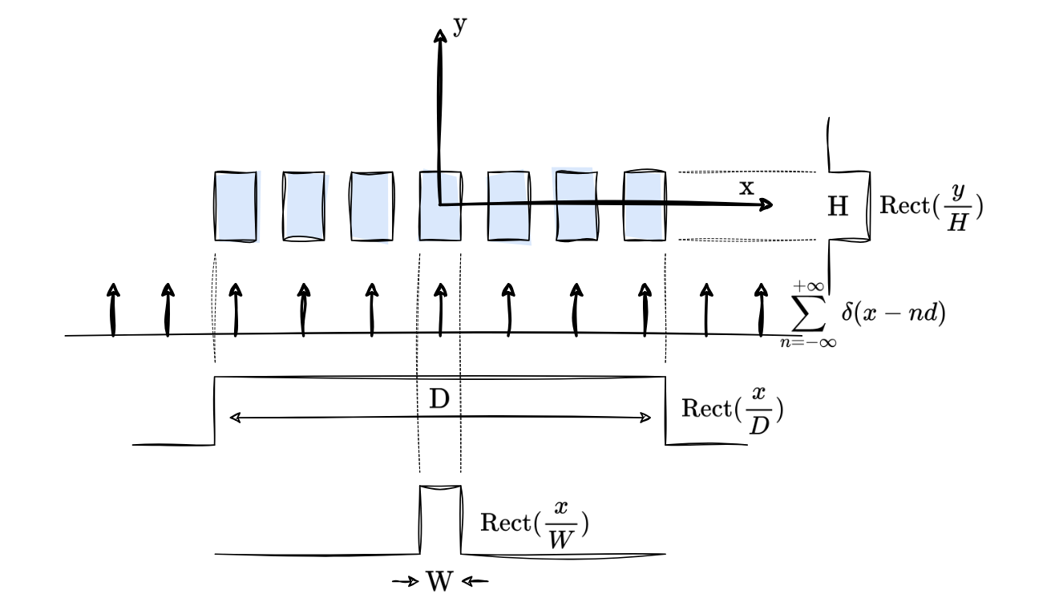
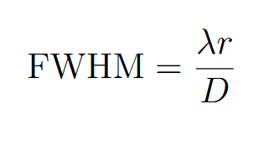
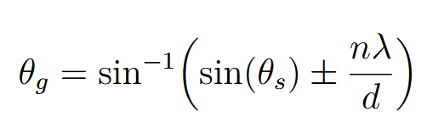
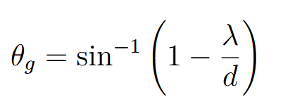
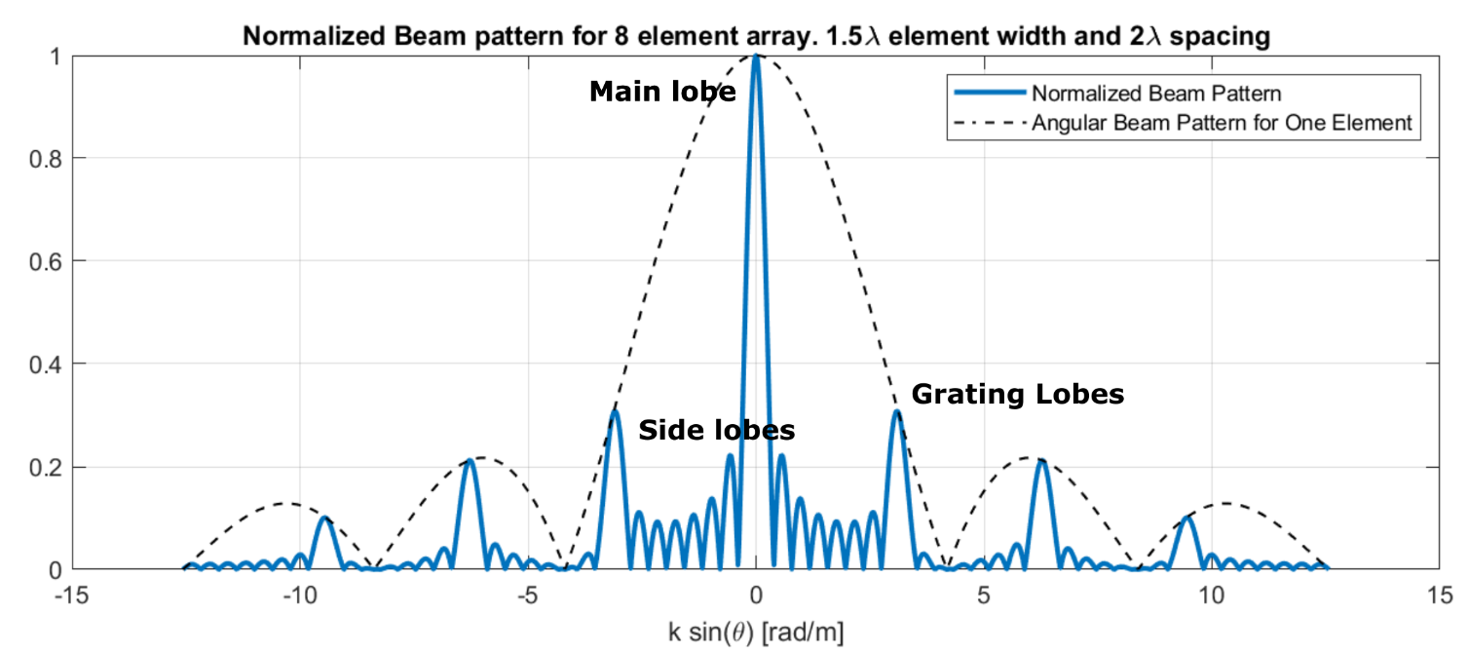


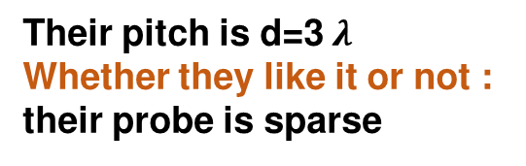
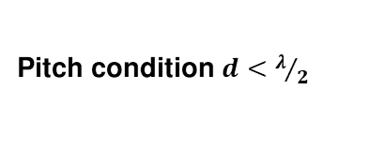
Sparse Array or Not ?
2 important metrics
Main-lobe width : affect resolution
Grating lobe : affect contrast
Extreme case $θ_{s}=90° , n=−1$:
The beampattern
is the Fourier transform of
the aperture function
Pitch condition $d<λ/2$
Their pitch is d=3 $λ$
Whether they like it or not :
their probe is sparse

Slide 26
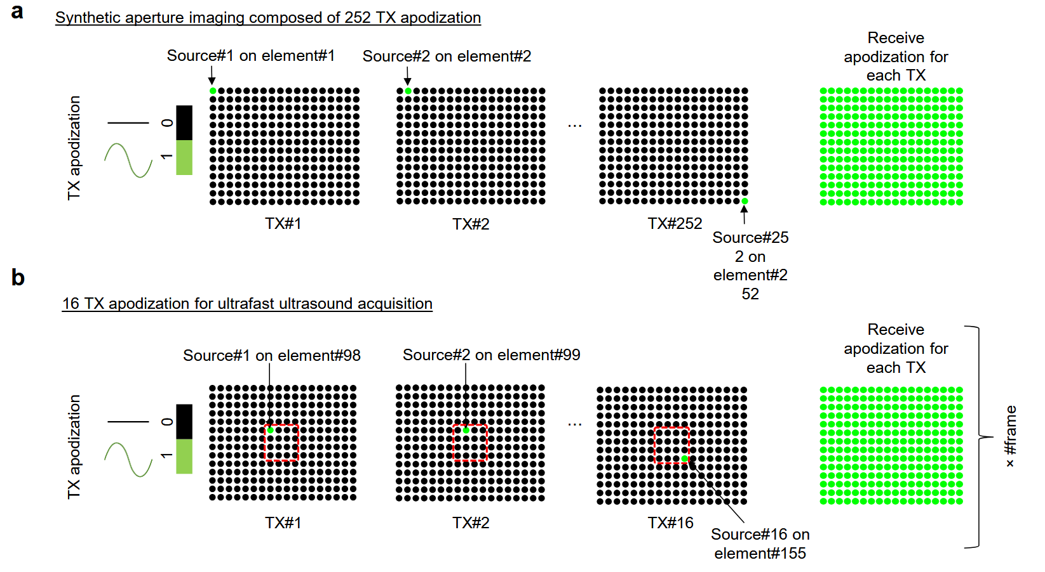
Imaging sequence
Diverging wave emissions : short pulses of two cycles (1 MHz).
PRF = 5000 Hz → 312.5 Hz
Total acquisition time
Data acquired in blocks
Number of blocks per experiment
Tube Phantom: 13 min
Heart: 5 min
Kidney: 5 min
Liver: 162 s (~2.7 min)
In vitro & ex vivo: 830 ms → 256 volumes/block
In vivo: 1.2 s blocks
Blocks spaced every 300 ms (for data saving)
Tube phantom: 1000 blocks
Ex vivo heart: 400 blocks
In vivo kidney: 290 blocks
In vivo liver: 133 blocks

Slide 27
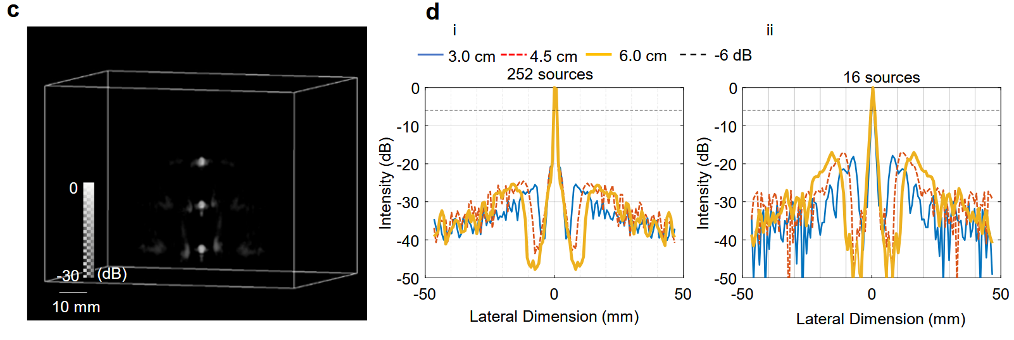


Results : PSFs
Simulation
Experimental
PSFs at depths of 3 cm, 4.5 cm, and 6 cm
252 sources :
Tip of a needs
16 sources :
Grating lobe level of approximately –25.50 dB, –24.57 dB, and –25.36 dB
Lateral resolution was found to be 1.15 mm, 1.17 mm, and 1.26 mm
Grating lobes of -22.40 dB and
lateral resolution of 1.06 mm
16 sources
Probably around -17dB
Probably around 1.20mm

Slide 28



Results : Flow tube
Reconstructed MB density volume
large imaging volume of 100 × 93 × 30 mm³
No grating lobes : filtered by tracking algorithm
Diameter was measured : 916 ± 38 μm
Agreement with the tube diameter (870 μm).
Measured flow in a agreement with the imposed flow
Polyethylene tube immersed in a water.
Diameter 870 μm and depth = 60 mm.
100 μL of microbubbles mixed with 100 ml injected
Rate of 5 mL/h , 100 mL/h , 150 mL/h , and 200 mL/h

Slide 29



Results : Isolated Heart
MB density map of the coronary network
3D flows velocity map
Experiment on the isolated perfused heart
isolated perfused heart
Normal heart flow : Left ventricle → Aorta → Coronary arteries → Heart muscle
Retrograde :
Volume: 120 × 100 × 82 mm³
Full coronary network visualized
Flow velocity: 10 – 300 mm/s
Vessel radius: 75 – 600 µm
pump fluid backward into the aorta
pressure forces the fluid into the coronary arteries
Oxygenated Krebs-Henseleit solution
Perfusion rate: 0.25 L/min=250 mL
Heart motion was reduced by setting the solution to 3°C : slow metabolism and contractions

Slide 30


Results : In-vivo
In vivo porcine kidney Setup
In vivo porcine liver Setup
3 swines fully anesthetized and mechanically ventilated
Real-time B-mode with Philips® Lumify (S4-1U probe) : for probe guidance
2D probe fixed using an articulated arm
Microbubbles :1mL(0.5 mL every minute) Intravenous injection (ear vein)
Acquisitions triggered between respiratory phases (ECG)

Slide 31




Results : In-vivo
MB density map of the kidney network
MB density map of the Liver network
3D flows velocity map
3D flows velocity map
Volume: 65 × 100 × 82 mm³
Velocity: up to 300 mm/s
More complex : harder due to organs/ribs/motion
Volume: 60 × 80 × 40 mm³
Vessel radius: 70 – 400 µm

Slide 32
Conclusions
Proposed a multi-lens array + 3D ULM to image whole-organ microvasculature
Validated in simulations, phantoms, ex vivo heart, in vivo kidney & liver
Achieved: 125 µm spatial resolution 312 Hz temporal resolution
Cost of the system less than €200k
Limitations
Spatial resolution, estimated at 75×75×75 μm not enough to visualize small capillaries (10 μm).
Improved by developing multi-lens arrays operating at higher frequency (2 to 3 MHz)
Detection based on correlation using gaussian modeled PSF
Low quality B-Mode due to grating lobes
The size of the array may cause patient discomfort

Slide 33





The media attention

