Slide 1
Deep Learning with Tensorflow
A deep dive approach

Slide 2
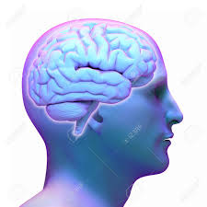
What is Deep Learning ?
Deep Learning is a subset of machine learning in artificial inteligence that mimics the working of human brain in processing the data and creating patterns for decision making

Slide 3
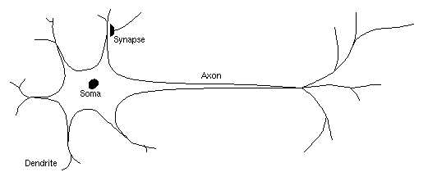
Biological neuron
The cell body or Soma is the processing area.
One or more Dendrites, receives signals from other neurons.
Axon, which in turn conveys
signals to other neurons

Slide 4
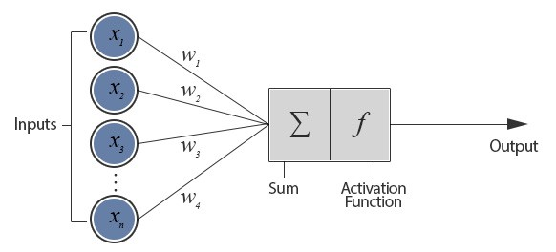
Artificial Neuron
One or more input connections and each connection is assigned a weight.
Activation function determines the numeric value of the output signal.
Output is transmitted to
other neurons

Slide 5

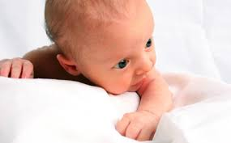
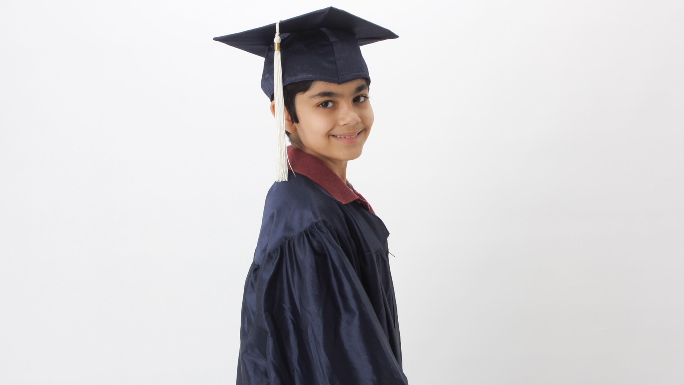
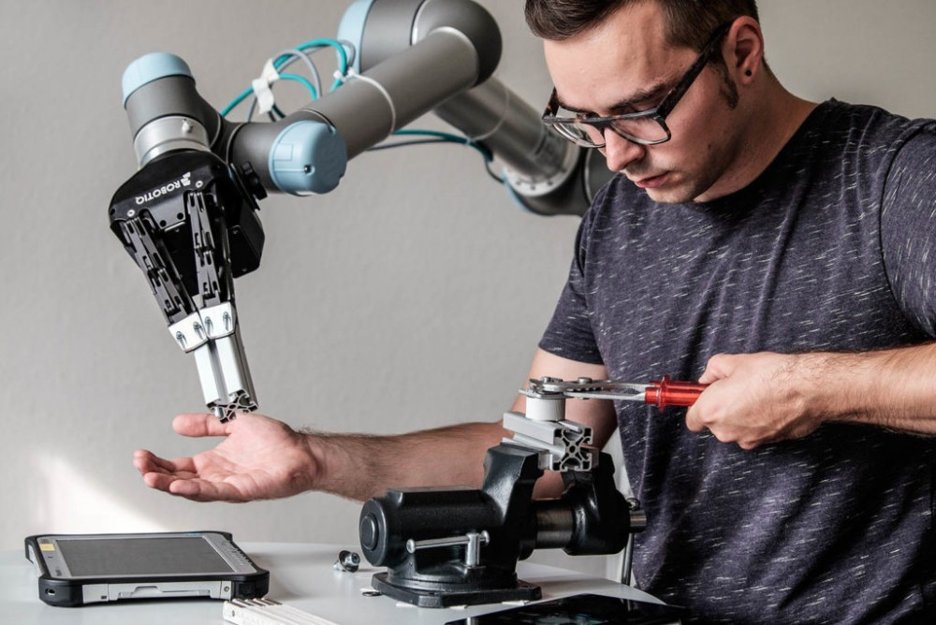
Learning process

Slide 6
Way of Learning
Supervised Deep Learning
  Training with labelled data
Unsupervised Deep Learning
  Training with unlabelled data
Deep Reinforcement Learning
  Training with reward feedback

Slide 7
So, What all deep learning can do ?

Slide 8
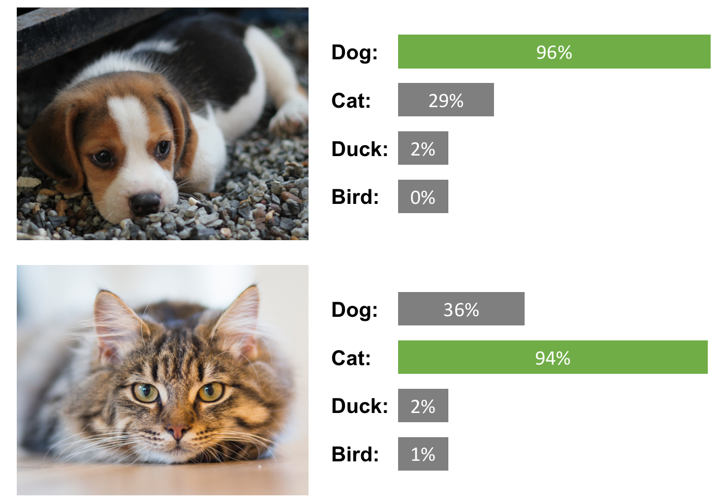
From here...
Classification

Slide 9
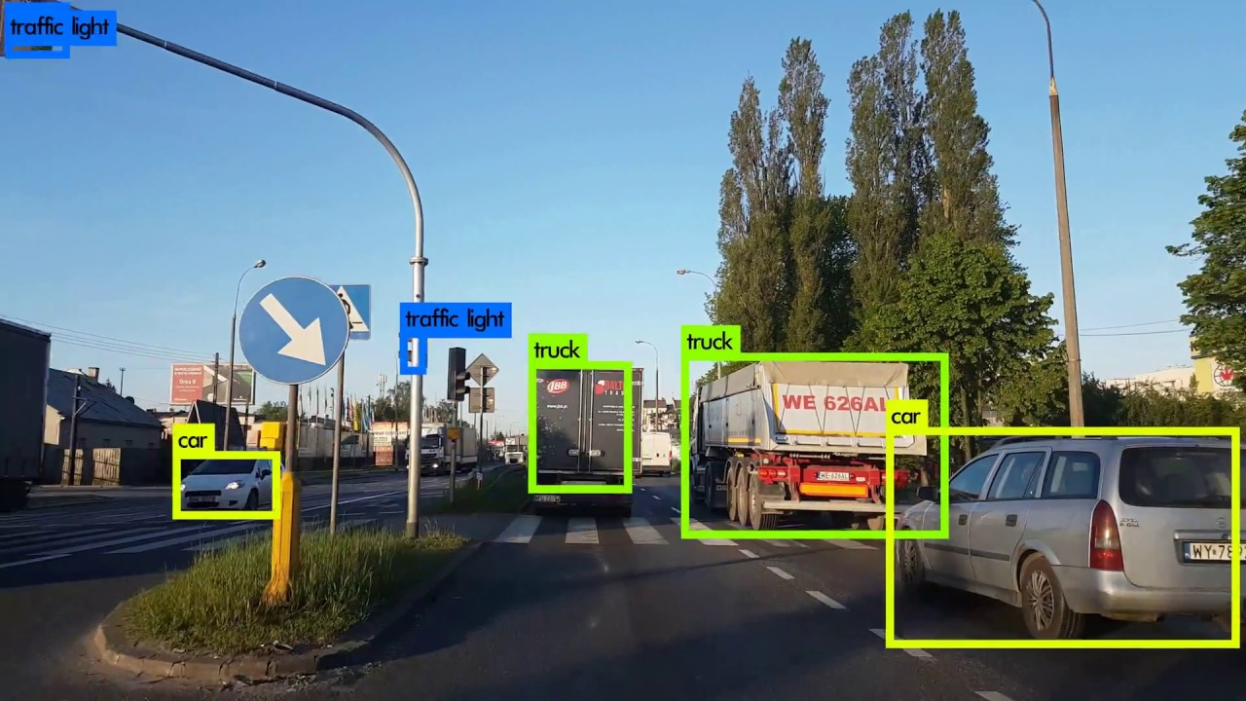
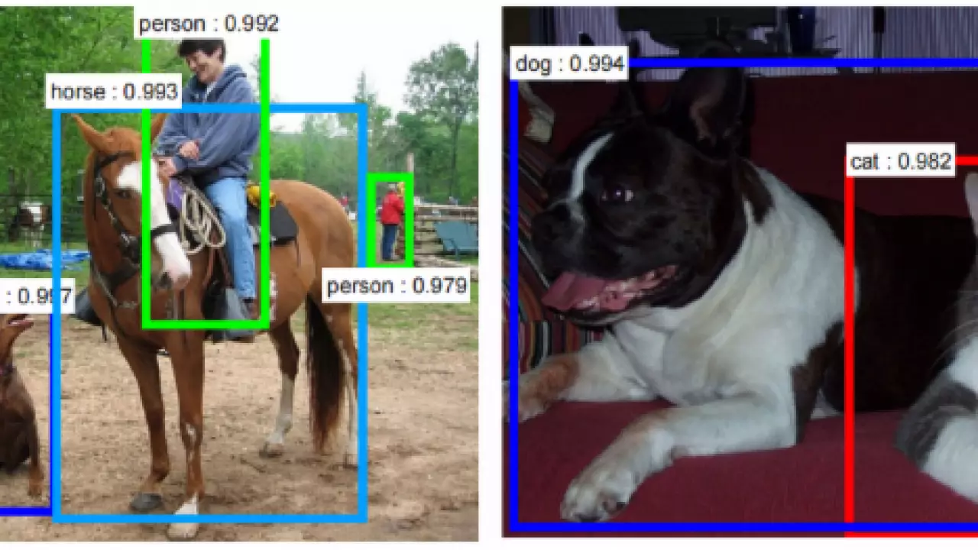
To here ...
Object detection

Slide 10
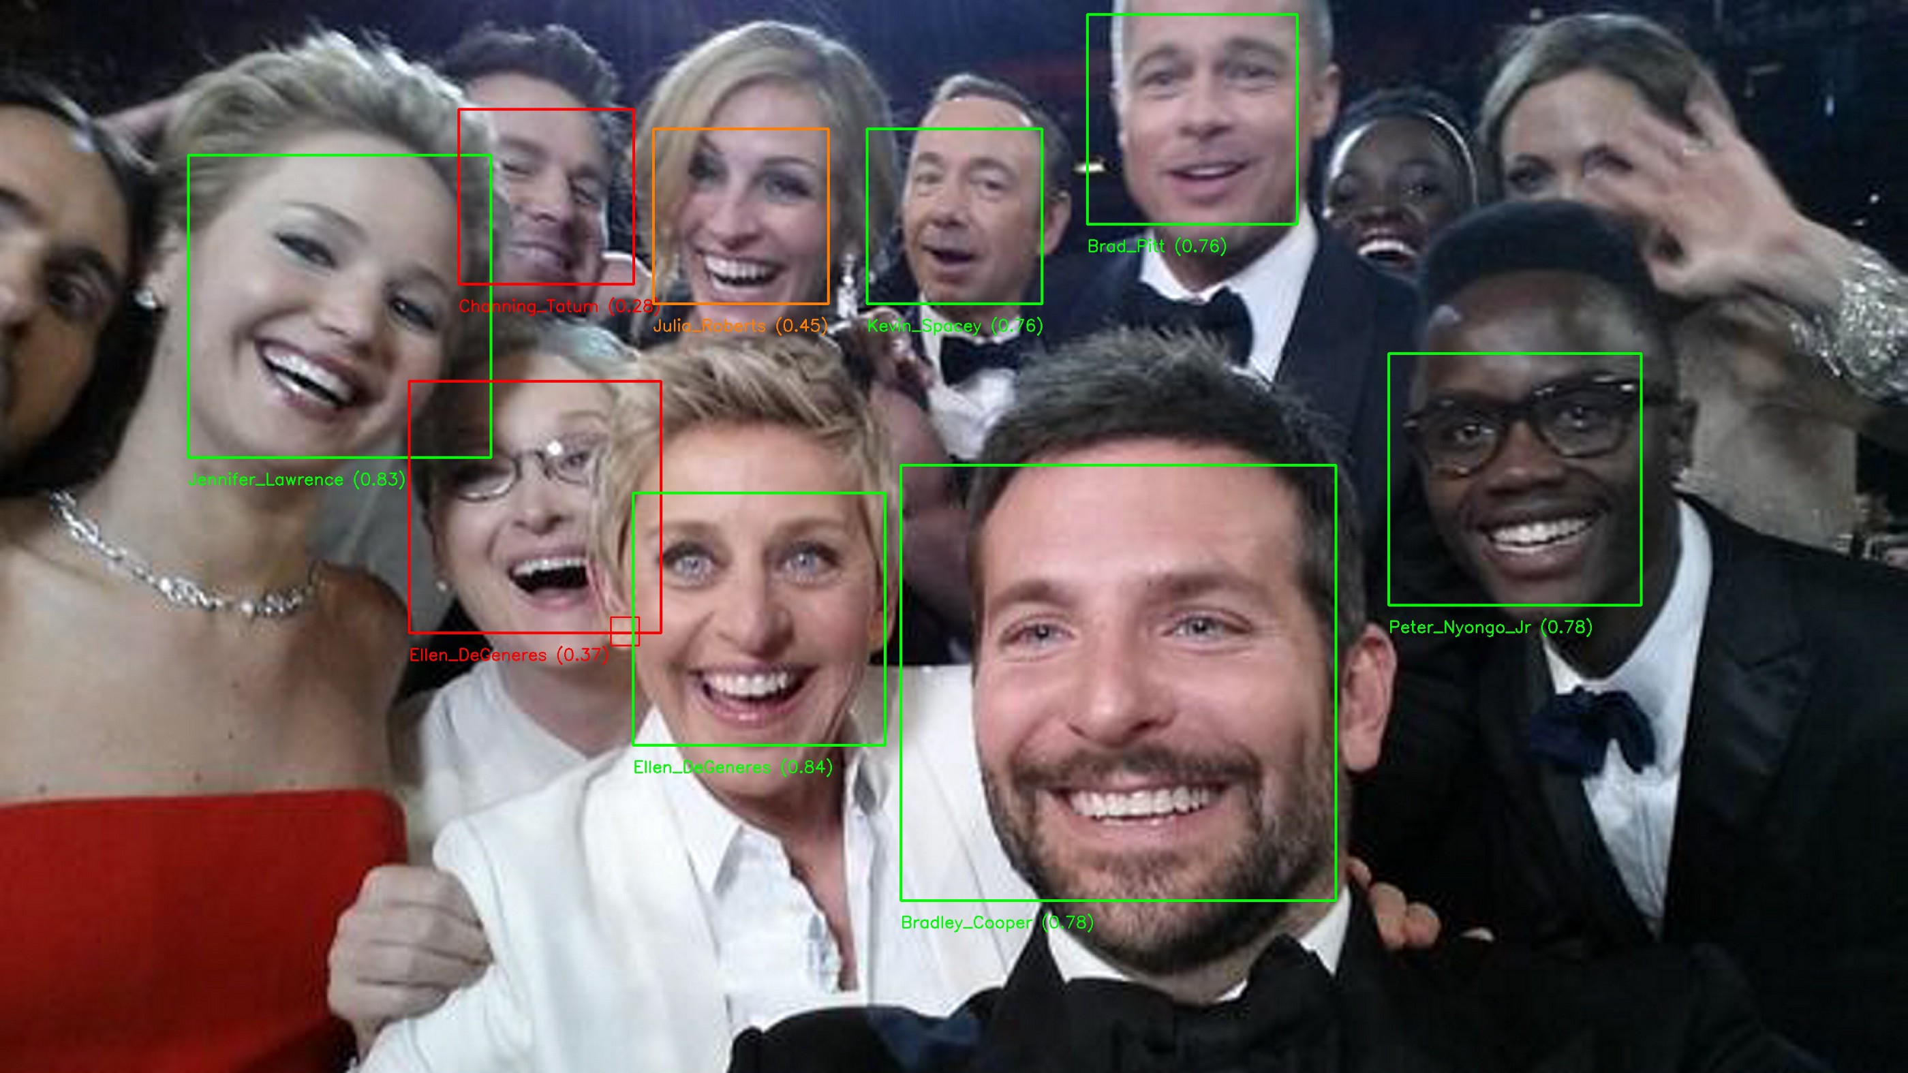
And here...
Facial Recognition

Slide 11
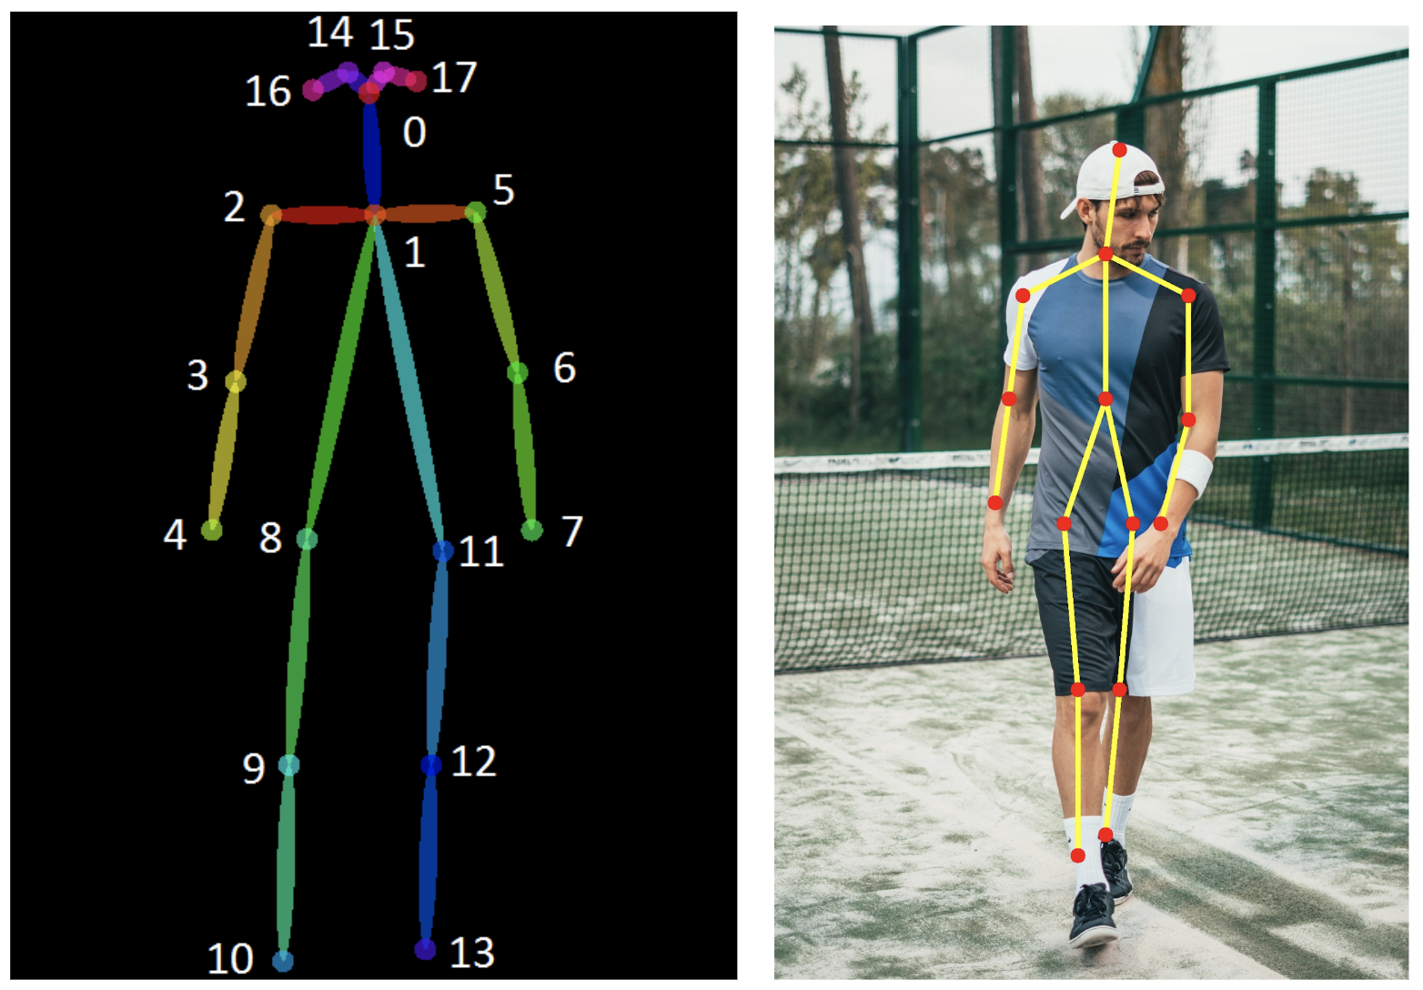
Pose estimation

Slide 12
How to build it ?

Slide 13
Basic building blocks
Input data : Numbers, Image, Video, Voice, Text or even pointclouds
Algorithm : A set of functions that defined to achieve a desired task
Hyperparameters: Configurable parameters that must be tuned in order to obtain a model with optimal performance

Slide 14
Basic building blocks
Training : It’s a process of allowing an algorithm to learn on set of input data.
Model: It’s a mathematical representation of desired task after the training process is completed with optimal hyper-paramter tuning.
Inference : Making prediction on new input data with the trained model.

Slide 15
Deep Neural network
Anything with one input, one output and one or more hidden layers are called Deep Neural Net.
A layer is nothing but a collection of neurons which takes and provides output.
And input are processed through activation functions assigned to neurons.

Slide 16
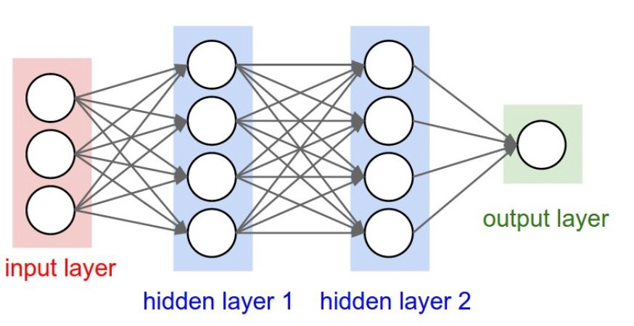
Deep Neural network
Typical Struture of a Deep Neural network

Slide 17
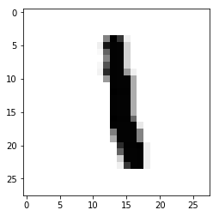
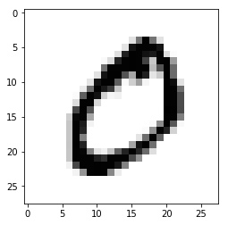
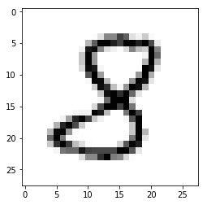
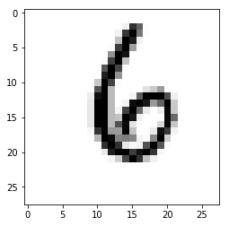
Classify hand written numbers - MNIST

Slide 18
Frameworks and Api’s
My working environment
  Python
  Tensorflow – Keras Api ( pip install tensorflow )
  OpenCV (later) ( pip install opencv-python)
  Colab

Slide 19
Training Process
Step 1 – Forward Propagation
Step 2 – Backward Propagation
The primary goal of training process is to achieve maximum accuracy with minimum loss by reaching global minima.

Slide 20
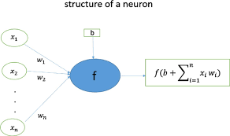
Forward Propagation
Also known as feed forward network
First the input data is passed to the input layer to which a weight is assigned to each neuron
Bias may also be added
(typically it will be 1)
Predicted : 7
Actual : 1

Slide 21
Backward Propagation
Two main funtion comes into action here,
  Loss function : Finds the loss value by matching predicted value with actual value and also finds the gradient of loss.
  Optimizer : It optimizes the weight values by moving backward the layers such that the loss value is minized. Learning rate determines how much value of weight should be adjusted.

Slide 22
Backward Propagation
Actual Value
Optimizer
Loss Function
Predicted Value

Slide 23
Global minima
Both forward and backward propagations are continued numerous steps until we reach global minima.
Learning rate value determines how quickly and how late we reach global minima.
Learning rate shouldn’t be too high as well as too low

Slide 24
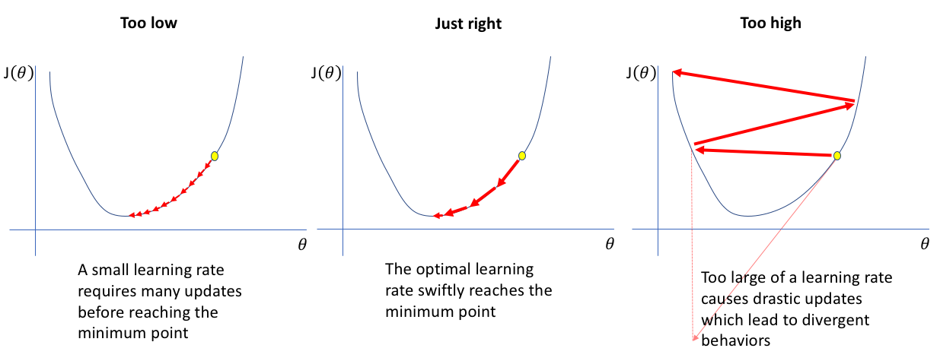
Learning Rate

Slide 26
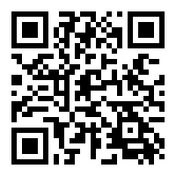
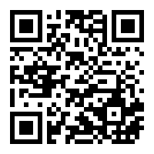

Useful links...
Google Colab Tensorflow OpenCV

Slide 27
Convolution Neural networks
A Convolutional Neural Network (ConvNet/CNN) is a Deep Learning algorithm which can take in an input image apply tranformation and differentiate one from the other.
It is inspired by the connectivity pattern of visual cortex in the human brain.

Slide 28
Why ConvNet
Image is nothing but a matrix of pixel values.
Flatten–ing an image and classifying using multi level perceptron may seem pretty good for simple images.
But it falls behind when it comes to a complex image like this

Slide 29
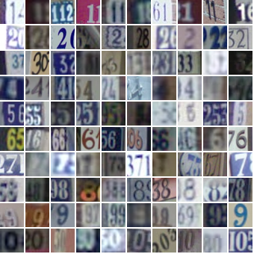
Street view housing number

Slide 30
Layers in a ConvNets
However there are many different layers in CNN; Convolution, pooling and fully connected layers are the important one.

Slide 31
Convolution Layer
Convolutional layer is the very first layer where we extract features from the images in our datasets.
Convolution is basically filtering the image with a smaller pixel filter to decrease the size of the image without loosing the relationship between pixels
When we apply convolution to 5x5 image by using a 3x3 filter with 1x1 stride. We will end up having a 3x3 output

Slide 32

Convolution
Here the filter is
1 | 0 | 0
0 | 1 | 0
1 | 0 | 1

Slide 33
Pooling Layer
Pooling layer is responsible for reducing the spatial size of the Convolved Feature.
Decreases the computational power required to process the data.
Useful for extracting dominant features which are rotational and positional invariant

Slide 34
Types of Pooling layer
Max Pooling returns the maximum value from the portion of the image covered by the Kernel.
Average Pooling returns the average of all the values from the portion of the image covered by the Kernel.
There are two types of Pooling: Max Pooling and Average Pooling. Max Pooling returns the maximum value from the portion of the image covered by the Kernel. On the other hand, Average Pooling returns the average of all the values from the portion of the image covered by the Kernel.

Slide 35
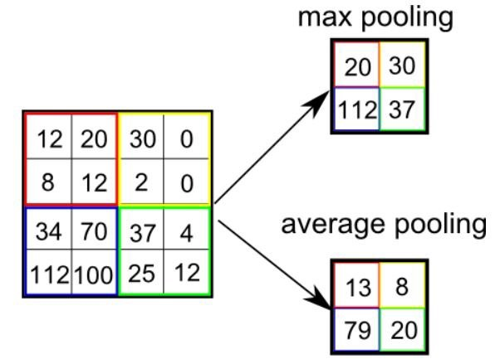
Pooling Layers

Slide 36
Efficiency
Adding convolution layer increases the accuracy.
And it also work better on RGB images.

Slide 37
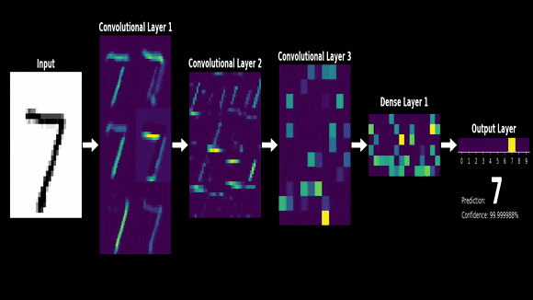
Inside convolution...

Slide 38
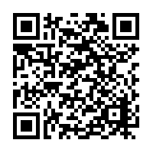
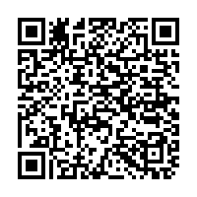
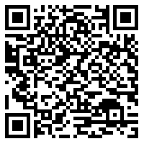
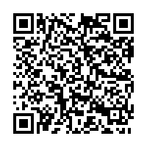
Useful links
List of Layers
Activation Functions
Loss Functions
Optimization Algorithms

Slide 39
Object detection
It’s a process of localizing the object and then classifying it into categories.
So, the algorithm has the additional method know as “Region Proposal Network” called selective search to locate the object first.
R-CNN made the first breakthrough in object detection on
Imagenet dataset

Slide 40
Transfer Learning
The process of taking a pre-trained model (the weights and parameters of a network that has been trained on a large dataset ) and “fine-tuning” the model with your own dataset.

Slide 41
Truth Behind
Will remove the last layer of the network and replace it with our own classifier.
The pre-trained model will act as a feature extractor.

Slide 42
Purpose of Transfer learning
Very less dataset is enough.
Low computing power required.
Faster training time than doing from scratch.
May get better accuracy.

Slide 43
Steps involved
Choose the pre-trained model
Prepare the data
Reconfigure the model
Training
Inference

Slide 44
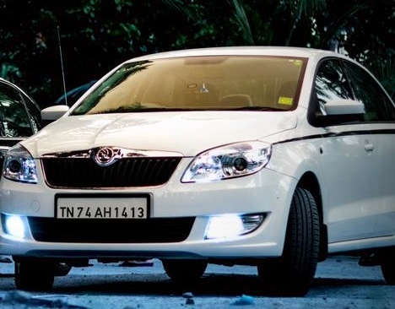
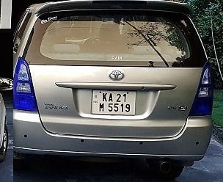
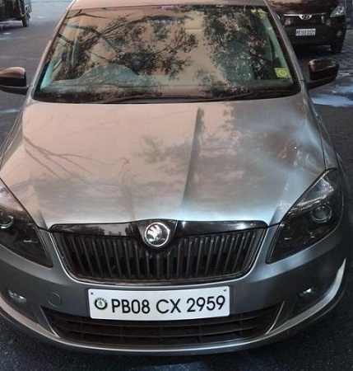
License Plate Detection
The idea here is to detect the license plate in the car in realtime.

Slide 45
Choosing the model
As our use case require to run on a realtime feed from a camera (30fps approx).
We have to choose an efficient model with low inference time and with good accuracy.
Model Zoo repository has list models

Slide 46
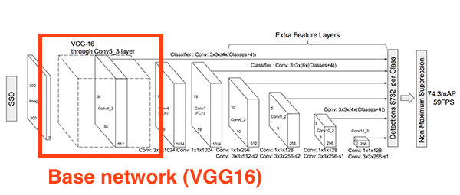
SSD Mobilenet

Slide 47
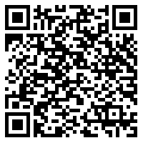
https://github.com/tensorflow/models/blob/master/research/object_detection/g3doc/detection_model_zoo.md

Slide 48
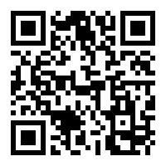
Prepare the data
Annotate the data using using labelImg
https://github.com/tzutalin/labelImg
pip3 install labelImg will do the trick

Slide 49
Prepare the data
It will create the xml file in corresspondence with pascalVOC format.
These xml files has to be converted to one csv file and the should be converted into tfrecord file.
Tfrecord file is the format that the model expects as an input data.

Slide 50
Reconfigure the model
Pipeline.config file is recofigured depending upon out input data and .pbtxt file is genrated.
Change number of class
Change train and test.record file path.
Change batch_size and num_of_steps

Slide 51
Training
Training can be started by calling train.py file inside model/research/object_detection folder
Check tensorboard for graph convergence and stop training.
End of training checkpoint file will be genrated along with protobuf (.pb) file and that’s our model file.

Slide 52
Inference

