Slide 1



Welcomes you to the Machine vision Challenge
- Walkthrough

Slide 2
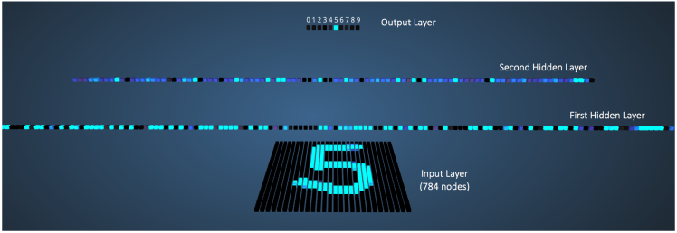
Machine Vision
| Slide 2

Slide 3
Challenge
Dataset URL: http://www.cis.fordham.edu/wisdm/includes/datasets/latest/WISDM_ar_latest.tar.gz
Challenge : Create a data model and inference to identify activity and person
Criteria: Smallest and most accurate
Walking
Jogging
Upstairs
Downstairs
Sitting
Standing
| Slide 3

Slide 4
Challenge – Submission procedure
Complete the following
Create date model
Make reasonable train/test split
Create confusion matrix for test data
Make all your code in jupyter ipython notebook in step by step format
Upload your code in Github
Send us the github link alone to sivakumar.sk!tcs.com,prabhakar.4@tcs.com, raj.chaudari@tcs.com
Time line : Submit before 13th End of the day ( Max.time 11.59 PM on Sunday)
| Slide 4

Slide 5
Thanks
Machine Vision -- A TTH R&I Team

