Slide 1
Client Server connection and data sharing using sockets in C++
Bibek Bhattarai
Santosh Tiwari
Rakesh Kumar Mahato
Nabin Dhami
BECE 2nd Semester
Ashmita Pandey

Slide 2
Socket Programming
Socket programming is a way of connecting two nodes on a network to communicate with each other.
One socket(node) listens on a particular port at an IP, while the other socket reaches out to the other to form a connection. The server forms the listener socket while the client reaches out to the server.

Slide 3
Socket Programming
Server Process
Client Process
socket()
socket()
bind()
listen()
accept()
connect()
recv()
recv()
send()
send()
close()
close()

Slide 4
Primitive | Meaning
Socket | Create a new communication endpoint
Bind | Attach a local address to a server
Listen | Announce willingness to accept connections
Accept | Block caller until a connection request arrives
Connect | Actively attempt to accept a connection
Send | Send some data over the connection
Receive | Receive some data over the connection
Close | Release the connection

Slide 5
Header Files
<sys/types.h> | This header file contains definitions of numbers of data types used in system calls
<sys/socket.h> | This header file includes a number of definitions of structures needed for socket. (sockaddr structure)
<netinet/in.h> | The header file ih.h contains constants and structures needed for internet domain addresses (sockaddr_in)
<stdlib.h> | The stdlib.h header defines four variables types, several macros, and various functions for performing general functions (atoi)
<netdb.h> | This header contains definition for network database operations ( gethostbyname() is used to resolve a hostname into all those characteristics with which this host can be identified over a network )

Slide 6
socket()
bind()
listen()
accept()
recv()
send()
close()
Create socket
Bind
Listen
Accept
Receive
Send
Close socket
Binds the socket to the address and port number specified in addr
Listen for connections.
Accept a connection
Connection is established between client and server and they are ready to transfer data

Slide 7
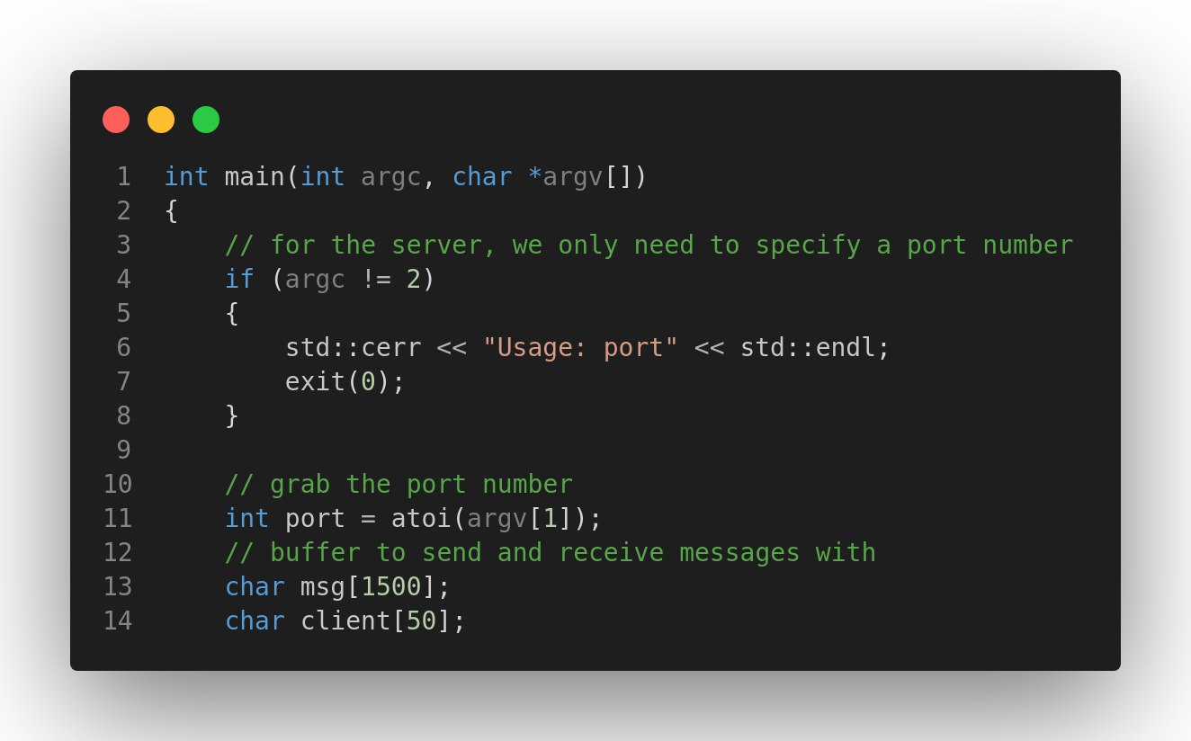
Command Line arguments are the given after the name of the program in command-line shell of Operating Systems. To pass command line arguments, we typically define main() function with two arguments i.e
argc (argument count) : Number of command line argument passed to the program.
argv( argument vector) : Array of strings (char pointer) representing those arguments.

Slide 8
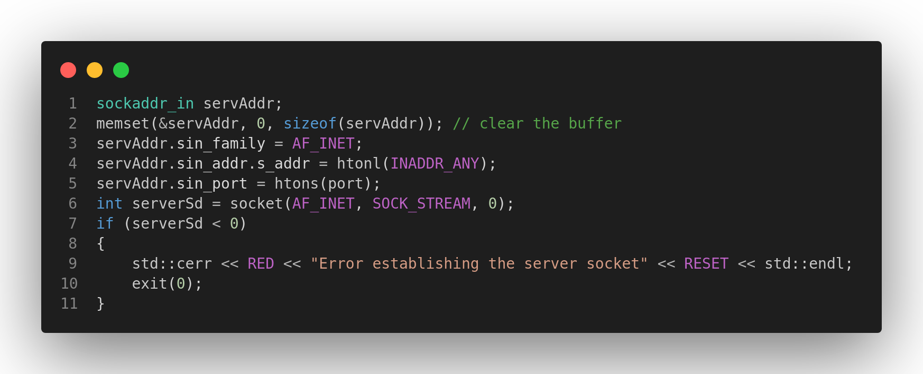
int serverSd = socket(family, type, protocol);
serverSd: socket descriptor an integer (like a file handle)
family: integer, communication domain, AF_INET, IPv4 protocols, internet addresses
type (communication type): SOCK_STREAM -reliable, 2-way connection based service
protocol ( specifies protocol): usually set to 0 i.e use default protocol
socket call doesn’t specify where data will be coming from, nor where it will be going to, just creates the interface, it returns -1 in case of failure.

Slide 9
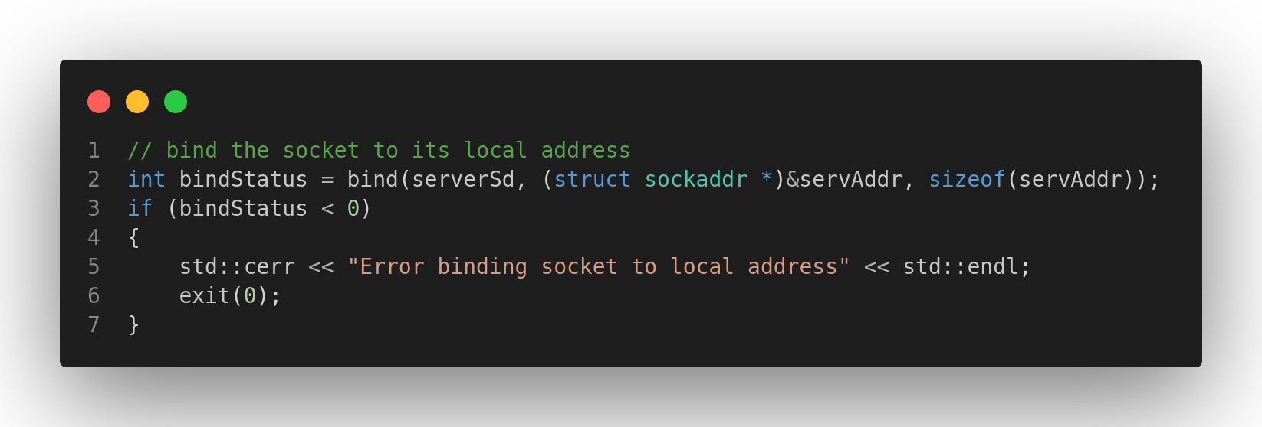
int bind(int serverSd,(struct sockaddr *)addr, socklen_t addrlen) After creation of the socket, bind function binds the socket to the address and port number specified in addr(custom data structure). In the example code, we bind the server to the localhost, hence we use servAddr to specify the IP address.

Slide 10
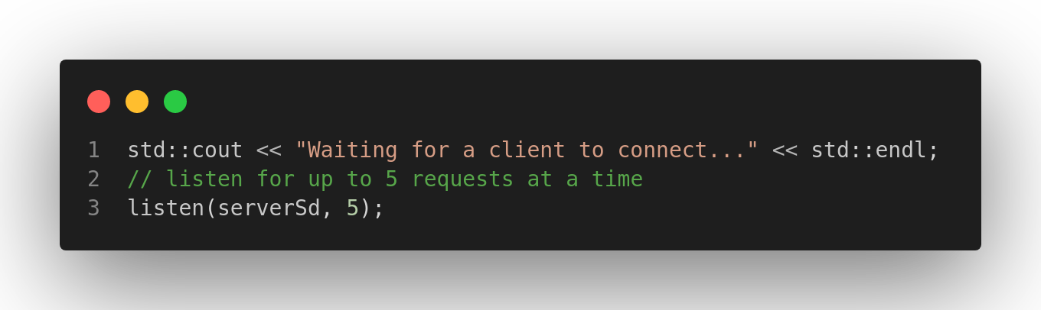
int listen(int sockfd, int backlog);
It puts the server socket in a passive mode, where it waits for the client to approach the server to make a connection. The backlog, defines the maximum length to which the queue of pending connections for sockfd may grow. If a connection request arrives when the queue is full, the client may receive an error with an indication of ECONNREFUSED.

Slide 11
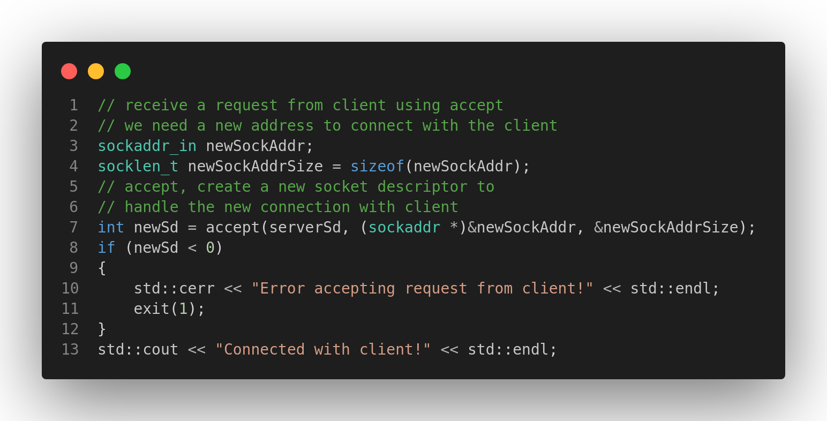
int s = accept(serverSd, &clientAddr, &addrLen);
s: integer, the new socket (used for data-transfer)
serverSd: integer, the socket (being listened on)
clientAddr: struct sockaddr, address of the active participant
addrLen: size of(clientAddr)

Slide 12
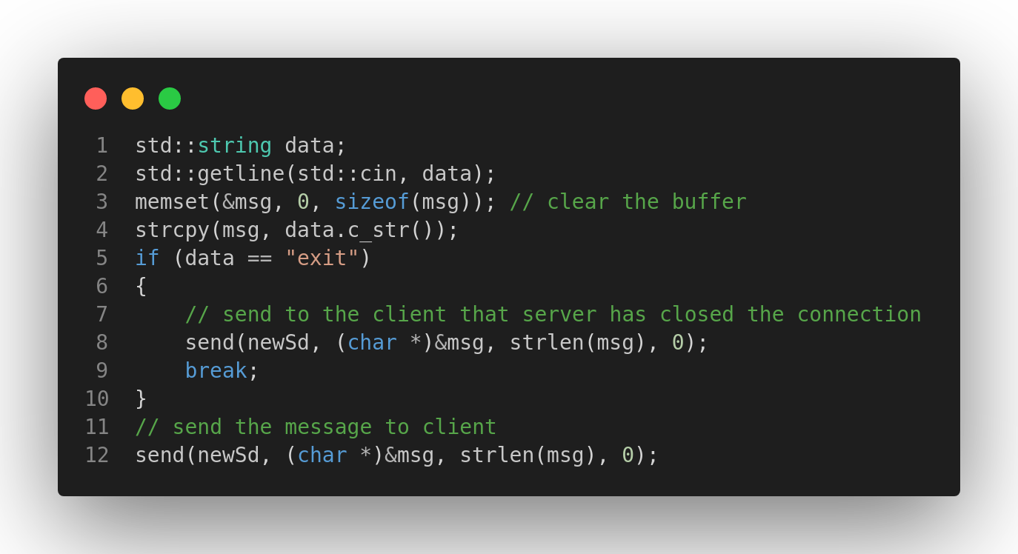
send(sockid, msg, msgLen, flags);
sockid
recvBuf: void stores received bytes
bufLen: length of buffer
flag : integer, special options, usually just 0

Slide 13
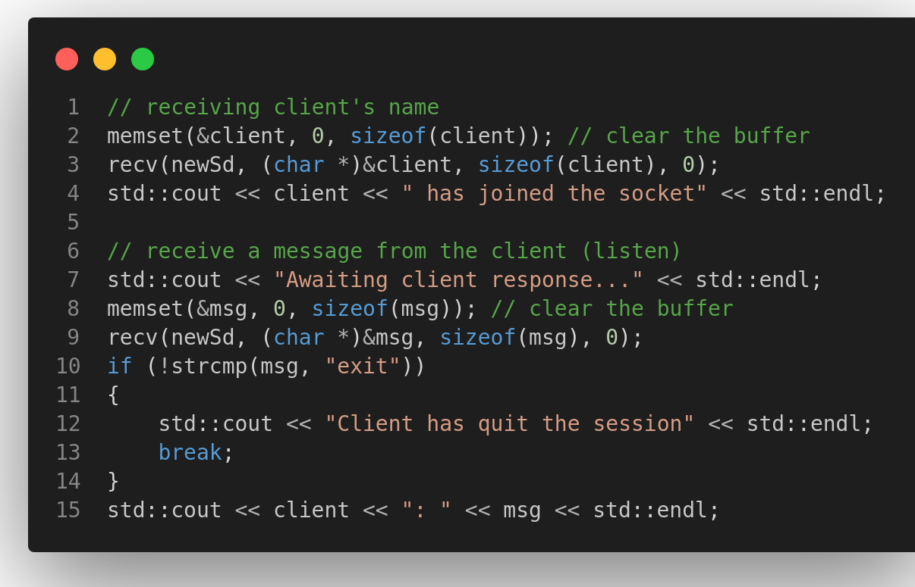
recv(sockid, recvBuf, bufLen, flags);

Slide 14
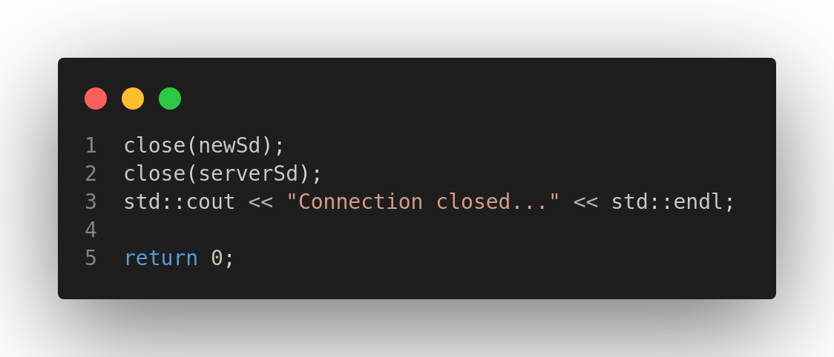

Slide 15
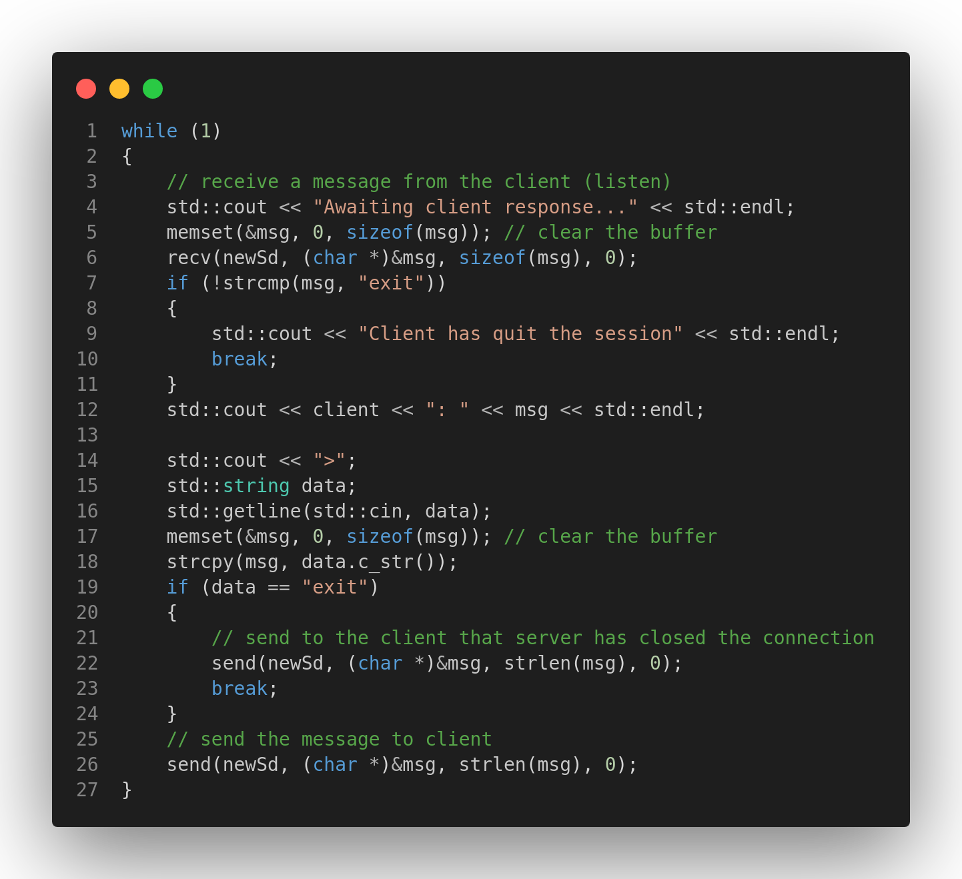

Slide 16
socket()
connect()
recv()
send()
close()
Create socket
Accept requests
Receive
Send data
Close socket
The connect() connects the socket to address specified by the addr
Client

Slide 17
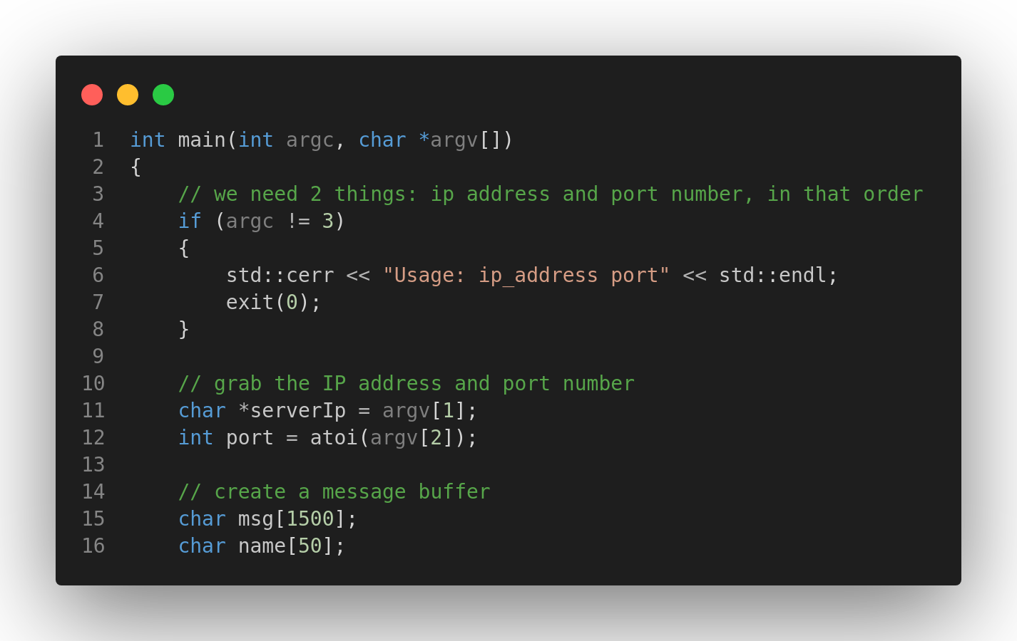
The atoi() converts the string argument to an integer(int)
It returns the converted integral number as an int value, if no valid conversion takes place then, it returns zero.

Slide 18
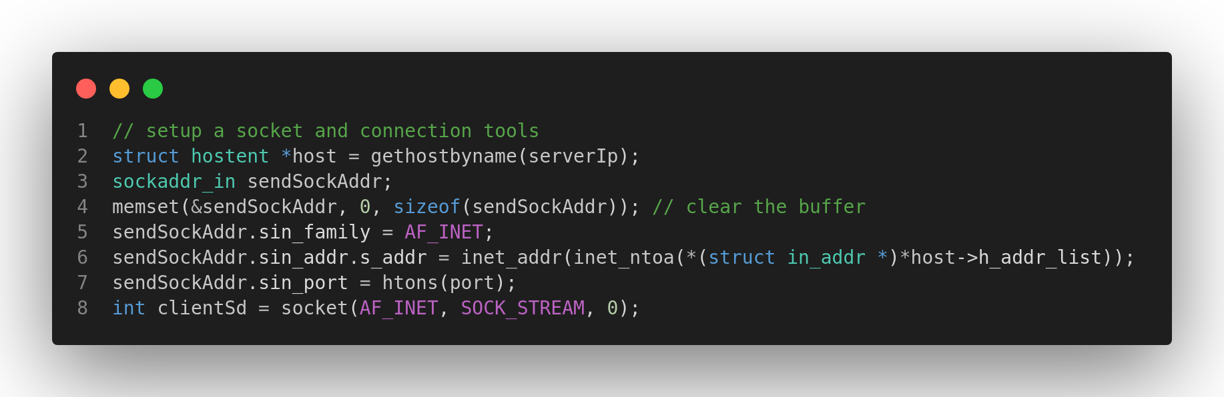
The memset() function copies a single character for a specified number of time to an object.
The memset() function takes three arguments and return str, the pointer to the destination string
The memory address
The character to copy
Number of bytes to copy
The htons() function converts the unsigned short integer hostshort from host byte order to network byte order.

Slide 19
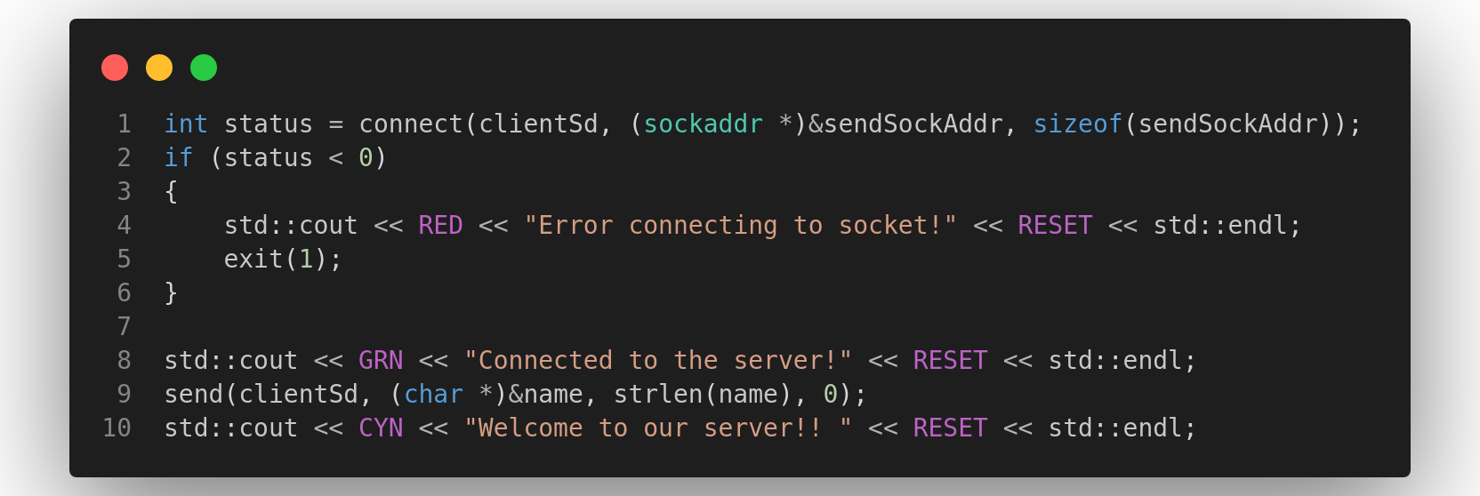
int connect(int sockfd, const struct sockaddr *addr, socklen_t addrlen);
Socket connection: Exactly same as that of server’s socket creation
Connect: The connect() system call connects the socket referred to by the file descriptor clientSd to the address specified by addr. Server’s address and port is specified in addr.

Slide 20
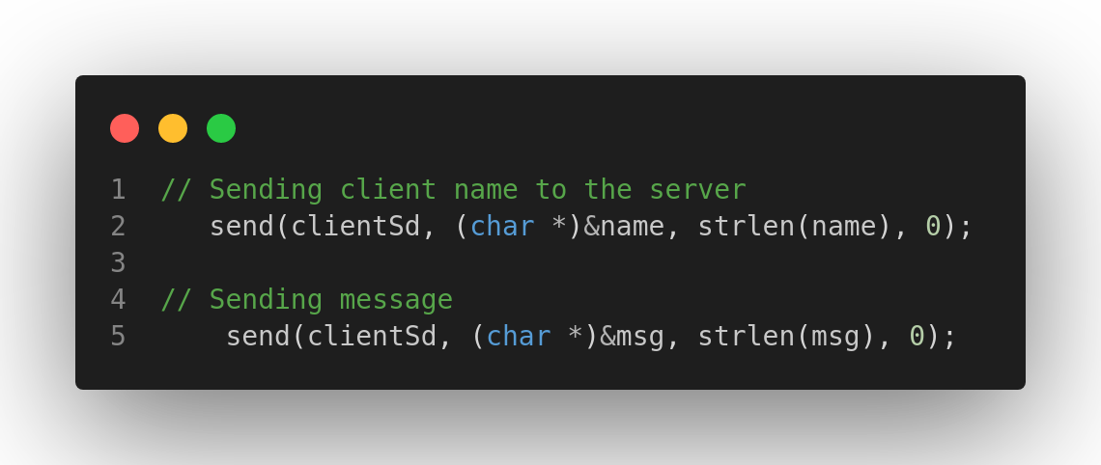

Slide 21
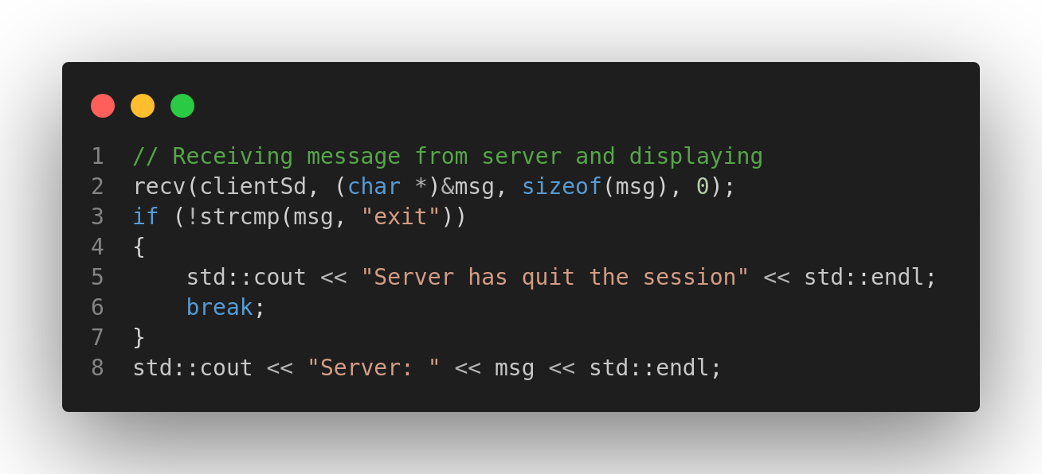
The strcmp() compares two strings character by character,
if the strings are equal, the function returns 0.

Slide 22
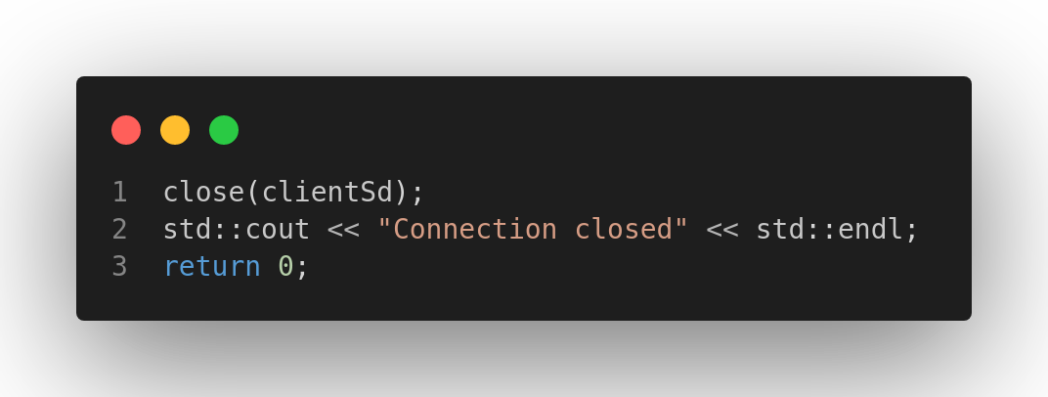

Slide 23
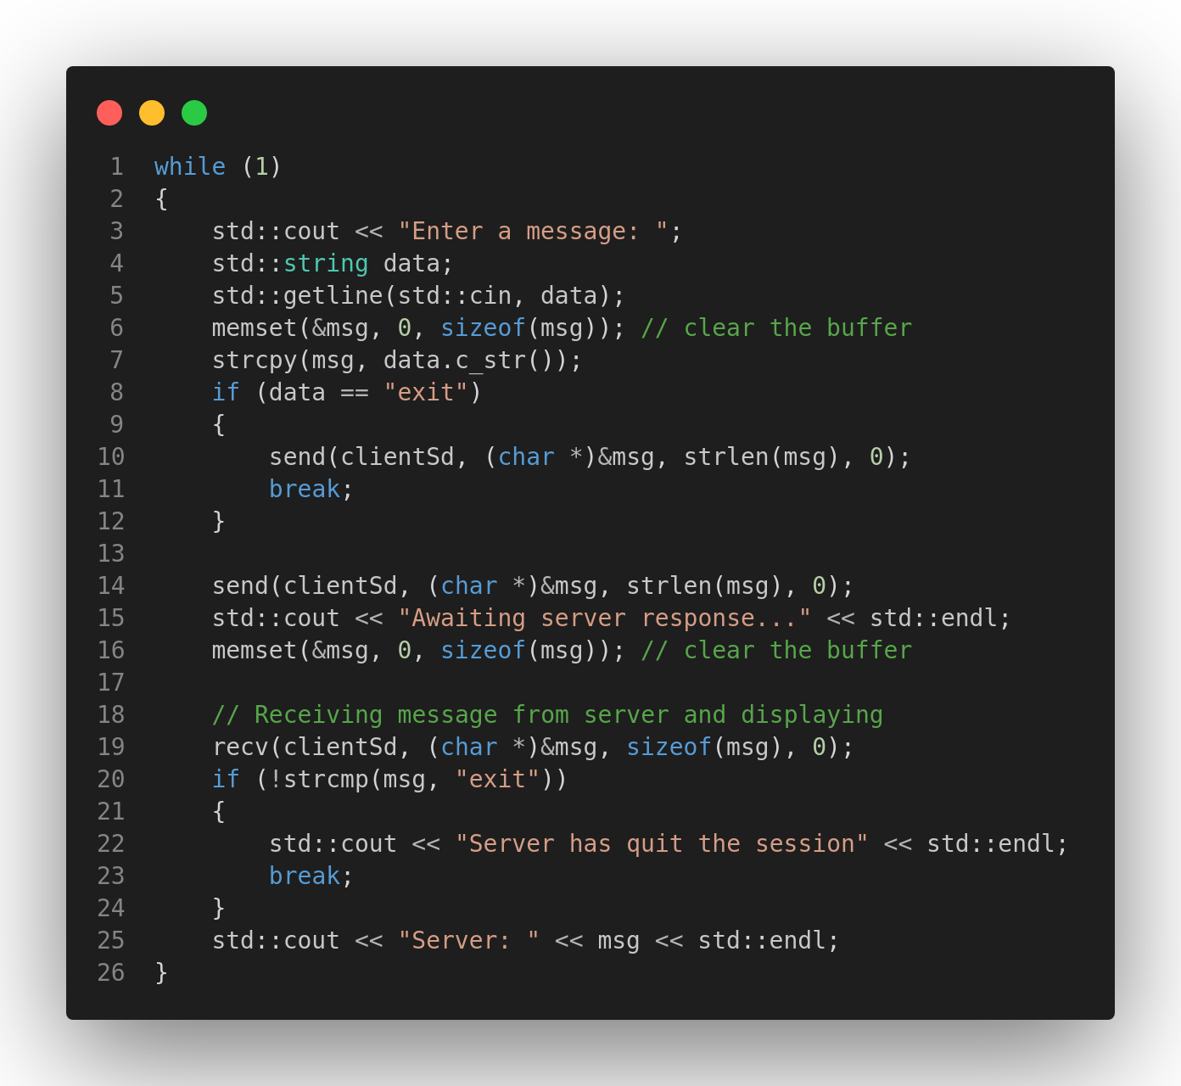
The getline() is used to read string or line from an inputstream user input.
The getline() reads a full line from a stream, such as newline character.

Slide 24
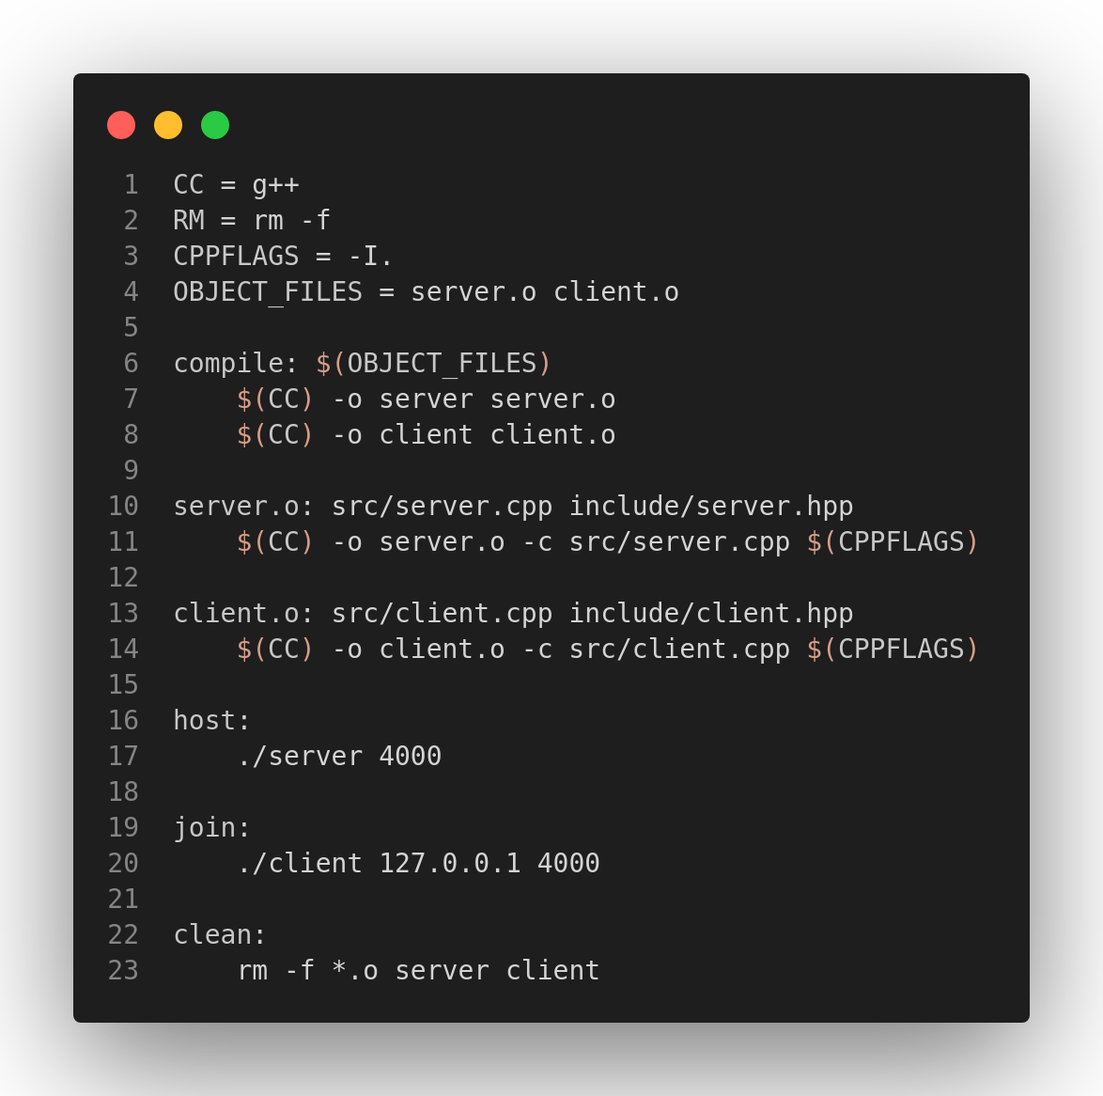
Makefile is a tool to simplify or organize code for compilation. It is a set of command ) with variables names and targets to create object file and to remove them. In a single Makefile we can create multiple targets to compile and to remove object, binary files

Slide 25
Thank you!!

