Slide 1
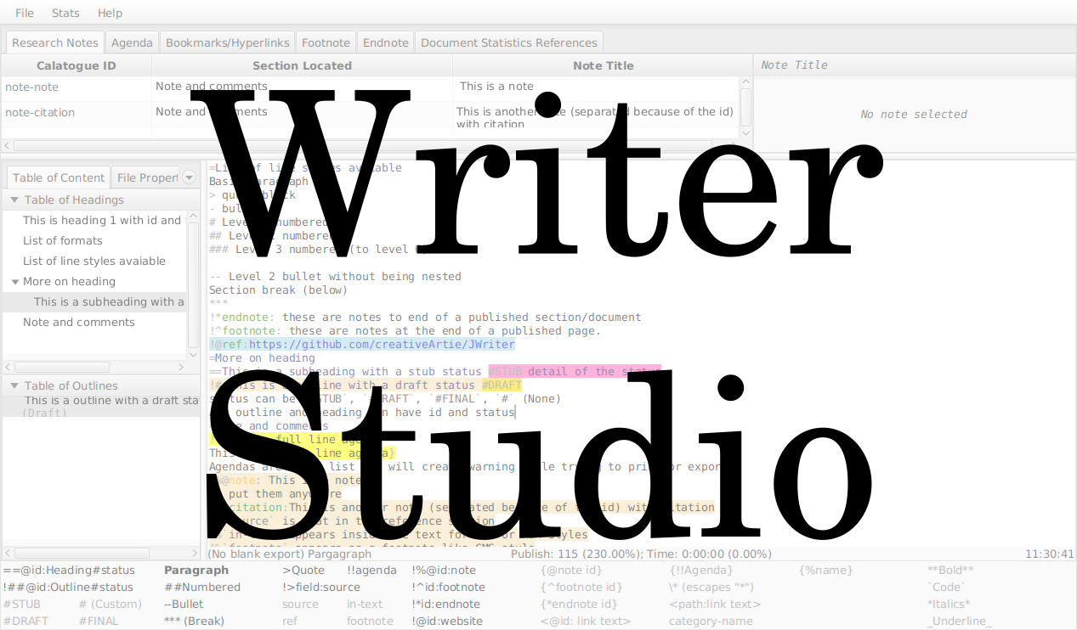

Slide 2
Writer Studio
This video will show you want I am trying to make
I couldn’t narrate for this video, because of speech apraxia, and social anxiety
Here are some free music for you instead

Slide 3
Information Panels
Things you use in your writing project.

Slide 4
Notes from research or idea explored
Notes has
- categories which
groups into a single page describing a single thing.
- a location which
associates to where you would want to use it

Slide 5
Reminders you decide to do later

Slide 6
Reusable hyperlinks to use in your document

Slide 7
Footnotes and endnotes for your document

Slide 8
Project statistics to added into the document

Slide 9
Navigation Panel
Navigating content files, and
(maybe someday) communication.

Slide 10
For:
- shows the section in the current
document
- selects the current document
location

Slide 11
For:
- manuscripts and letters related to
the writing project
- project options and notebook
navigation

Slide 12
Main Writing Screen
Breaks each writing process into
different tabs
In which you can go distraction-less full screen mode.

Slide 13
For:
- brainstorming exercise
- author details
- document meta data like keywords

Slide 14
For:
- research on the web, with
mechanism to stop distractions
- note organization

Slide 15
For:
- writing outline
- writing the first draft
- editing without using
tools
Will have the second
mode that formats
using toolbar
You can use these
markup syntax to
format.

Slide 16
For:
- spelling and grammar checker
- wordiness and word choice
- (maybe) human editor communication
- (maybe) content analysis
For editor tab, this is split into two parts
- one showing the edited records or editing problems
and
- the other showing the actual writing

Slide 17
For:
- formatting and export to
file type (at least .pdf)
- (Possibly) printing
- (Maybe also sent to email,
publishing website, etc.)
- (Maybe professional
printing)

Slide 18
Thanks for watching

