Slide 1


Bank of Baroda Hackathon - 2022
Technology Partner
Your Team Name : Codenture
Your team bio :
We are a team of highly motivated developers, aiming on creating projects that would benefit the society as a whole.
Date : 19/09/2022

Slide 2
Problem Statement?
The problem statement of this hackathon is Automated Cheque processing. In this problem we will create a model using Artificial Intelligence and Machine learning with their respective applications. We create this model because there are lots of cheque comes in a branches of bank which takes more time in processing and verifying. Therefore we will help to people, banks and Government as well. Also, this model will find more accurate in Data processing like signature extraction, image acquisition and many more. This model is multilingual in which all regional language should be implement on it and also this model reduce processing time.
Signature Verification
Fraud Detection

Slide 3
User Segment & Pain Points
This model is mainly prepared for banks, people, government. Manual check processing is very complex, time consuming and having chances of bouncing the cheques. Generally in manual checking there are a chances of hacking the account and in withdrawal of cash by doing handwritten signature. Through this product, we can reduce this above mentioned problem and it measures the data very accurately and extract the feature very accurately as well. Automated cheque processing is doing by Optical Character Recognition (OCR), image acquisition, Magnetic ink character recognition (MICR). This model also reduced white spaces and does not compromised with quality.
Reduces Human Labour
Faster Transaction
Secure Transaction
Fraudulent Cheque Detection

Slide 4
Pre-Requisite
In this model we use Some technologies-
Artificial Intelligence
Machine learning
Optical Character Recognition
CNN
Feature Extraction
Python
HTML, CSS, JS
Magnetic Ink character recognition
Flask/Django/React

Slide 5
Azure tools or resources
Infrastructure as a services Azure files Windows, Linux Virtual Network Platform as services Visual code Cloud Services SQL Database Other Resources Machine learning Magnetic ink character recognition Object Character Recognition NLP, Image Recognition, Convolutional Neutral Network

Slide 6
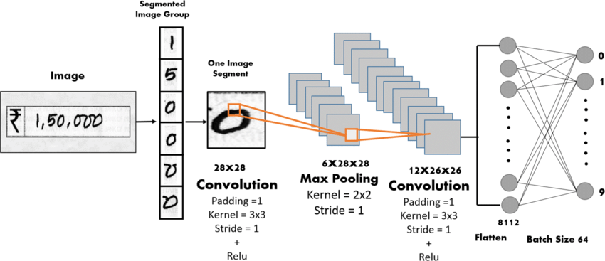
Any Supporting Functional Documents
At first, the image acquisition can be done by scanning cheques. Then, it is further divided into four parts: Segmentation of cheque, Handwritten text extraction from cheque, signature feature extraction and verification and CNN model for amount identification.
The architecture of signature feature extraction:
Input bank cheque-->Cropping to domain of signature-->Feature extraction-->Sign Recognition-->Display message.

Slide 7
Key Differentiators & Adoption Plan
Unlike competitors, our program would provide full-proof solution to cheque processing, starting from scanning the cheque image to transferring the funds from one account to another (Imitated by SQL databases).
The program would ensure data privacy and security as the data extracted from cheques would be stored in SQL Databases.
Most of the cheque processing programs don’t focus on the fraudulent detection factor, in our program we would not only verify the signature but also create a model for identifying different handwriting on the same cheque that would be indicating frauds.
For current usage, the model would be deployed on Flask/Django/React. Allowing users to seamlessly use the following program.

Slide 8
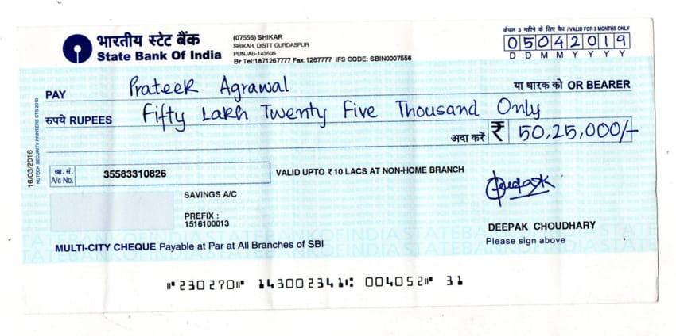
GitHub Link:- https://github.com/kumarguptavaibhav/Automated-cheque-processing-BOB-Hackathon
GitHub Repository Link & supporting diagrams, screenshots, if any
Image Processing and Data Extraction Techniques
Field Extraction using OCR
Modified CNN
Feature Extraction and PCA
Verification
If (Validation==True)
Success Transaction
Failed Transaction

Slide 9
Thank You
Vaibhav Kumar Gupta
Khyati Jha
Sourabh Pargai

