Slide 1
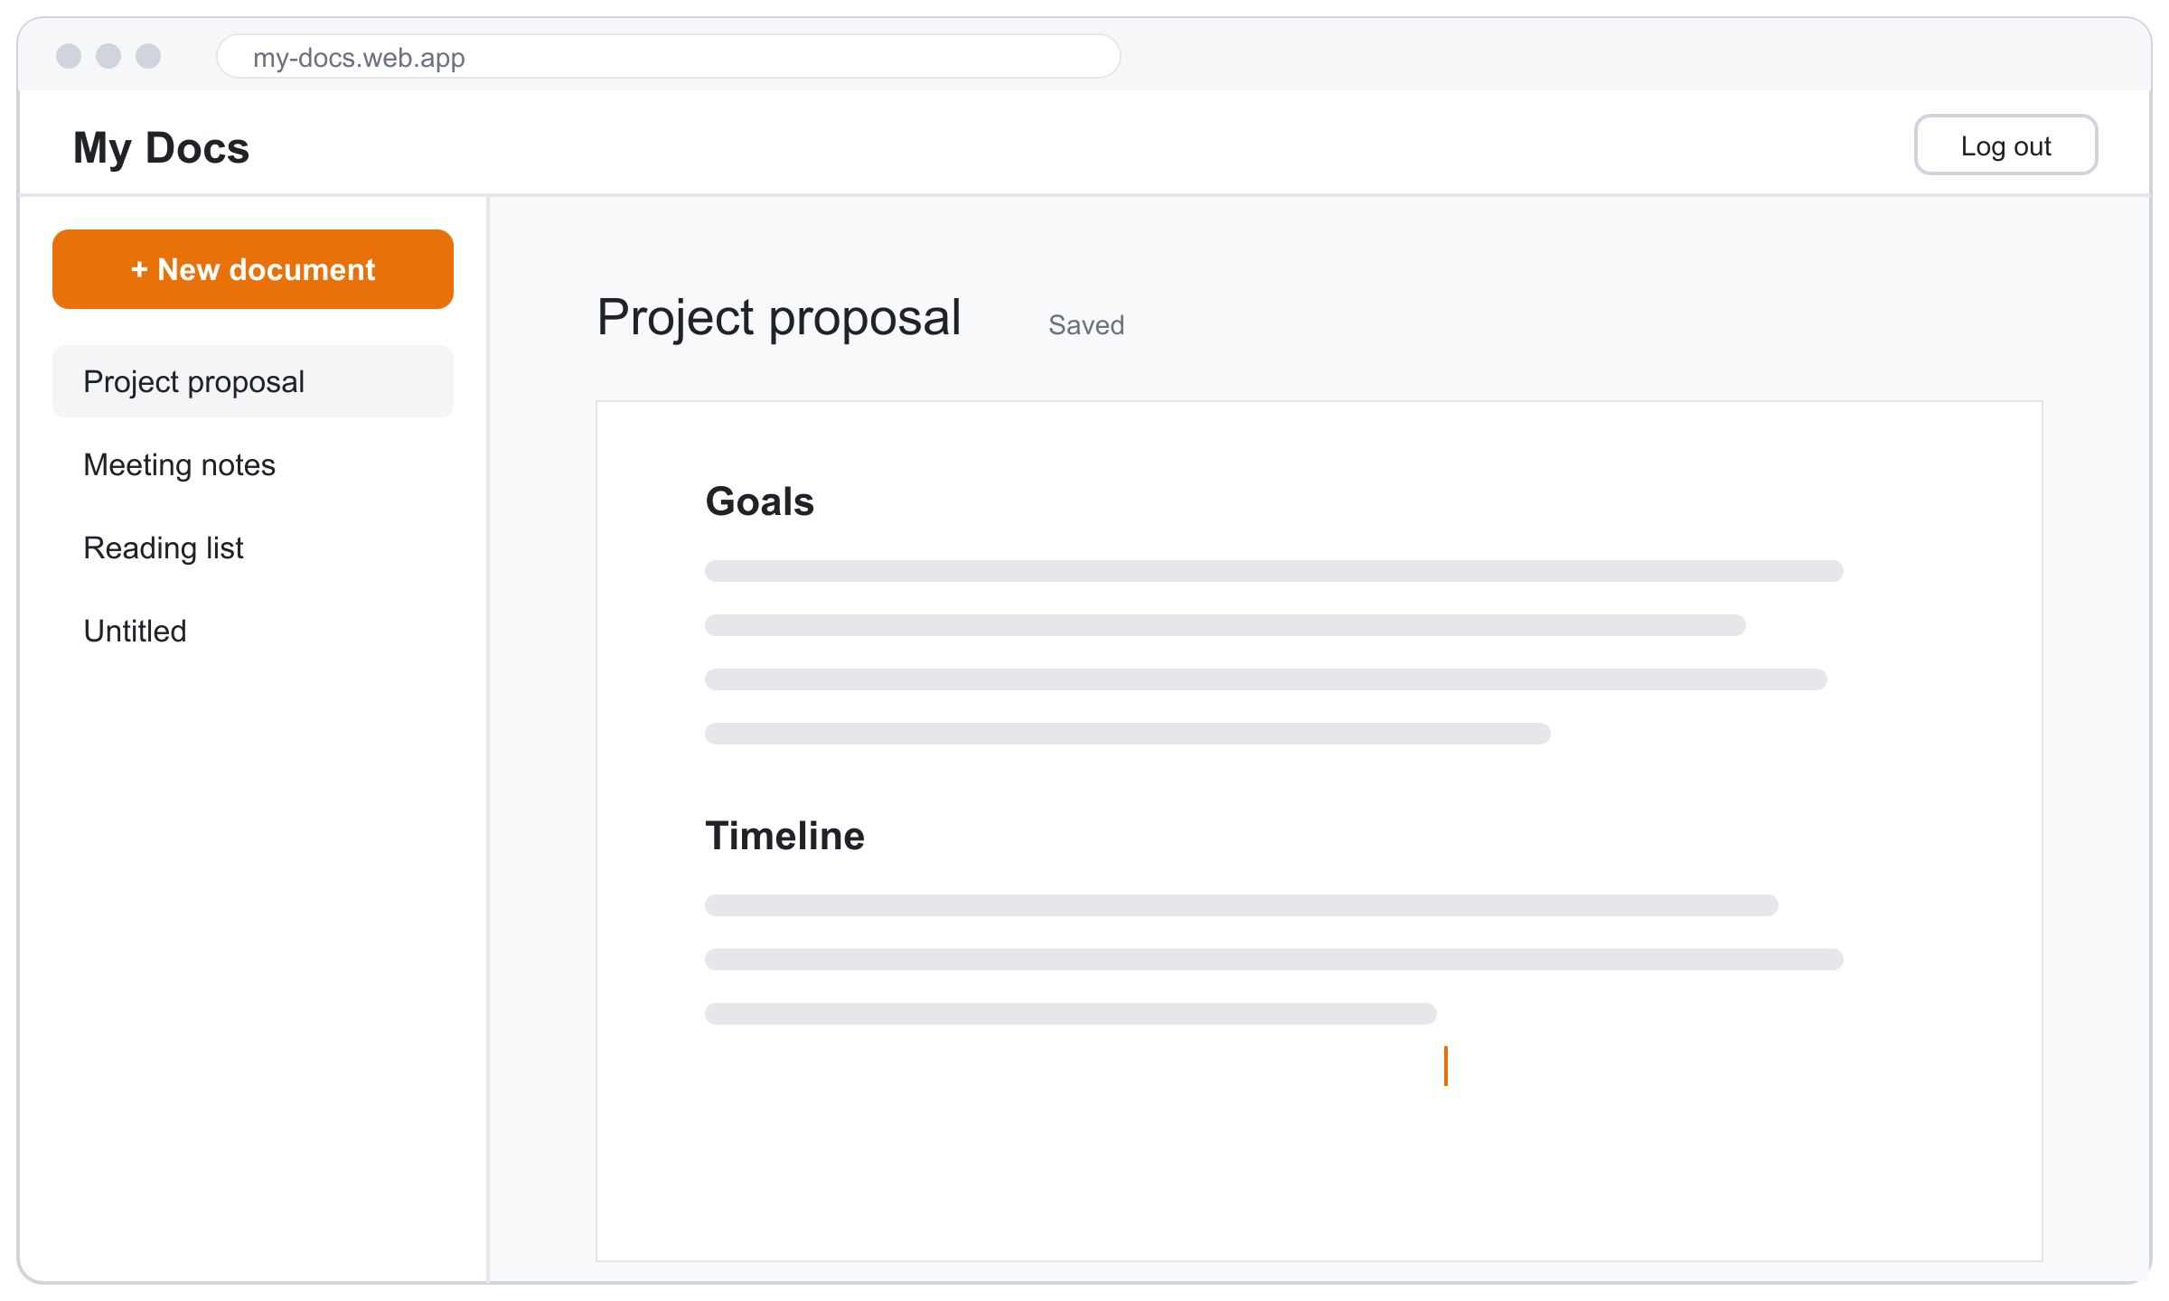
Build full-stack web apps with HTML, CSS, JS & Firebase
THE SIMPLE WAY
Three files, no installs, no build tools. Firebase Auth for users, Firestore for data.
What you will build: a minimal documents app
Notes:
Everything in this deck uses the simplest possible tools: plain HTML, CSS and JavaScript files, and Firebase loaded straight from Google's CDN with an import line. No npm, no bundler, no framework.

Slide 2
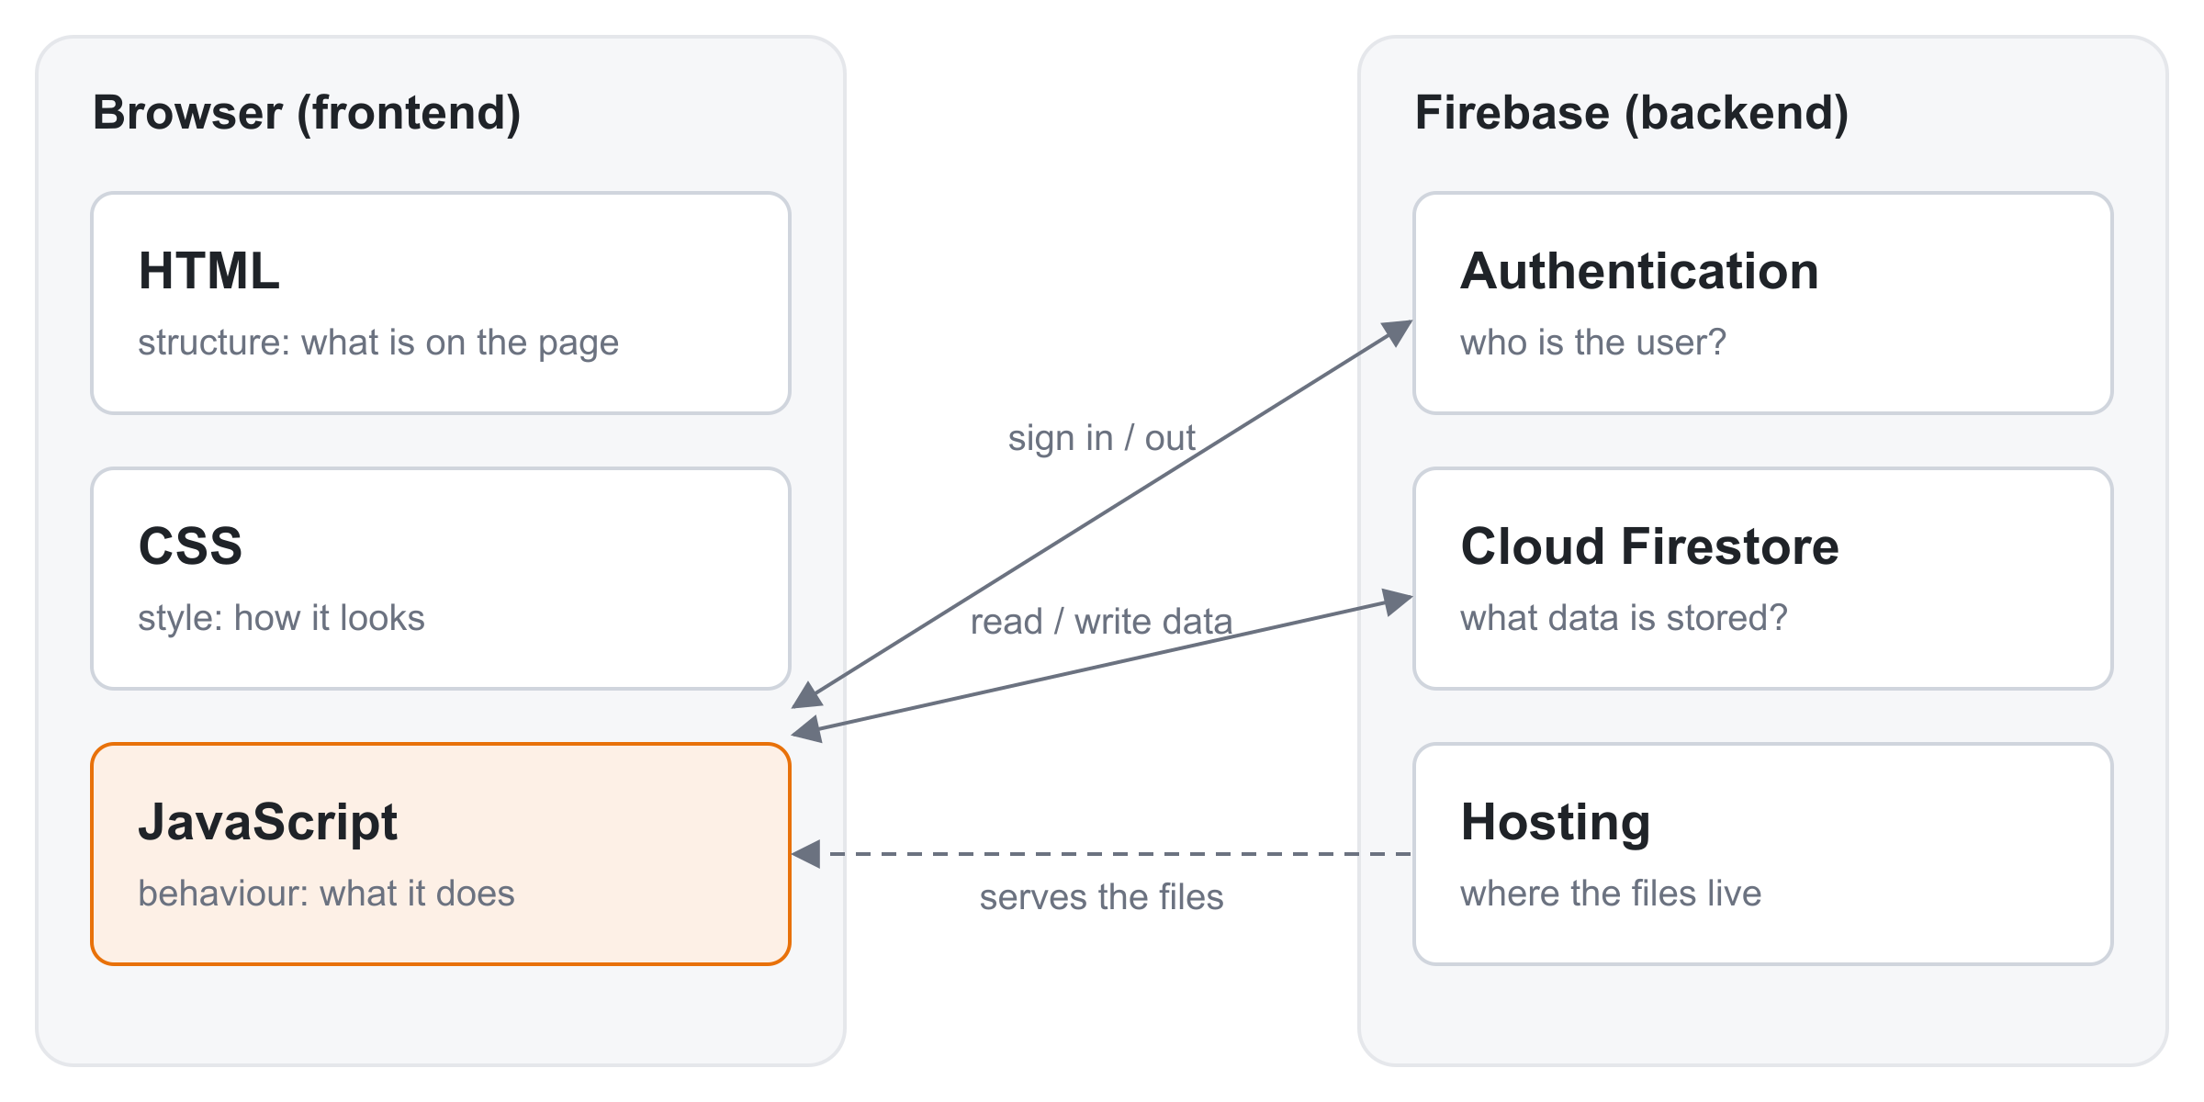




Four layers, each with one job
THE BIG PICTURE
HTML: what is on the page
Headings, inputs, buttons, lists.
CSS: how it looks
Colours, spacing, layout.
JavaScript: what it does
Reacts to clicks, talks to Firebase, updates the page.
The browser runs your three files. Firebase is the backend, so you don't write or run a server.
Firebase: the backend
Auth remembers who is logged in. Firestore saves the data.

Slide 3
Six steps from empty folder to live app
ROADMAP
1
2
3
4
5
6
Set up
Firebase project + three empty files
HTML
Write the page's elements
CSS
Make it look good
DOM
Make it react with JavaScript
Firebase
Log users in, save their data
Ship
Protect the data, put it online
The whole app is 3 files: index.html, style.css and app.js. Steps 2–4 work offline. Step 5 connects to the cloud.

Slide 4
Create the project and three files
STEP 1 · SET UP
In the Firebase console
On your computer
1
console.firebase.google.com → Add project
folder
my-app/
├─ index.html what is on the page
├─ style.css how it looks
└─ app.js what it does + Firebase
2
Click the web icon </> to add a web app, then copy the config it shows you
3
Authentication → Sign-in method → turn on Email/Password
Run it locally: open the folder in VS Code and click "Go Live" (Live Server extension). Opening index.html by double-click won't work, because JS modules need a web server.
4
Firestore Database → Create database
Nothing to install for Firebase: app.js imports it from Google's CDN (step 5).

Slide 5
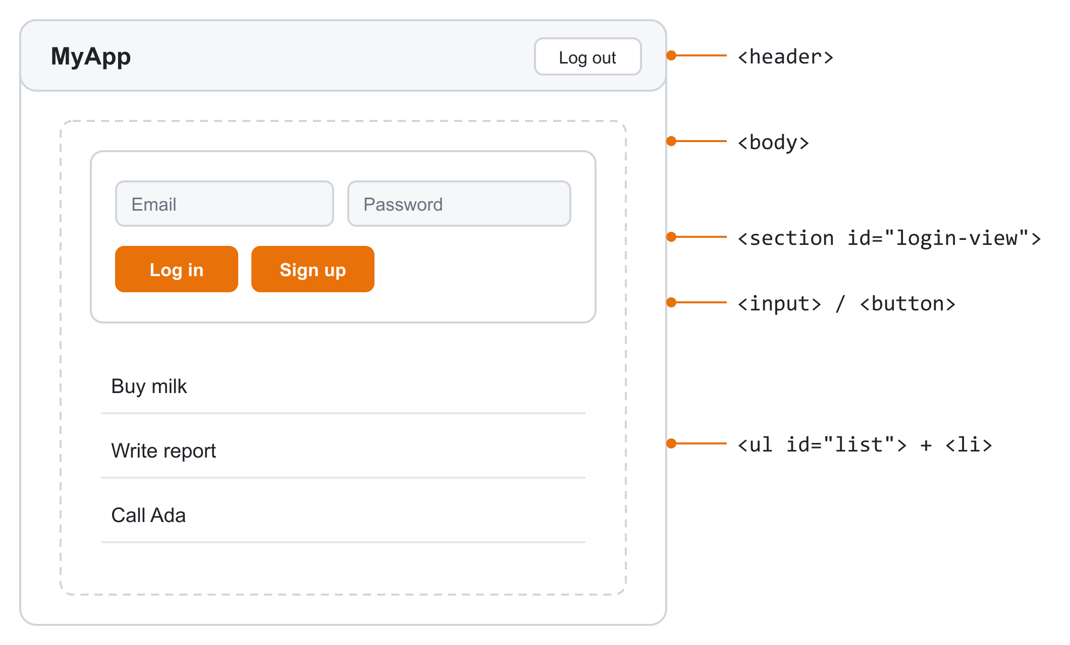
HTML is the structure: boxes inside boxes
STEP 2 · HTML
index.html
<!doctype html>
<html>
<head> <!-- setup the user doesn't see -->
<title>My App</title>
<link rel="stylesheet" href="style.css">
<script type="module" src="app.js"></script>
</head>
<body> <!-- what the user sees -->
<header>
<h1>My App</h1>
</header>
<section id="login-view">
<input id="email" placeholder="Email">
<button id="login">Log in</button>
</section>
<ul id="list"></ul>
</body>
</html>
A tag opens and closes: <h1>Title</h1>. Tags inside tags make the structure.
<head> links the CSS and JS files. <body> is the visible page.
Give an element an id so JavaScript can find it.

Slide 6
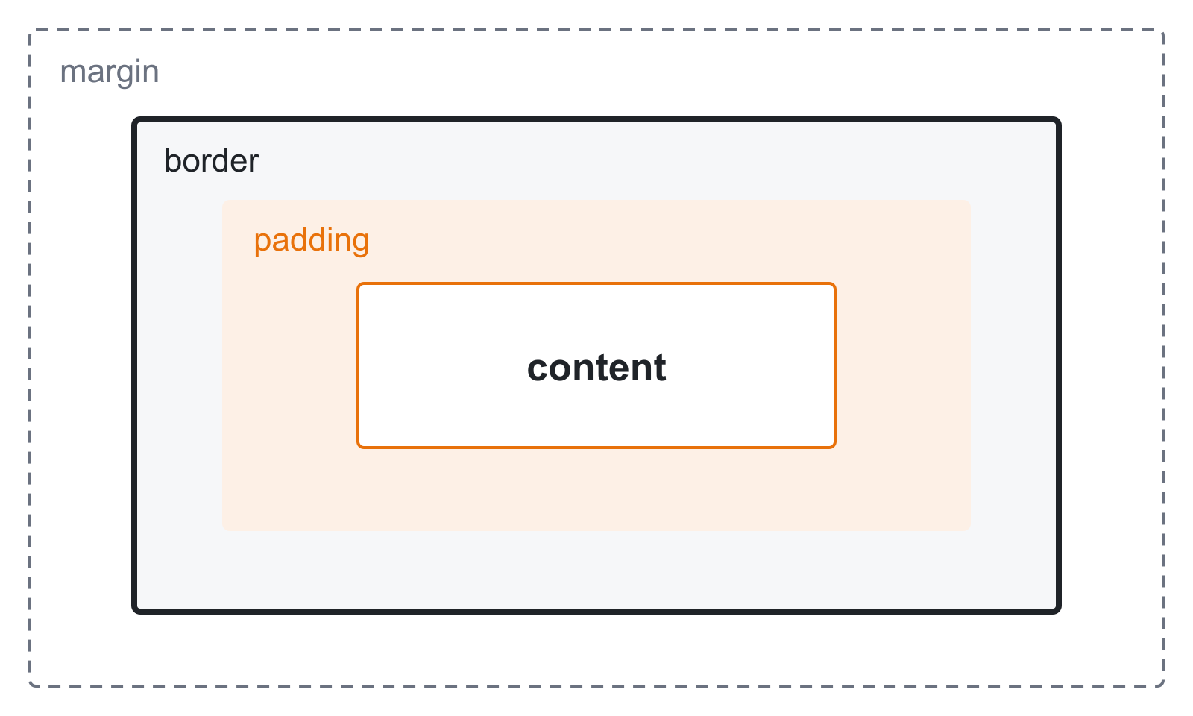
CSS picks elements, then sets how they look
STEP 3 · CSS
style.css
/* selector { property: value; } */
body { font-family: system-ui; } /* a tag */
.card { padding: 24px; } /* a class */
#error { color: crimson; } /* an id */
header { display: flex; } /* layout */
1
Link it
<link rel="stylesheet" href="style.css"> in the <head>
2
Select
A selector picks elements: by tag, .class or #id
Every element is a box
padding = space inside the border, margin = space outside it.
3
Style
Each property: value sets one thing, like color or padding
When two rules clash
#id beats .class beats tag. If they tie, the rule written last wins.

Slide 7
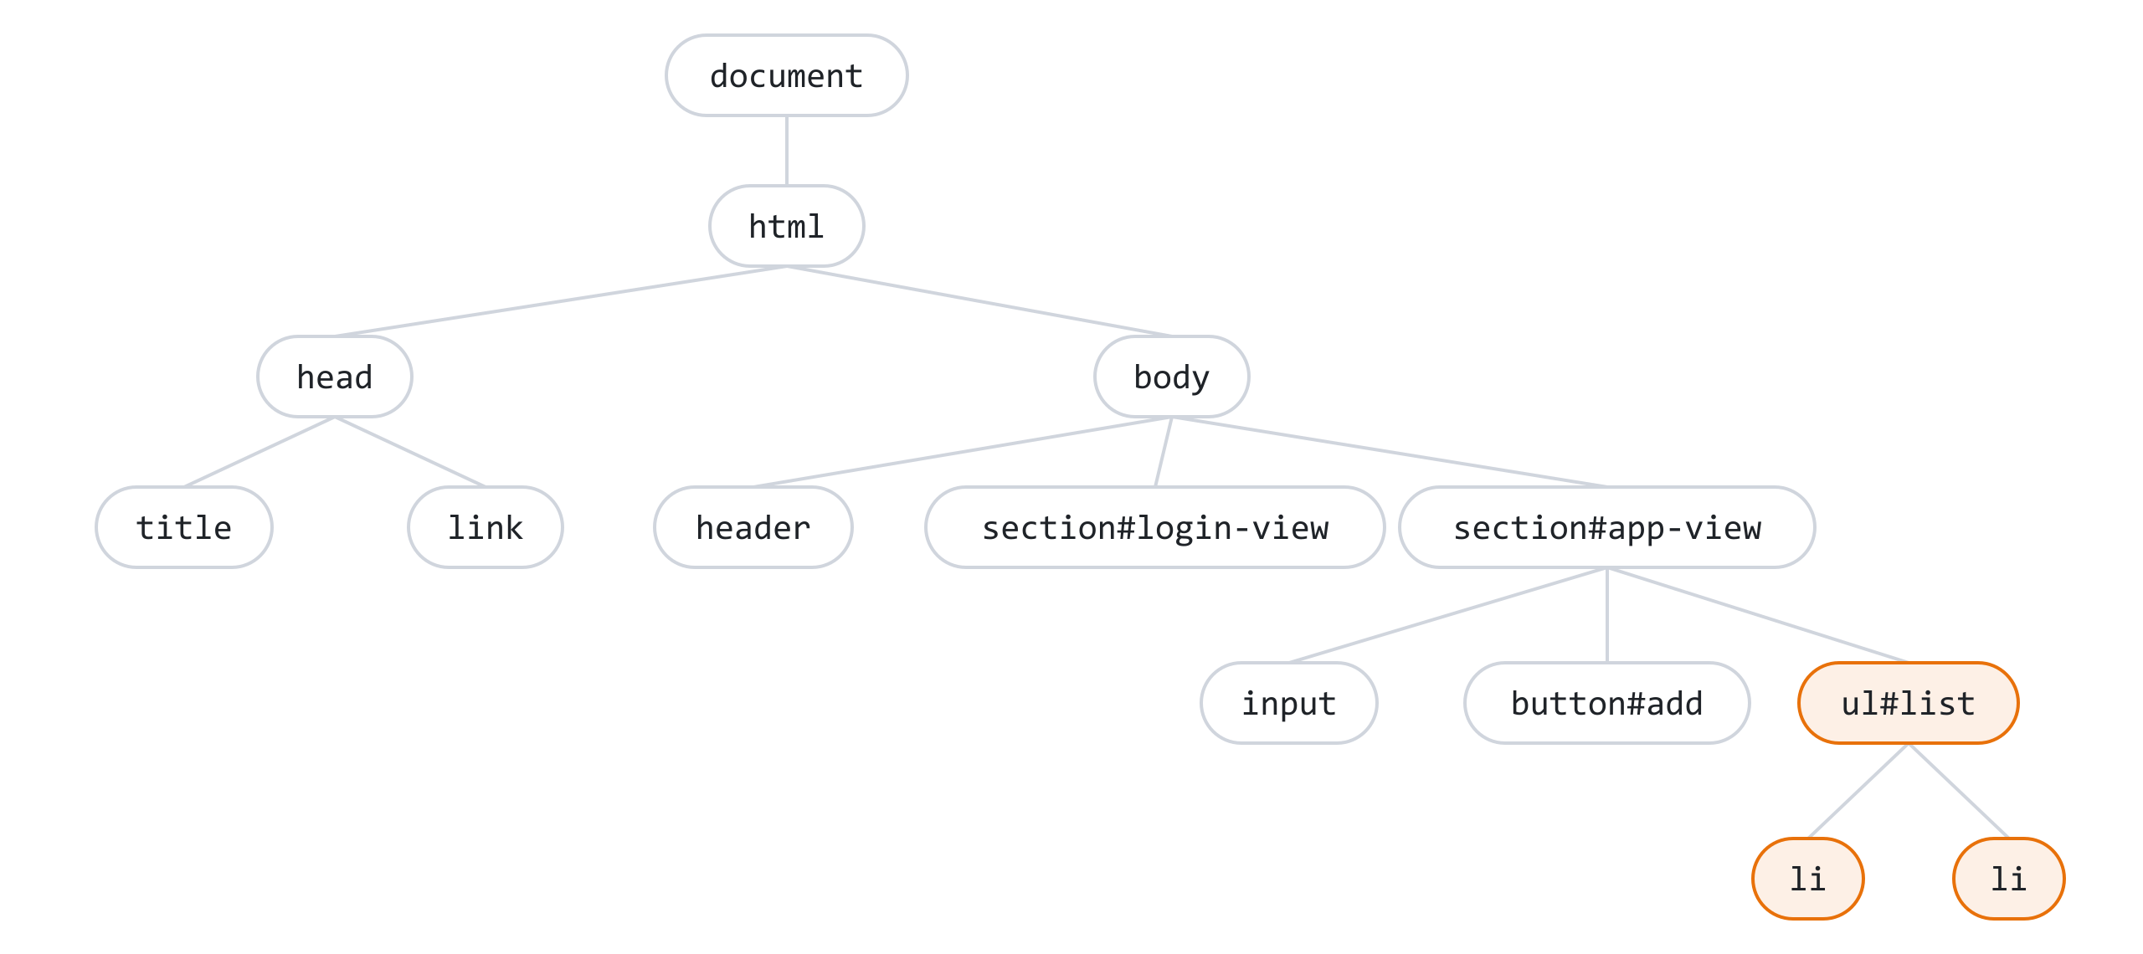
JavaScript changes the page through the DOM
STEP 4 · THE DOM
app.js
// 1. Find an element by its id
const list = document.getElementById("list");
// 2. Run code when it's clicked
document.getElementById("add").addEventListener("click", () => {
// 3. Make a new element
const li = document.createElement("li");
li.textContent = "New item";
// 4. Put it on the page
list.append(li);
});
The browser turns your HTML into a tree of objects called the DOM. JavaScript can find any of them, react to clicks on them, and add or change them. The page updates instantly.
Four moves do almost everything: find, listen, create, update.

Slide 8
Load Firebase with one import line, no installs
STEP 5 · CONNECT FIREBASE
1
type="module"
This attribute on the script tag lets app.js use import.
index.html
<script type="module" src="app.js"></script>
2
Import from the CDN
Paste Google's URL into the import. The browser downloads it.
app.js (top)
// 1. Import Firebase from the CDN (no install, no build step)
import { initializeApp } from "https://www.gstatic.com/firebasejs/10.12.2/firebase-app.js";
import {
getAuth, onAuthStateChanged,
createUserWithEmailAndPassword, signInWithEmailAndPassword, signOut,
} from "https://www.gstatic.com/firebasejs/10.12.2/firebase-auth.js";
import {
getFirestore, collection, doc, addDoc, deleteDoc, query, where, onSnapshot,
} from "https://www.gstatic.com/firebasejs/10.12.2/firebase-firestore.js";
// 2. Connect to your project (copy this from the Firebase console)
const app = initializeApp({
apiKey: "YOUR_API_KEY",
authDomain: "your-app.firebaseapp.com",
projectId: "your-app",
appId: "YOUR_APP_ID",
});
const auth = getAuth(app);
const db = getFirestore(app);
3
Paste your config
From the console (step 1). It tells Firebase which project is yours.
Is apiKey a secret? No. It only names your project. Your data is protected by login + rules (step 6).

Slide 9
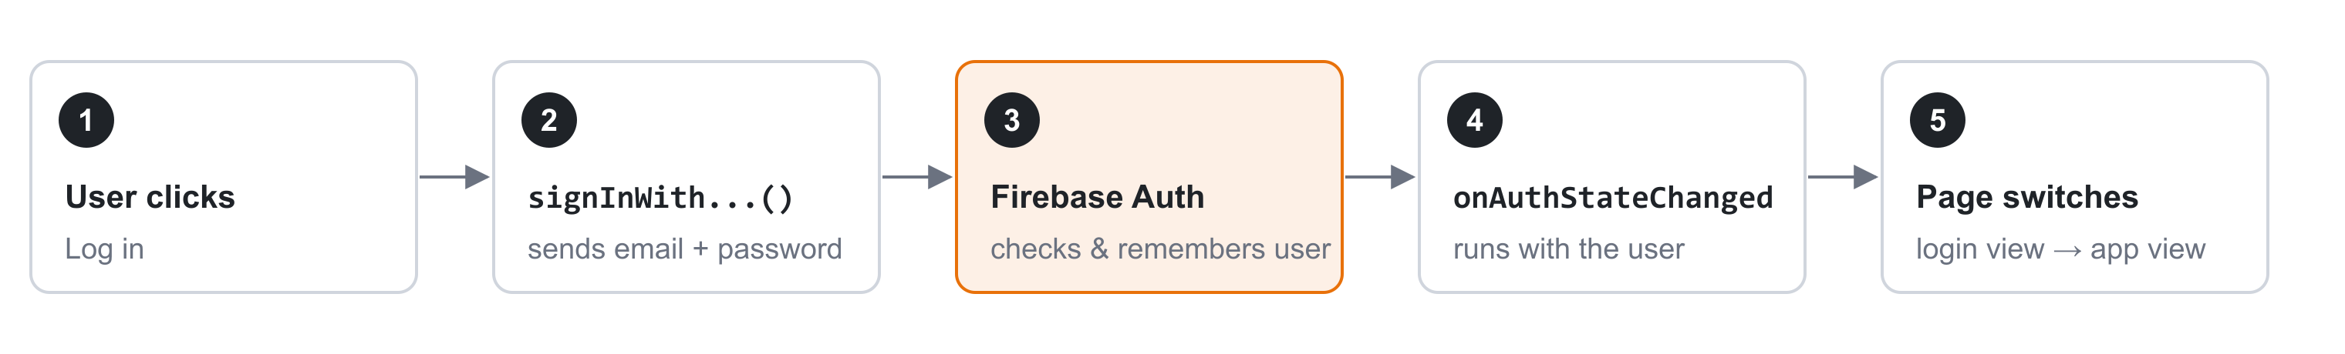
Log users in with three Firebase functions
STEP 5 · AUTHENTICATION
try / catch
shows Firebase's error (wrong password, etc.) on the page.
app.js · buttons
app.js · react to login / logout
// 4. Sign up, log in, log out
document.getElementById("signup").addEventListener("click", async () => {
try {
await createUserWithEmailAndPassword(auth, email.value, password.value);
} catch (e) {
error.textContent = e.message;
}
});
document.getElementById("login").addEventListener("click", async () => {
try {
await signInWithEmailAndPassword(auth, email.value, password.value);
} catch (e) {
error.textContent = e.message;
}
});
logoutBtn.addEventListener("click", () => signOut(auth));
// 5. Show the right view when the user logs in or out
let stopListening = null;
onAuthStateChanged(auth, (user) => {
if (user) {
loginView.hidden = true;
appView.hidden = false;
logoutBtn.hidden = false;
showItems(user);
} else {
loginView.hidden = false;
appView.hidden = true;
logoutBtn.hidden = true;
if (stopListening) stopListening();
}
});

Slide 10
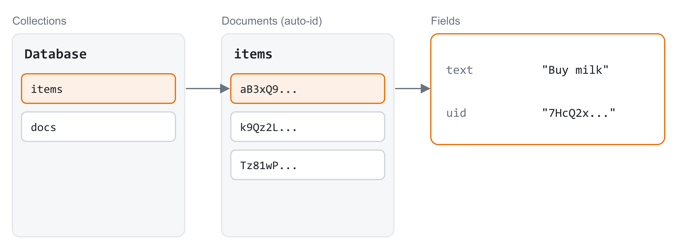
Firestore saves data as documents in collections
STEP 5 · FIRESTORE
TO… | USE
Save a new item | addDoc()
Read items, live | onSnapshot()
Change an item | updateDoc()
Delete an item | deleteDoc()
Like folders and files
A collection ("items") holds documents. A document holds fields, like a JS object.
Store the user's uid
Saving uid on each item lets you load only that user's items, and lock them with rules.
onSnapshot calls your function again every time the data changes, so the list on screen is always up to date.

Slide 11
Save, show and delete items
STEP 5 · FIRESTORE
app.js · save
app.js · show + delete
// 6. Firestore: add, show (live) and delete items
document.getElementById("add").addEventListener("click", async () => {
if (newItem.value === "") return;
await addDoc(collection(db, "items"), {
text: newItem.value,
uid: auth.currentUser.uid,
});
newItem.value = "";
});
function showItems(user) {
const myItems = query(
collection(db, "items"),
where("uid", "==", user.uid)
);
// onSnapshot runs now AND every time the data changes
stopListening = onSnapshot(myItems, (snapshot) => {
list.innerHTML = "";
snapshot.forEach((item) => {
const li = document.createElement("li");
li.textContent = item.data().text;
const del = document.createElement("button");
del.textContent = "Delete";
del.addEventListener("click", () => {
deleteDoc(doc(db, "items", item.id));
});
li.append(del);
list.append(li);
});
});
}
1
collection(db, "items")
Which collection to use. Created automatically on first save.
2
query + where
Only this user's items.
3
onSnapshot
Clear the list, add one <li> per item. textContent keeps it plain, safe text.

Slide 12

Protect the data, then put it online
STEP 6 · SHIP
firestore.rules (paste in console → Firestore → Rules)
terminal
rules_version = '2';
service cloud.firestore {
match /databases/{database}/documents {
// Each item belongs to the user whose uid is stored on it
match /items/{id} {
allow read, update, delete: if request.auth.uid == resource.data.uid;
allow create: if request.auth.uid == request.resource.data.uid;
}
}
}
npm install -g firebase-tools
firebase login
firebase init hosting # public folder: .
firebase deploy
Your app is now live at your-app.web.app.
Other hosts work too (e.g. Netlify Drop). Add their domain in Authentication → Settings → Authorized domains.
In plain words: you can only see or change an item if its uid is yours.
Rules run on Google's servers. Anyone can edit JavaScript in their browser, but nobody can get past the rules.

Slide 13
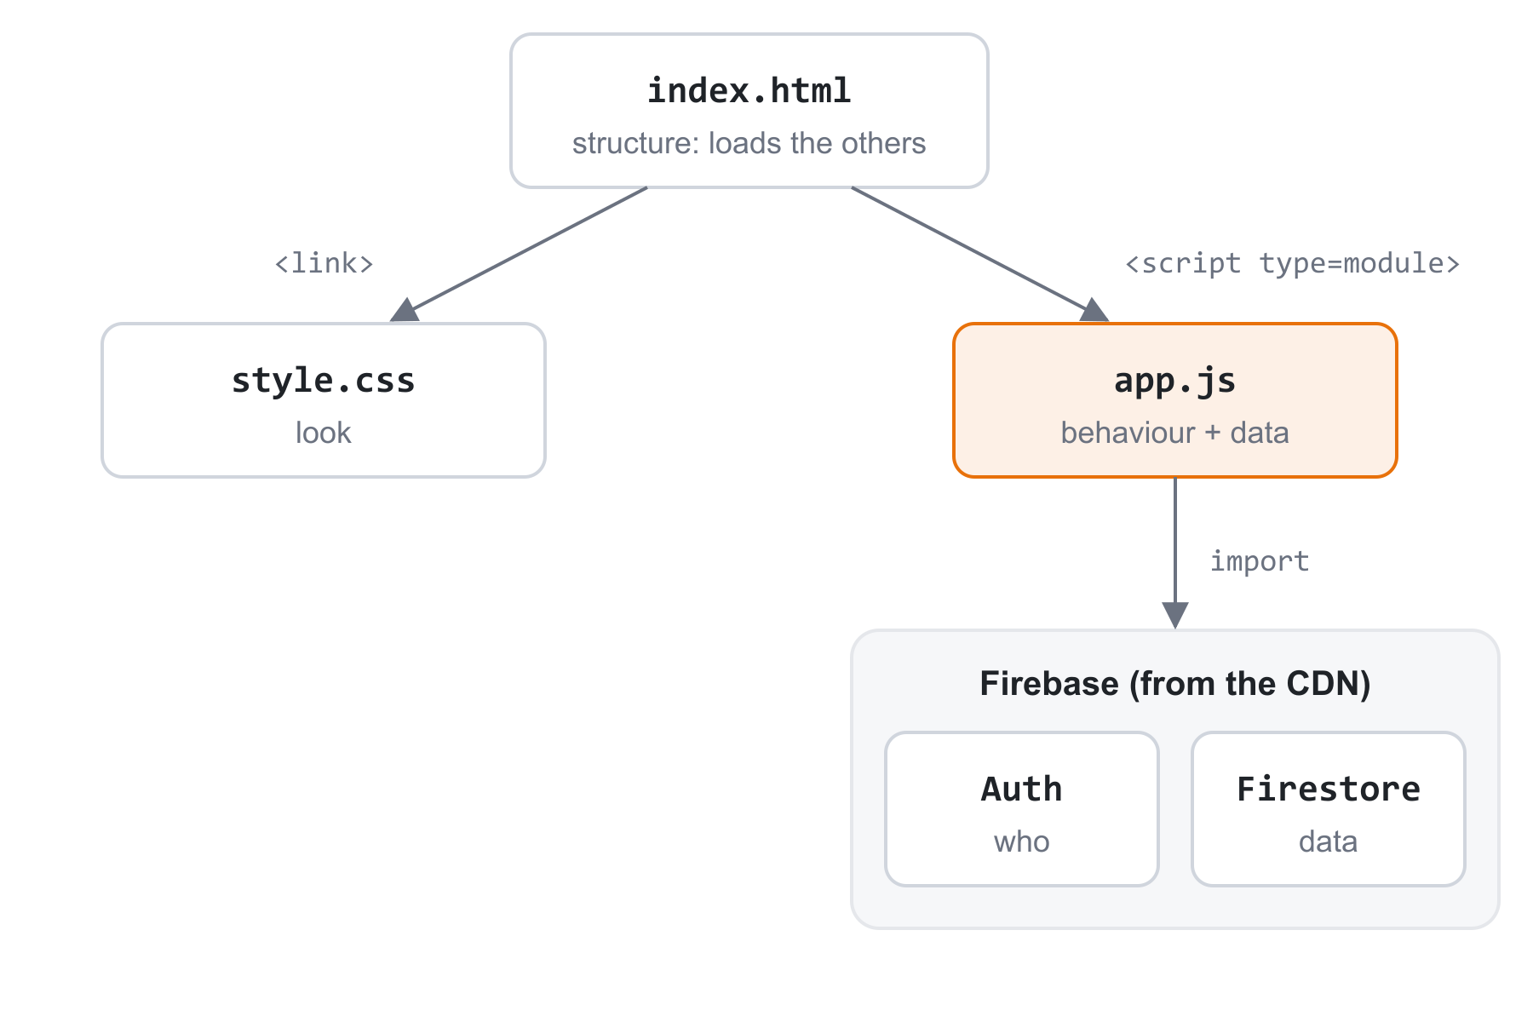
Three files you can turn into any app
THE REUSABLE TEMPLATE
To make a new app from it
1
Copy the folder
Paste your own config into app.js (section 2)
2
Change the HTML
Swap the inputs in #app-view for the ones your app needs
3
Change the data
In section 6, rename "items" and the fields you save and show
4
Update the rules
Use the same collection name
The template is everything from steps 2–6: a login screen and a live list saved in Firestore.
5
Deploy
firebase deploy

Slide 14
index.html: a login view and an app view
TEMPLATE · INDEX.HTML
index.html (1/2)
index.html (2/2)
<!doctype html>
<html lang="en">
<head>
<meta charset="UTF-8">
<meta name="viewport" content="width=device-width, initial-scale=1">
<title>My App</title>
<link rel="stylesheet" href="style.css">
<script type="module" src="app.js"></script>
</head>
<body>
<header>
<h1>My App</h1>
<button id="logout" hidden>Log out</button>
</header>
<!-- Shown when logged out -->
<section id="login-view">
<input id="email" type="email" placeholder="Email">
<input id="password" type="password" placeholder="Password">
<button id="login">Log in</button>
<button id="signup">Sign up</button>
<p id="error"></p>
</section>
<!-- Shown when logged in -->
<section id="app-view" hidden>
<input id="new-item" placeholder="New item">
<button id="add">Add</button>
<ul id="list"></ul>
</section>
</body>
</html>
Two views, one page
JavaScript shows one section and hides the other with the hidden attribute: no page reloads.
Every button has an id
That's how app.js finds it: document.getElementById("login").

Slide 15
style.css, and how app.js is organised
TEMPLATE · STYLE.CSS + APP.JS
style.css
app.js in six sections
body {
font-family: system-ui, sans-serif;
color: #1f2328;
max-width: 640px;
margin: 40px auto;
padding: 0 16px;
}
header { display: flex; justify-content: space-between; align-items: center; }
input { padding: 8px; border: 1px solid #ddd; border-radius: 6px; }
button {
padding: 8px 14px;
border: none;
border-radius: 6px;
background: #e8710a;
color: white;
cursor: pointer;
}
ul { padding: 0; }
li { display: flex; justify-content: space-between; padding: 10px 0;
border-bottom: 1px solid #eee; list-style: none; }
#error { color: crimson; }
1
Import Firebase from the CDN
same in every app
2
Connect your config
same
3
Grab elements getElementById
your ids
4
Sign up / in / out button clicks
same
5
Switch views onAuthStateChanged
same
6
Your data add, show, delete
your app
Orange steps are the only parts you change.

Slide 16
A minimal Google Docs, built from the template
EXAMPLE · DOCS APP
Sidebar: a live list of your documents
A white "page" you type on (contenteditable)
Autosave 1 second after you stop typing
Ctrl+B and Ctrl+I already work in the page
one Firestore document
docs/{id}
title "Project proposal"
body "<b>Goals</b><div>...</div>"
uid "7HcQ2x..."
Rules: the same as the template, with "docs" instead of "items".
Sections 1–5 of app.js are copied unchanged. Only the HTML, the CSS and section 6 are new.

Slide 17
Layout: a sidebar and a paper page
EXAMPLE · DOCS APP
index.html · the new #app-view
style.css · added rules
<section id="app-view" hidden>
<aside>
<button id="new-doc">+ New document</button>
<ul id="doc-list"></ul>
</aside>
<main>
<input id="title" placeholder="Untitled">
<small id="status"></small>
<div id="page" contenteditable="true"></div>
</main>
</section>
/* Two columns: sidebar + editor */
#app-view { display: grid; grid-template-columns: 220px 1fr; gap: 32px; }
#app-view[hidden] { display: none; }
#doc-list { padding: 0; }
#doc-list li { list-style: none; padding: 8px; cursor: pointer; }
#doc-list li:hover { background: #eceef1; }
#title { font-size: 24px; border: none; background: none; width: 70%; }
#status { color: #6b7280; }
/* The "paper" */
#page {
min-height: 900px;
margin-top: 16px;
padding: 64px;
background: white;
box-shadow: 0 1px 4px rgba(0, 0, 0, 0.15);
outline: none;
}
contenteditable="true"
turns a plain <div> into a text editor. No library needed.
Why the [hidden] rule?
display: grid would override the hidden attribute, so we hide it again explicitly.

Slide 18
Create, open and autosave documents
EXAMPLE · DOCS APP
app.js · section 6
app.js · autosave
// 6. Documents
let currentId = null; // id of the open document
let timer = null;
// Create a new, empty document and open it
document.getElementById("new-doc").addEventListener("click", async () => {
const newDoc = await addDoc(collection(db, "docs"), {
title: "Untitled",
body: "",
uid: auth.currentUser.uid,
});
openDoc(newDoc.id, "Untitled", "");
});
// Put a document into the editor
function openDoc(id, title, body) {
currentId = id;
titleInput.value = title;
page.innerHTML = body;
}
// Autosave: wait until typing stops for 1 second, then save
function save() {
if (currentId === null) return;
statusText.textContent = "Saving...";
clearTimeout(timer);
timer = setTimeout(async () => {
await updateDoc(doc(db, "docs", currentId), {
title: titleInput.value,
body: page.innerHTML,
});
statusText.textContent = "Saved";
}, 1000);
}
titleInput.addEventListener("input", save);
page.addEventListener("input", save);
How autosave works
Each keystroke cancels the last timer and starts a new 1-second one, so it saves once you pause, not on every key.
updateDoc() changes the fields you pass and leaves the rest alone.
The sidebar
showDocs() is the template's showItems() with "docs": each <li> opens its document when clicked.

Slide 19
Same recipe, any app
RECAP
1
2
3
4
5
HTML
Elements with ids
CSS
Selectors + properties
DOM
Find, listen, create, update
Firebase
Import from CDN, Auth + Firestore
Ship
Rules + firebase deploy
Ideas for what to add next
Google sign-in
signInWithPopup(auth, new GoogleAuthProvider())
Sort by date
Save a date field and sort the list in JavaScript
Share a doc
Save a list of emails on it and allow them in the rules
Code: the template and the docs app are in the template/ and docs-app/ folders next to this deck.

