Slide 1
Ajax ?
By Abhishek Kumar

Slide 2
What is Ajax?
AJAX is not a programming language.
AJAX is a technique for accessing web servers from a web page.
AJAX stands for Asynchronous JavaScript And XML.
Asynchronous means that we are exchanging data to/from the server in the background without having to refresh the page.
AJAX allows web pages to be updated asynchronously by exchanging data with a web server behind the scenes. This means that it is possible to update parts of a web page, without reloading the whole page.

Slide 3
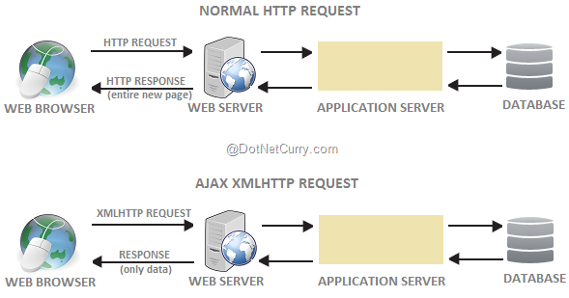

Slide 4
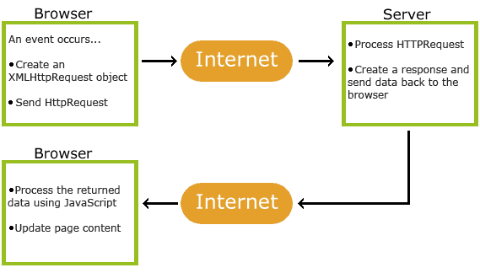
An event occurs in a web page (the page is loaded, a button is clicked)
An XML Http Request object is created by JavaScript.
The XML Http Request object sends a request to a web server.
The server processes the request.
The server sends a response back to the web page .
The response is read by JavaScript .
Proper action (like page update) is performed by JavaScript .

Slide 5
Why Ajax ?
No page Reload on each Request.
Update a part of page not full page if required.
Send Data to server in background.
Receive Data from server in background.
Better User Experience.
Improve speed and improvement .
Multiple Requests are happening concurrently in the same time or client doesn’t have to wait for response from a server in order to make new request.

Slide 6
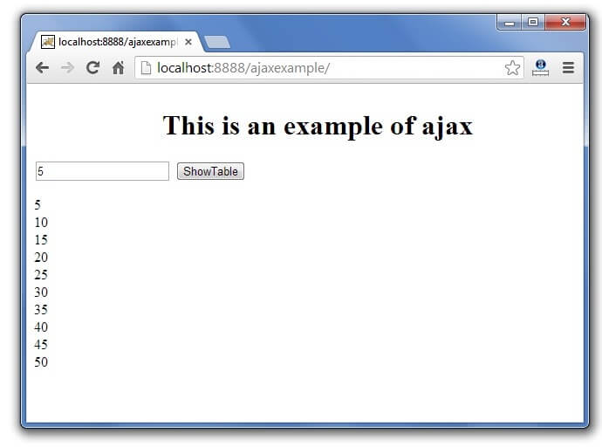
Where we use Ajax ?
It can be use anywhere in a web application where small amount of information can be saved or retrieved from the server without posting back to web pages.

Slide 7
How we can use Ajax?
Step1:-Create an xml http request object.
Step2:-Making a Request to the server .
Step3:-Handaling the response coming from the server.
Step4:-Send the request.
XMLHttpRequest (XHR) objects are used to interact with servers. You can retrieve data from a URL without having to do a full page refresh.

Slide 8
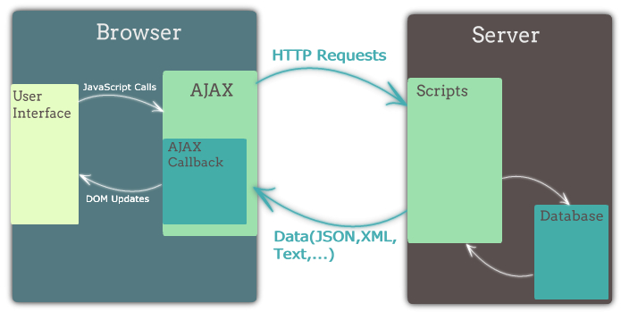
Html ,css, javascript ,xml , json and php are the different Technologies comes in Ajax.
Html and css are used at client side.
Javascript is used to make request.
Xml and json are the request format.
Php is used at the server side.

Slide 9
References
W3schools
JavaTpoint

Slide 10
Thank You

