Slide 1









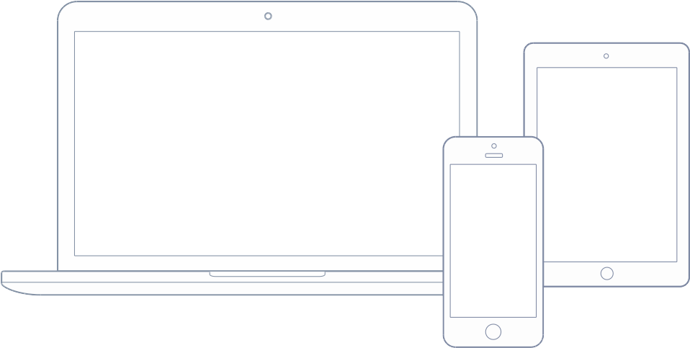






ARCHITECTURE OVERVIEW
BACKEND BUSINESS LOGIC is coded in perl to access and manipulate data structure stored in mongoDB. Clients communicate with backend through our SDKs encapsulating WebSocket packets processing and connection persistence.
THIRDPARTY API INTEGRATION We use perl as a glue to access third party APIs for account, payment, SMS, cloud storage and other resources.
FILE AND MEDIA are hosted on Apache server and normally they will be delivered through CDN (Content Delivery Network). Image, audio and video upload and processing scripts use perl as well. Upload and download works over HTTP.
FRONT END PC/WEB are built with JS/CSS/HTML and the framework we use is AngularJS.
FRONT END MOBILE are coded in their respective language of choice. They are done in Java and Objective-C and we are migrating to Kotlin and Swift in the near future.
HTTP
HTTP
WebSocket
HTTP
WebSocket
WebSocket
HTTP
http://www.hehuo168.com/en
http://www.hehuo168.com/en

