Slide 1
Structuring Open Access to Knowledge: The Creative Commons Story
Professor Brian Fitzgerald
Head of School of Law QUT

Slide 2
CC: Key Themes
Sharing, Accessing, Collaborating and Negotiating: Content, Culture and Production – “with a minimum of fuss”
Fueled by the negotiability, innovation and creative potential of the digital environment – “cut and paste”, “remix” “P2P”
Free Culture – Free to Access – a repository of open space or commons unencumbered by large transaction costs and threats of law suits - Lessig, The Future of Ideas (2001); Free Culture (2004)
Creative Innovation – core economic driver – Florida, Rise of the Creative Class (2002) – CC slogan “get creative”
Peer to Peer Production and User Led Innovation - Y Benkler, “Coase's Penguin, or Linux and the Nature of the Firm”, (2002) 112 Yale Law Journal 369

Slide 3
Implementing CC
Locate/build and inform people of creative resources
Establish easy to implement generic non discriminatory protocols for access to and reutilising or reusing of content – a process of “licensing out”
Make it easier to negotiate out or access copyright material
Builds on free software model

Slide 4
Free and Open Source Software
“The powerful insight that Richard Stallman and his advisers at the Free Software Foundation .. discovered was that if you want to structure open access to knowledge you must leverage off or use as a platform your intellectual property rights. The genius of Stallman was in understanding and implementing the ethic that if you want to create a community of information or creative commons you need to be able to control the way the information is used once it leaves your hands. The regulation of this downstream activity was achieved by claiming an intellectual property right (copyright in the code) at the source and then structuring its downstream usage through a licence (GNU GPL). This was not a simple “giving away” of information but rather a strategic mechanism for ensuring the information stayed “free” as in speech. It is on this foundation that we now see initiatives like the Creative Commons expanding that idea from open source code to open digital content.”: A Fitzgerald and B Fitzgerald Intellectual Property in Principle (2004) at [11.100].

Slide 5
Negotiating and Managing IPRS for Open Access – CreativeCommons.org
CreativeCommons.org – based at Stanford Univ.
Provides licences for allowing people to reutilise content on certain conditions
Licence Language - Common, Legal and Code – easy to use and understand
To implement - create a link to the CC licence or insert conditions of reuse in your code or metadata

Slide 6
Four main protocols
Attribution: Other people may use, modify and distribute the work, as long as they give the original author credit.
Non-commercial: Other people may use, modify and distribute the work, but for non-commercial purposes only.
No derivatives: Other people may use and distribute the work, but can not modify it to create derivative works.
Share alike: Other people may modify the work and distribute derivatives, but only on the condition that the derivatives are made available to other people on the same licence terms. This term can not be used with the No Derivatives term, because it applies only to derivative works.

Slide 7
International Creative Commons iCommons
Christiane Asschenfeldt – iCommons Coordinator
QUT – Institutional Affiliate in Australia - DVC Tom Cochrane (QUT), Ian Oi (Blakes) and myself - Project Leaders
Translating licences and philosophy of creative commons into each national jurisdiction – porting – to assist enforceability Differences - Australian to US law: copyright terminology, TPA, moral rights

Slide 8
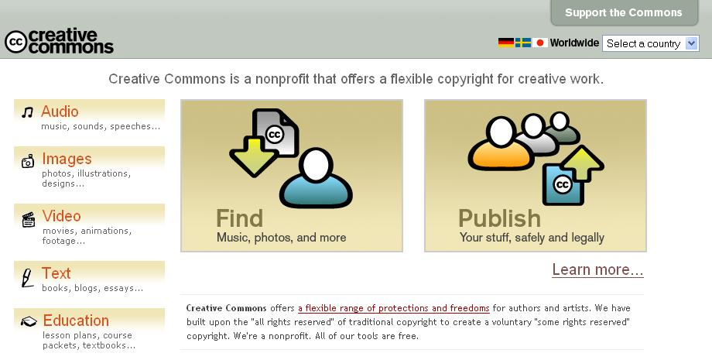

Slide 9
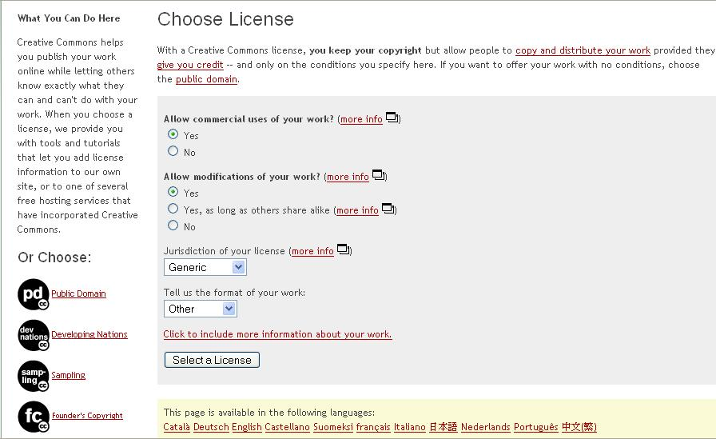

Slide 10
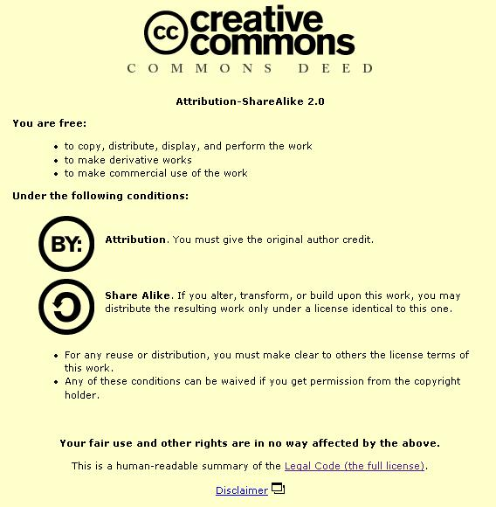

Slide 11
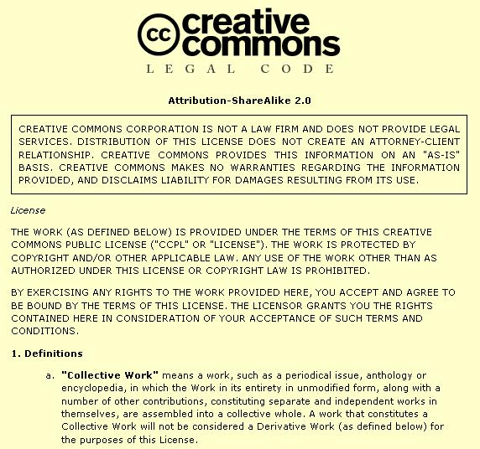

Slide 12

An Example
Colin Mutchler contributed an acoustic guitar melody to Opsound, called ‘My Life’

Slide 13
Cora Beth came across the track and added a violin part, calling it “My Life Changed”

Slide 14
rjmarshall remixed the track and several others from the Opsound pool, and created “Our Lives Are Changing”

Slide 15
John Holowach remixed the remix, and created “The Big Finale”

Slide 16
Another example – Former QUT Student
AC Plays Guitar – Conscious and Confused

Slide 17
PD, Founders’ and DN Licences
    The Public Domain Dedication licence. This licence relinquishes all claims to copyright that a creator has over an item and makes it available in the public domain.
    Founders’ Copyright. Creative Commons and a contributor will enter into a contract to guarantee that the relevant creative work will enter the public domain after 14 years, unless the author chooses to extend for another 14. To re-create the functionality of a 14- or 28-year copyright, the contributor will sell the copyright to Creative Commons for $1.00, at which point Creative Commons will give the contributor an exclusive license to the work for 14 (or 28) years.
    The Developing Nations licence. This licence allows creators to invite a wide range of royalty-free uses of their material in developing nations while retaining full copyright in the developed world.

Slide 18
Sampling Licences
    There are three different versions of the Sampling licence available:
      The Sampling Licence. This licence allows users to use part of the licensed material for any purpose other than advertising, but does not allow users to perform, display or distribute copies of the whole of the licensed material for any purpose.
      The Sampling Plus Licence. This licence allows users to use part of the licensed material for any purpose other than advertising. It also allows users to perform, display and distribute copies of the whole of the licensed material for non-commercial purposes.
      The Noncommercial Sampling Plus Licence. This licence allows users to use the whole or a part of the licensed material for non-commercial purposes.
      The Music Sharing licence. This licence was developed for musicians who want to spread their music on the web and filesharing networks legally for fans to download and share, while protecting the music from commercial use or remixing of any kind.

Slide 19
Wired Magazine
Wired magazine has produced a compact disc where the work of artists and bands are distributed under Creative Commons licences. The Wired CD was released together with the November 2004 of Wired Magazine.Sixteen recording artists agreed to participate in this project and contribute their work for inclusion on the Wired CD.
There are two different licences under which tracks on the Wired CD are distributed. Thirteen recording artists chose to distribute their work under the Sampling Plus Licence. Three recording artists chose to distribute their work under the Noncommercial Sampling Plus Licence.

Slide 20
Existing Projects
Public Library of Science – www.plos.org – uses CC licences
AEShareNet – AESL a corporation funded in part by Commonwealth and State Governments
Australian Creative Resource Archive (ACRA) –UQ Ipswich www.uq.edu.au/acro
Common Content Website
BBC Creative Archive
Creative Commons Search Engine
A lot of other content using CC – over 1 million objects

Slide 21
Application to Government
State/Government Ownership of Copyright
CLRC Report – www.clrc.gov.au
Open Content Licensing possibilities

Slide 22
Role of Libr@ries
Some have questioned how such a distributed project as Creative Commons can succeed. The power is in the network that is created and social branding that occurs. The project managers in the Creative Commons are many: the licensing projects, repositories or conservancies of digital content and the institutional users within the knowledge industries such as libr@aries..
At the most fundamental level libr@ries will connect users to the Creative Commons by cataloguing (see for example the Creative Commons search engine http://creativecommons.org/getcontent/) open content and its whereabouts: the content that can be accessed, reutilised and for what purposes. A core task of any reputable libr@ry will be informing its users of the protocols, projects and repositories of the open content world. Understanding open content protocols will be critical to the acquisition and development of knowledge in the digital environment and introductory university courses on information management and retrieval along with libr@ries will facilitate this task. Libr@ries will not only direct people to distributed open content but it can be expected that many will become repositories or conservancies collecting and managing open content within their institution or jurisdiction.
The interesting challenge in all of this will be as to how libr@ries respond and adapt to a distributed network of open content in which they will be critical agents. Moving the openness of being able to read and reutilise content in a physical library to the virtual worlds of the digital environment where the right to read is inherently an act of reproduction will to some small extent depend on the power of open content and the information commons. If libr@ries are to be effective then the “total control” of digital content by copyright owners must be balanced by other more social models of information management that allow for further innovation and creativity.

Slide 23
Relationship to Copyright
Not anti-copyright
Relies on and is complementary to copyright
Aims to make copyright more alive active and accessible

Slide 24
P2P Liability
Kazaa Cases – one in Australia - Universal Music Australia Pty Ltd v Sharman License Holdings Ltd (2004) 205 ALR 319
“If the product at issue is not capable of substantial or commercially significant noninfringing uses, then the copyright owner need only show that the defendant had constructive knowledge of the infringement. On the other hand, if the product at issue is capable of substantial or commercially significant noninfringing uses, then the copyright owner must demonstrate that the defendant had reasonable knowledge of specific infringing files and failed to act on that knowledge to prevent infringement.” MGM v Grokster Ltd 380 F. 3d 1154 (9th Cir. Cal. 2004)
Will innovative P2P technology survive the law suits – what role for CC?

Slide 25
Motivation for Sharing
Ideologically and financially this may be acceptable – the most compelling example in Australia is government where information is ultimately owned by and for the people
Open contenting one version of your material e.g. a draft (E Print) or a chapter may in fact be a strategy for enhancing the commercialised version of your content
A wish to share with others for creative and educational purposes – peer production
Publicity – what the free and open software movement calls “egoboo” or reputation within the open community which in some cases will be exploited commercially down the track
Negotiability – through technologically implemented generic protocols that can be utilised with the click of a mouse
“What is junk to one may be gold to another” – the idea that the off cuts or digital junk of one person may be the building blocks of knowledge and creative genius for another
“indirect appropriation” – money, design and use of end product, pleasure or social profile gained through involvement in peer production - Benkler

Slide 26
Animation

Slide 27
Further Reading
B Fitzgerald, "Structuring Knowledge Through Open Access: The Creative Commons Story" in C Kapitzke and B Bruce (eds.) New Libraries and Knowledge Spaces: Critical Perspectives on Information Education (2005) Lawrence Erlbaum and Assoc.

