Slide 1
Creative Commons (CC) : A New Model for Copyright Management
Professor Brian Fitzgerald
Head of School of Law QUT

Slide 2
CC: Key Themes
Sharing, Accessing, Collaborating and Negotiating: Content, Knowledge, Culture and Production – “with a minimum of fuss”
Fueled by the negotiability, innovation and creative potential of the digital environment – “cut and paste”, “remix” “P2P”
Free Culture – Free to Access – a repository of open space or commons unencumbered by large transaction costs and threats of law suits - Lessig, The Future of Ideas (2001); Free Culture (2004)
Creative Innovation – core economic driver – Florida, Rise of the Creative Class (2002) – CC slogan “get creative”
Peer to Peer Production and User Led Innovation - Y Benkler, “Coase's Penguin, or Linux and the Nature of the Firm”, (2002) 112 Yale Law Journal 369 – Collaborative Innovation

Slide 3
Implementing CC
Locate/build and inform people of creative resources
Establish easy to implement generic non discriminatory protocols for access to and reutilising or reusing of content – a process of “licensing out”
Make it easier to negotiate out or access copyright material
Builds on free software model

Slide 4
Free and Open Source Software
“The powerful insight that Richard Stallman and his advisers at the Free Software Foundation .. discovered was that if you want to structure open access to knowledge you must leverage off or use as a platform your intellectual property rights. The genius of Stallman was in understanding and implementing the ethic that if you want to create a community of information or creative commons you need to be able to control the way the information is used once it leaves your hands. The regulation of this downstream activity was achieved by claiming an intellectual property right (copyright in the code) at the source and then structuring its downstream usage through a licence (GNU GPL). This was not a simple “giving away” of information but rather a strategic mechanism for ensuring the information stayed “free” as in speech. It is on this foundation that we now see initiatives like the Creative Commons expanding that idea from open source code to open digital content.”: A Fitzgerald and B Fitzgerald Intellectual Property in Principle (2004) at [11.100].

Slide 5
Negotiating and Managing IPRS for Open Access – CreativeCommons.org
CreativeCommons.org – not for profit corp. based in SFO
Provides licences for allowing people to reutilise content on certain conditions
Licence Language - Common, Legal and Code – easy to use and understand
To implement - create a link to the CC licence or insert conditions of reuse in your code or metadata

Slide 6
Four main protocols
Attribution: Other people may use, modify and distribute the work, as long as they give the original author credit.
Non-commercial: Other people may use, modify and distribute the work, but for non-commercial purposes only.
No derivatives: Other people may use and distribute the work, but can not modify it to create derivative works.
Share alike: Other people may modify the work and distribute derivatives, but only on the condition that the derivatives are made available to other people on the same licence terms. This term can not be used with the No Derivatives term, because it applies only to derivative works.
Need to mention Moral Rights (asserted) in Australian licence

Slide 7
International Creative Commons iCommons
Christiane Asschenfeldt – iCommons Coordinator
QUT – Institutional Affiliate in Australia Translating licences and philosophy of creative commons into each national jurisdiction – porting – to assist enforceability Differences - Australian to US law: copyright terminology, TPA, moral rights

Slide 8
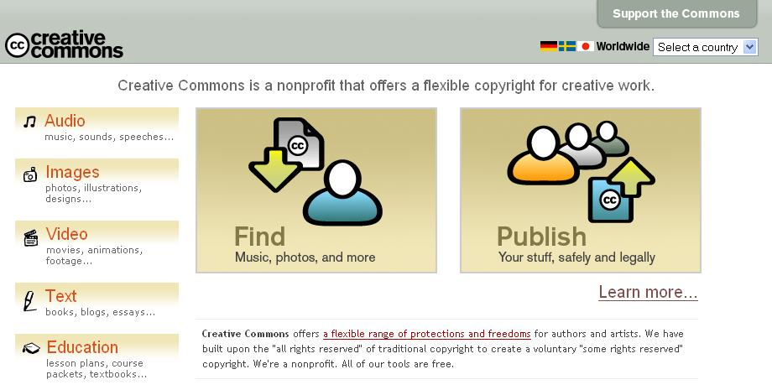

Slide 9
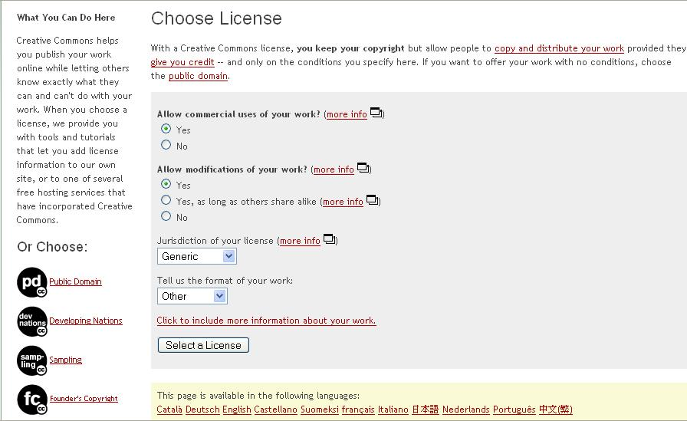

Slide 10
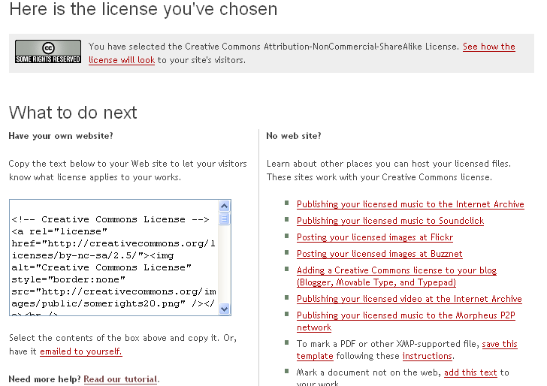

Slide 11
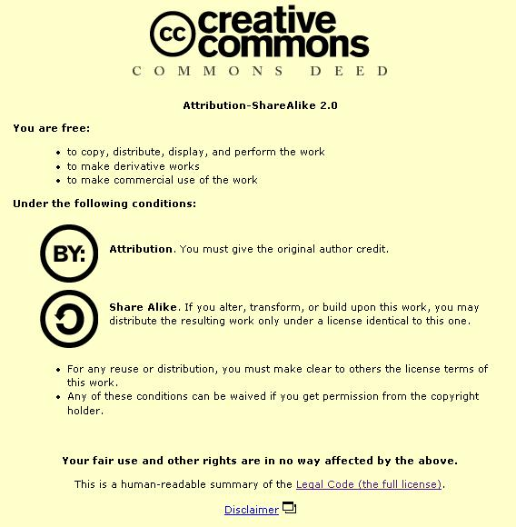

Slide 12
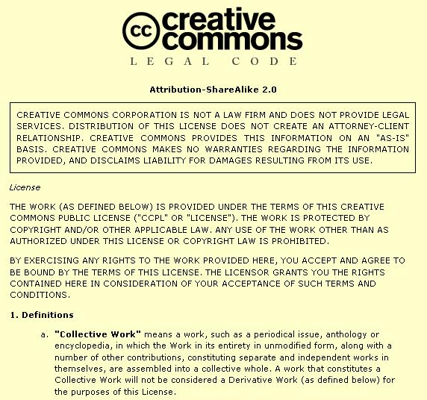

Slide 13
CC Badge

Slide 14
Sampling Licences
    There are three different versions of the Sampling licence available:
      The Sampling Licence. This licence allows users to use part of the licensed material for any purpose other than advertising, but does not allow users to perform, display or distribute copies of the whole of the licensed material for any purpose.
      The Sampling Plus Licence. This licence allows users to use part of the licensed material for any purpose other than advertising. It also allows users to perform, display and distribute copies of the whole of the licensed material for non-commercial purposes.
      The Noncommercial Sampling Plus Licence. This licence allows users to use the whole or a part of the licensed material for non-commercial purposes.
      The Music Sharing licence. This licence was developed for musicians who want to spread their music on the web and filesharing networks legally for fans to download and share, while protecting the music from commercial use or remixing of any kind.

Slide 15
Wired Magazine
Wired magazine has produced a compact disc where the work of artists and bands are distributed under Creative Commons licences. The Wired CD was released together with the November 2004 of Wired Magazine.Sixteen recording artists agreed to participate in this project and contribute their work for inclusion on the Wired CD.
There are two different licences under which tracks on the Wired CD are distributed. Thirteen recording artists chose to distribute their work under the Sampling Plus Licence. Three recording artists chose to distribute their work under the Noncommercial Sampling Plus Licence.

Slide 16
Existing Projects
Public Library of Science – www.plos.org – uses CC
AEShareNet – AESL a corporation funded in part by Commonwealth and State Governments
Australian Creative Resource Archive (ACRA) – UQ Ipswich www.acro.edu.au
BBC Creative Archive http://creativearchive.bbc.co.uk/
Creative Commons Search Engine – search.creativecommons.org
CommonContent.org Website
Over 53 million objects – linked to CC licences
Australian users: LAMS Community www.lamscommunity.org OnlineOpinion.com.au Vibewire.net.au Creativecommons.org.au

Slide 17
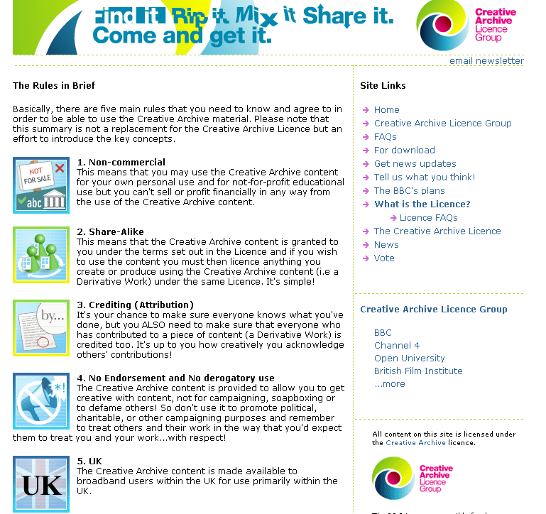

Slide 18
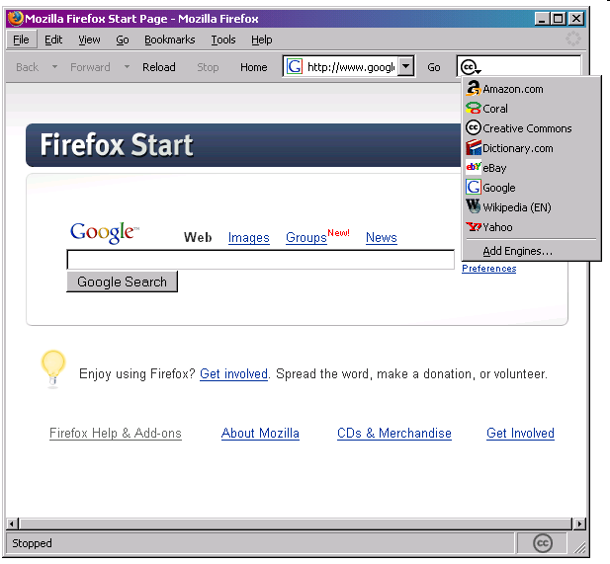

Slide 19
Application to Government
State/Government Ownership of Copyright
CLRC Report – www.clrc.gov.au
Open Content Licensing possibilities
EU Directive on Reuse of and OECD Work on Public Sector Information (PSI) Management
UK Common Information Environment (CIE) – CC in the UK Public Sector www.intrallect.com/cie-study/ Report%20for%20CIE%20-19th%20July.pdf

Slide 20
Relationship to Copyright
Not anti-copyright
Relies on and is complementary to copyright
Aims to make copyright more alive active and accessible

Slide 21
Motivation for Sharing
Ideologically and financially this may be acceptable – the most compelling example in Australia is government where information is ultimately owned by and for the people
Open contenting one version of your material e.g. a draft (E Print) or a chapter may in fact be a strategy for enhancing the commercialised version of your content
A wish to share with others for creative and educational purposes – peer production
Publicity – what the free and open software movement calls “egoboo” or reputation within the open community which in some cases will be exploited commercially down the track
Negotiability – through technologically implemented generic protocols that can be utilised with the click of a mouse
“What is junk to one may be gold to another” – the idea that the off cuts or digital junk of one person may be the building blocks of knowledge and creative genius for another
“indirect appropriation” – money, design and use of end product, pleasure or social profile gained through involvement in peer production - Benkler

Slide 22
The Dynamic of Distributed Knowledge
The dynamic of serendipitous creation, research and innovation – allowing unknown parts and paths to be joined together through the dynamic nature of a distributed web
Collaboration the new innovation
Important to teachers and students
Libr@ries will need to understand these developments

Slide 23
Open Access
The Open Access (OA) Movement is intimately connected with the Creative Commons movement and particularly the Science Commons project <sciencecommons.org>. Open Access as defined in the Berlin Declaration on Open Access to Knowledge in the Sciences and Humanities (2003) http://www.zim.mpg.de/openaccess-berlin/berlindeclaration.html and the Bethesda Statement on Open Access Publishing (2003) http://www.earlham.edu/~peters/fos/bethesda.htm seeks to open up access to research, data sets and scholarship especially that which is publicly funded. Creative Commons licences are seen as a mechanism through which open access to research can be promoted: R Poynder, “The Role of DRM in Open Access” (2005) www.indicare.org

Slide 24
Teaching and Learning
A recent high-level report from the Australian Carrick Institute for Learning and Teaching in Higher Education authored by Deborah Southwell et al entitled Strategies for effective dissemination of project outcomes (2005) the following comments are made:
In recent months potential answers to some of these questions have developed in the form of a wider understanding about new forms of licensing which involve the sharing of rights rather than holding an exclusive monopoly of rights. Perhaps the best known of these forms internationally is the Creative Commons licence, of which an Australian version has been in existence since January 2005. Under Creative Commons licenses, it is possible for creators of intellectual property to provide conditions in which others may use copy and modify their work, providing that the results of this are fully attributed, and that the uses to which the intellectual property is put are not commercially exploited unless this is specifically agreed. Creative Commons licensing offers the possibility of accelerating the dissemination of innovation because it reduces confusion or uncertainty in terms of the disposition of IP that might be created, particularly in circumstances where the development of content is as a result of public investment of one form or another.
The development of this form of licensing comes at a time when at a policy level the Commonwealth is also concerned to see that the results of publicly funded research are available in a more open and generally accessible way than they have been to date, particularly where research outputs are the subject of monopoly approaches to the assignment of copyright in publishing.
A generally applicable guideline in the dissemination of teaching innovations should be that a Creative Commons licensing approach should be the de facto approach to assist dissemination. (pp24-25)

Slide 25
DEST SII “Legal Protocols” Project
This Project starting immediately and running through to the middle of 2007 will consider management of copyright for open access in research repositories
QUT is the lead institution – I am project leader

Slide 26
QUT Led ARC Centre of Excellence in Creative Industries and Innovation
Considers Creative Innovation
Including Creative Workforce
I am Project Leader of Law
Creative Innovation Clinic – across Law, Education, Business, IT and Creative Industries
Creative Commons Research

Slide 27
CC Remix School Based Showcase
Could we have school students work with CC material to create product for a national showcase – presented through a website?

Slide 28
Concl

