Slide 1
The Future of Copyright on the Internet: In Search of Principle?
Professor Brian Fitzgerald
QUT Law School

Slide 2
The Digital Landscape
Perfect and infinite copying and communication
At low or no cost
Worldwide
Copyright Owners Response: law, technology, market, norms – or a combination e.g. law and technology
WCT and WPPT – 1996
Anti-circumvention laws; file sharing law suits

Slide 3
Three Themes
Rise of the consumer interest – Sony PlayStation Case and the AUSFTA/TPM Exceptions Inquiry
Remix and Reuse – The Panel Cases, Crown Copyright and Creative Commons
Innovative/Disruptive Technologies – Kazaa Litigations, Google Top Gainers
Culture and Economy

Slide 4
Sony PS2 Mod Chip Case
Kabushiki Kaisha Sony Computer Entertainment v Stevens [2002] FCA 906 – www. austlii.edu.au
Sony argued Stevens had breached s116A Copyright Act 1968 in that he had sold or distributed a circumvention device, namely mod chips. A circumvention device as defined in s10 Copyright Act: A device (including a computer program) having only a limited commercially significant purpose or use, or no such purpose or use, other than the circumvention, or facilitating the circumvention, of a technological protection measure.

Slide 5
Technology
The PlayStation is coded (through what is called Regional Access Coding (RAC) contained within a track on each CD read by a chip known as a “Boot ROM” located on the circuit board of the PlayStation console (hereafter called “RAC/Boot ROM”) to play games available in the region in which the PlayStation was sold. This means that a game purchased in the US or Japan cannot be played on a PlayStation purchased in Australia; the platform will not support it. As well a copied, burnt or unauthorised version of a game will not play on the PlayStation, as the copying process does not embed the necessary coding in the copy.

Slide 6
Legislation
A technological protection measure (TPM) is defined under s10(1) Copyright Act as:
  A device or product, or a component incorporated into a process, that is designed, in the ordinary course of its operation, to prevent or inhibit the infringement of copyright in a work or other subject-matter by either or both of the following means:
    (a) by ensuring that access to the work or other subject matter is available solely by use of an access code or process (including decryption, unscrambling or other transformation of the work or other subject-matter) with the authority of the owner or exclusive licensee of the copyright:
    (b) through a copy control mechanism.

Slide 7
Sony Case: First Decision
Justice Sackville held that Regional Access Coding (RAC) was not a technological protection measure because it did not and was not designed to prevent access to the copyright content or to act as a copy control mechanism of the copyright content. The crucial finding being that RAC did not prevent reproduction of a game, it only prevented user of a game that was not coded for the region in which the PlayStation was sold: paras 92, 118. Therefore, the mod chip could not be a circumvention device because it was not designed for the purpose of circumventing a technological protection measure.

Slide 8
Sony Case: Practical Effect
Justice Sackville rejected the argument that RAC had the “practical effect” of inhibiting or preventing access or copying in that it created a disincentive for copying by making it difficult for copied games to be played.

Slide 9
Sony Case: RAM Argument
The more complex argument made by Sony was that RAC was a TPM because it prevented copies of the games being made in the RAM (Random Access Memory) or temporary memory of the PlayStation console: para 119ff.
The Judge rejected this argument predominantly on the basis that reproduction in RAM was of such a limited and temporary nature that it was not reproduction “in a material form” as required by the s31(1)(a)(i) Copyright Act.

Slide 10
Sony Case: On Appeal - FFC
On 30 July 2003, the Full Federal Court of Australia (French, Lindgren and Finkelstein JJ) overturned the decision of Sackville J at first instance, and held that the sale and distribution of PlayStation mod chips contravened s116A of the Copyright Act. The Court held that Regional Access Coding (RAC) embedded on PlayStation Games and activated by the Boot ROM chip on the circuit board of the PlayStation console was a technological protection measure for the purposes of s116A Copyright Act even though it did not prevent copying as such but merely provided a disincentive for copying or burning games – the so-called “practical effect argument”.
Kabushiki Kaisha Sony Computer Entertainment v Stevens [2003] FCAFC 157

Slide 11
High Court
The High Court rejected the holding of the FFC that RAC/Boot ROM was a TPM and confirmed the reasoning of Sackville J to find that Stevens was not liable for infringement of s 116A of Copyright Act
The Court agreed with Sackville J and the majority in the Full Federal Court that arguments based on temporary reproduction in RAM were not sustained.

Slide 12
High Court
Gleeson CJ, Gummow, Hayne and Heydon JJ
It is important to understand that the reference to the undertaking of acts which, if carried out, would or might infringe, is consistent with the fundamental notion that copyright comprises the exclusive right to do any one or more of "acts" primarily identified in ss 31 and 85-88 of the Act. The definition of "technological protection measure" proceeds on the footing that, but for the operation of the device or product or component incorporated into a process, there would be no technological or mechanical barrier to "access" the copyright material or to make copies of the work after "access" has been gained

Slide 13
High Court
Gleeson CJ, Gummow, Hayne and Heydon JJ
Interpretation fits with permitted purpose exceptions
Penal Character
Section Designed to Prevent Infringement
Avoid Overbroad Construction – Lawful playing of games
Inhibit includes Impair

Slide 14
High Court – Kirby J
Had it been the purpose of the Parliament, by the enactment of the Digital Agenda Act, to create a right to control access generally, it had the opportunity to say so. It even had overseas precedents upon which it could draw. The Australian Government was pressed to provide protection for all devices that "control access". This is evident in the definition of TPM suggested to the Australian Parliamentary Committee by the International Intellectual Property Alliance. Such a definition would effectively have mirrored the provision adopted by the Congress of the United States in the Digital Millennium Copyright Act of 1998. By the time the Australian definition of TPM was enacted, the United States Act had been in force for two years. Nevertheless, the propounded definition of wider ambit was not accepted. Instead, in Australia, the Parliament chose to focus its definition upon protection from infringement of copyright as such.

Slide 15
High Court – Kirby J
Avoiding over-wide operation: There is an additional reason for preferring the more confined interpretation of the definition of TPM in the Copyright Act. This is because the wider view urged by Sony would have the result of affording Sony, and other rights holders in its position, a de facto control over access to copyrighted works or materials that would permit the achievement of economic ends additional to, but different from, those ordinarily protected by copyright law. If the present case is taken as an illustration, Sony's interpretation would permit the effective enforcement, through a technological measure, of the division of global markets designated by Sony. It would have the effect of imposing, at least potentially, differential price structures in those separate markets. In short, it would give Sony broader powers over pricing of its products in its self-designated markets than the Copyright Act in Australia would ordinarily allow
It may be accepted, as the primary judge concluded, that "[t]he fact that a device can be said to be designed to achieve two or more objectives, only one of which is to prevent or inhibit the infringement of copyright, does not ... of itself ... take the device outside the definition of" a TPM. It may also be accepted that Sony's device was not designed primarily to achieve a particular non-copyright purpose. Nevertheless, where a choice of interpretation has to be made, the existence of the additional non-copyright purpose of enforcing global market price differentiation does constitute a reason to prefer an outcome that is consistent with the balances ordinarily inherent in copyright legislation over a result that is not.

Slide 16
High Court – Kirby J
Upholding fundamental rights: A further reason, not wholly unconnected with the last, is relevant to the choice to be made in selecting between the competing interpretations of the definition of TPM. The interpretation favoured by the primary judge confines that definition and hence the operation of s 116A of the Copyright Act and the civil remedies which that section provides. The Full Court's broader view gives an undifferentiated operation to the provisions of s 116A that clearly impinges on what would otherwise be the legal rights of the owner of a Sony CD ROM and PlayStation console to copy the same for limited purposes and to use and modify the same for legitimate reasons, as in the pursuit of that person's ordinary rights as the owner of chattels.

Slide 17
AUSFTA Obligations Enacted
US Free Trade Agreement Implementation Act 2004 (Cth) which came into effect on 1 January 2005. The Act amends the definition of ‘material form’ and ‘copy’ in section 10 of the Act and creates an exception to infringement where the reproduction is made as part of the technical process of using a non-infringing copy of the copyright material (see ss 43B and 111B). The critical difference being that temporary reproduction of a whole or substantial part of a computer program (game) or film (game) in RAM generated from an infringing copy of the copyright material will be unlawful.
Sony Case – RAM arguments – infringing material – uphold?

Slide 18
AUSFTA Obligations to be Enacted
Under the Australia-United States Free Trade Agreement (AUSFTA), Australia is required to implement a new liability scheme for circumventing technological protection measures by 1 January 2007. The AUSFTA requires Australia to introduce civil and criminal remedies in relation to the following three categories of activity:
Acts of circumvention of technological protection measures that prevent access to copyrighted material
Dealings with (manufacturing, selling etc) devices and services that may be used to circumvent a technological protection measure that controls access to copyrighted material, and
Dealings with devices and services that may be used to circumvent a technological protection measure that protects copyright other than by restricting access to copyrighted material. “TPM Review Issues Paper”

Slide 19
AUSFTA – 17.4.7 (b)
(b) Effective technological measure means any technology, device, or component that, in the normal course of its operation, controls access to a protected work, performance, phonogram, or other protected subject matter, or protects any copyright.

Slide 20
AUSFTA Implementation
There are two elements involved in implementing the TPM obligation. The first element is the development of amendments to the Copyright Act 1968 to ensure compliance with Article 17.4.7. The second element involves a determination of whether there are additional exceptions to TPM liability that would be appropriate for Australia to create.
The Attorney-General’s Department is currently undertaking the first element.
At the request of the Attorney-General, the House of Representatives Standing Committee on Legal and Constitutional Affairs (the Committee) are undertaking the second element. The Committee announced this reference on Wednesday 24 August 2005. Information about the reference can be accessed at http://www.aph.gov.au/house/committee/laca/previnq.htm.
AG’s Newsletter August 2005 http://www.ag.gov.au/agd/WWW/enewsCopyrightHome.nsf/Page/eNews_Issue_37_-_August_2005

Slide 21
Does RAC Become a TPM under the Amended Law?
Obligations?
Balancing Consumer Interest – software embedded in consumer goods
Exceptions

Slide 22
Segmenting Markets Through Code
Fit with removal of Parallel Importation barriers
Does it breach the Trade Practices Act – competition/antitrust law – is it bad in economics?
Efficient to price discriminate across markets – is such an argument sustainable in the face of rapid online distribution of digital content – where international exhaustion of rights has occurred
Can code be used to define the limits of consumer products in this way?

Slide 23
Sony v Gamemasters 87 F. Supp. 2d 976 (N.D. Cal. 1999)
39. Defendant concedes in its opposition papers that "[t]he Game Enhancer makes temporary modifications to the [PlayStation] computer program ... [c]hanging these codes with the Game Enhancer does not alter the underlying software made by SONY." (Def. Opp. at 6). Based upon the declarations before this Court, the Game Enhancer's distinguishing feature appears to be its ability to allow consumers to play import or non-territorial SCEA video games. As discussed above, SCEA specifically designed the PlayStation console to access only those games with data codes that match the geographical location of the game console itself. The Game Enhancer circumvents the mechanism on the PlayStation console that ensures the console operates only when encrypted data is read from an authorized CD-ROM. (Pltf's Reply at 7). Thus, at this stage, the Game Enhancer appears to be a device whose primary function is to circumvent "a technological measure (or a protection afforded by a technological measure) that effectively controls access to a system protected by a registered copyright...." 17 U.S.C. § 1201(a)(2)(A).

Slide 24
Critical Question
The critical question concerning the continued relevance of the Stevens v Sony reasoning will be whether the amended Australian law will equate “access” with “use”. If “controls access” means for example controlling access to copyright subject matter before any act of using, reproduction or communication occurs then the Stevens v Sony reasoning will remain important, as regional access coding does not “control access” before the relevant act. It does not stop someone being able to access the copyright subject matter for the purpose of using, copying or communicating it. This approach fits well with the argument proposed by the IIPA that access should be decoupled from the activity that goes on after access is achieved; access is merely the lock on the door. It does not concern itself with any activity (e.g. use) that will occur after access has been achieved. However if “controls access” means for example the right to control use or playing of a game on a PlayStation after access to copyright subject matter has been achieved then the Stevens v Sony reasoning will be of limited application.

Slide 25
The Panel Cases
The culture of remix – very much alive and achievable in the digital environment – building on the past to create the future
Collaborative Innovation
Substantial part, fair dealing - sampling
A-G’s Fair Use Review
The economic and cultural balance to be struck

Slide 26
Remix Example: Red vs Blue
‘Machinima’ – a form of filmmaking which uses computer games as the animation platform
Uses the popular Halo games on the Microsoft XBox
Each character (and the camera) is controlled by a human player
The footage recorded is then edited and a voiceover track added.
This is a clip from the first episode of Red vs Blue, by RoosterTeeth productions:

Slide 27

Red vs Blue – Halo Machinima

Slide 28
Remix example: The Shining
A remix of Stanley Kubrick’s classic 1980 horror film, The Shining, into a trailer for a new, feel-good movie:

Slide 29

Remix example – The Shining

Slide 30
Remix example: Cantina Crawl 7
Machinima from Star Wars Galaxies
Each character is a human player performing choreographed dance moves:

Slide 31


Slide 32
Crown Copyright
CLRC, Crown Copyright Review
Public Domain – judgments and legislation
Licencing question - negotiating out Crown Copyright – owned by and for the Australian people
Taxonomy, Politics and Economy of Information
Reuse Principles
Open Content Licencing: Creative Commons (CC) - A New Model for Copyright Management

Slide 33
CC: Key Themes
Sharing, Accessing, Collaborating and Negotiating: Content, Knowledge, Culture and Production – “with a minimum of fuss”
Fueled by the negotiability, innovation and creative potential of the digital environment – “cut and paste”, “remix” “P2P”
Free Culture – Free to Access – a repository of open space or commons unencumbered by large transaction costs and threats of law suits - Lessig, The Future of Ideas (2001); Free Culture (2004)
Creative Innovation – core economic driver – Florida, Rise of the Creative Class (2002) – CC slogan “get creative”
Peer to Peer Production and User Led Innovation - Y Benkler, “Coase's Penguin, or Linux and the Nature of the Firm”, (2002) 112 Yale Law Journal 369 – Collaborative Innovation

Slide 34
Free and Open Source Software
“The powerful insight that Richard Stallman and his advisers at the Free Software Foundation .. discovered was that if you want to structure open access to knowledge you must leverage off or use as a platform your intellectual property rights. The genius of Stallman was in understanding and implementing the ethic that if you want to create a community of information or creative commons you need to be able to control the way the information is used once it leaves your hands. The regulation of this downstream activity was achieved by claiming an intellectual property right (copyright in the code) at the source and then structuring its downstream usage through a licence (GNU GPL). This was not a simple “giving away” of information but rather a strategic mechanism for ensuring the information stayed “free” as in speech. It is on this foundation that we now see initiatives like the Creative Commons expanding that idea from open source code to open digital content.”: A Fitzgerald and B Fitzgerald Intellectual Property in Principle (2004) at [11.100].

Slide 35
Four main protocols
Attribution: Other people may use, modify and distribute the work, as long as they give the original author credit.
Non-commercial: Other people may use, modify and distribute the work, but for non-commercial purposes only.
No derivatives: Other people may use and distribute the work, but can not modify it to create derivative works.
Share alike: Other people may modify the work and distribute derivatives, but only on the condition that the derivatives are made available to other people on the same licence terms. This term can not be used with the No Derivatives term, because it applies only to derivative works.
Need to mention Moral Rights (asserted) in Australian licence

Slide 36
International Creative Commons iCommons
QUT – Institutional Affiliate in Australia Translating licences and philosophy of creative commons into each national jurisdiction – porting – to assist enforceability Differences - Australian to US law: copyright terminology, TPA, moral rights
Public Library of Science – www.plos.org – uses CC
AEShareNet – AESL a corporation funded in part by Commonwealth and State Governments
Australian Creative Resource Archive (ACRA) – UQ Ipswich www.acro.edu.au
BBC Creative Archive http://creativearchive.bbc.co.uk/
Creative Commons Search Engine – search.creativecommons.org
Over 53 million ‘link backs’ to CC licences (20k to Aust Licence)

Slide 37
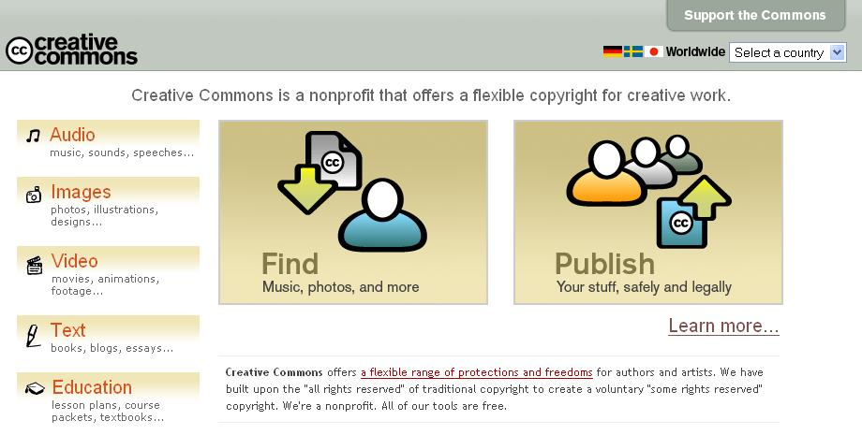

Slide 38


Slide 39
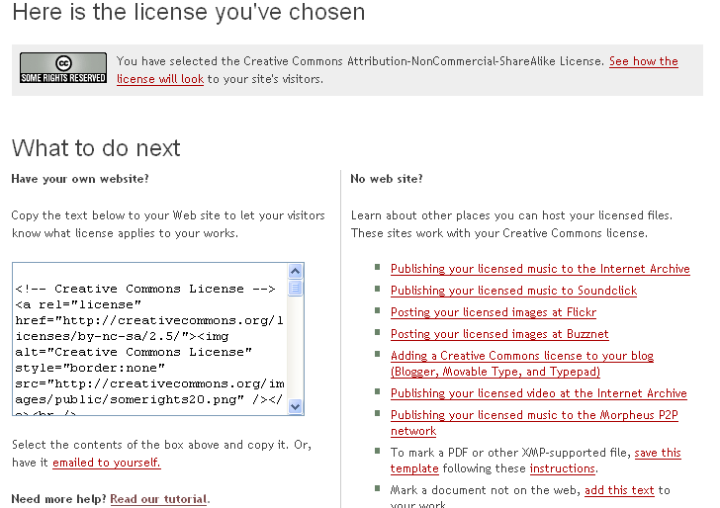

Slide 40
CC Badge

Slide 41
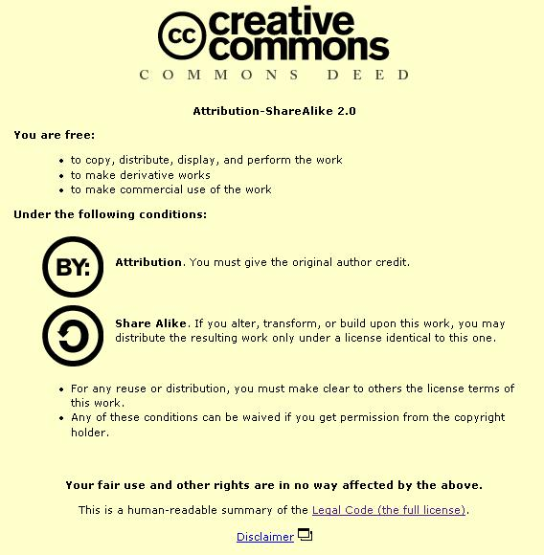

Slide 42
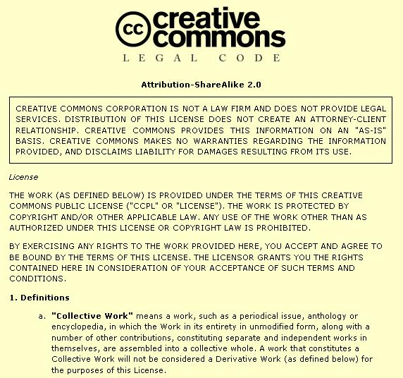

Slide 43
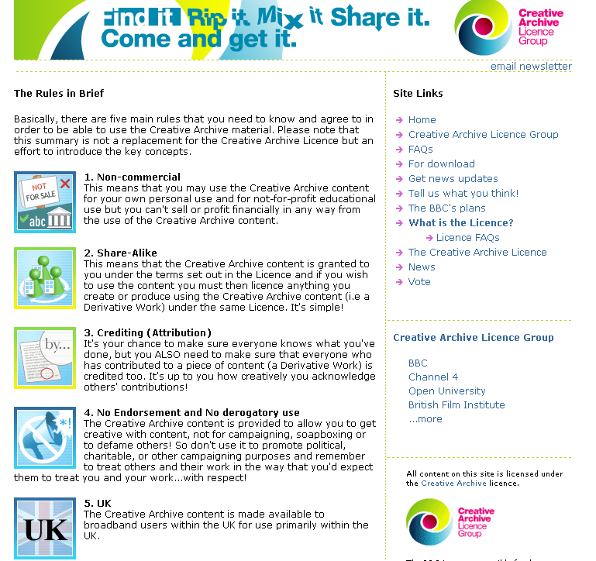

Slide 44
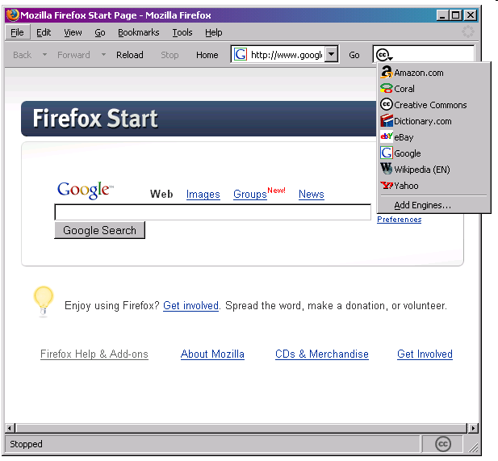

Slide 45
Application to Government
State/Government Ownership of Copyright
CLRC Report – www.clrc.gov.au
Open Content Licensing possibilities
EU Directive on Reuse of and OECD Work on Public Sector Information (PSI) Management
UK Common Information Environment (CIE) – CC in the UK Public Sector www.intrallect.com/cie-study/ Report%20for%20CIE%20-19th%20July.pdf

Slide 46
Relationship to Copyright
Not anti-copyright
Relies on and is complementary to copyright
Mentioned in recent cases: MGM v Grokster (US Supreme Court); Universal v Sharman (Aust Fed Court)
QUT – OAK Law Project – DEST Funded – www.oaklaw.qut.edu.au
ARC Centre of Excellence for Creative Industries and Innovation – Law Program – www.cci.edu.au

Slide 47
Motivation for Sharing
Ideologically and financially this may be acceptable – the most compelling example in Australia is government where information is ultimately owned by and for the people
Open contenting one version of your material e.g. a draft (E Print) or a chapter may in fact be a strategy for enhancing the commercialised version of your content
A wish to share with others for creative and educational purposes – peer production
Publicity – what the free and open software movement calls “egoboo” or reputation within the open community which in some cases will be exploited commercially down the track
Negotiability – through technologically implemented generic protocols that can be utilised with the click of a mouse
“What is junk to one may be gold to another” – the idea that the off cuts or digital junk of one person may be the building blocks of knowledge and creative genius for another
“indirect appropriation” – money, design and use of end product, pleasure or social profile gained through involvement in peer production - Benkler

Slide 48
Why CC is important?
Provides a facility for those that want to share copyright material lawfully - to augment knowledge
Sponsors and Profiles creativity
Allows collaboration and annotation - CCMixter
Links in with the growth of open access repositories providing new sources of knowledge
Open to all
Allows you to release a NC version under CC and still commercialise any other version
Core Skill of the digital generation - OER

Slide 49
Innovative Technologies
Kazaa and Grokster Cases
P2P File Sharing Software
Innovative new way of communicating
Primary use has been to facilitate the sharing of music and more recently movies, Voice Over IP (VOIP eg Skype)

Slide 50
Authorisation
To what extent can the law of authorisation accommodate innovative yet disruptive technologies?
Authorisation – factors to consider include – power to prevent, relationship existing, reasonable steps to prevent or avoid – s 36 (1A), 101 (1A)
Amstrad, Australian Tape Manufacturers
Breyer J in dissent in Grokster

Slide 51
Information Environmentalism
To what extent are existing property owners obligated to preserve this digital environment?
To what extent should they be?
Is such a principle too difficult to establish?

Slide 52
Google Top Gainers
Wikipedia
Baidu
World of Warcraft
Apple iTunes v DarkNet
Green Day
Google Print/Book Search

Slide 53
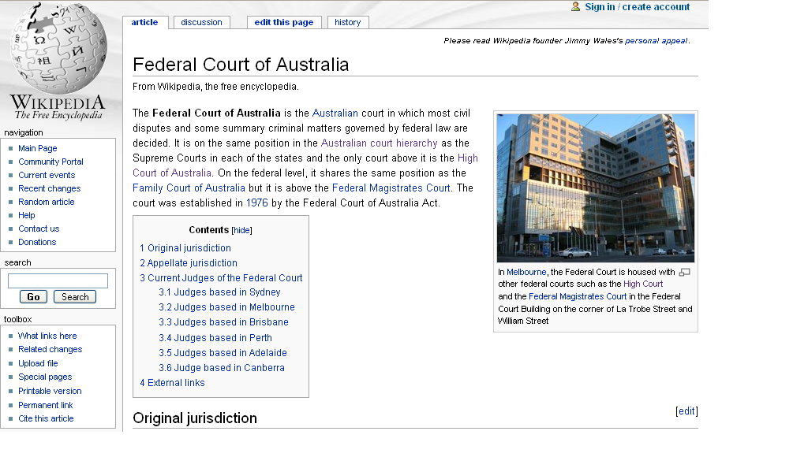
Wikipedia - read

Slide 54
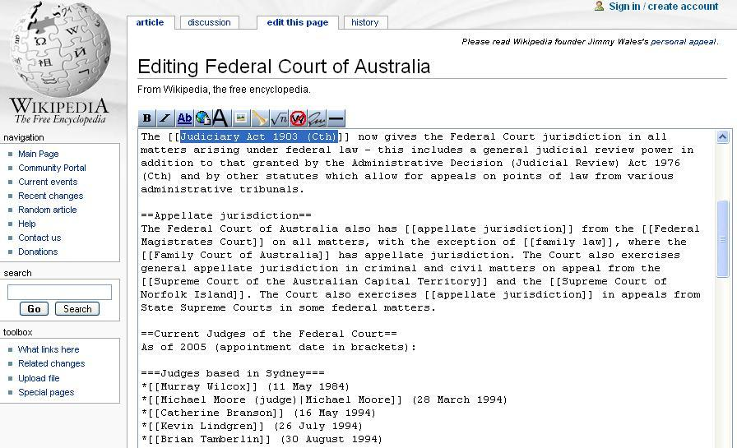
Wikipedia - edit

Slide 55
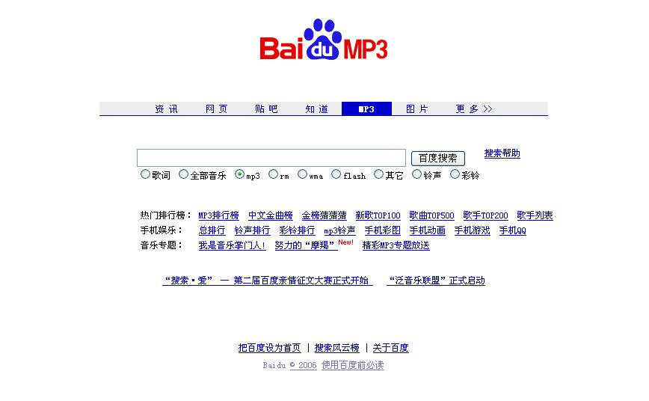
Baidu

Slide 56


World of Warcraft

Slide 57
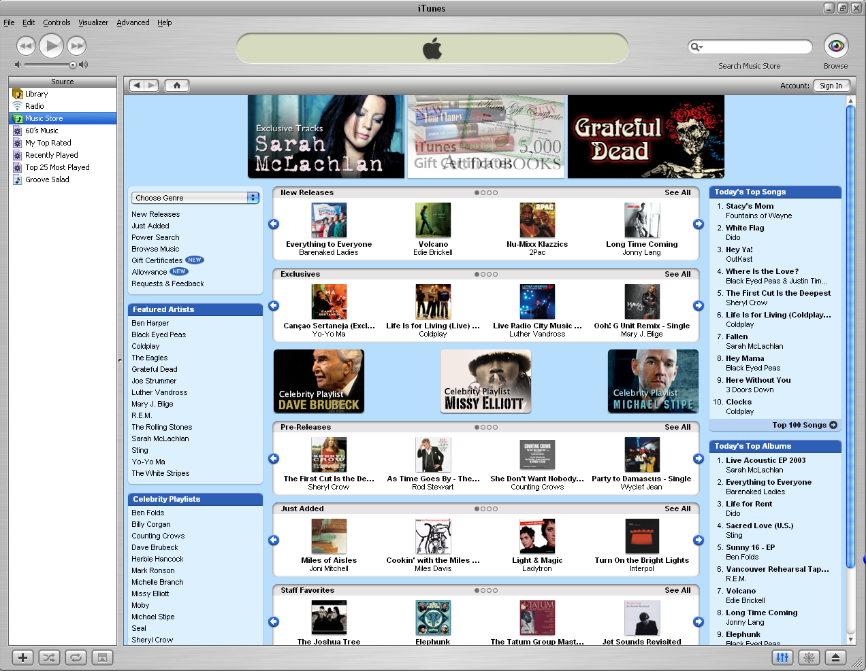
Apple iTunes Music Store

Slide 58

Greenday

Slide 59

Dean Gray
‘Mashup’ remix of Greenday’s album American Idiot
Released non-commercially on personal website
Removed 10 days later after receiving a Cease and Desist letter from Warner Music.

Slide 60

Google Print / Google Book Search

Slide 61
Conclusion
There is a lot of activity happening in this area. The law needs to be responsive – as it always has been – to the competing interests of a rapidly changing society. Today we have looked at some issues that are currently before the courts and the legislators. The key theme is that we need to closer attention to the principles at play in this new environment and how they might be reconciled and enhanced

