Slide 1

CC and Government:
How CC licences have enabled open access to public sector materials in Australia
CC Asia Pacific 2010: Open for Innovation
Korea
4-5 June 2010
AUSTRALIA

Slide 2
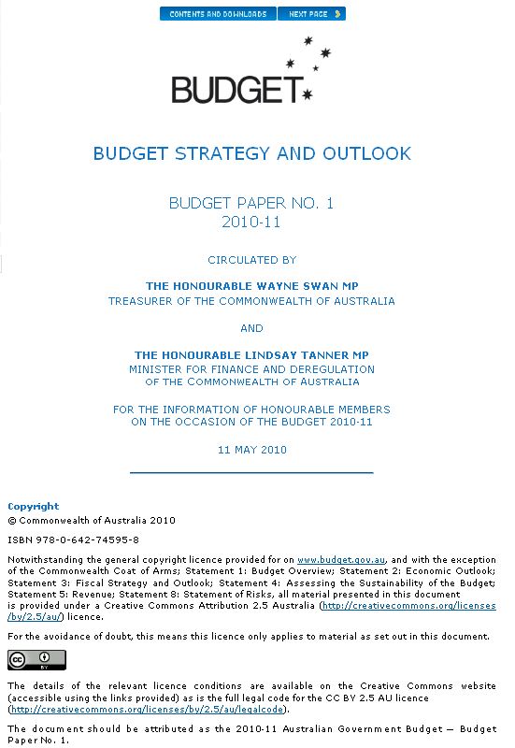
Federal Budget Papers

Slide 3
Crown Copyright
Vast amounts of government copyright materials
Copyright applies to:
  Informational works
  Research outputs (reports, papers, databases)
  Cultural materials
In Australia, UK, NZ, UK data compilations are protected by copyright if they are sufficiently original
  Protection extends only to the arrangement of the collected components
  Copyright does not apply to mere facts/information
Public Sector Information (PSI) in a broad sense includes material that is:
  created within government by government employees;
  produced externally by recipients of government funding; or
  prepared by non-government parties and lodged with government under a statutory obligation or regulatory direction.
AUSTRALIA

Slide 4
Complex flows of Information
Flow of information
  Within government – among departments, agencies, different levels of government
  between government and community:
    From government to community
    From community to government to community
Problem of “licence logjams”
  No licences; inconsistent terms; incomprehensible; transaction cost of negotiated permissions
Promoting the flow of information requires appropriate policy frameworks and licensing practices
AUSTRALIA

Slide 5
Open Access to PSI
Creating a commons of public sector materials
  New conceptualisation of “public domain”
  Not just a no rights “wasteland [or] dump on the outskirts of respectable culture” (Bollier, Viral Spiral)
  Something of value in its own right – open knowledge and content that can be accessed, reused and distributed
  Encompasses materials that are copyright-protected and made available for access and reuse under open source software and open content licences
AUSTRALIA

Slide 6
Open Access to PSI
“Open access to government data can dramatically increase the value created from the data both socially and economically [and] the society as a whole benefits from access to the data”
      Senator Kate Lundy, Free and Open Source Software for Geospatial Conference 2009
How do we enable PSI to move without impediment among government agencies and between government and the private sector?
AUSTRALIA

Slide 7
Creative Commons (CC)
Copyright licensing vs “no rights” approach
Advantages of copyright-based open licensing approach for government:
  Open licensing mirrors the fundamental justification for recognising copyright in government materials
  Supports government’s open access policy objectives
  Provenance and attribution
  Avoids financial and technical lock-up of taxpayer-funded materials
AUSTRALIA

Slide 8
Creative Commons (CC)
Advantages of CC for use by government:
  Enforceability of licence
  Explicit statement of reuse rights
  Clear statement that info is sourced from government (attribution/provenance) – increased user confidence
  Universal recognition of symbols
  Discoverability of digital objects
  Enables legal remix and mashup
AUSTRALIA

Slide 9
Creative Commons (CC)
Attribution and Provenance
Clause 4, CC-BY 2.5 Australia Legal Code
  Attribution requirements based on economic rights of copyright owners to maintain electronic rights management information (ERMI) and moral rights (attribution/no false attribution/integrity)
    Copy of CC Licence/URI of licence must be included
    All copyright notices must be kept intact
    Clear and reasonably prominent credit must be give to the Original Author
    Work not to be falsely attributed
    Must not do anything that results in a material distortion of, mutilation of, or material alteration to the work that is prejudicial to the Original Author’s honour or reputation
AUSTRALIA

Slide 10
Creative Commons (CC)
Termination on breach
If a user of a CC licence breaches the terms of the licence, the licence and the rights granted under it terminate automatically.
    Clause 7(a), Legal Code, Attribution 2.5 Australia
In the absence of a licence, the ordinary principles of copyright law come into operation.
Following termination, any unauthorised use of the copyright material by the licensee may be an infringement of copyright that is subject to civil and criminal penalties.
AUSTRALIA

Slide 11
Creative Commons (CC)
Irrevocable
Perpetual grant of rights, lasting for the full duration of copyright.
  Clauses 3 and 7(b), Legal Code, Attribution 2.5 Australia.
No express provision which entitles the licensor to terminate the licence solely for the licensor’s convenience
However the licensor reserves the right to release the work under a different licence or to stop distributing it at any time.
  Clause 7(a), Legal Code, Attribution 2.5 Australia.
AUSTRALIA

Slide 12
Creative Commons (CC)
Enforceable
    open licences such as CC licences will be upheld by the courts, even if applied to copyright materials distributed for no financial reward – in Australia, non-contractual (bare) licences are enforceable
      Trumpet Software v OzEmail [1996] FCA 560 (Federal Court of Australia)
failure to comply with the licence conditions may be an infringement of copyright, for which the usual remedies will apply.
The most authoritative consideration to date of the effectiveness of open licences is the decision of the United States Court of Appeals for the Federal Circuit in Jacobsen v Katzer (US Federal Circuit) in August 2008 - the defendant had gone beyond the scope of the open licence and thereby infringed copyright
AUSTRALIA

Slide 13
OECD PSI Recommendation
the “Openness” principle states:
  “Maximising the availability of public sector information for use and re-use based upon presumption of openness as the default rule to facilitate access and re-use. Developing a regime of access principles or assuming openness in public sector information as a default rule wherever possible no matter what the model of funding is for the development and maintenance of the information. Defining grounds of refusal or limitations, such as for protection of national security interests, personal privacy, preservation of private interests for example where protected by copyright, or the application of national access legislation and rules.”
the “Access and transparent conditions for re-use” principle states:
  “Encouraging broad non-discriminatory competitive access and conditions for re-use of public sector information, eliminating exclusive arrangements, and removing unnecessary restrictions on the ways in which it can be accessed, used, re-used, combined or shared, so that in principle all accessible information would be open to re-use by all. Improving access to information over the Internet and in electronic form. Making available and developing automated on-line licensing systems covering re-use in those cases where licensing is applied, taking into account the copyright principle below.”
AUSTRALIA

Slide 14
How CC came to be applied to PSI in Australia – a chronology
1990s: Cutler, Wainwright – digital content strategy proposals
2001: Office of Spatial Data Management (OSDM) access and reuse policy
2004: Launch of Creative Commons in Australia
2004: Launch by Queensland Government of Spatial Information Licensing Project
2005: Unlocking the Potential: Digital Content Industry Action Agenda, Strategic Industry Leaders Group report to the Australian Government
2005 – 2006: Queensland Government’s Government Information Licensing Framework (GILF) proposed use of Creative Commons licensing for PSI
2007 – 2010: GILF project continues as a Queensland Government-QUT collaboration, developing knowledge about and models for use of CC on PSI
2007 on: Australian Bureau of Statistics (ABS), Geoscience Australia (GA), Bureau of Meteorology (BoM) implement open access and adopt CC licensing; National Library of Australia; Australian Broadcasting Corporation; various State and local government initiatives
2008: OECD Ministerial Seoul Declaration on the Future of the Internet Economy - OECD Recommendations on publicly funded research (2006) and Access to PSI (2008)
2008: Venturous Australia report on National Innovation System (Cutler Report)
2009: Australia’s Digital Economy, Future Directions (Department of Broadband, Communications and the Digital Economy)
2009: EDIC Report (and Victorian Government’s response (2010)
Government 2.0 Taskforce (2009), “Engage: Getting on with Government 2.0” (December 2009) and Government’s response
2009: New Zealand (draft) Government Open Access Licensing Framework (NZGOAL); UK Power of Information report
2009 – 2010: Freedom of Information/Right to Information reforms – State and Federal legislation

Slide 15
Unlocking the Potential: Digital Content Industry Action Agenda (2005)
Recommended that the digital content industry should:
  Engage with work on alternative approaches to intellectual property licensing, such as Creative Commons;
  Develop ways of improving access to Government intellectual property for commercial exploitation by digital content firms, to encourage innovation.

Slide 16

Venturous Australia (2008)
Recommendation 7.7
Australia should establish a National Information Strategy to optimise the flow of information in the Australian economy.
The fundamental aim of a National Information Strategy should be to:
  utilise the principles of targeted transparency and the development of auditable standards to maximise the flow of information in private markets about product quality; and
  maximise the flow of government generated information, research, and content for the benefit of users (including private sector resellers of information).
.

Slide 17
Venturous Australia (2008)
Recommendation 7.8
Australian governments should adopt international standards of open publishing as far as possible. Material released for public information by Australian governments should be released under a creative commons licence.
Recommendation 7.10
A specific strategy for ensuring the scientific knowledge produced in Australia is placed in machine searchable repositories be developed and implemented using public funding agencies and universities as drivers.

Slide 18

Victorian Parliament’s Economic Development and Infrastructure Committee (EDIC) Report, Improving Access to Victorian Public Sector Information and Data (2009)

Slide 19
Victorian Parliament’s EDIC Report (2009) - Key Recommendations
Recommendation 1: That the Victorian Government release a public statement indicating that it endorses open access as the default position for the management of its public sector information.
Recommendation 2: That the Victorian Government develop a whole-of-government Information Management Framework (IMF) with the following key features:
  that the object of the IMF is to promote and facilitate increased access to and re-use of Victorian public sector information (PSI) by government, citizens, and businesses;
  that the default position of the IMF be that all PSI is made available;
  that the IMF define and describe criteria under which access to PSI may be restricted, or released under licence;
  that PSI made available under the IMF be priced at no cost or marginal cost; and
  that the IMF establish a systematic and consistent whole-of- government methodology for categorisation, storage and management of PSI.

Slide 20
Victorian Parliament’s EDIC Report (2009)
Recommendation 14:
That the Victorian Government adopt the Creative Commons licensing model as the default licensing system for the Information Management Framework.
Chairman’s Foreword: “The second key recommendation of the Committee is that the Victorian Government make use of the Creative Commons licensing model for the release of PSI. The Committee was told Creative Commons licences can be appropriately used for up to 85 per cent of government information and data, providing a simple to understand and widely used system for the re-use of PSI.”

Slide 21
Victorian Government’s response to EDIC (2010)
Endorsed the EDIC’s overarching recommendation that the default position for the management of PSI should be open access.
Committed to the development of a whole-of-government Information Management Framework (IMF) whereby PSI is made available under Creative Commons licensing by default with a tailored suite of licences for restricted materials.
Supported Recommendation 14 (adopt CC licensing as the default licensing system for the IMF).
Government’s response was released under a CC licence (CC BY-NC-ND)
  © Government of Victoria
  This report is protected by copyright. Apart from any use permitted under the Copyright Act 1968, and those explicitly granted below, all other rights are reserved.
  Except for the Victorian Government logo and except where otherwise stated the Whole of Victorian Government Response to the Final Report of the Economic Development and Infrastructure Committee’s Inquiry into Improving Access to Victorian Public Sector Information and Data by Victorian Government is licensed under a Creative Commons Attribution-Noncommercial-No Derivative Works 2.5 Australia Licence (the Licence).

Slide 22
Government 2.0 Taskforce Report (2009)
Engage: Getting on with Government 2.0 (22 December 2009) – http://gov2.net.au/report
Central recommendation: A declaration of open government by the Australian Government
Accompanying the Government’s announcement of its policy response to this report, a declaration of open government should be made at the highest level, stating that:
  using technology to increase citizen engagement and collaboration in making policy and providing service will help achieve a more consultative, participatory and transparent government
  public sector information is a national resource and that releasing as much of it on as permissive terms as possible will maximise its economic and social value to Australians and reinforce its contribution to a healthy democracy
  online engagement by public servants, involving robust professional discussion as part of their duties or as private citizens, benefits their agencies, their professional development, those with whom they are engaged and the Australian public. This engagement should be enabled and encouraged.
The fulfilment of the above at all levels of government is integral to the Government’s objectives including public sector reform, innovation and using the national investment in broadband to achieve an informed, connected and democratic community.

Slide 23
Government 2.0 Taskforce report (2009)
Recommendation 6: Make public sector information open, accessible and reusable [chapter 5, p 58]
6.1 By default Public Sector Information (PSI) should be:
  free
  based on open standards
  easily discoverable
  understandable
  machine-readable
  freely reusable and transformable.
6.2 PSI should be released as early as practicable and regularly updated to ensure its currency is maintained.
6.3 Consistent with the need for free and open reuse and adaptation, PSI released should be licensed under the Creative Commons BY standard as the default.

Slide 24
Government 2.0 Taskforce report (2009)
Recommendation 6: Make public sector information open, accessible and reusable
6.6 Where ownership of the PSI data rests with the Commonwealth, data should be released under CC BY licence. Negotiation with the other party/parties will be required to ensure release under CC BY for PSI which is not owned by the Commonwealth or is shared with another party/parties….
6.7 Copyright policy should be amended so that works covered by Crown copyright are automatically licensed under a CC BY licence at the time at which Commonwealth records become available for public access under the Archives Act 1983
6.8 Any decision to withhold the release of PSI, other than where there is a legal obligation to withhold release, should only be made with the agreement of, or in conformity with policies endorsed by the proposed Office of Information Commissioner…
6.9 The Australian Government should engage other members of the Council of Australian Governments, to extend these principles into a national information policy agreed between all levels of government: federal, state, territory and local

Slide 25

Government’s response to Gov 2.0 Taskforce report (2010)
http://www.finance.gov.au/publications/govresponse20report/index.html
Generally accepted Gov 2.0 Taskforce’s recommendations (12 out of 13)
  agreed in principle to Recommendation 6, including:
    6.3 Consistent with the need for free and open reuse and adaptation, PSI released should be licensed under the Creative Commons BY standard as the default.
Government’s response was released under a Creative Commons Attribution (CC BY) 2.5 Australia licence

Slide 26
Further examples of adoption
Australian Bureau of Statistics
Geoscience Australia
Bureau of Meteorology
NBN Implementation Study (May 2010)
Federal Budget Papers (May 2010)
Australian Parliament (June 2010)
AUSTRALIA

Slide 27
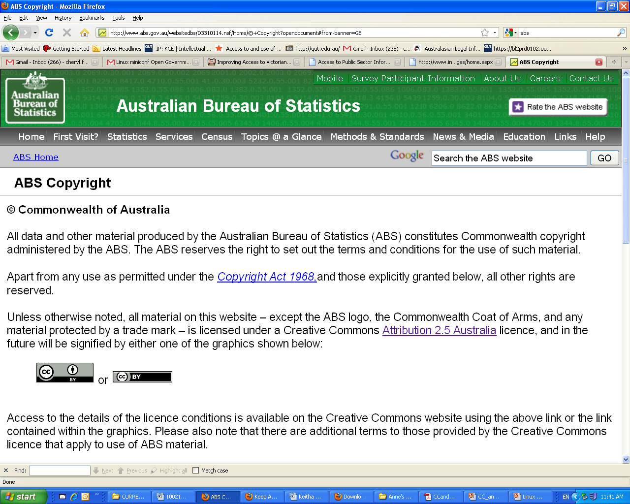
Examples of adoption in Australia
AUSTRALIA

Slide 28
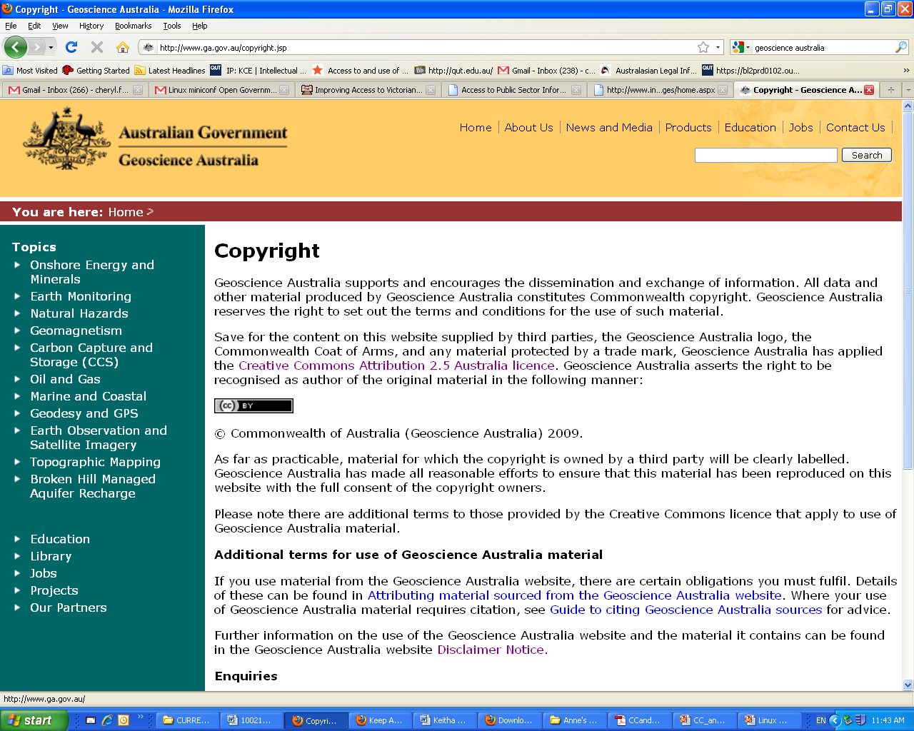
Examples of adoption in Australia
AUSTRALIA

Slide 29
Update: Geoscience Australia
SE Asia Satellite Data for IFCI - National Earth Observation Group, Geoscience Australia
processed satellite data used for working out the year-to-year change in tropical forest cover in SE Asia - This work is tied to international efforts to reduce the rate and impact of climate change – data forms inputs to national carbon accounting systems, which countries (and international aid sponsors) then use to objectively monitor trends in the carbon economy.
Nearly all releases are under CC
Australia has encouraged Thai and Indonesian space agencies to take the same approach

Slide 30
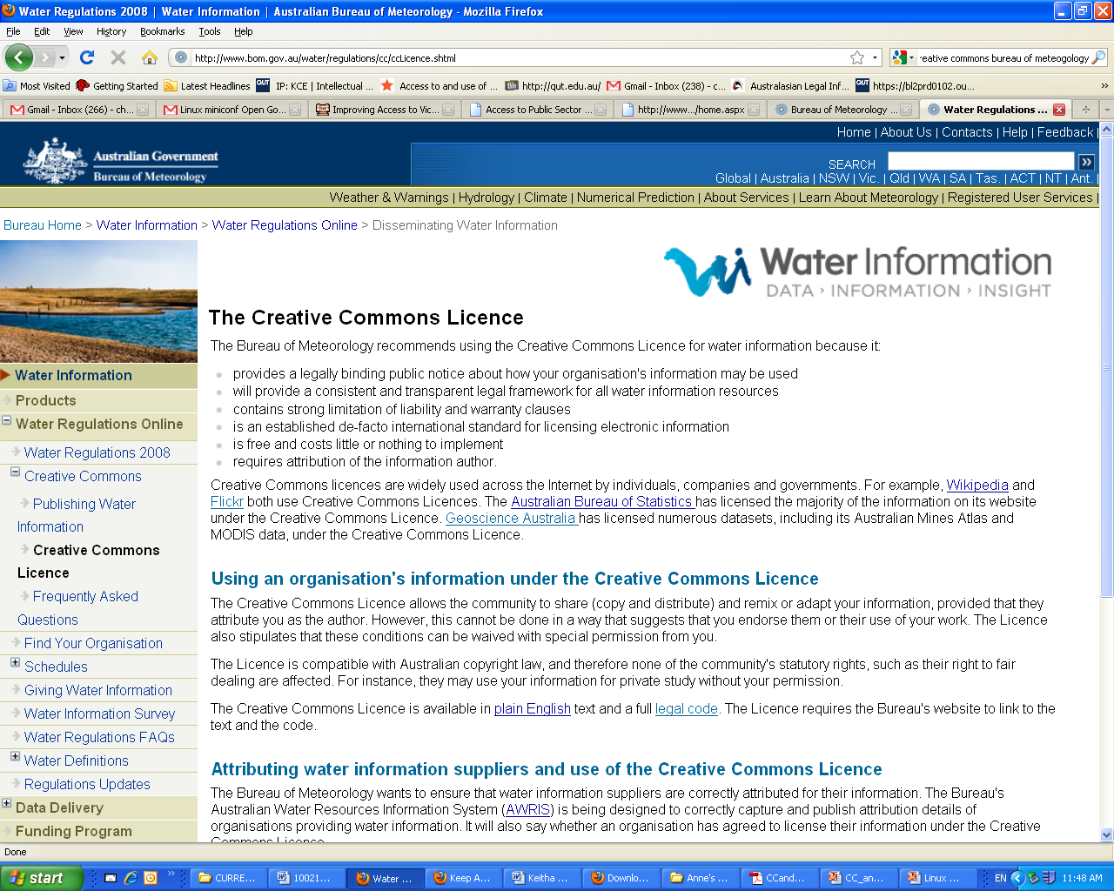
Examples of adoption in Australia
AUSTRALIA

Slide 31
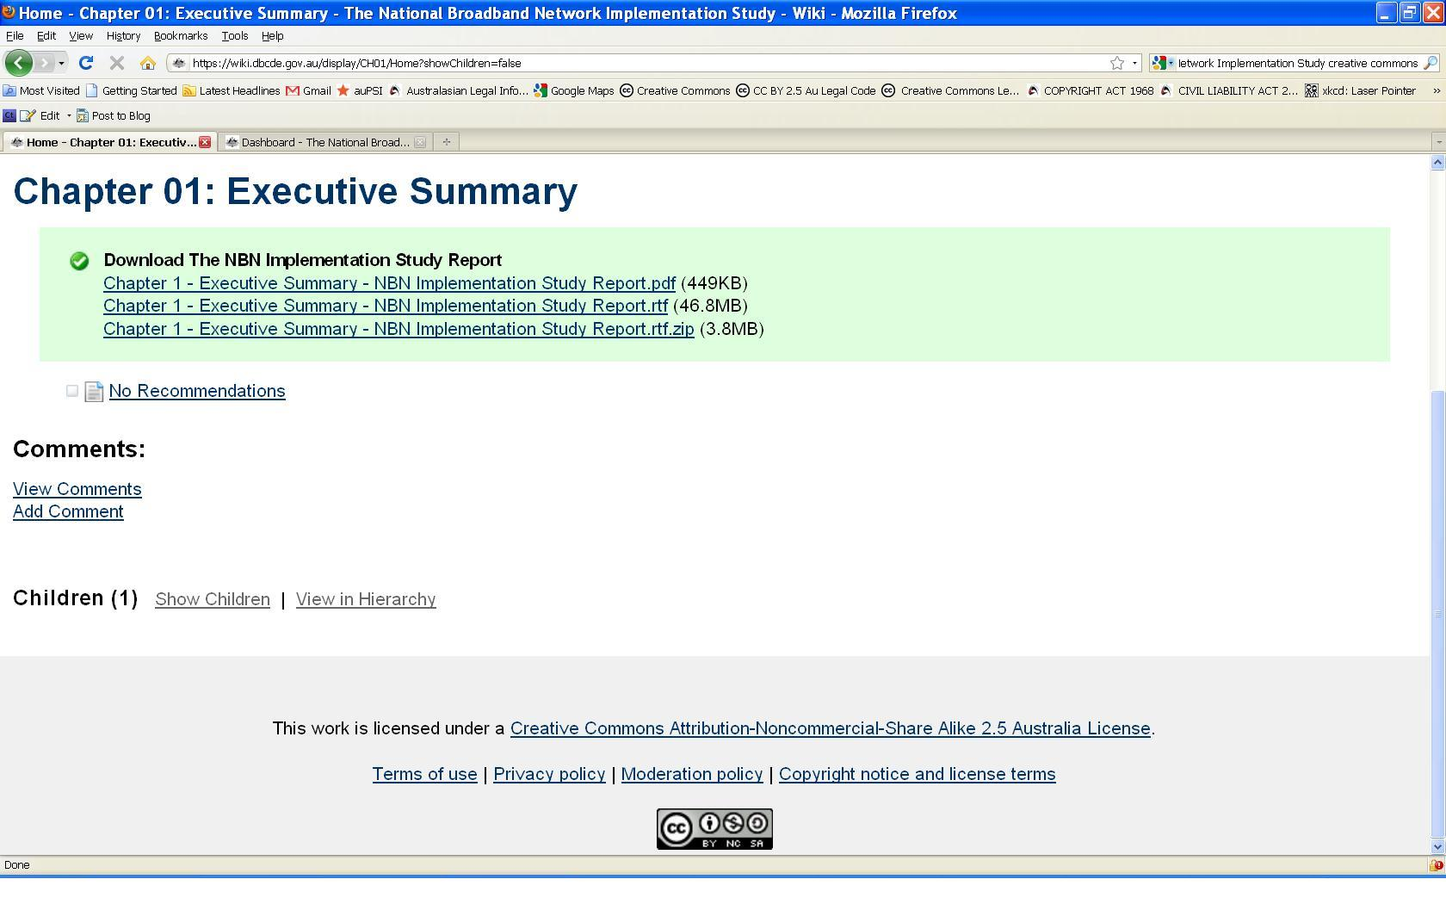

National Broadband Network Implementation Study and Wiki

Slide 32
Federal Budget Papers

Slide 33
Policies and Principles on Access To and Reuse of Public Sector Information: a review of the literature in Australia and selected jurisdictions
Professor Anne Fitzgerald
The full economic, cultural and environmental value of information produced or funded by the public sector can be realised through enabling greater access to and reuse of the information. To do this effectively it is necessary to describe and establish a policy framework that supports greater access and reuse among a distributed, online network of information suppliers and users. The objective of the literature review is to identify materials published in Australia and elsewhere dealing with policies, principles and practices relating to access to and reuse of public sector information.
http://www.aupsi.org/publications/reports.jsp
See also: Open Access Policies, Practices and Licensing: A Review of the Literature in Australia and Selected Jurisdictions by Professor Anne Fitzgerald at http://eprints.qut.edu.au/28026/

Slide 34
Policies and Principles on Access To and Reuse of Public Sector Information: a review of the literature in Australia and selected jurisdictions
Professor Anne Fitzgerald
http://www.aupsi.org/publications/reports.jsp
  Now available:
    Chapter 1: Australia
    Chapter 2: New Zealand
    Chapter 3: International
    Chapter 5: United States
    Chapter 6: Canada
  Forthcoming:
    Chapter 4: Europe, UK and Ireland
    Chapter 7: Asia

Slide 35
References
2005-2006 - Stage 2 Report of GILF Project – Access to Government Information and OCL – An Access and Use Strategy http://www.qsic.qld.gov.au/ - see also http://www.gilf.gov.au
July 2007 – First National Summit – Qld Parliament House – Conference Report on the Australian National Summit on OA to PSI - http://www.qsic.qld.gov.au/
March 2008 - Second National Summit http://datasmart.oesr.qld.gov.au/Events/datasmart.nsf/0/D5A62A2C8FAA54754A2573D40018342A?OpenDocument http://www.osdm.gov.au/Events/182.aspx
The Report of the Victorian Parliament’s Economic Development and Infrastructure Committee (EDIC), Inquiry into Improving Access to Victorian Public Sector Information and Data (EDIC Report), was tabled in the Victorian State parliament on 24 June 2009 - http://www.parliament.vic.gov.au/edic/inquiries/access_to_PSI/final_report.html
  Government of Victoria, Whole of Government Response to the Final Report of the Economic Development and Infrastructure Committee’s Inquiry into Improving Access to Victorian Public Sector Information and Data, February 2010, available at http://www.diird.vic.gov.au/diird-projects/access-to-public-sector-information
Government 2.0 Taskforce report, Engage: Getting on with Government 2.0 (December 2009) – http://gov2.net.au/report

Slide 36
References
Enabling Open Access to Public Sector Information with Creative Commons Licences - The Australian Experience’, Anne Fitzgerald et al, Chapter 14 in Access to Public Sector Information: Law, Technology & Policy (Edited by B. Fitzgerald), Sydney University Press, 2010; available also at http://eprints.qut.edu.au/29773/
ANDS Guide: ‘Copyright and Data’ http://ands.org.au/guides/copyright-and-data-awareness.html
ANDS Guide: ‘Creative Commons and Data’ http://ands.org.au/guides/cc-and-data.html
Building the Infrastructure for Data Access and Reuse in Collaborative Research (OAK Law Project) http://www.oaklaw.qut.edu.au/reports
OAK Law Project Report No. 1: Creating a legal framework for copyright management of open access within the Australian academic and research sectors (2006) http://eprints.qut.edu.au/6099/1/Printed_Oak_Law_Project_Report.pdf

